Slide 1
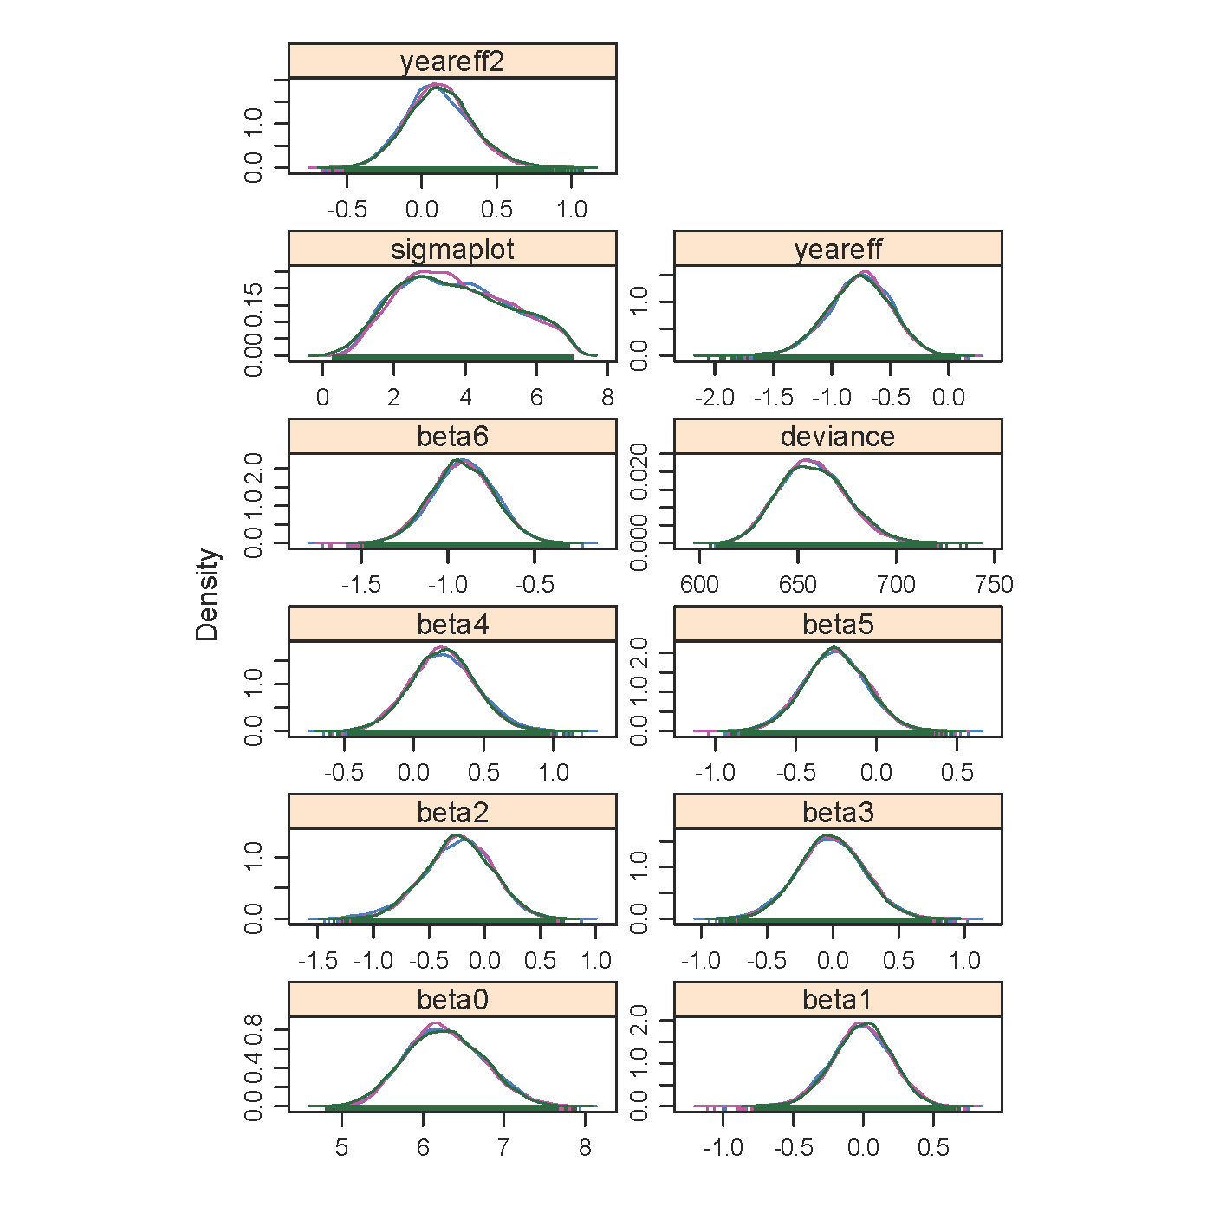
Posterior distribution of parameters
human development index
intercept
year
Δ sea surface temperature
fish species richnes
year²
plastic counts
chlorophyll a
harvest intensity

