Slide 1
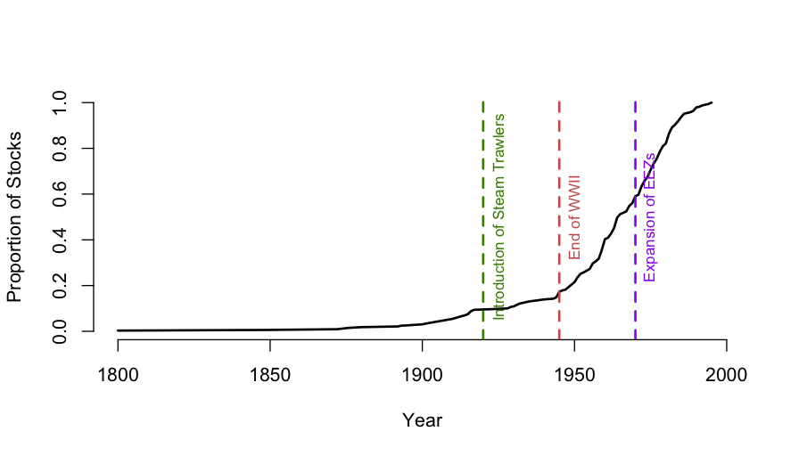
The History of Fishery Surveys

