Slide 1
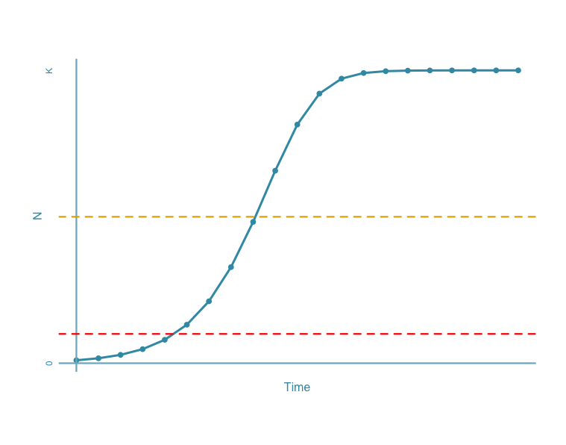
Fisheries Collapse
Maximum Sustainable Yield is defined as one-half of the carrying capacity
The definition of Collapse has been widely agreed on as: 20% of the Maximum Sustainable Yield
MSY
Collapse
Costello, C. et al. 2012. Status and Solutions for the World’s Unassessed Fisheries. Science 338:517–520.
Myers, R. A., J. A. Hutchings, and N. J. Barrowman. 1997. Why do fish stocks collapse? The example of cod in Atlantic Canada. Ecological applications 7:91–106.
Worm, B., et al. 2009. Rebuilding Global Fisheries. Science 325:578 –585.

Slide 2
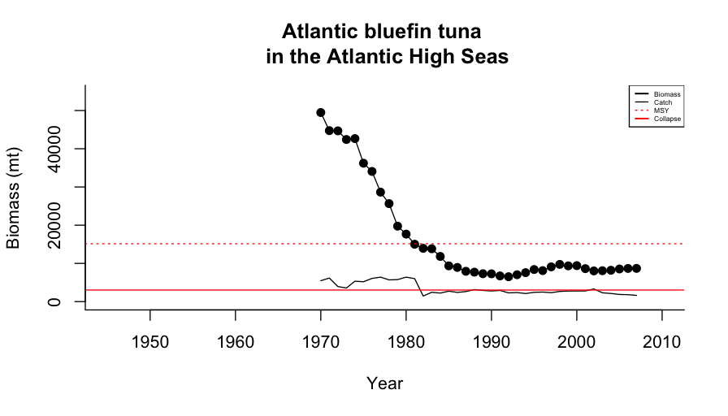
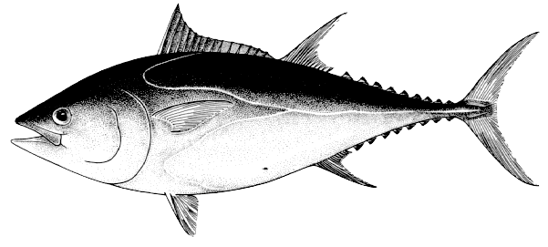
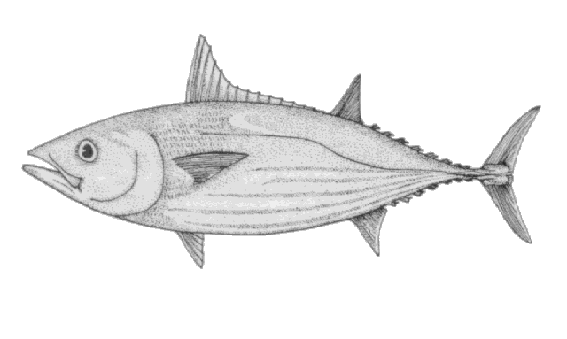
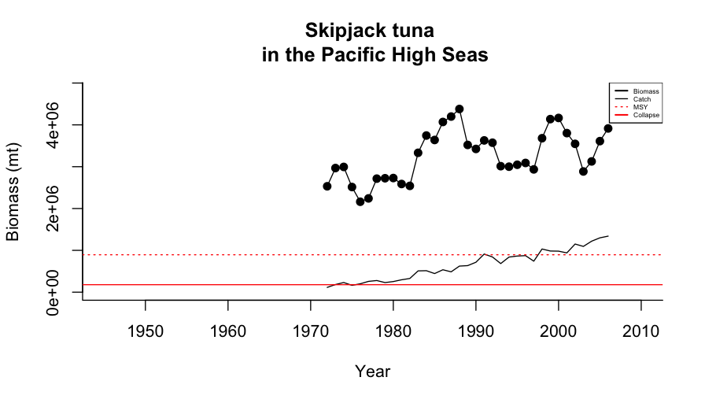
MSY
Collapse
MSY
Collapse

Slide 3
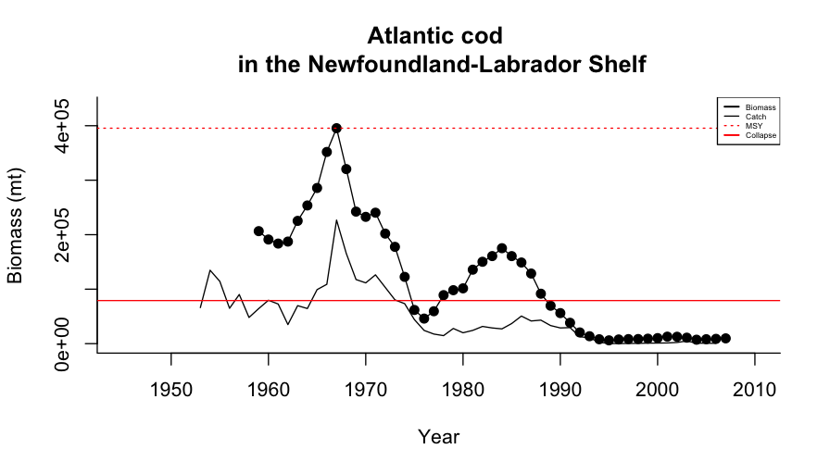
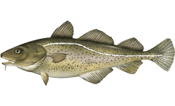

Iconic Atlantic cod fishery Collapse
40,000 fishery workers lost their jobs overnight
Notes:
2 July, 1992 fisheries minister John Crosbieunder police protection
Announced a two-year moratorium on cod fishing

Slide 4
