Slide 1
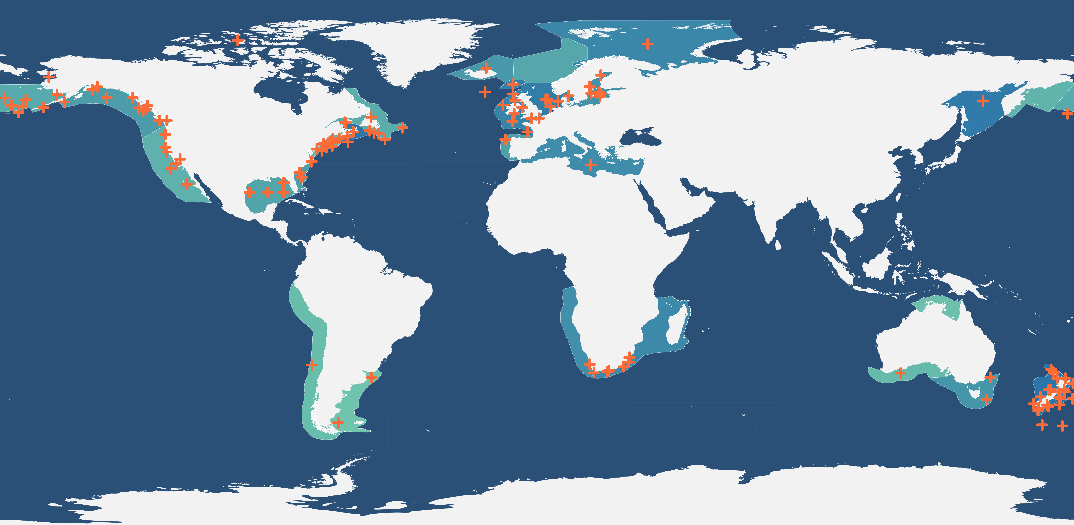
Notes:
Map only shows the LMEs in which RAM stocks are found.
Orange crosses show estimated centroid of each stock’s area

