Slide 1


Managing your code: quietly introducing Git - a friend for life Part 2
Thanks to all contributors:
Alison Pamment, Sam Pepler, Ag Stephens, Stephen Pascoe, Kevin Marsh, Anabelle Guillory, Graham Parton, Esther Conway, Eduardo Damasio Da Costa, Wendy Garland, Alan Iwi and Matt Pritchard.

Slide 2
Managing code in the olden days
Create “working_dir”...add some code
Write some outputs...change the code
Publish a paper...change the code
Copy “working_dir” to “working_dir2”
Change the code
Copy a version to a CD
...now which version is current? Is it “working_dir” or “working_dir2”? And which one relates to that paper?

Slide 3
But those days are gone!
Scientists are typically required to publish data and code (by their funders/institutions).
Collaboration between scientists requires data-sharing; this implicitly relies on code-sharing.
There are tools that make it easy to record our changes, document our workflow and “fix” releases of our code at important steps along the way.

Slide 4
Introducing Git
There are many different Version Control tools:
SVN (Subversion) is very popular and (relatively) easy to grasp; eclipsed by…
Git, which is also:
More useful for collaboration
Distributed and fast
Very well supported in terms of tooling
Has free repository hosts on the web (GitHub, BitBucket etc.,).
Notes:
Talk through slide

Slide 5
More about Git
Git is a distributed Version Control System (VCS):
you store a complete copy of a repository within your working copy.
this means you can work offline:
there is no default ‘central’ server - if you want one, you (and your team) just nominate where it is - typically GitHub!
Notes:
Talk through slide

Slide 6
What is a Git repository?
A directory tree containing files and subdirectories.
Old and different versions of those files and subdirectories.
A set of information to enable you to navigate across versions.

Slide 7
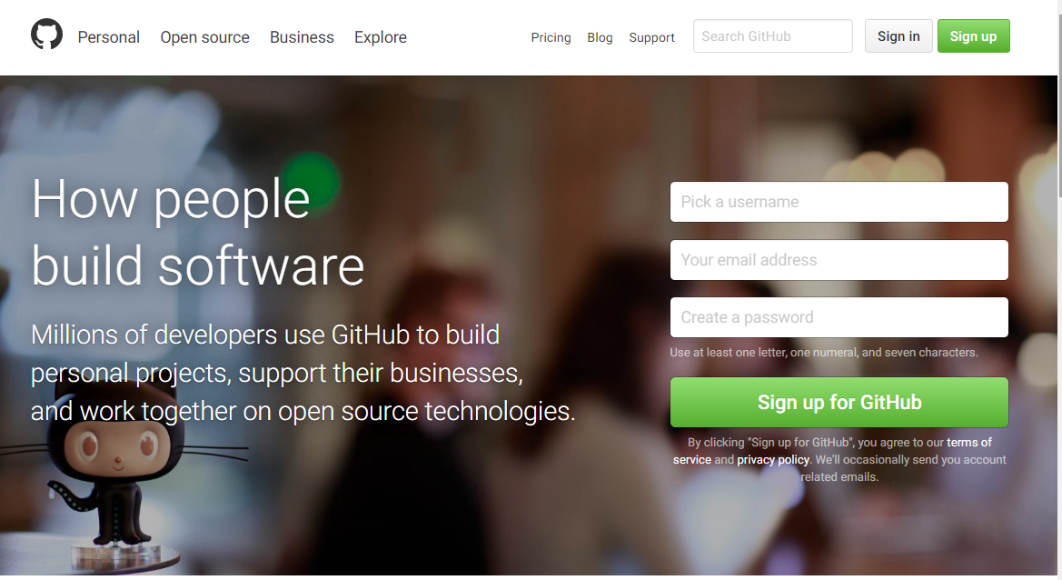
Not Introducing GitHub
https://github.com
A service for hosting git repositories.
Notes:
GitHub is a web site and eco-system of web tools that make code development easier.

Slide 8
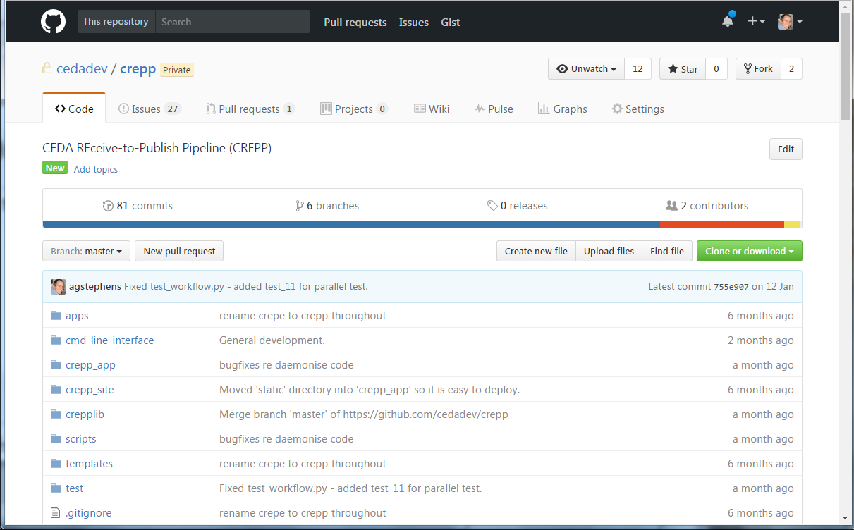
GitHub: repositories (public or private)
Notes:
You can create public or private code (and small data) repositories. A full version of your code is stored on the GitHub servers and can be shared with anyone you like.

Slide 9
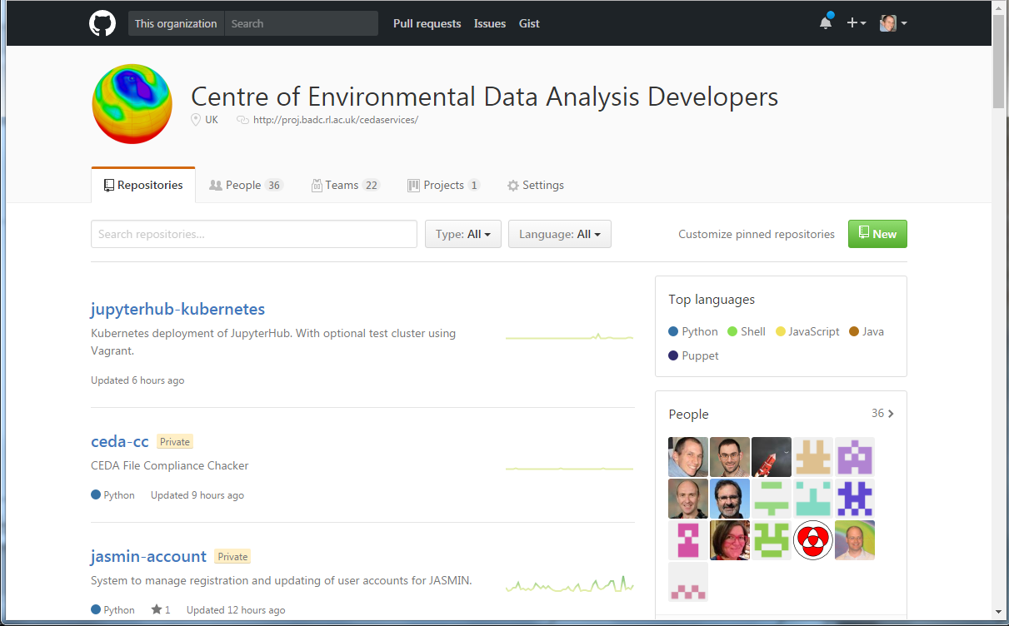
GitHub: organisations
Notes:
You can create organisations that group together a set of collaborators that work on projects collectively.

Slide 10
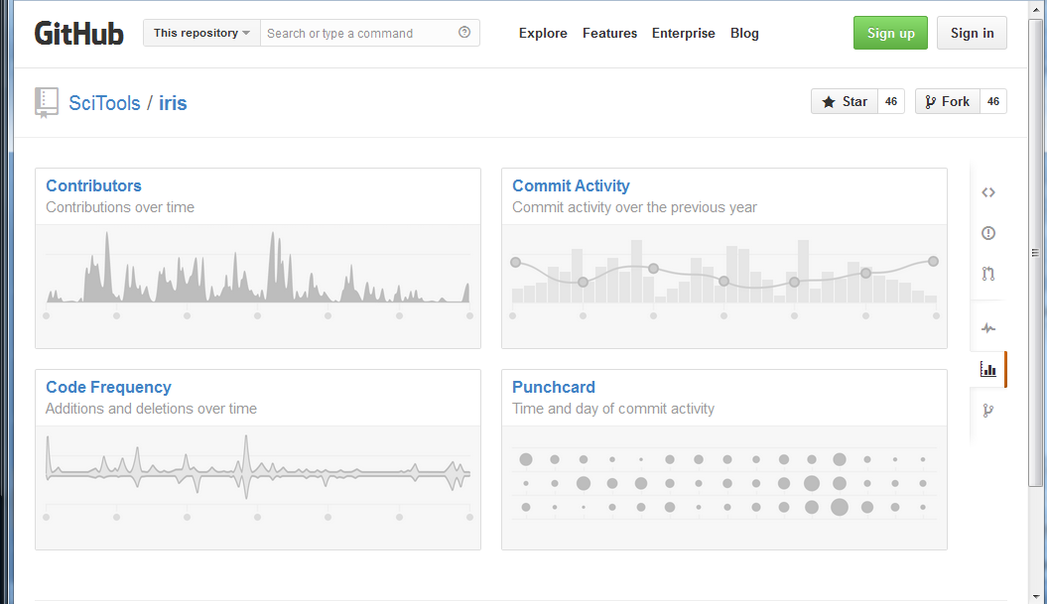
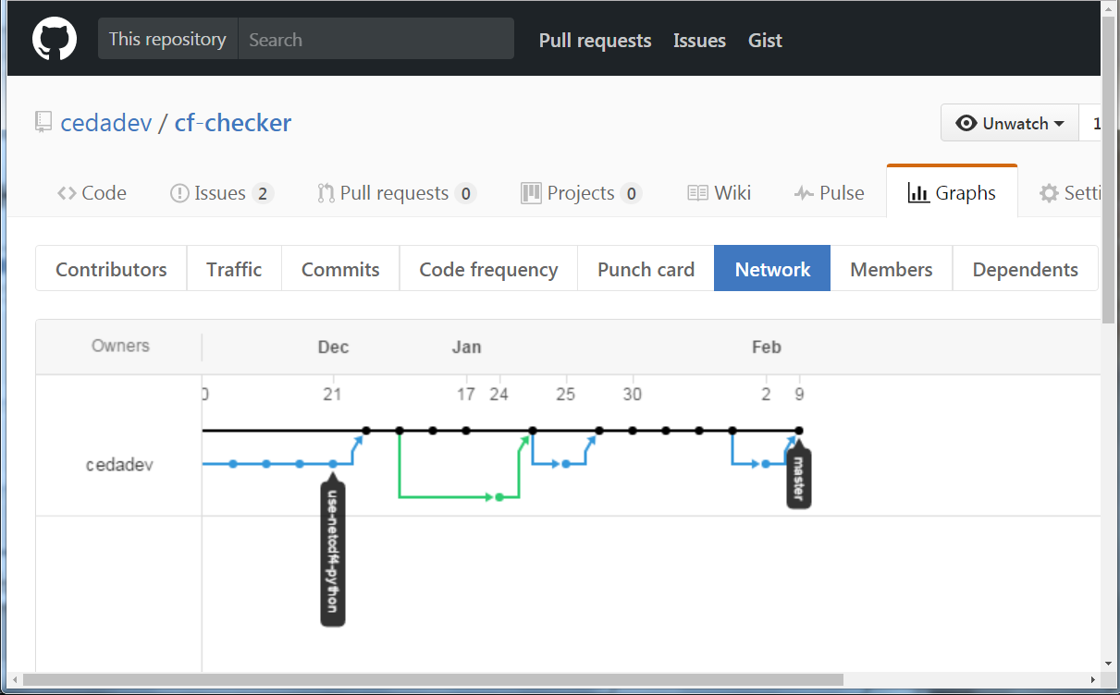
GitHub: collaboration (branch/fork)
Notes:
Multiple people can easily collaborate on code with tried-and-testing tools for branching and merging work in different strands.

Slide 11
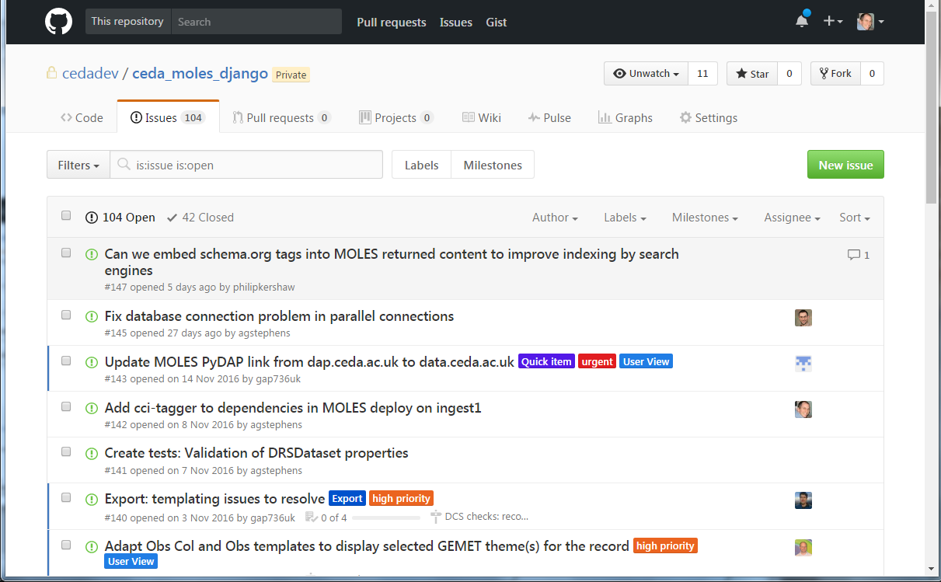
GitHub: Issue tracking
Notes:
You can manage all you bugs, problems and improvement plans as GitHub Issues - label them and even assign them to others in your team.

Slide 12
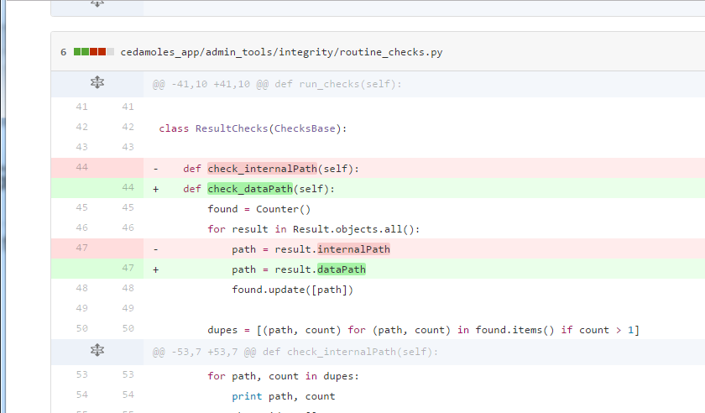
GitHub: history and change
Notes:
All changes made to the repository are stored in the history. At any point you can revert back (or across to other branches). Here we see an annotated difference between two versions in the history of the code. You can do this for individual files or the entire repository.

Slide 13
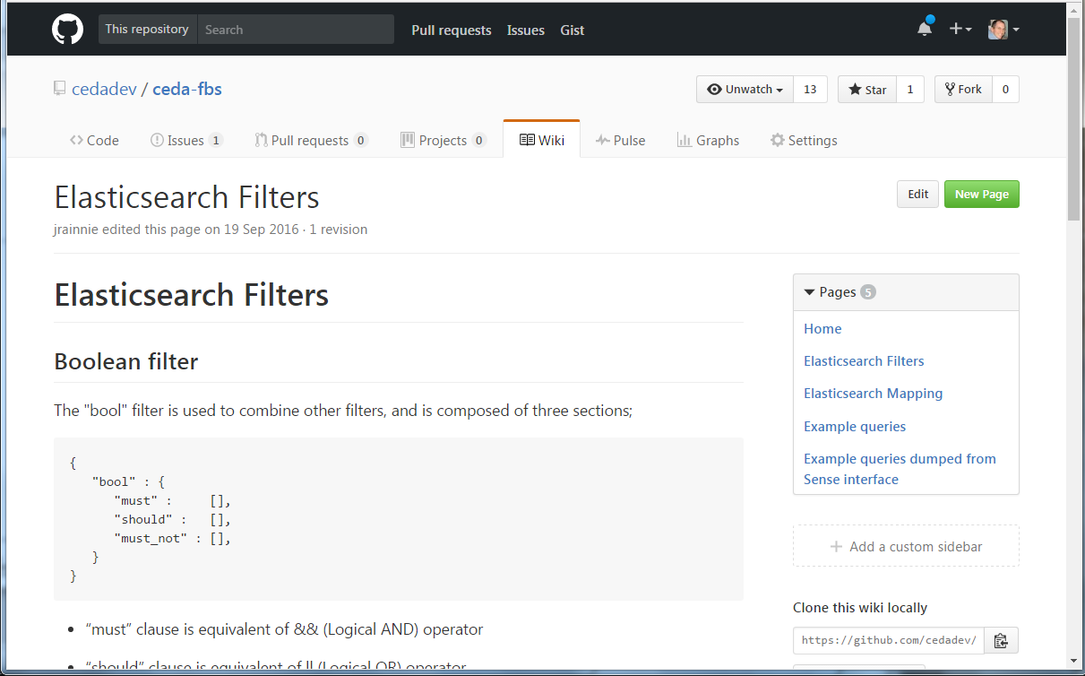
GitHub: wikis
Notes:
And you can document your code on the free wiki built in to each GitHub repo. And there are hundreds of other features and integrations with other tools that make code management easier.

Slide 14
GitHub Code-Sharing Example
STFC CEDA Firewall
GitHub
Private GIT Repository
Push/Pull
Public CEDA Projects: COWS WPS
Private CEDA Project:
COWS WPS
Public UoR Projects: COWS WPS
Fork
Pull-
Request
Push/
Pull
UoR Firewall
Private GIT Repository
Private UoR Project: COWS WPS
Notes:
This slide shows how GitHub provides a public collaborative set of Git repositories and tools through which organisations can interact.
In this example STFC CEDA has its own internal Git repository.
It can push/pull to the remove (public) copy of the repository on GitHub.
Another organisation, University of X, can have their own local (private) version and interact in the same way with the GitHub repository.
GitHub has extra tools, such as “forking” and “pull-requests” to allow useful tracking and interactions between the different versions.

Slide 15
Github does lots of funky things, but…
On this course we are going only using it as a remote repository.
We are going to concentrate on simply using git.

Slide 16
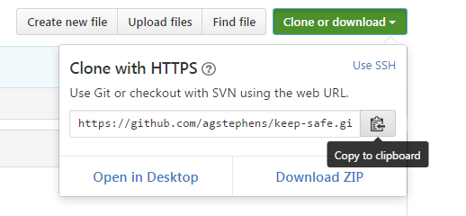
Where to start 1: Git clone
This makes a copy of a repository locally. We did this at the start of the course.
$ git clone https://agstephens@github.com/agstephens/keep-safe

Slide 17
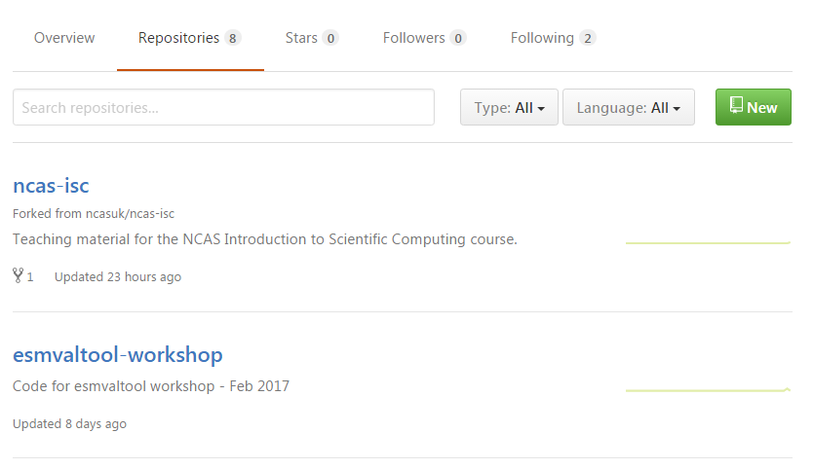
Where to start 2: Create a repository on Github
Navigate to "Repositories" and click "New".

Slide 18
Where to start 3: start a new repository from existing files
$ ls
x y z
$ git init
Initialized empty Git repository in /Users/sjp23/play/york_workshop_shell/test-pakage/.git/
$ git add .
$ git commit –m’Initial commit from existing files'
[master (root-commit) 71ecfcf] Initial commit from existing files
3 files changed, 0 insertions(+), 0 deletions(-)
create mode 100644 x
create mode 100644 y
create mode 100644 z

Slide 19
Add a file to your local repo
1. Enter the repository directory:
$ cd ncas-isc
2. Create a new file:
$ echo "hello world" > hello.txt
3. Tell Git about the file:
$ git add hello.txt
4. Commit the file to the local Git repository:
$ git commit -m "added hello"
5. Push any updates to the remote GitHub repo:
$ $ git push

Slide 20
So, what just happened?
We cloned the remote repository to our file system.
Now there are two identical copies of one repo.
We created a new text file.
We added and committed that new file to the local version of the repo.
We used push to update the remote repo.
GitHub Local
Clone (& pull)
Change
Add/ Commit
Push

Slide 21
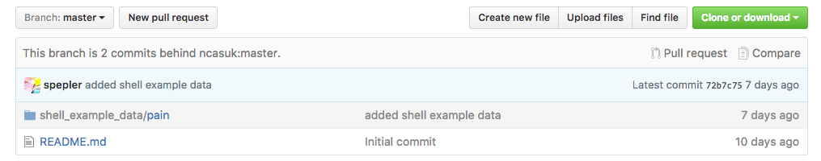
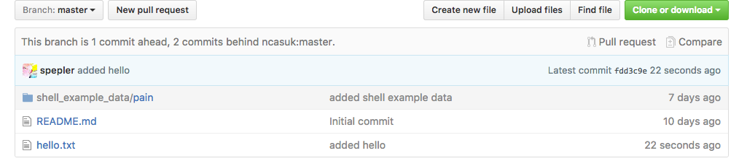
Let's look on GitHub
Before…
After…

Slide 22
The Plan: Use Git/GitHub all week
This stuff is hard to learn - we know that from experience.
A presentation is quickly forgotten.
So, we propose that you use Git/GitHub for every exercise.
You have a fork (copy) of the course material and you are going to update this with files from exercises throughout the course.

Slide 23
Lets make some test files
$ mkdir mydir
$ echo "hi" > hi.txt
$ echo "testing..." > mydir/t1.txt
$ ls
README.md hi.txt hello.txt mydir

Slide 24
Git Status
Use to see what stage files are at
$ git status
On branch master
Your branch is up-to-date with 'origin/master'.
Untracked files:
(use "git add <file>..." to include in what will be committed)
hi.txt
mydir/
nothing added to commit but untracked files present (use "git add" to track)

Slide 25
Git add
Adding files tells git to start looking after them or add a new version if it already knows about it.
$ git add .
$ git status
On branch master
Your branch is up-to-date with 'origin/master'.
Changes to be committed:
(use "git reset HEAD <file>..." to unstage)
new file: hi.txt
new file: mydir/t1.txt

Slide 26
Add another file
These files are all staged to go into the repository, but are not committed yet.
$ echo "testing..." > mydir/t2.txt
$ git add mydir/t2.txt
$ git status
On branch master
Your branch is up-to-date with 'origin/master'.
Changes to be committed:
(use "git reset HEAD <file>..." to unstage)
new file: hi.txt
new file: mydir/t1.txt
new file: mydir/t2.txt

Slide 27
Lets commit
Now the files are in the local repository. The working tree is the same as repository.
$ git commit -m 'Adding my new greetings files'
[master fe70026] Adding my new greetings files
3 files changed, 3 insertions(+)
create mode 100644 hi.txt
create mode 100644 mydir/t1.txt
create mode 100644 mydir/t2.txt
$ git status
On branch master
Your branch is ahead of 'origin/master' by 1 commit.
(use "git push" to publish your local commits)
nothing to commit, working tree clean

Slide 28
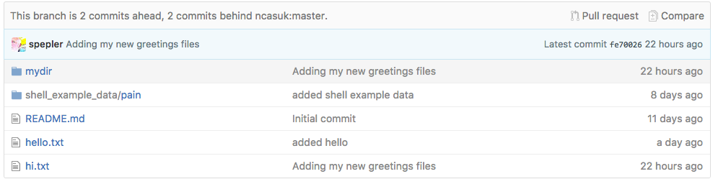
Push the new version back to Github
Make the repo on Github match the local repo.
$ git push
Counting objects: 5, done.
Delta compression using up to 4 threads.
Compressing objects: 100% (3/3), done.
Writing objects: 100% (5/5), 465 bytes | 0 bytes/s, done.
Total 5 (delta 0), reused 0 (delta 0)
To github.com:spepler/ncas-isc.git
fdd3c9e..fe70026 master -> master

Slide 29
Enough?
If you are working on your own then that is all you need to know.
You can keep track of changes in your code, you know its safe and you can share it with people.

Slide 30
Working with other people
$ git clone git@github.com:spepler/ncas-isc.git ncas-isc2
Cloning into 'ncas-isc2'...
remote: Counting objects: 17, done.
remote: Compressing objects: 100% (11/11), done.
remote: Total 17 (delta 1), reused 16 (delta 0), pack-reused 0
Receiving objects: 100% (17/17), done.
Resolving deltas: 100% (1/1), done.
$ cd ncas-isc2
$ ls
README.md hello.txt hi.txt mydir shell_example_data
$ emacs hello.txt
$ cat hello.txt
hello world
New line
Red Fred clones a copy of the repository and changes a file

Slide 31
They commit their changes and push back to Github
$ git add hello.txt
$ git commit -m 'added new line'
[master d274491] added new line
1 file changed, 1 insertion(+)
$ git push
Counting objects: 3, done.
Delta compression using up to 4 threads.
Compressing objects: 100% (2/2), done.
Writing objects: 100% (3/3), 283 bytes | 0 bytes/s, done.
Total 3 (delta 1), reused 0 (delta 0)
remote: Resolving deltas: 100% (1/1), completed with 1 local objects.
To github.com:spepler/ncas-isc.git
fe70026..d274491 master -> master

Slide 32
Black Bob downloads changes using git pull
$ git pull
remote: Counting objects: 3, done.
remote: Compressing objects: 100% (1/1), done.
remote: Total 3 (delta 1), reused 3 (delta 1), pack-reused 0
Unpacking objects: 100% (3/3), done.
From github.com:spepler/ncas-isc
fe70026..d274491 master -> origin/master
Updating fe70026..d274491
Fast-forward
hello.txt | 1 +
1 file changed, 1 insertion(+)

Slide 33
Black Bob looks at change log
$ git log hello.txt
commit d274491d34d96aa92eb110e472006070e537dda0
Author: Sam Pepler <sam.pepler@stfc.ac.uk>
Date: Fri Feb 24 12:26:47 2017 +0000
added new line
commit fdd3c9eb7cbea69cce46ea22326ed5c801bb75f8
Author: Sam Pepler <sam.pepler@stfc.ac.uk>
Date: Thu Feb 23 11:13:13 2017 +0000
added hello

Slide 34
Exercise
Make a new repo on github by clicking on the new repository button.
Clone the repository: $ git clone <repo_url>
Make a new directory in your cloned repo and a new file containing a few lines of text.
Add the file and directory to your local repo: $ git add <newfile> <newdir>
Commit the changes: $ git commit -m ‘Add some test files’
Update Github repo: $ git push

Slide 35
Other tools in the Git ecosystem
Notes:
There are loads of great free tools to work with SVN and GIT. Here are just a few examples...

Slide 36
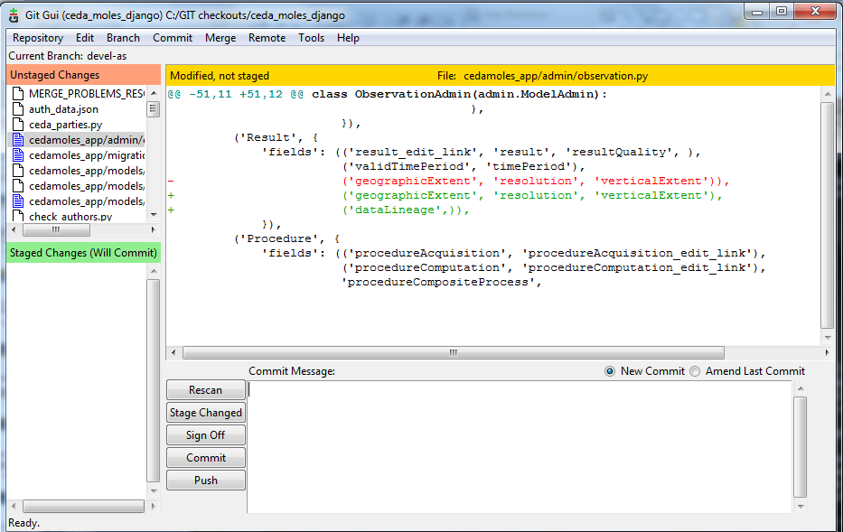
git gui
Full set of GUIs for interacting with local and remote repos.
Notes:
The Git gui provides a user interface to look at your local repository, files, changes, conflicts etc.

Slide 37
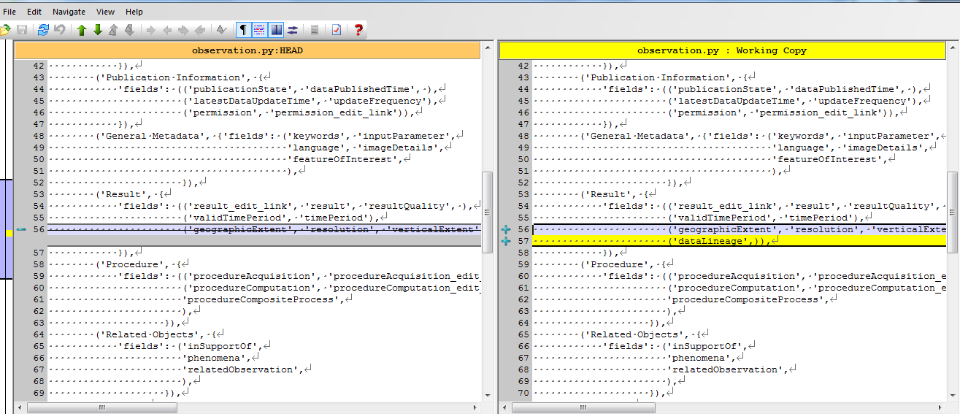
TortoiseGIT (for Windows)
Provides GUIs for adding/committing/changing - including a side-by-side diff…
Notes:
TortoiseGIT is a free GUI that works on linux and Windows. Here it is showing a diff between two different versions of a file.

Slide 38
The why - one more time
Using version control will save you time – No more accidentally deleting your workspace, or working on the wrong version of a file.
It will make you a better programmer – It encourages good working practices: such as documenting change.
It will help you collaborate more effectively – Others can access tagged releases of your code.
It will boost your scientific integrity – Helping you document your work; aiding reproducibility.
It will make you feel safe – No more waking up at 3 a.m. wondering if you backed up your work!
Notes:
This slide is intentionally evangelical! Talk through it.

Slide 39
The NCAS GitHub organisation
An NCAS GitHub organisation has been set up.
This allows repositories to be set up that where users could share code when it has become a more formal collaboration.
If you want to become part of the NCAS GitHub please contact Ag, James or Dan and send them your GitHub account ID.

Slide 40
Further information
Git documentation:
http://git-scm.com/documentation
Nice Git reference:
http://gitref.org/
GitHub:
http://github.com/

Slide 41
Acknowledgements
We would like to Acknowledge the following authors for some of the content presented here:
“Introduction to GIT”. Lukas Fittl (http://fittl.com).
“Git and GitHub”. Darren Oakley.

