Slide 1
The Unix Shell
Text Editors and Terminals

Slide 2
What is an Editor
An text editor is a program used to edit text!
There are lots of them, but they all manipulate a stream of characters so you can save them in a file.
Some editors use a window – gedit, notepad
Others just use the terminal window – vi, emacs

Slide 3
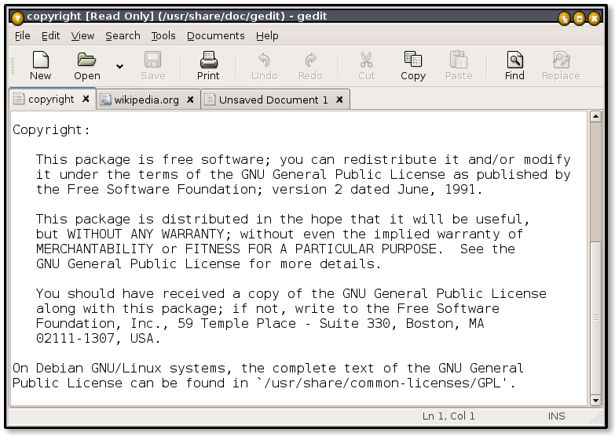
Today we will be using gedit

Slide 4
What is a terminal
A terminal is a program used to talk to a shell
We will be learning what a shell is later…

Slide 5
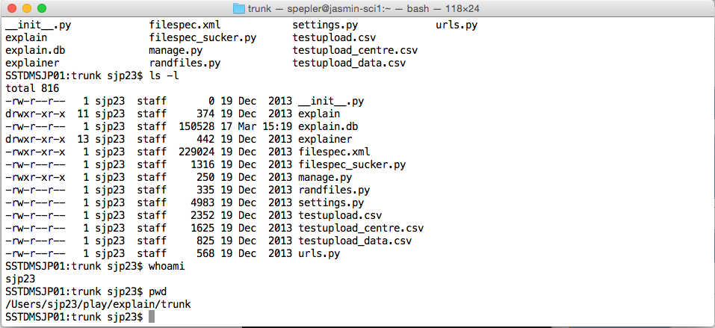
Today we will be using term

Slide 6
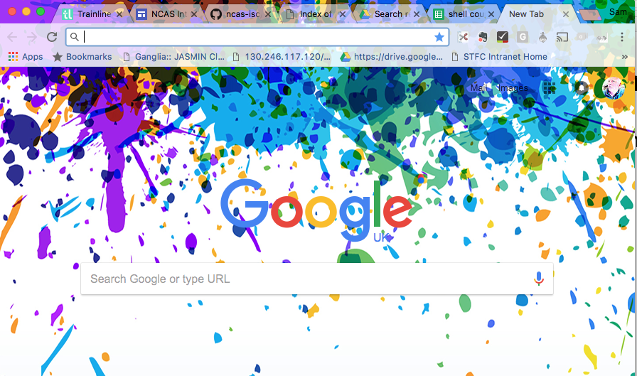
Web browser
Does not matter which one.

Slide 7
Shell Day 1
00:05 | editors and the terminal | presentation
00:05 | Make sure everyone is happy | setup
00:05 | intro to git | presentation
00:10 | Github sign up | setup
00:30 | Unix shell intro, Files and directories | presentation
00:20 | Exploring the file system | exercise
00:15 | Pipes and filters | presentation
00:20 | Pipes and filters exercise | exercise
00:15 | permissions | presentation
00:15 | Permission exercise | exercise
00:20 | COFFEE
00:15 | Finding stuff | presentation
00:20 | Needle in haystack | exercise
00:20 | Job control and variables | presentation
00:20 | Controlling jobs exercise | exercise

Slide 8
Shell Day 2
00:05 | Remember yesterday? | presentation
00:10 | Remember yesterday exercise | exercise
00:20 | Git talk | presentation
00:15 | Git exercise | exercise
00:20 | shell scripts | presentation
00:20 | shell script exercise | exercise
00:30 | COFFEE
00:15 | Using ssh | presentation
00:35 | ssh exercise | exercise
00:30 | transferring files and other useful stuff | presentation
00:30 | transferring files | exercise
00:30 | Everybody happy - what else do you want to know
01:00 | LUNCH

