Slide 1
Text Editors and Terminals

Slide 2
What is an Editor
An text editor is a program used to edit text!
There are lots of them, but they all manipulate a stream of characters so you can save them in a file.
Some editors use a window – gedit, notepad
Others just use the terminal window – vi, emacs

Slide 3
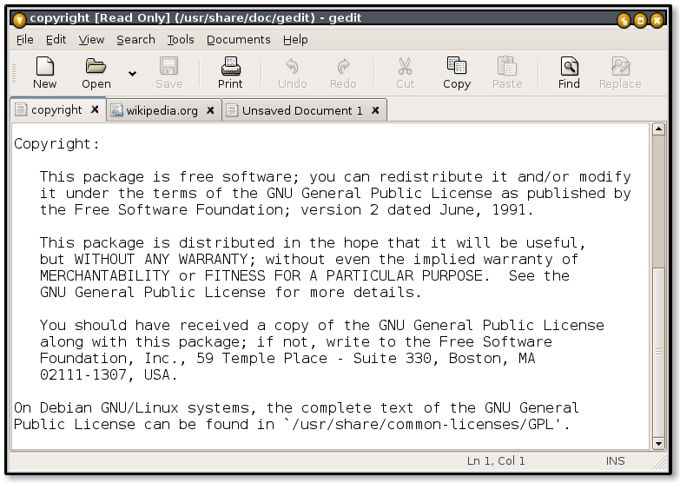
Today we will be using gedit

Slide 4
What is a terminal
A terminal is a program used to talk to a shell
We will be learning what a shell is later…

Slide 5
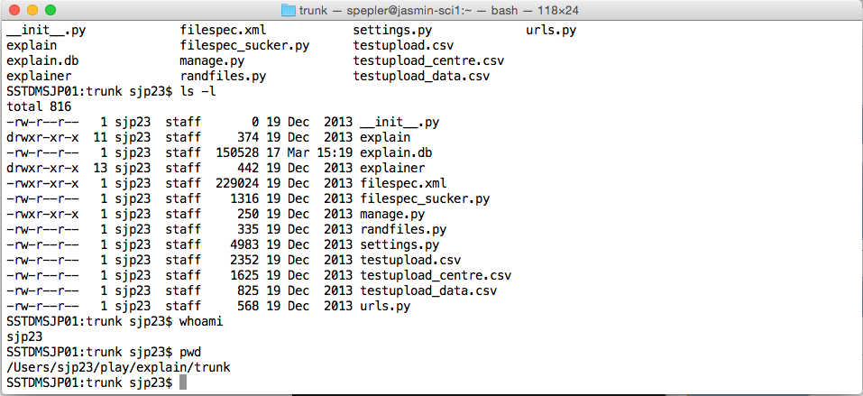
Today we will be using term

