Slide 1
Why Good Data Curation is Essential for Doing Good Science
Thanks to all contributors:
Alison Pamment, Sam Pepler, Ag Stephens, Stephen Pascoe,
Anabelle Guillory, Esther Conway, Alan Iwi, Matt Pritchard,
Sarah Callaghan, David Hooper, Charlotte Pascoe
On behalf of the course team
(STFC/NERC:CEDA, NERC:NCAS CMS, NERC:NCAS Leeds)

Slide 2
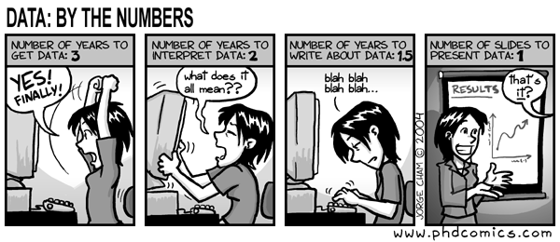
Creating a dataset is hard work!
"Piled Higher and Deeper" by Jorge Cham
www.phdcomics.com

Slide 3
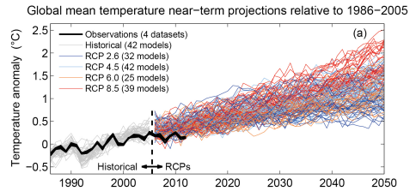
IPCC global mean surface temperature projections
IPCC Working Group I 5th Assessment Report, Chapter 11, Figure 25.

Slide 4
Reasons to care about good data management (1)
Data can be expensive, even impossible, to reproduce
As scientists we need to be able to analyse and re-analyse our data
We need a systematic, automated approach to handle large data volumes
We need to share our data with collaborators
We want to compare with data produced by other researchers

Slide 5
Reasons to care about good data management (2)
We want to archive our data for long term preservation (often a funding requirement)
We want our work to be cited in other studies to gain academic credit
So we need robust and efficient methods of reading, writing, storing, moving, finding and citing data

Slide 6
Automating data interactions
Wherever possible we use:
common software tools
which are designed to work with
standard file formats
which in turn comply with
metadata conventions
There is (some) pain involved in learning these…
… but they make your life easier in the end

Slide 7
Standard file formats

Slide 8
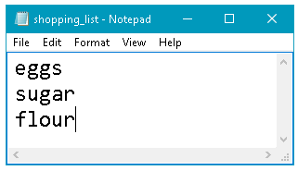
Standard file formats: ascii text
shopping_list.txt
$ cat shopping_list.txt
eggs
sugar
flour
An ascii file seems simple and standard computer operating systems, e.g. Linux, Windows, Mac, etc. allow the user to easily create and display such files but it is still a binary encoded file format

Slide 9
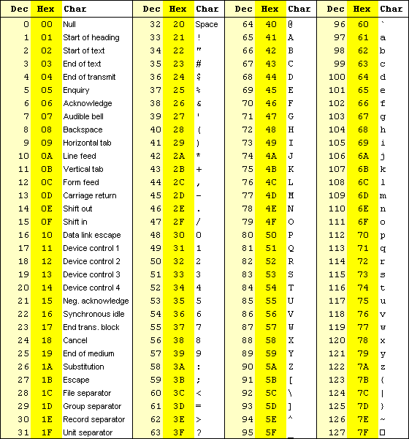
ASCII Encoding table
Codes for:
Lower case a – z
Upper case A-Z
Digits 0 – 9
Punctuation !?()% etc.
Terminal control
Inside the file:
85 (53 in hex, 01010011 bin) is “S”.
Notes:
This is a table of the ascii text codes. E.g. 85 (53 in hex, 01010011 bin) is “S”. This has been more or less the same since 1963.

Slide 10
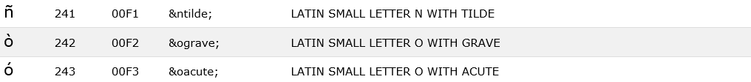
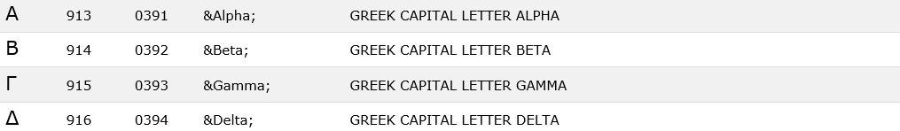
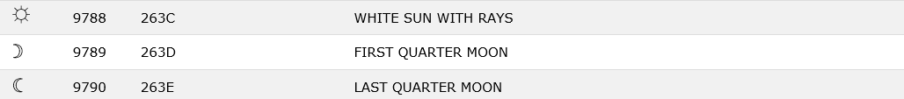
Ascii extensions
ASCII encoding has been more or less the same since 1963.
Unicode (UTF-8) retains the original ascii codes but extends to many thousands of characters
Notes:
Some of the charahers are printable
Some are about terminal control.
ASCII 2 and Unicode extend this into many more characters.

Slide 11
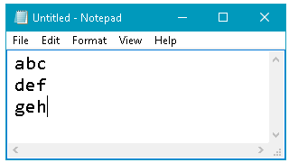
Text file gotchas
Some text characters are not represented in Unicode, e.g., ‘smart’ quotes: “ ” ‘ ’ and ‘non-printing’ characters – most often this results from copying and pasting from word processors and web browsers
Use text editor settings to save as ascii or unicode
Moving between operating systems, e.g. Linux and Windows
Use unix2dos or dos2unix Linux commands to add/remove ^M characters at end of line
$ vi myfile.txt
abc^M
def^M
geh^M

Slide 12
Ascii for data storage
Useful for small amounts of data, e.g. list of values, and for temporary storage
Portable and many tools available for reading / writing
It’s a standard file encoding, but no standard way to structure data so difficult to develop standardized data processing tools
No guarantee that metadata will exist or be structured
Not recommended for long-term data storage

Slide 13
Comma separated variables
Structured ascii file that can be used with a standard text editor so it is ‘human readable’
Easily processed by spreadsheet applications (data arranged in rows and columns)
Defined csv formats for atmospheric measurements include NASA Ames (.na) and BADC-CSV (.csv)
These data storage formats have defined metadata conventions

Slide 14
BADC-CSV 1
$ cat simple-example.csv
Conventions,G,BADC-CSV,1
title,G,My data file,
creator,G,Prof W E Ather,Reading
contributor,G,Sam Pepler,BADC
long_name,1,time, days since 2007-03-14
long_name,2,air temperature,
long_name,3,met station air temperature,
creator,3,unknown,Met Office
coordinate_variable,1,x,
location_name,G,Rutherford Appleton Lab,
data,,,
1,2,3,
0.8,2.4,2.3,
1.1,3.4,3.3,
2.4,3.5,3.3,
3.7,6.7,6.4,
end data,,,

Slide 15
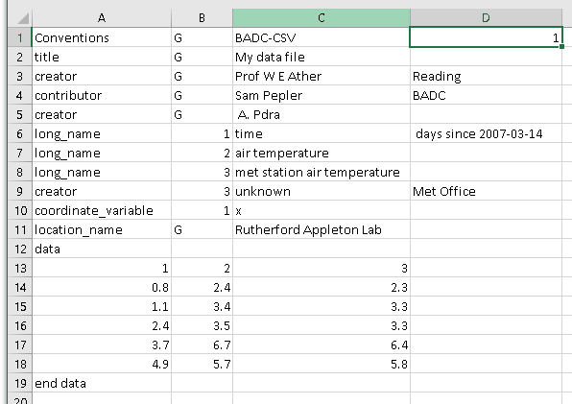
BADC-CSV 2

Slide 16
CSV gotchas
Non-ASCII characters – cut and paste from other places
Date / time formats can vary between applications and formats, e.g. BADC-CSV expects YYYY-MM-DD hh:[mm:ss]
Coordinate values should be monotonic
‘Missing data’ value must be outside valid range of data
It’s possible to write metadata that are no help to anyone, e.g. author’s name = Sam, variable name = sam3.

Slide 17
.csv for data storage
Works well for storing 1D or 2D data
Portable and many tools available for reading / writing
Data and metadata standards are defined – use them!!
Examples and documentation: http://help.ceda.ac.uk/category/4423-formats
Provided standards are followed, .csv is suitable for long-term data storage

Slide 18
NetCDF (.nc)
For big data need more flexible file formats such as NetCDF
Not ascii, therefore not directly human readable
Efficient for storing large volumes of numeric data – byte, integer, floating point data types
Can store multi-dimensional arrays, e.g. NumPy arrays
Portable (independent of hardware architecture)
Many software tools available to process NetCDF files and manipulate data
Metadata conventions well defined, most notably, NetCDF conventions and CF conventions

Slide 19
File Formats
Many file formats are in use:
GRIB (.grb) GRIdded Binary: binary format & the data is packed to increase storage efficiency. GRIB data is also self-describing (e.g. ECMWF data)
PP (.pp) Output from the Met Office Unified Model
.png, .jpg Image file formats
.mp4 Video file format
xls, docx, etc. Proprietary formats from common software tools
Don’t use proprietary formats for long term storage because proprietary software is needed to read them.

Slide 20
Metadata

Slide 21
Metadata – Data about the data
Who produced the data?
How was it done?
Why was it done?
When was it produced?
Where does the data relate to?
What are the data?

Slide 22
Metadata – Data about the data
Discovery metadata – enable the data to be found, e.g. experiment name, date, geographical area
Browse metadata – more detailed metadata, e.g., what variables were observed/modelled
Usage metadata – highly detailed e.g. variable names, units, precise coordinates, processing algorithms
Citation metadata – e.g. links to academic papers citing the data, post fact annotations
‘Extra’ metadata – e.g. detailed metadata about the instrument used

Slide 23
Discovery Metadata

Slide 24


Searching for data (1)
I want to find a library book on Python programming…
…I can search the library catalogue for “python”…

Slide 25
Searching for data (2)
“Monty Python at Work”, Michael Palin. Publisher: Hern Books. TV Comedy.
“Learning Python”, Mark Lutz. Publisher: O’ Reilly. Computer Programming.
“Ball Pythons: Caring For Your New Pet (Reptile Care Guides)”, Casey Watkins. Publisher: TokaySEO. Animal care.

Slide 26

Searching for data (3)
“Learning Python”, Mark Lutz. Publisher: O’ Reilly.
2015, 382 pp, Computer Science, Shelf Mark 3L52, Dewey: 00532.44.3

Slide 27
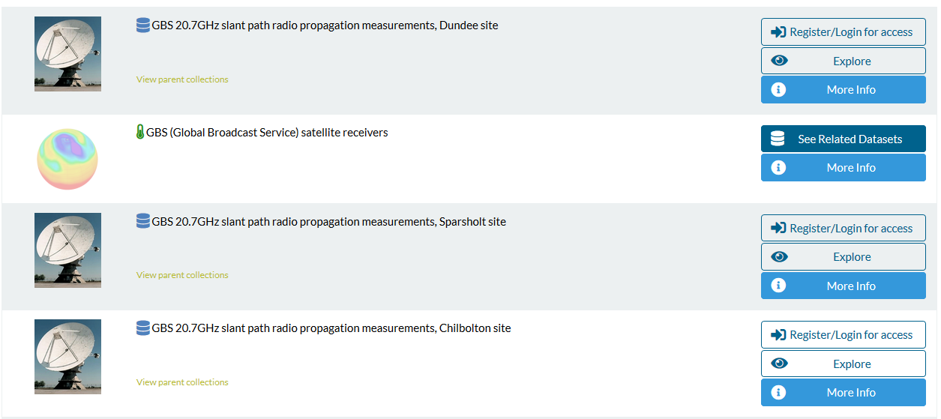
CEDA “MOLES” catalogue
Search CEDA data holdings for atmospheric and EO data at catalogue.ceda.ac.uk

Slide 28
Usage Metadata

Slide 29
The first 10 (of 240) lines from the file sw010203
(taken from the NERC MST Radar Facility archives)
4.31 155.3 3.92 136.1 5.15 140.2 4.23 137.1 4.75 150.2 4.71 137.9
4.35 146.5 4.52 138.0 4.83 153.7 5.40 145.8 4.63 141.0 4.90 137.3
4.31 143.3 4.58 157.0 4.94 141.7 4.65 143.1 4.63 143.0 4.88 149.5
5.42 148.5 4.92 140.4 4.04 146.7 3.92 151.5 5.02 135.3 5.06 151.6
4.65 152.3 4.31 168.8 3.79 145.3 5.92 152.9 5.02 145.8 4.77 161.6
4.79 144.1 4.60 147.5 5.33 150.1 4.81 141.0 6.02 146.9 4.38 149.0
4.42 142.5 4.58 133.4 4.35 150.5 4.96 149.8 5.56 143.4 5.08 148.5
5.19 141.6 4.40 142.4 4.10 152.6 5.02 134.0 4.94 142.9 5.27 144.4
5.38 141.5 5.88 144.8 6.00 140.1 4.75 158.3 5.08 148.1 5.46 163.5
4.27 150.8 4.69 138.8 5.71 144.0 5.21 138.8 5.00 132.4 5.06 144.4
What is known about this file? sw indicates that the file contains "surface" wind data
(i.e. speed and direction) from the location Frongoch 010203 represents the date in YYMMDD format
1st February 2003
(British convention)
2nd January 2003
(North American convention)
3rd February 2001
(Swedish convention)

Slide 30
The first 10 (of 240) lines from the file sw010203
(taken from the NERC MST Radar Facility archives)
4.31 155.3 3.92 136.1 5.15 140.2 4.23 137.1 4.75 150.2 4.71 137.9
4.35 146.5 4.52 138.0 4.83 153.7 5.40 145.8 4.63 141.0 4.90 137.3
4.31 143.3 4.58 157.0 4.94 141.7 4.65 143.1 4.63 143.0 4.88 149.5
5.42 148.5 4.92 140.4 4.04 146.7 3.92 151.5 5.02 135.3 5.06 151.6
4.65 152.3 4.31 168.8 3.79 145.3 5.92 152.9 5.02 145.8 4.77 161.6
4.79 144.1 4.60 147.5 5.33 150.1 4.81 141.0 6.02 146.9 4.38 149.0
4.42 142.5 4.58 133.4 4.35 150.5 4.96 149.8 5.56 143.4 5.08 148.5
5.19 141.6 4.40 142.4 4.10 152.6 5.02 134.0 4.94 142.9 5.27 144.4
5.38 141.5 5.88 144.8 6.00 140.1 4.75 158.3 5.08 148.1 5.46 163.5
4.27 150.8 4.69 138.8 5.71 144.0 5.21 138.8 5.00 132.4 5.06 144.4
What can we guess?
Values are clearly arranged in pairs
1st value of pair (e.g. 4.31) must represent speed - probably in units of m s⁻¹ 2nd value of pair (e.g. 155.3) must represent direction - probably in units of ° from North (but meteorological or vector convention?)
240 lines, each with 6 columns, each with a pair of values => 1440 pairs of values
There are 1440 minutes in a day => 1 minute sampling

Slide 31
The first 10 (of 240) lines from the file sw010203
(taken from the NERC MST Radar Facility archives)
4.31 155.3 3.92 136.1 5.15 140.2 4.23 137.1 4.75 150.2 4.71 137.9
4.35 146.5 4.52 138.0 4.83 153.7 5.40 145.8 4.63 141.0 4.90 137.3
4.31 143.3 4.58 157.0 4.94 141.7 4.65 143.1 4.63 143.0 4.88 149.5
5.42 148.5 4.92 140.4 4.04 146.7 3.92 151.5 5.02 135.3 5.06 151.6
4.65 152.3 4.31 168.8 3.79 145.3 5.92 152.9 5.02 145.8 4.77 161.6
4.79 144.1 4.60 147.5 5.33 150.1 4.81 141.0 6.02 146.9 4.38 149.0
4.42 142.5 4.58 133.4 4.35 150.5 4.96 149.8 5.56 143.4 5.08 148.5
5.19 141.6 4.40 142.4 4.10 152.6 5.02 134.0 4.94 142.9 5.27 144.4
5.38 141.5 5.88 144.8 6.00 140.1 4.75 158.3 5.08 148.1 5.46 163.5
4.27 150.8 4.69 138.8 5.71 144.0 5.21 138.8 5.00 132.4 5.06 144.4
In which order should we read the data?
Column by column and then row by row or vice versa?
Try both ways and plot time series of the speed and direction data There should be no sharp discontinuities in speed or direction
Vector (i.e. towards which the wind is blowing) or meteorological direction? Compare with synoptic pressure maps or MST radar data

Slide 32
The first 10 (of 240) lines from the file sw010203
(taken from the NERC MST Radar Facility archives)
4.31 155.3 3.92 136.1 5.15 140.2 4.23 137.1 4.75 150.2 4.71 137.9
4.35 146.5 4.52 138.0 4.83 153.7 5.40 145.8 4.63 141.0 4.90 137.3
4.31 143.3 4.58 157.0 4.94 141.7 4.65 143.1 4.63 143.0 4.88 149.5
5.42 148.5 4.92 140.4 4.04 146.7 3.92 151.5 5.02 135.3 5.06 151.6
4.65 152.3 4.31 168.8 3.79 145.3 5.92 152.9 5.02 145.8 4.77 161.6
4.79 144.1 4.60 147.5 5.33 150.1 4.81 141.0 6.02 146.9 4.38 149.0
4.42 142.5 4.58 133.4 4.35 150.5 4.96 149.8 5.56 143.4 5.08 148.5
5.19 141.6 4.40 142.4 4.10 152.6 5.02 134.0 4.94 142.9 5.27 144.4
5.38 141.5 5.88 144.8 6.00 140.1 4.75 158.3 5.08 148.1 5.46 163.5
4.27 150.8 4.69 138.8 5.71 144.0 5.21 138.8 5.00 132.4 5.06 144.4
It is often possible to "decode" ASCII files in this way, it is much more difficult for binary.
No-one will be prepared to make this effort unless they have a strong need for the data.
The data will becomes useless if the file name is changed - the date information is not recorded anywhere else.
Even if the data can be read, they may be of little scientific value unless something is known about: the type of instrument used, where it was located & how it was operated.

Slide 33
The partial contents of file
nerc-mstrf-wind-sensors_capel-dewi_20080114_wxt510.nc
global attributes:
:verbose_metadata = "Free text description" ;
:file_version_number = 1s ;
:data_year = 2008s ;
:data_month = 1s ;
:data_day = 14s ;
dimensions:
time = 1440 ;
variables:
float longitude() ;
longitude:units = "degrees_east" ;
longitude:axis = "X"
float latitude() ;
latitude:units = "degrees_north" ;
latitude:axis = "Y" ;
float altitude() ;
altitude:units = "m" ;
altitude:axis = "Z" ;
int time(time) ;
time:units = "seconds since 2008-01-14 00:00:00 +00:00" ;
time:axis = "T" ;
float mean_wind_speed(time) ;
mean_wind_speed:units = "m s-1" ;
mean_wind_speed:coordinates = "latitude longitude altitude" ;
mean_wind_speed:cell_methods = "time: minimum (interval: 3 s)" ;
mean_wind_speed:missing_value = 99.9f ;
short mean_wind_direction(time) ;
mean_wind_direction:units = "degree" ;
mean_wind_direction:coordinates = "latitude longitude altitude" ;
mean_wind_direction:cell_methods = "time: minimum (interval: 3 s)";
mean_wind_direction:missing_value = 999s ;

Slide 34
But why go to all this trouble?

Slide 35
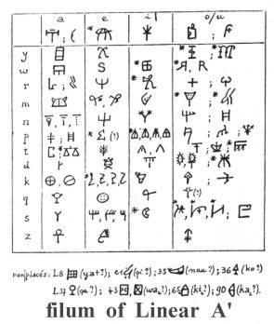
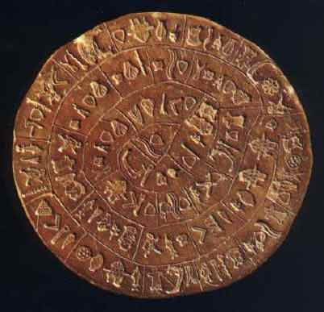
It’s ok, I’ll just do regular backups
Phaistos Disk, 1700BC
These documents have been preserved for thousands of years!
But they’ve both been translated many times, with different meanings each time.
Data Preservation is not enough, we need Active Curation to preserve Information
Notes:
Extra slide 5

Slide 36
Increasing Data Impact
Good data and metadata formats...
Help to guarantee unambiguous content
Permit metadata harvesting from the data
Ensure future users can open data files
How future proof is an Excel spread sheet?
Enable data to be cited (DOI)
And let the scientists concentrate on doing science
Notes:
This slide is to explain why we need Good data and good metadata for long term preservation.

Slide 37
How NOT to manage your data…
https://www.youtube.com/watch?v=N2zK3sAtr-4

Slide 38
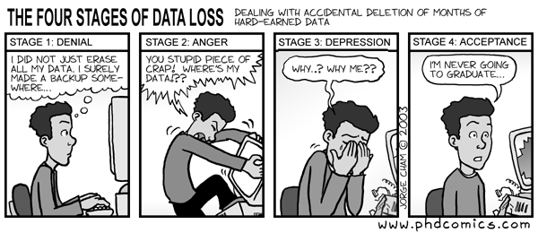
Why archive data anyway?
"Piled Higher and Deeper" by Jorge Cham
www.phdcomics.com

