Slide 1


Managing your code: quietly introducing Git - a friend for life
Thanks to all contributors:
Alison Pamment, Sam Pepler, Ag Stephens, Stephen Pascoe, Kevin Marsh, Anabelle Guillory, Graham Parton, Esther Conway, Eduardo Damasio Da Costa, Wendy Garland, Alan Iwi and Matt Pritchard.

Slide 2
Managing code in the olden days
Create “working_dir”...add some code
Write some outputs...change the code
Publish a paper...change the code
Copy “working_dir” to “working_dir2”
Change the code
Copy a version to a CD
...now which version is current? Is it “working_dir” or “working_dir2”? And which one relates to that paper?

Slide 3
But those days are gone!
Scientists are typically required to publish data and code (by their funders/institutions).
Collaboration between scientists requires data-sharing; this implicitly relies on code-sharing.
There are tools that make it easy to record our changes, document our workflow and “fix” releases of our code at important steps along the way.

Slide 4
So, working on the premise that we accept that we need to know about, and use, version control…

Slide 5

We will use Git and GitHub
Notes:
There are lots of different version control systems. We recommend using Git as the tool, and that you use GitHub as the free on-line service to manage your repository.

Slide 6
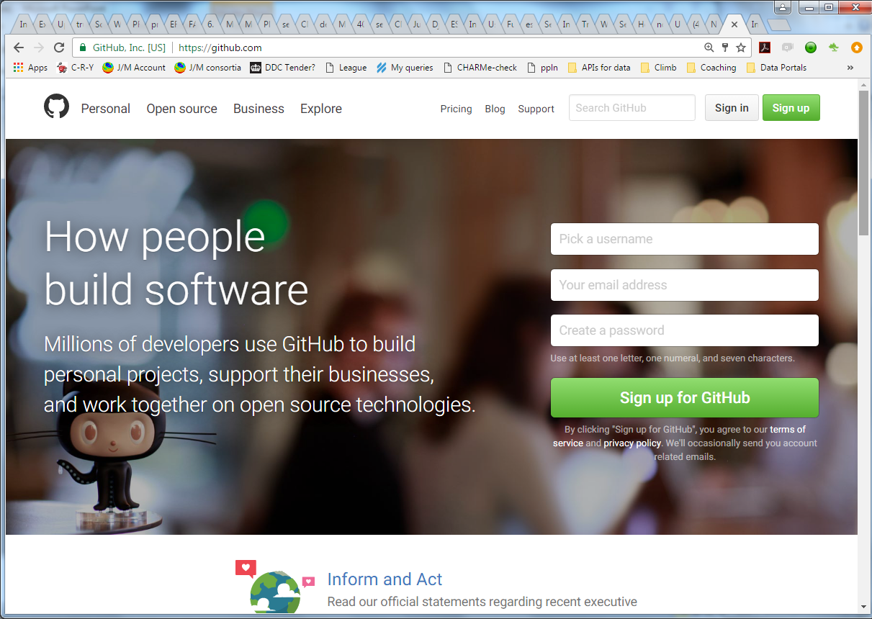
Introducing GitHub
https://github.com
Notes:
GitHub is a web site and eco-system of web tools that make code development easier.

Slide 7
Let's get started with GitHub
Anyone can get a free GitHub account - you'll only need to pay if you want private repos
We are going to learn Git and GitHub by using them throughout this course.
Let's get started… ☺

Slide 8
Create a GitHub account
Go to: https://github.com and sign up:

Slide 9
Authentication
You can use either a username/password or SSH key authentication. The latter is more secure but many folks use username/password.
For this course we will use username/password for simplicity.

Slide 10
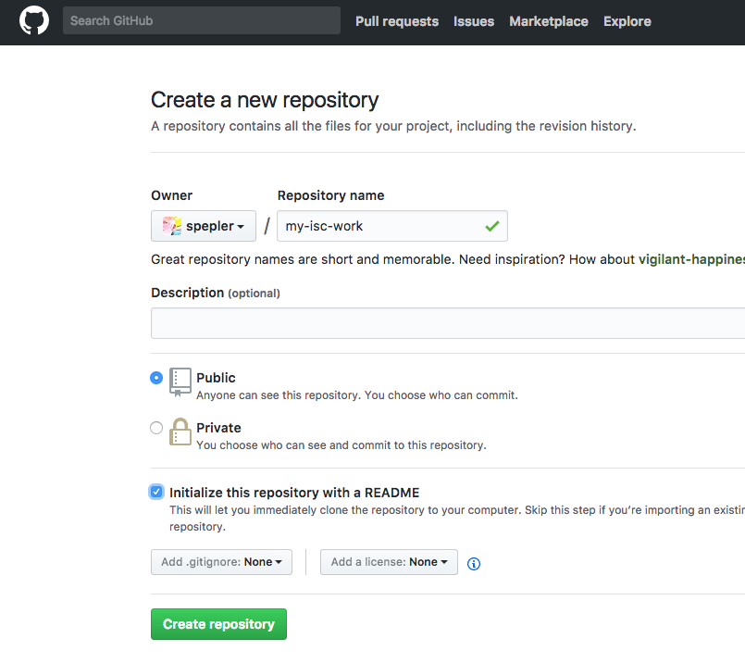
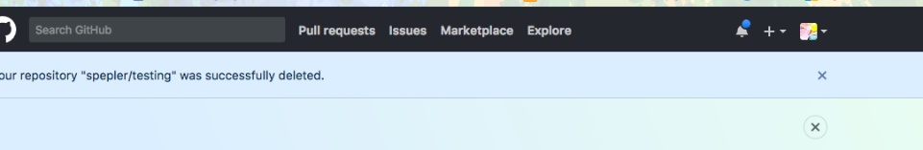
Make a repo
1) Click to add a new repo
2) Call new repo my-isc-work
3) Click the add README box

Slide 11
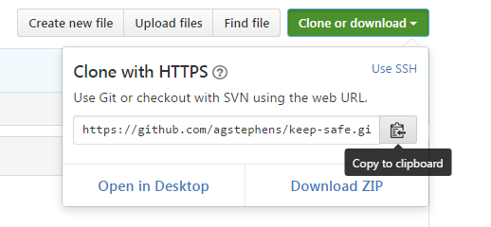
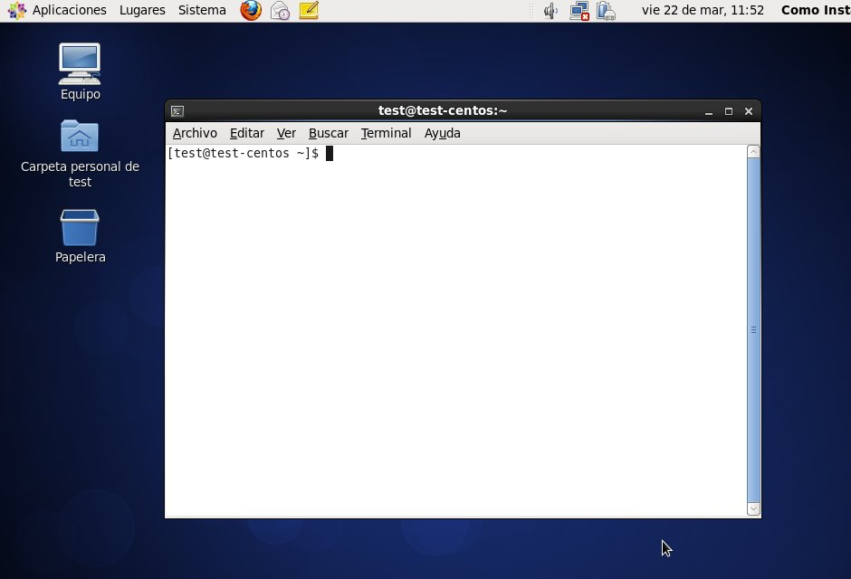
Copy the clone link
Click "Clone or download " and copy the link.
Go to your Linux Terminal.

Slide 12
Copy the clone link
Make sure you are in your home directory:
Write the git clone command and add the URL to the repository (which is different for each user):
$ cd
$ git clone https://<username>@github.com/<username>/my-isc-work

Slide 13
The my-isc-work repo is now on the laptop and I can list the README.md file
$ cd my-isc-work/
$ ls
README.md
$ touch x
$ ls
README.md x
$ git add x
$ git commit x -m 'new x file'
[master 3aefe17] new x file
1 file changed, 0 insertions(+), 0 deletions(-)
create mode 100644 x
$ git push
Counting objects: 3, done.
Delta compression using up to 4 threads.
Compressing objects: 100% (2/2), done.
Writing objects: 100% (3/3), 272 bytes | 272.00 KiB/s, done.
Total 3 (delta 0), reused 0 (delta 0)
To https://github.com/spepler/my-isc-work.git
183fa53..3aefe17 master -> master
Make a blank file “x”
Use git add and git commit to put the file under version control
Use git push to update github copy of the repo with the changes (in this case adding the “x” file)

Slide 14
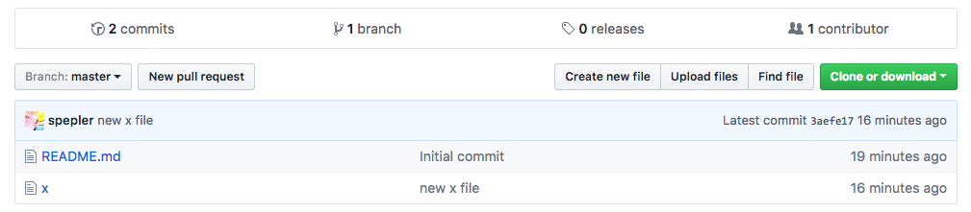
Now it’s visible on github

Slide 15

I’ll be back…
There is already a copy of the course materials on your laptop from a public github repository.
You are setup on Github for use latter in the course.
We’ll add more git stuff as we go.

