Slide 1
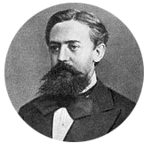
Markov Models and Maximum Entropy
Speaker: Hu Weilong
2017-04-13

Slide 2




Content
Hidden Markov Models
Maximum Entropy
MEMMs
Content
Further Work

Slide 3
Hidden Markov Models
Part 1

Slide 4
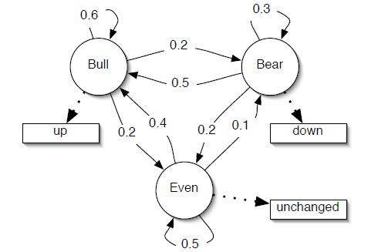
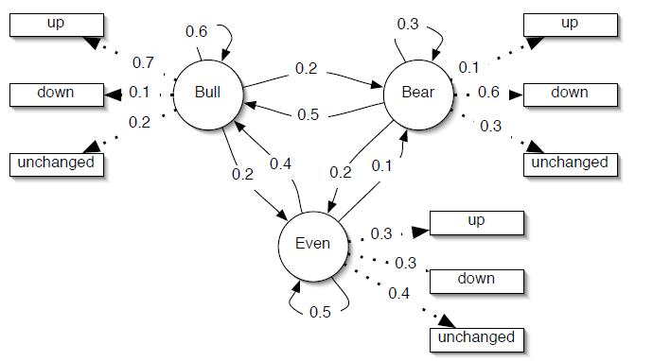
Hidden Markov Models
Overview
Overview
Representing sequential data.
part-of-speech tagging，text segmentation, noun-phrase chunking.
Markov Process & Hidden Markov Models
Finite state automaton；transition between states
State sequence is “hidden”
Notes:
Overview：
特别适合建模序列数据，在这些方面应用广泛
模型比较：
左图：有限状态自动机，状态之间存在转移概率
右图：每个状态发射为任意观测值，给定观测序列，状态序列隐藏。

Slide 5





Hidden Markov Models
Introduction
Formal definition of a HMM
$$λ=(A, B, π)$$
S is our state alphabet set, and V is the observation alphabet set，Q to be a fixed state sequence of length T, and corresponding observations O:
$$V= \left(v_{1}, v_{2}, ⋯, v_{N}\right) O = o_{1}, o_{2}, ⋯, o_{T}$$
$$S = \left(s_{1}, s_{2}, ⋯, s_{N}\right) Q = q_{1}, q_{2}, ⋯, q_{T}$$
A is a transition array, B is the observation array, π is the initial probability array:
$$A = [a_{ij}] , a_{ij}=P(q_{t} = s_{j} |q_{t−1} = s_{i})$$
$$B = [b_{i}(k)] , b_{i}(k) = P(o_{t} = v_{k}|q_{t} = s_{i})$$
$$π = [π_{i}] , π_{i} = P(q_{1} = s_{i})$$
Two assumptions of a HMM
1. Markov assumption:
$$P(q_{t}|q_{1}^{t−1}) = P(q_{t}|q_{t−1})$$
2. Independent assumption:
$$P(o_{t}|o_{1}^{t−1} , q_{1}^{t}) = P(o_{t}|q_{t})$$
Notes:
S是状态字典集，V是观测值字典集
O，Q分别是长度为T的观测序列与状态序列
1.马尔科夫假设：
当前状态只决定于前一个状态
2.独立性假设：
当前观测值只依赖于当前状态

Slide 6
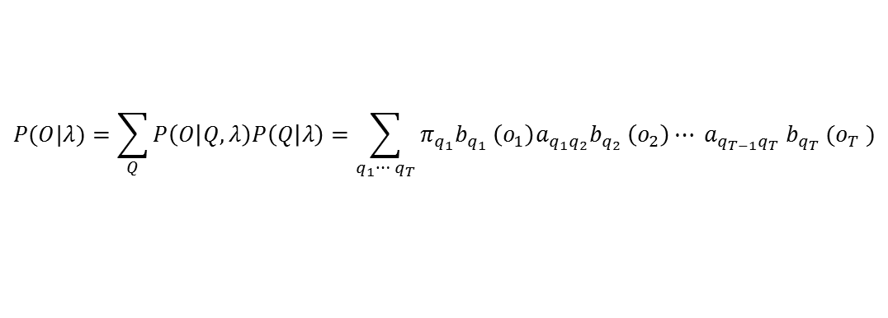

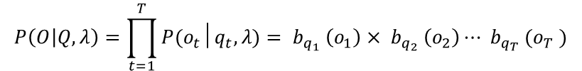

Hidden Markov Models
Evaluation
Evaluate$P(O|λ)$
The probability of the observations O for a specific state sequence Q is:
$$P\left(O | Q, λ\right)=\prod_{t=1}^{T}{P(o_{t}│q_{t}, λ)}= b_{q_{1}} \left(o_{1}\right)× b_{q_{2}} \left(o_{2}\right)⋯ b_{q_{T}} (o_{T} )$$
and the probability of the state sequence is:
$$P\left(Q | λ\right)=π_{q_{1}}a_{q_{1}q_{2}}a_{q_{2}q_{3}}⋯ a_{q_{T−1}q_{T}}$$
so we can calculate the probability of the observations given the model as:
$$P(O|λ)=\sum_{Q}{P\left(O | Q,λ\right)P\left(Q | λ\right)}=\sum_{q_{1}⋯ q_{T}}{π_{q_{1}}b_{q_{1}} \left(o_{1}\right)a_{q_{1}q_{2}}b_{q_{2}} \left(o_{2}\right)⋯ a_{q_{T−1}q_{T}} b_{q_{T}} (o_{T} )}$$
This result allows the evaluation of the probability of O, but to evaluate it directly would be exponential in T.
Notes:
对模型进行估计，估计P（O|）,这个概率可以看做该模型预测一个观测序列的能力。
给定状态序列Q，由独立性假设，表示为一系列乘积
根据马尔科夫假设，状态序列的概率可表示为……
使用全概率公式
虽然该公提供了预测O的概率，但是直接计算得复杂度是T的指数幂。

Slide 7
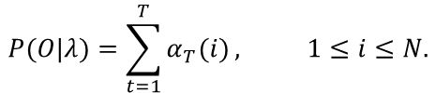
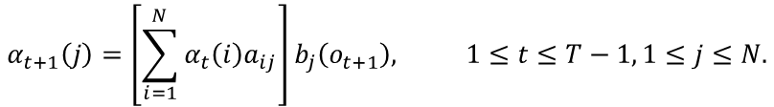

Hidden Markov Models
Evaluation
Forward algorithm
define the forward probability variable:
$$α_{t}(i)=P(o_{1},o_{2},⋯,o_{t},q_{t}=s_{i}|λ)$$
forward algorithm is as follows:
1
$$α_{i}\left(i\right)=π_{i}b_{i}\left(o_{1}\right), 1≤i≤N.$$
2
$$α_{t+1}\left(j\right)=\left[\sum_{i=1}^{N}{α_{t}\left(i\right)a_{ij}}\right]b_{j}\left(o_{t+1}\right), 1≤t≤T−1, 1≤j≤N.$$
3
$$P(O|λ)=\sum_{t=1}^{T}{α_{T}(i)}, 1≤i≤N.$$
by caching values the forward algorithm reduces the complexity of calculations involved to $N^{2}T$ rather than $2TN^{T}$
Notes:
为了解决计算商的复杂度，使用网格算法缓存中间结果。
定义前向变量作为t-1时刻所有状态到达该（i）状态的概率和。
基础步
推导步 t时刻所有状态到达j状态的概率和，再乘积
终结步：网格最后一列求和，即是产生O序列的概率。
有效地将时间复杂度从2TN^T 缩短到了N^2T

Slide 8
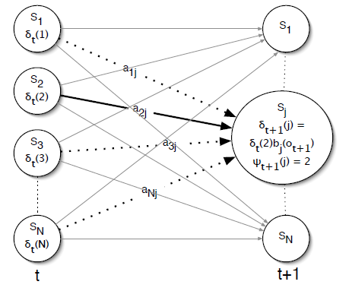



Hidden Markov Models
Decoding
Discover hidden state sequence
the probability of the most probable state path for the partial observation sequence:
$$δ_{t}\left(i\right)=\max_{q_{1},q_{2},⋯,q_{t−1}}{P(q_{1} q_{2}⋯,q_{t}=s_{i},o_{1},o_{2},⋯,o_{t}|λ)}$$
Viterbi algorithm is as follows:
1
$$δ_{1}\left(i\right)=π_{i}b_{i}\left(o_{1}\right), { ψ}_{1}\left(i\right)= 0, 1≤ i≤ N.$$
2
$$δ_{t}\left(j\right)= \max_{1≤i≤N}\left[δ_{t−1}\left(i\right)a_{ij}\right]b_{j}\left(o_{t}\right), 2≤ t≤ T, 1≤ j≤ N$$
$ψ\left(j\right)=$ $arg\max_{1≤j≤N}\left[δ_{t−1}\left(i\right)a_{ij}\right], 2≤ t≤ T, 1≤ j ≤ N$
3
$$P^{∗}=\max_{1≤i≤N}{δ_{T}(i)}$$
$$q_{T}^{∗} = arg\max_{1≤ i≤ N}{[ δ_{T}\left(i\right)]}$$
4
$$q_{t}^{∗}=ψ_{t+1}\left(q_{t+1}^{∗}\right), t= T−1, T−2, ⋯, 1$$
Notes:
下一个问题是已知观测序列，求解状态序列，称之为解码。
定义一个变量，表示t时刻到达i状态的最大概率，定义φ函数表示的是到达本状态概率最大的前一时刻状态。如图所示
Viterbi算法：
基础步没变
网格每个节点存储从前一时刻到达该状态最大的概率，以及达到最大条件的前一时刻状态
计算完T的长度
根据φ存储的最大值状态进行回溯查找最符合观测序列的状态序列
只能找到最好，找不到第二好

Slide 9



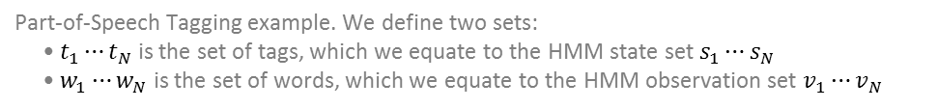
Hidden Markov Models
Learning
Supervised training
Part-of-Speech Tagging example. We define two sets:
• $t_{1}⋯t_{N}$ is the set of tags, which we equate to the HMM state set $s_{1}⋯s_{N}$
• $w_{1}⋯w_{N}$ is the set of words, which we equate to the HMM observation set $v_{1}⋯v_{N}$
So,
$$a_{ij}=P\left(t_{i} | t_{j}\right)=\frac{Count(t_{i}, t_{j})}{Count(t_{i})}$$
$$b_{j}(k)=P(w_{k}|t_{j})=\frac{Count(w_{k}, t_{j})}{Count(t_{j})}$$
$$π_{i}=P(q_{1}=t_{i})=\frac{Count(q_{1}=t_{i})}{Count(q_{1})}$$
Notes:
参数学习，分为有监督和无监督。
有监督以POS为例， t是标签集合，s是状态集合，w是词集合，v是观测值集合，其中每个词的标签都指定好了
Aij = tj标签在ti标签后面的个数 / ti标签的个数
Bj(k) = wk被标记为tj标签的个数 /
Πi = ti标签开头个数 / 总开头标签的个数

Slide 10
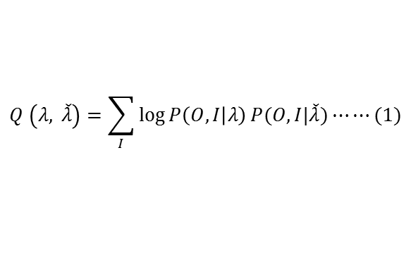
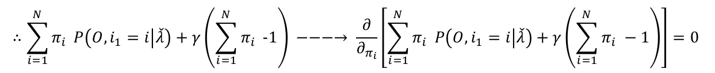

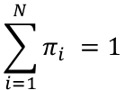

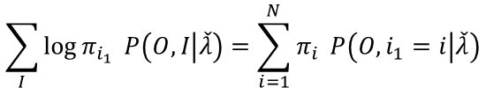
Hidden Markov Models
Learning
Unsupervised training
$$\left(O,I\right)=(o_{1},o_{2},⋯,o_{T}, i_{1}, i_{2},⋯,i_{T})$$
It’s likelihood function is
$$logP(O,I|λ)$$
Expectation:
$$Q \left(λ, \check{λ}\right)=\sum_{I}{\log{P\left(O,I | λ\right)}}P(O,I|\check{λ})⋯⋯(1)$$
$$P\left(O,I | λ\right)=π_{i_{1}}b_{i_{1}}\left(o_{1}\right)a_{i_{1}i_{2}}b_{i_{2}}\left(o_{2}\right)⋯ a_{i_{T−1}i_{T}}b_{i_{T}}(o_{T})⋯⋯(2)$$
$$∴ Q \left(λ,\check{λ}\right)=\sum_{I}{\log{π_{i_{1}}}} P\left(O,I | \check{λ}\right)+\sum_{I}{\left(\sum_{t=1}^{T−1}{\log{a_{i_{t}i_{t+1}}}}\right)}P\left(O,I | \check{λ}\right)+\sum_{I}{\left(\sum_{t=1}^{T}{\log{b_{i_{t}}\left(o_{t}\right)}}\right)}P\left(O,I | \check{λ }\right)⋯⋯(3)$$
Maximization(for the first part of Equation (3) ):
$$\sum_{I}{\log{π_{i_{1}}}} P\left(O,I | \check{λ}\right)=\sum_{i=1}^{N}{π_{i}} P\left(O,i_{1}=i | \check{λ}\right)$$
$$\sum_{i=1}^{N}{π_{i} =1}$$
Constraint:
$$∴\sum_{i=1}^{N}{π_{i}} P\left(O,i_{1}=i | \check{λ}\right)+γ\left(\sum_{i=1}^{N}{π_{i} }−1\right) −−−→ \frac{∂}{∂_{π_{i}}}\left[\sum_{i=1}^{N}{π_{i}} P\left(O,i_{1}=i | \check{λ}\right)+γ\left(\sum_{i=1}^{N}{π_{i} }−1\right)\right]=0$$
Notes:
无监督学习，前向-后向算法
完全数据是（O，I），写出似然函数是……，然后运用EM算法。
E步，λ帽是当前参数值
M步，拉格朗日乘子法

Slide 11


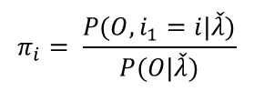

Hidden Markov Models
Learning
Unsupervised training
$$P(O,i_{1}=i|\check{λ}) +γπ_{i}=0$$
$$π_{i}= \frac{P(O, i_{1}=i|\check{λ})}{P(O|\check{λ})}$$
Similarly:
$$a_{ij}= \frac{\sum_{t=1}^{T−1}{P(O, i_{t}=i, i_{t+1}=j|\check{λ})}}{\sum_{t=1}^{T−1}{P\left(O, i_{t}=i\right|\check{λ}) }}$$
$$b_{j}(k)= \frac{\sum_{t=1}^{T}{P\left(O, i_{t}=j | \check{λ}\right)I\left(o_{t}=v_{k}\right)}}{\sum_{t=1}^{T}{P\left(O, i_{t}=j\right|\check{λ}) }}$$
$$I\left(o_{t}=v_{k}\right) is b_{j}\left(o_{t}\right) partial derivative of b_{j}(k)$$
Notes:
对πi进行求和求出λ，然后在求出πi
同理

Slide 12
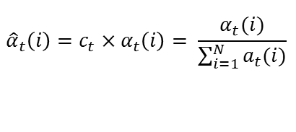
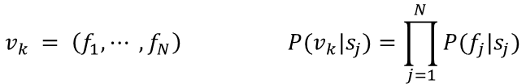
Hidden Markov Models
Other
Multi-Dimensional Feature Space
One solution to this problem is to use a multinomial model that assumes the features of the observations are independent
$$v_{k} = \left(f_{1}, ⋯ , f_{N}\right) P(v_{k}|s_{j})=\prod_{j=1}^{N}{P(f_{j}|s_{j})}$$
Implementing HMMs
floating-point underflow is a significant problem
1
Viterbi underflow
log all the probability values and then add values instead of multiply
2
Forward algorithm underflow
use scaling coefficients that keep the probability values in the dynamic range of the machine
$${\hat{α}}_{t}\left(i\right)=c_{t}×α_{t}\left(i\right)= \frac{α_{t}(i)}{\sum_{i=1}^{N}{a_{t}(i)}}$$
Notes:
观测值往往不是一维的，是多维的，
观测值表示为各项独立的多项分布
实现过程中遇到浮点数下溢问题，因为概率一般相当小
不同算法不同解决方法

Slide 13
Maximum Entropy
Part 2

Slide 14
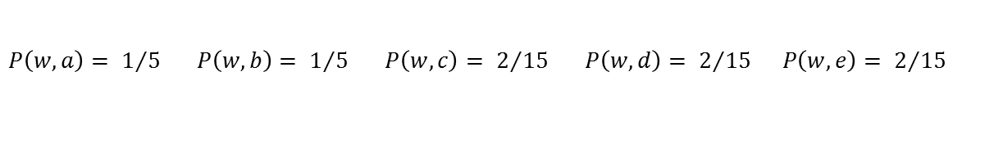
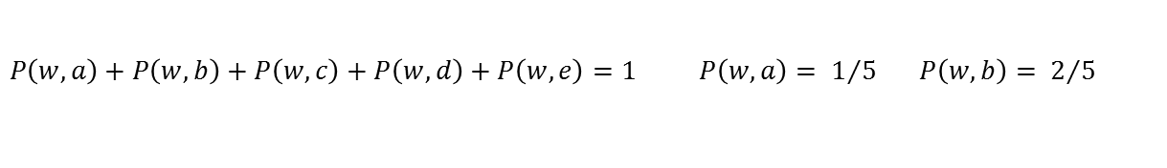
Maximum Entropy
Maximum Entropy Models
Motivating Example
word $w$ may be translated into $a, b, c, d, e$, we want to find a decision model $P(f)$, i.e.$P\left(w,a\right), P\left(w,b\right),⋯,P(w,e)$
some constraint :
$$P\left(w,a\right)+P\left(w,b\right)+P\left(w,c\right)+P\left(w,d\right)+P\left(w,e\right)=1 P\left(w,a\right)= 1/5 P\left(w,b\right)= 2/5$$
The most intuitive model is:
$$P\left(w,a\right)= 1/5 P\left(w,b\right)= 1/5 P\left(w,c\right)= 2/{15} P\left(w,d\right)= 2/{15} P\left(w,e\right)= 2/{15}$$
model all that is known and assume nothing about that which is unknown(uniform)
Principle of maximum entropy
Take precisely stated prior data or testable information about a probability distribution function. Consider the set of all trial probability distributions that would encode the prior data. According to this principle, the distribution with maximal information entropy is the proper one.
Notes:
一个小例子
W被翻译为五个值，求解一个模型表示各翻译概率，其中有一些约束。
于是最符合常识的模型是，
对已知的知识建模，对未知的不过任何假设
最大熵原理的实质就是，在已知部分知识的前提下，关于未知分布最合理的推断就是符合已知知识最不确定或最随机的推断，
这是我们可以作出的唯一不偏不倚的选择，任何其它的选择都意味着我们增加了其它的约束和假设，
这些约束和假设根据我们掌握的信息无法作出

Slide 15

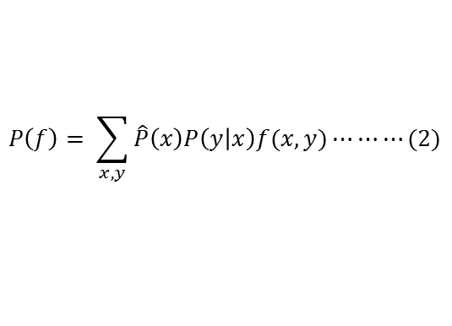
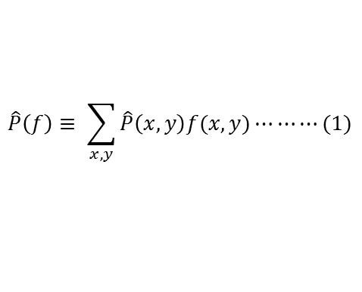
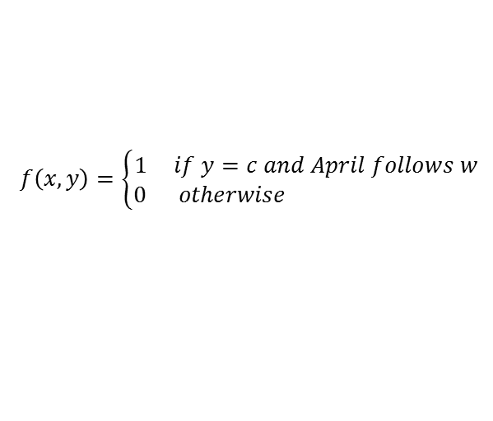
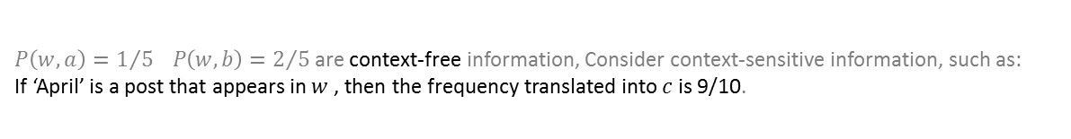
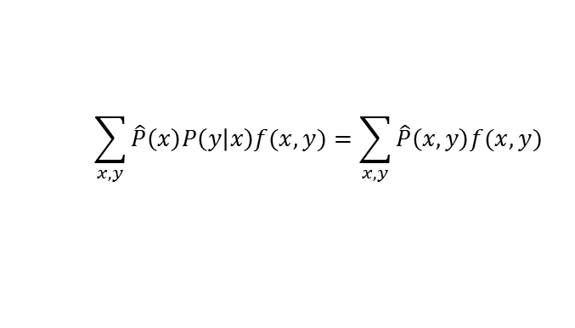
Maximum Entropy
Features and constraints
Features and constraints
$P\left(w,a\right)=1/5 P\left(w,b\right)=2/5$are context-free information, Consider context-sensitive information, such as:
If ‘April’ is a post that appears in $w$ , then the frequency translated into $c$ is 9/10.
$$f\left(x,y\right)=\left\{\begin{aligned}1 if y=c and April follows w \\ 0 otherwise \end{aligned}\right.$$
$$\hat{P}\left(f\right)≡ \sum_{x,y}{\hat{P}\left(x,y\right)f(x,y)⋯⋯⋯(1)}$$
We can represent the statistics of any sample as an expectation of the appropriate binary instruction function. We call this function a feature function or feature,
$$P\left(f\right)= \sum_{x,y}{\hat{P}\left(x\right)P\left(y | x\right)f(x,y)}⋯⋯⋯(2)$$
$$P\left(f\right)= \hat{P}(f)⋯⋯⋯(3)$$
Combined with (1),(2),(3)
$$\sum_{x,y}{\hat{P}\left(x\right)P\left(y | x\right)f(x,y)}=\sum_{x,y}{\hat{P}\left(x,y\right)f(x,y)}$$
We call (3) a constraint equation or a constraint.
Notes:
以上约束都是上下文无关的，我们也可以考虑上下文有关的，比如
当“April 出现在w后是，w被翻译为c的概率是9/10
于是使用一个指示函数来表示这个特征，这里我们称之为特征或者特征函数，
特征f关于经验分布p(x,y)的的期望值，就是一个感兴趣的统计值 -----------------（1）
我们可以将任何样本的统计表示成一个适当的二值指示函数的期望值
当我们发现一个统计量，我们觉得有用时，我们让模型去符合它（拟合），来利用这一重要性。
拟合过程通过约束模型p分配给相应特征函数的期望值来实现。特征f关于模型p(y|x)的期望值是： ---------（2）
这里，是x在训练样本中的经验分布。我们约束这一期望值和训练样本中f的期望值相同。那就要求： ----（3）
我们称（3）为约束等式（constraint equation）或者简称约束（constraint）。我们只关注那么满足（3）的模型，不再考虑那些和训练样本中特征f频率不一致的模型

Slide 16
MEMMs
2000-ICML
Maximum Entropy Markov Models for Information Extraction and Segmentation
Part 3

Slide 17
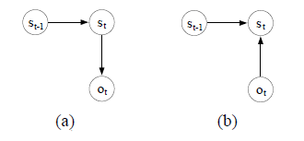
Maximum Entropy Markov Models
Introduction
Two problems
1
the observation probabilities are typically represented as a multinomial distribution over a discrete, finite vocabulary of words
in some applications the set of all possible observations is not reasonably enumerable
2
inappropriately uses a generative joint model in order to solve a conditional problem in which the observations are given
This Paper
move away from the generative, joint probability parameterization of HMMs to a conditional model that represents the probability of reaching a state given an observation and the previous state
Notes:
两个问题：
观测概率通常表示为离散字典上的多项分布，这种表示方式不太合适，不能表示交叉特征和互相依赖的特征。
而且很多应用场景下观测变量不一定是可枚举的。
2. 一般情况下观测值已知，试图用一个生成的联合概率模型去解决条件概率问题。
本文提出一个条件概率模型，表示给定前一个状态和观测值的……，如右图

Slide 18
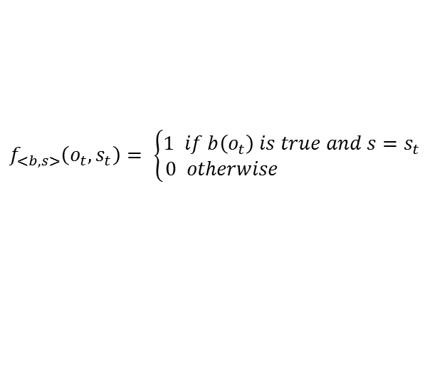
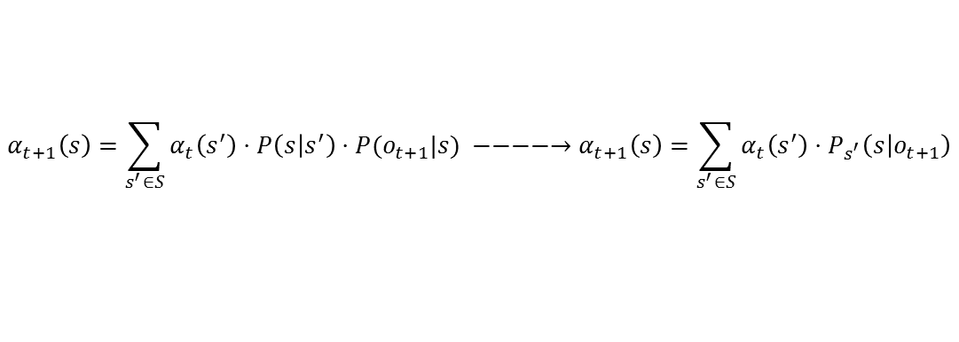

Maximum Entropy Markov Models
Method
New Model
HMM transition and observation functions are replaced by a single function
$$P\left(s | s^{′},o\right)=P_{s^{′}}(s|o)$$
Viterbi Step:
$$α_{t+1}\left(s\right)=\sum_{s^{′}∈S}{α_{t}\left(s^{′}\right)⋅P\left(s | s^{′}\right)⋅P(o_{t+1}|s)} −−−−→α_{t+1}\left(s\right)=\sum_{s^{′}∈S}{α_{t}\left(s^{′}\right)⋅P_{s^{′}}\left(s | o_{t+1}\right)}$$
An Exponential Model for Transitions
n binary feature
for specific $s′$, each feature a gives a function $f_{a}\left(o,s\right), a= <b, s>$
$$f_{<b,s>}\left(o_{t},s_{t}\right)= \left\{\begin{aligned}1 if b\left(o_{t}\right) is true and s=s_{t} \\ 0 otherwise \end{aligned}\right.$$
for each previous state $s′$ and feature a, transition function $P_{s^{′}}\left(s | o\right)$ satisfys:
$$\frac{1}{m_{s^{′}}}\sum_{k=1}^{m_{s^{′}}}{f_{a}\left(o_{t_{k}}, s_{t_{k}}\right)= }\frac{1}{m_{s^{′}}}\sum_{k=1}^{m_{s^{′}}}{\sum_{s∈S}{P_{s^{′}}\left(s | o_{t_{k}}\right)f_{a}\left(o_{t_{k}}, s\right)}}−−−−−→ P_{s^{′}}\left(s | o\right)=\frac{1}{Z\left(o, s^{′}\right)}exp⁡(\sum_{a}{λ_{a}f_{a}\left(o, s\right))}$$
Notes:
新模型中，转移概率和发射概率被合并为一个概率
于是，在Viterbi算法中，相应作出改变
文中的条件概率是用最大熵来建模，所以也是一个指数模型
首先，定义了n个特征，比如 观测量是单词“apple”，观测量是大写字母，
对于一个特定的s’和一个特定的特征，可以写出其特征函数
然后对于每个s’和一个特征，因为训练样本的特征函数期望值等于模型的特征函数期望值这个约束，写出等式

Slide 19
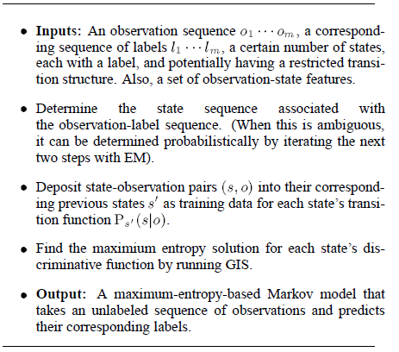
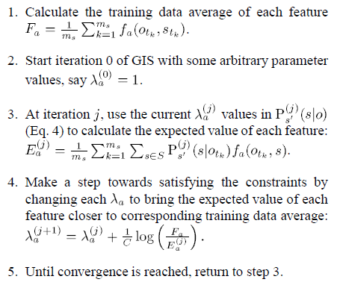
Maximum Entropy Markov Models
Method
Parameter Estimation by Generalized Iterative Scaling
Notes:
左图是参数估计的整体过程：
输入是观测值o和对应的标记I，以及带有标记的状态（隐含了转移概率），还有一系列的特征，
当状态序列和标签序列对应不明确时，使用下面步骤
对于每一对（s,o）,都和对应的s’组成一个训练数据。
对于每一个s’,运用GIS算法求解
输出一个最大熵马尔科夫模型，能预测观测序列的标记。
右图GIS算法
求解训练样本中特征函数期望值
初始迭代前假设模型为均匀分布
利用当前参数，得到当前模型的特征函数期望值
为了满足约束，修正参数
重复步骤3知道收敛

Slide 20
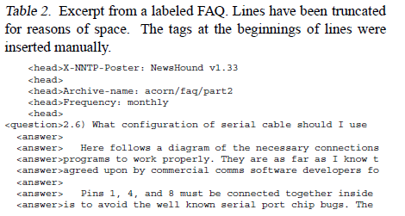
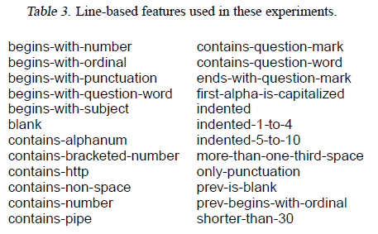
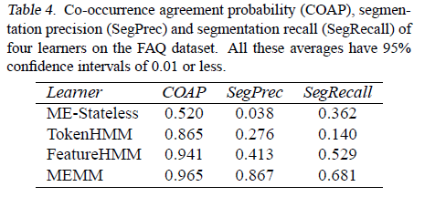
Maximum Entropy Markov Models
Experiment
Experimental Results
Notes:
本文实验数据集是来自7个新闻组的38个FAQ文件，整理之后格式如左上图
右上角是24个特征
下面是实验结果，指标有三个，其中
COAP是共生协议概率来反映片段边界被识别而忽略片段的标签
SP和SR就是准确率与召回率
ME-Stateless：最大熵分类器，独立考虑每一行，不考虑行之间依赖关系
TokenHMM：4个状态的传统HMM，考虑单词，每行的状态一致，所以状态转变在行尾
FeatureHMM：会将每行文本通过表3转变为特征，训练后为每一行输出一个标记
结果：
使用行特征比基于单词特征有效得多
结构上的特征，比如“如果离开了head片段，就不要在分配head标记”，比行特征更重要。

Slide 21
Further Work
Part 4

Slide 22
Further work
This paper
other text-related applications
partially labeled data
Others
Conditional Random Fields
Structured prediction
……
Notes:
本文将来工作：
应用于其他文本相关工作
考虑部分标注的数据
其他序列化标注工作：
CRF
结构化感知器

Slide 23

Hu Weilong
Thank you for your view ！
huweilong@whu.edu.cn

