Slide 1
Neural Machine Translation
Huang Ting

Slide 2

Sequence to Sequence Learning with
Neural Networks
2014_NIPS

Slide 3
Introduction
Our method uses a multilayered Long Short-TermMemory (LSTM) to map the input sequence to a vector of a fixed dimensionality, and then another deep LSTM to decode the target sequence from the vector.
Notes:
解决了深度神经网络DNN不能用于序列建模的问题（序列长度不固定）。提出了LSTM对序列建模，能够解决序列的长距离依赖问题。通过将源语言反向输入，可以为序列到序列模型提供更多短期依赖，提升模型性能。

Slide 4
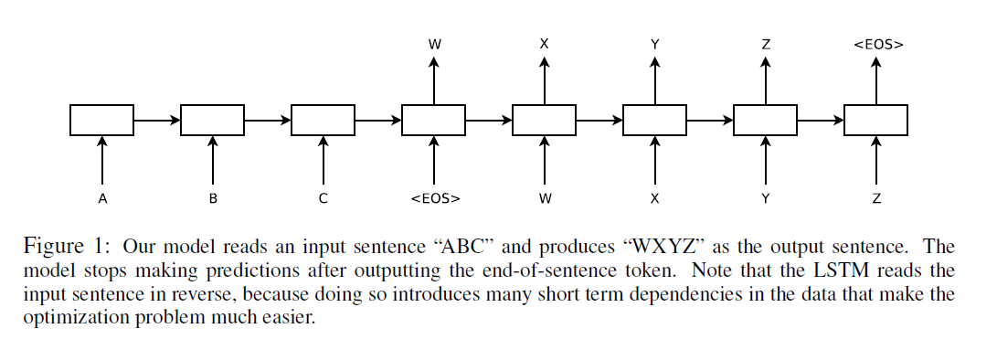
Introduction

Slide 5

The model
RNN
It would be difficult to train the RNNs due to the resulting long term dependencies. However, the Long Short-Term Memory (LSTM) is known to learn problems with long range temporal dependencies, so an LSTM may succeed in this setting.

Slide 6
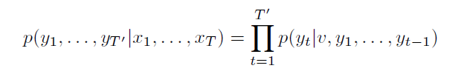
The model
Goal of LSTM
Two different LSTMs: one for the input sequence and another for the output sequence
An LSTM with four layers
Reverse the order of the words of the input sentence

Slide 7
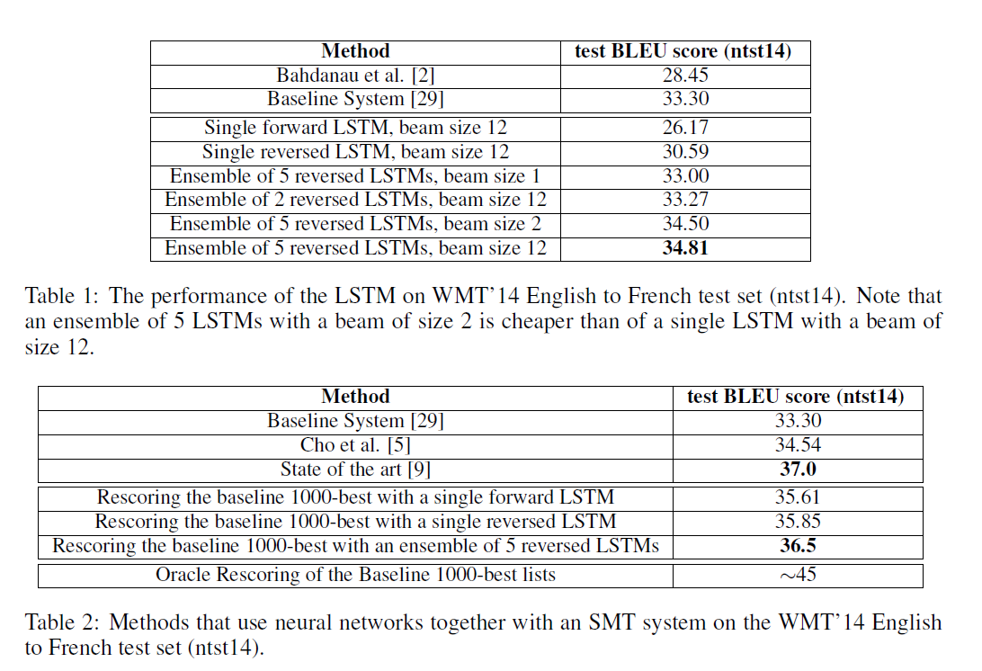
Experimental Results

Slide 8
NEURAL MACHINE TRANSLATION
BY JOINTLY LEARNING TO ALIGN AND TRANSLATE
2015_ICLR

Slide 9
Introduction
We conjecture that the use of a fixed-length vector is a bottleneck in improving the performance of this basic encoder–decoder architecture, and propose to extend this by allowing a model to automatically (soft-)search for parts of a source sentence that are relevant to predicting a target word, without having to form these parts as a hard segment explicitly.

Slide 10
Introduction
We introduce an extension to the encoder–decoder model which learns to align and translate jointly. Each time the proposed model generates a word in a translation, it (soft-)searches for a set of positions in a source sentence where the most relevant information is concentrated. The model then predicts a target word based on the context vectors associated with these source positions and all the previous generated target words.

Slide 11



The model
RNN ENCODER–DECODER

Slide 12
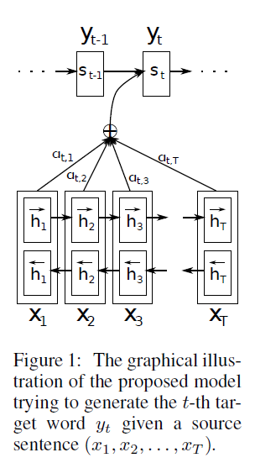





The model
LEARNING TO ALIGN AND TRANSLATE

Slide 13
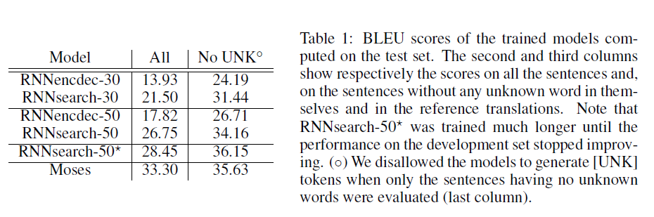
Experimental Results

Slide 14
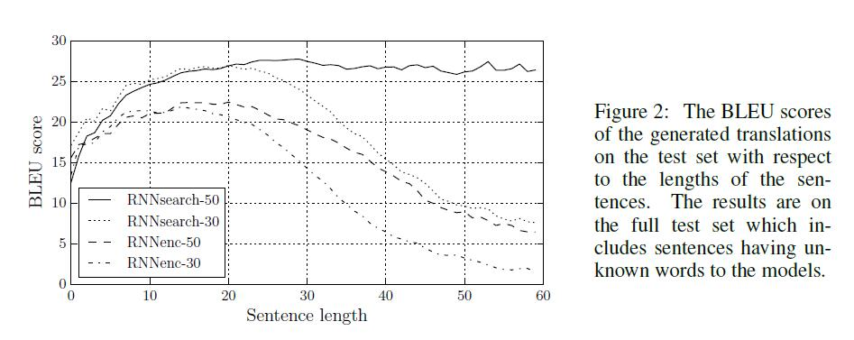
Experimental Results

Slide 15
Effective Approaches to Attention-based Neural Machine Translation
2015_EMNLP

Slide 16
Introduction
This paper examines two simple and effective classes of attentional mechanism: a global approach which always attends to all source words and a local one that only looks at a subset of source words at a time.

Slide 17
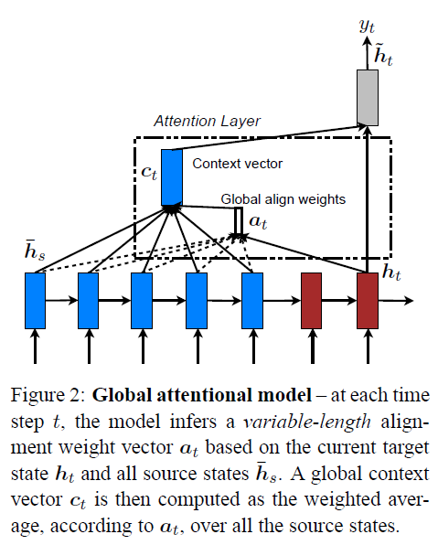
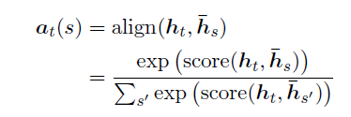
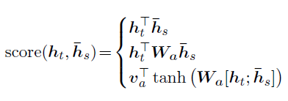
The model
Global Attention

Slide 18
The model
Comparison to (Bahdanau et al., 2015)
Use hidden states at the top LSTM layers in both the encoder and decoder VS bi-directional encoder and non-stacking unidirectional
decoder
Different ways in computing the score

Slide 19



The model
Local Attention
Monotonic alignment (local-m)
Predictive alignment (local-p)
alignment weights
Notes:
算权重的时候为了让越靠近pt的词越重要，在原权重公式上加了高斯分布。

Slide 20
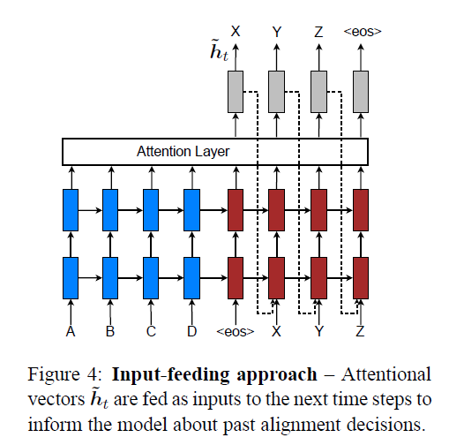
The model
Input-feeding Approach
Attentional vectors are concatenated with inputs at the next time steps
Notes:
希望在每次预测一个词之前能够知道之前词的对齐信息，即哪些源句子中的词已经被翻译过了。

Slide 21
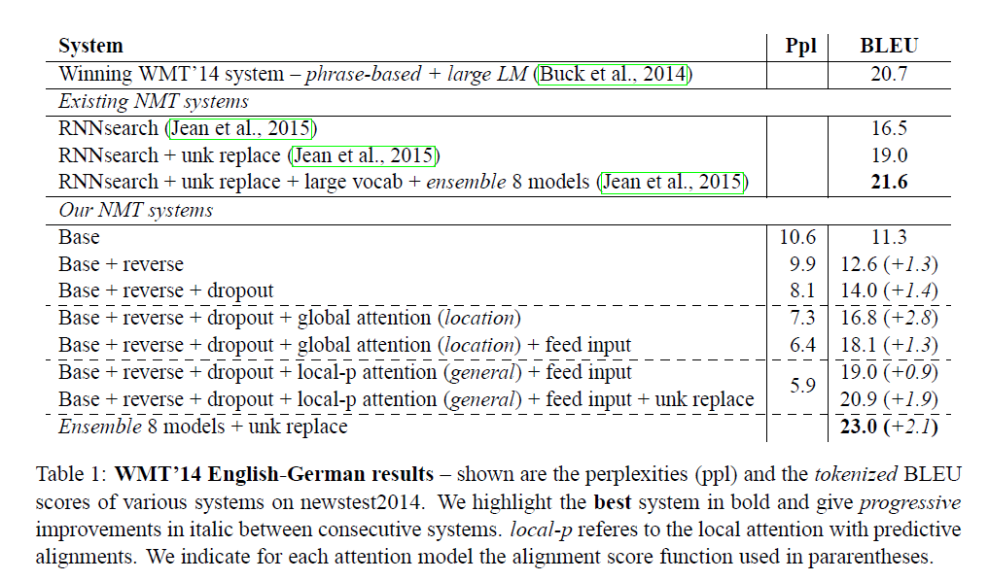
Experimental Results

Slide 22
THANK YOU

