Slide 1


Representations of Knowledge Graphs with Neighbors
黄婷

Slide 2
01
Neighborhood Mixture Model for Knowledge Base Completion
CoNLL(C) 2016

Slide 3
Introduction
In this paper, we define a novel entity representation as a mixture of its neighborhood in the knowledge base and apply this technique on TransE—a well-known embedding model for knowledge base completion.

Slide 4
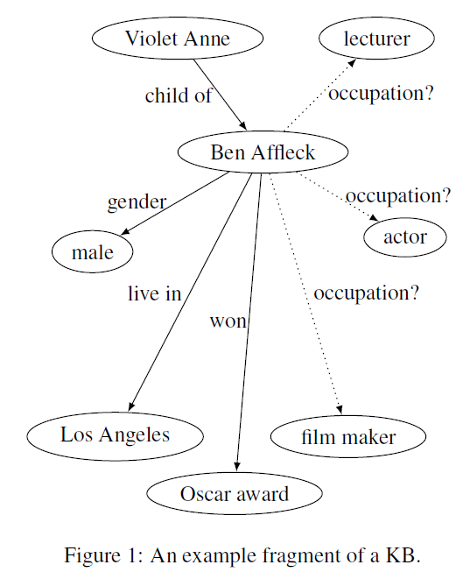
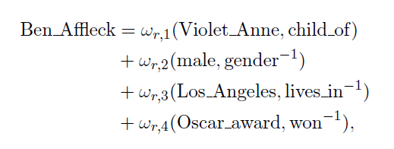
Introduction

Slide 5





Method
TransE
TransE-NMM
Notes:
这里的邻域信息包含了与目标实体相连的边和实体

Slide 6
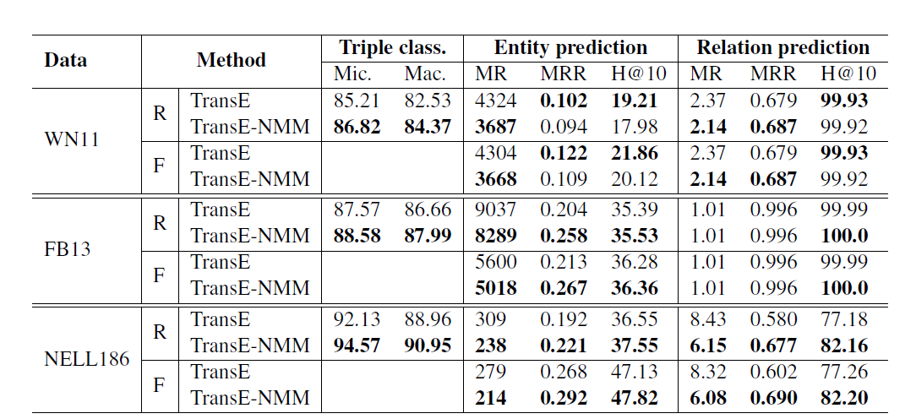
Experiments

Slide 7
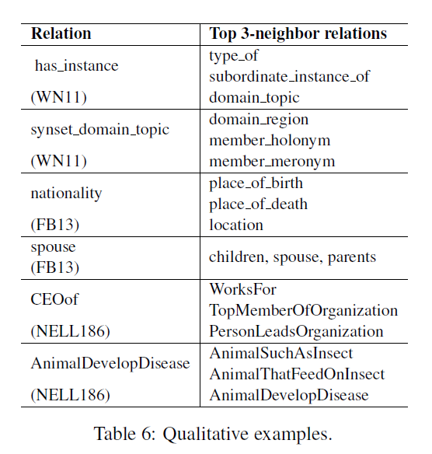
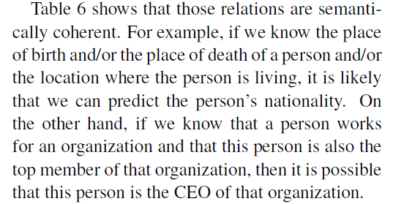
Qualitative results

Slide 8
Analysis
优点
(1) 第一个提出运用邻节点和关系作为上下文信息辅助决策
(2) 嵌入到TransE的方式简单易训练
缺点
(1) 效果提升不明显
(2) 注意力机制简单粗暴
(3) 直接用表示向量作为上下文向量，不能很好地建模三元组内部语义和上下文语义

Slide 9
02
GAKE: Graph Aware Knowledge Embedding
COLING(B) 2016

Slide 10
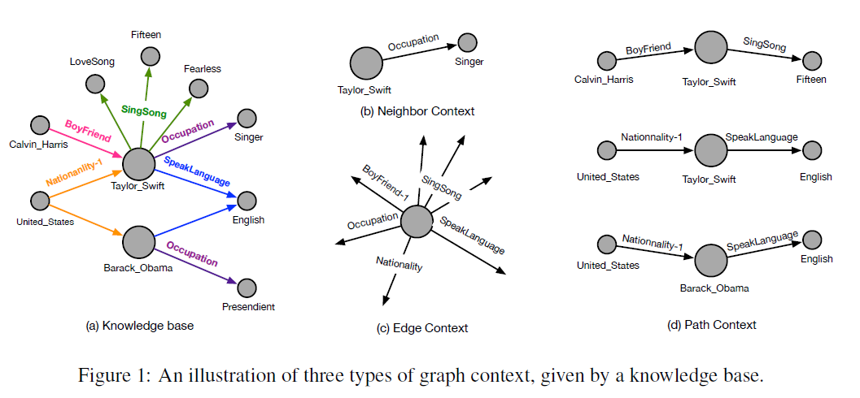
Introduction

Slide 11
Introduction
(1)We treat a given knowledge base as a directed graph instead of a set of independent triples, and extract different types of graph context to study the representation of knowledge.
(2) We propose a novel and general representation learning approach, GAKE (Graph Aware Knowledge Embedding), which can be easily extended to consider any type of graph context.
(3) We propose an attention mechanism in our approach to learn representation power of different entities and relations.

Slide 12
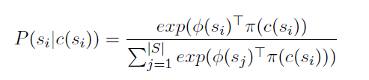
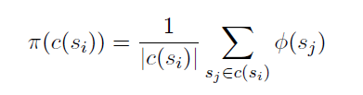
Method
Learning Objective
we consider three types of context: neighbor context CN(si), path context CP (si), and edge context CE(si).

Slide 13



Method
Neighbor context
Path context
Edge context
Notes:
Neighbor context：给定一个实体，与其相连的边和顶点都叫做neighbor context，其实在Trans系列中，利用三元组信息进行语义表示。
Path context：随机选择一些从给定实体出发的路径，路径上的点和边构成这个context。首先随机产生一个L值表示路径长度，然后再每一步通过random walk随机选择目标节点的neighbor直到路径长度到达上限。
Edge context：与该实体相连的所有边

Slide 14
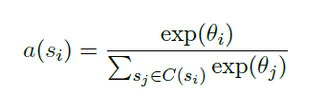
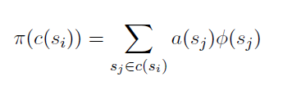

Method
Attention Mechanism
Model Learning

Slide 15
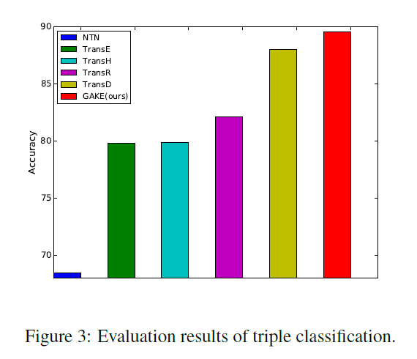
Experiments
Triple Classification

Slide 16
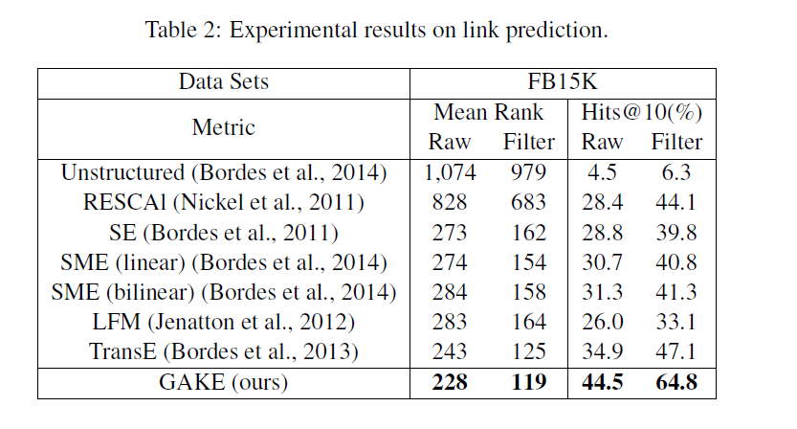
Experiments
Link Prediction

Slide 17
Analysis
优点
(1) 实验效果好
(2) 提出了三种上下文信息：邻节点、关系、关系路径
缺点
直接将上下文中的关系和实体向量取平均或者加权平均，丢失了结构信息
注意力机制没有约束，纯靠系统学习

Slide 18
03
Translating Representations of Knowledge Graphs with Neighbors
SIGIR(A) 2018

Slide 19
Introduction
In this paper, we propose a method named TransN, which considers the dependencies between triples and incorporates neighbor information dynamically.
Firstly, we apply effective neighbor selection to reduce the number of neighbors.
Second, we try to encode neighborhood information with context embeddings.
Third, we further utilize attention mechanism to focus on most influential nodes since different neighbors provide different level of information.

Slide 20



Method
Neighbor Selection
the number of selected neighbor of entity e
exponential decay

Slide 21


Method
Neighbor-based Representation
object embedding : represent the meaning of entity and relation
$$h,r,t$$
context embedding : capture the interactions between entities or relations
$$h_{c},r_{c},t_{c}$$

Slide 22


Method
Neighbor-based Representation
linear combination from its object embedding and context embeddings of its neighbors
relation-based attention

Slide 23


Training Objective
score function
objective function

Slide 24
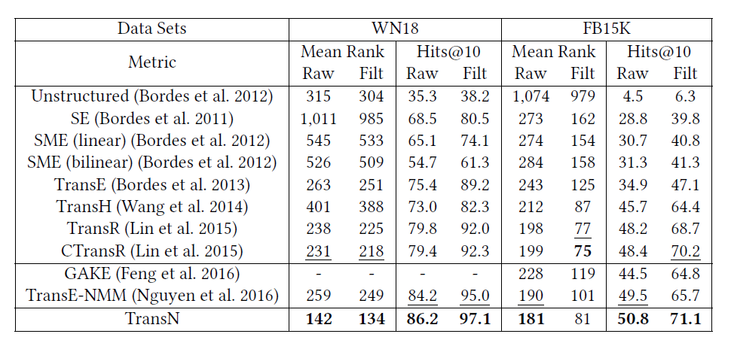
Experiments
Link Prediction

Slide 25
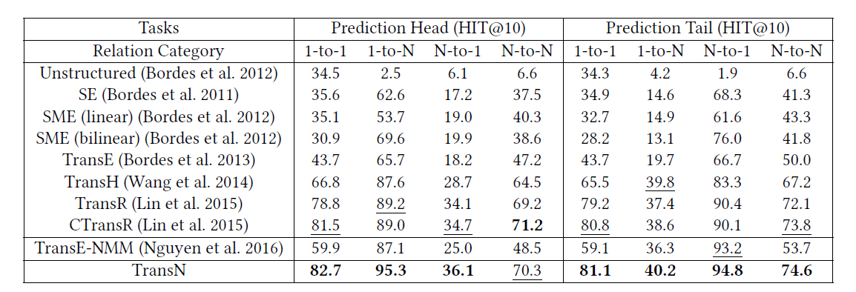
Experiments
Link Prediction

Slide 26
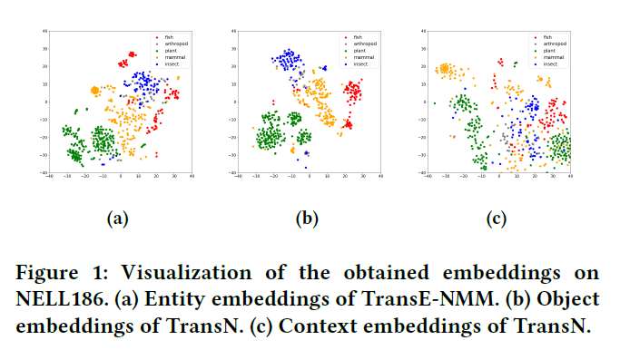
Experiments
Qualitative Analysis

Slide 27
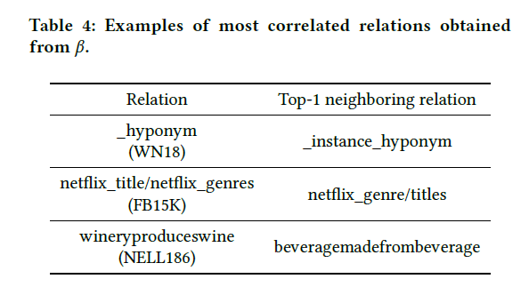
Experiments
Qualitative Analysis

Slide 28
Analysis
优点
(1) 实验效果好
(2) 用object embedding和context embedding对实体与关系建模，分开建模了三元组内部语义和上下文语义，值得借鉴
(3) 基于关系对邻节点建立attention，值得借鉴
缺点
在邻节点选择上，用了数量限制和指数方式递减，不清楚该过程如何选择好的邻节点
考虑邻节点的同时没有考虑关系，关系路径等

Slide 29
04
Mine

Slide 30

思考
邻节点选择
不足
改进
第一篇和第二篇论文虽然都用到了邻节点，但是没有讲述选择过程，而是直接为每个实体的邻节点数量设定阈值。
第三篇虽然提到了邻节点筛选，但是没有讲具体怎么筛选，只是在每一个epoch指数递减邻节点数量，直到达到阈值。
（1）根据第一篇和第三篇的实验分析结果，在预测关系r时，邻节点对应的关系中权重最大的几个关系其实与关系r语义相关。
（2）能否根据语义相关性（contextually relevant）选择邻节点？

Slide 31
思考
邻边的应用
不足
改进
第一篇用到了邻边作为邻域信息，但是只是简单混合。
（1）根据第二篇的介绍可以知道邻边对于三元组预测是有促进作用的，所以引入邻边作为补充信息很有必要。
(2) 第三篇根据邻边建立attention但 是不作为补充信息引入三元组。

Slide 32
改进
Neighbor-based Representation
object embedding : represent the meaning of entity and relation
$$h,r,t$$
context embedding : capture the interactions between entities or relations
$$h_{c},r_{c},t_{c}$$

Slide 33
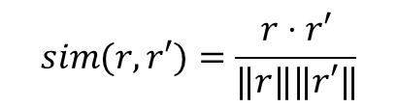
Method
Neighbor Selection
the number of selected neighbor of entity e
exponential decay
$$sim(r,r′)=\frac{r⋅r′}{‖r‖‖r′‖}$$
NO
YES

Slide 34

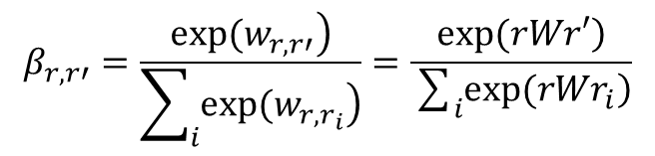
Method
Neighbor-based Representation
linear combination from its object embedding and context embeddings of its neighbors
relation-based attention
$$β_{r,r′}=\frac{\left.exp(w_{r,r′}\right)}{\sum_{i}{\left.exp(w_{r,r_{i}}\right)}}=\frac{\left.exp(rWr′\right)}{\sum_{i}{\left.exp(rWr_{i}\right)}}$$
NO
YES

Slide 35
感
谢
聆
汇报人：黄婷
听

