Slide 1
解耦上下文增强的少样本槽填充方法
汇报人：袁尤良
日期：2021/10/26

Slide 2
研究背景与现状
少样本学习
自然语言理解中的槽填充
研究目的与意义
研究思路及方法
总结

Slide 3
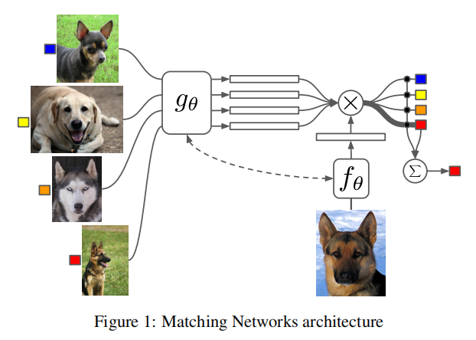
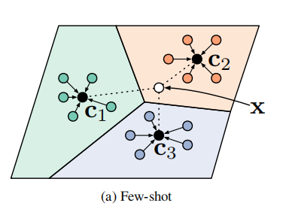
研究背景与现状
图片引用自参考文献2
图片引用自参考文献3
以 Matching Network 和 Prototype Network 为代表的工作在 CV 领域掀起了少样本学习的热潮
Notes:
Although Deep Learning models have show their power in NLU, these models still require abundant labeled training data.
But for new domains, there are only a few samples. Thus, fewshot learning(Fei-Fei et al., 2006; Lake et al., 2015; Vinyals et al., 2016) has received more and more attention in rencent years ( Yu et al.,2018;Fritzler et a;., 2019;Geng et al., 2019; Hou et al., 2020; Su et al.,2020). These approaches extract transferable knowledge among old domains and transferred to new domains quickly with few examples

Slide 4
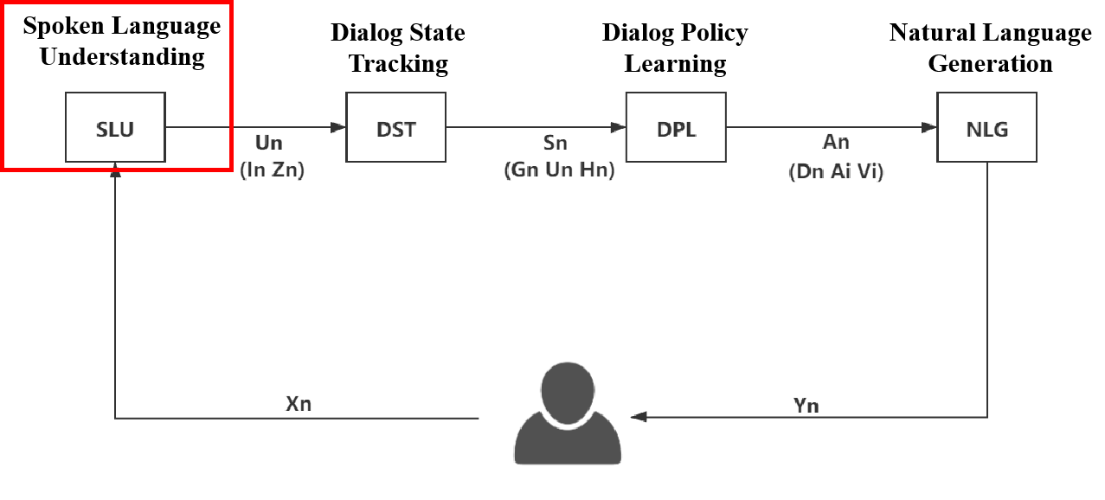
研究背景与现状
槽填充
意图识别
SLU
SLU：建立智能对话系统的重要一环
Notes:
Slot tagging(Tur and De Mori,2011) is a core task in natural language understanding(NLU) Which a key conponent of task-oriented dialogue system(Young et al.,2013).Now, Slot tagging is usually formulatd as a sequence labeling problem(Mesnil et al., 2015;Sarikaya et al.,2016;Liu and Lane, 2016)

Slide 5
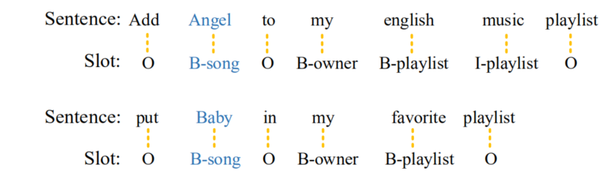
研究背景与现状
输入：文本序列
输出：标注序列
Notes:
Slot tagging(Tur and De Mori,2011) is a core task in natural language understanding(NLU) Which a key conponent of task-oriented dialogue system(Young et al.,2013).Now, Slot tagging is usually formulatd as a sequence labeling problem(Mesnil et al., 2015;Sarikaya et al.,2016;Liu and Lane, 2016)

Slide 6
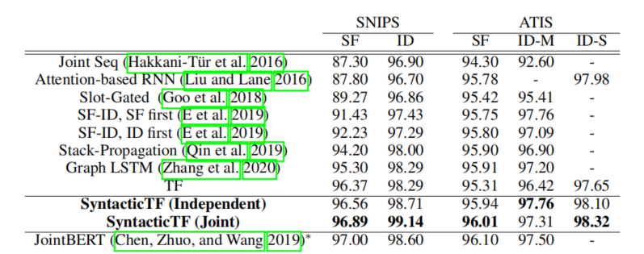
研究背景与现状
图片引用自参考文献1
基于神经网络的模型在两个经典数据集上取得了极好的表现
那么在少样本、低资源的情况下是否能保持一致的表现呢
Notes:
Although Deep Learning models have show their power in NLU, these models still require abundant labeled training data.
But for new domains, there are only a few samples. Thus, fewshot learning(Fei-Fei et al., 2006; Lake et al., 2015; Vinyals et al., 2016) has received more and more attention in rencent years (Fritzler et a;., 2019; Geng et al., 2019; Hou et al., 2020). These approaches extract transferable knowledge among old domains and transferred to new domains quickly with few examples

Slide 7
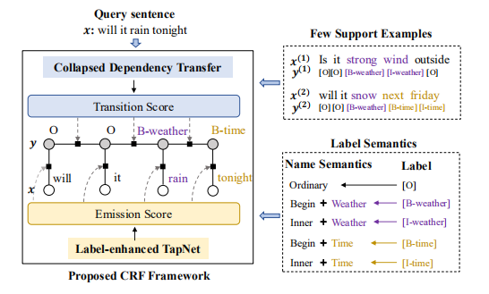
研究背景与现状
Yutai Hou（参考文献4） 采用基于相似度计算的方法在少样本槽填充任务得到了良好的效果
Zhu Su （参考文献5）采用归一化投影的方式解决了相似度计算中的偏置问题
图片引用自参考文献4
Notes:
The similarity-based few-shot learning motheds classify an item in a new domain according to its similarity with the representation of each class, and has been widely used in classification problems(Vinyals et al., 2016; Snell et al., 2017; Sung et al., 2018; Yan et al., 2018; Yu et al., 2018; Sun et al., 2019; Geng et al., 2019; Yoon et al., 2019)
A general encoder is learned in rich-resource domains to extract feature for items in resource domain and per class representation is obtained from few labeled samples(support set) by utilizing the encoder.
By considering both the item similarity and label dependency, model Label-enhanced TapNet with CDT achieved state-of-the-art performance. Performance of the model has been further improved by using vector projection similarity(Su et al. 2020)
There is a problem in all previous similarity-based approaches(in slot tagging task), they pay too more attention to the word and ignore the importance of environment of the word. For example, “ add ghost on the dance floor to my autumn lounge playlist”, they will compute the similarity between “ghost on the dance floor” and class representation of class B/I-entity_name. This is rediculous, because we classify the entity name by its environment(“add” and “to”) rather than the words themselves.他们看问题太不全面了,或者说期望于把中性词与环境融为一体而达到同时考虑的效果,但是这样会彼此干扰.

Slide 8
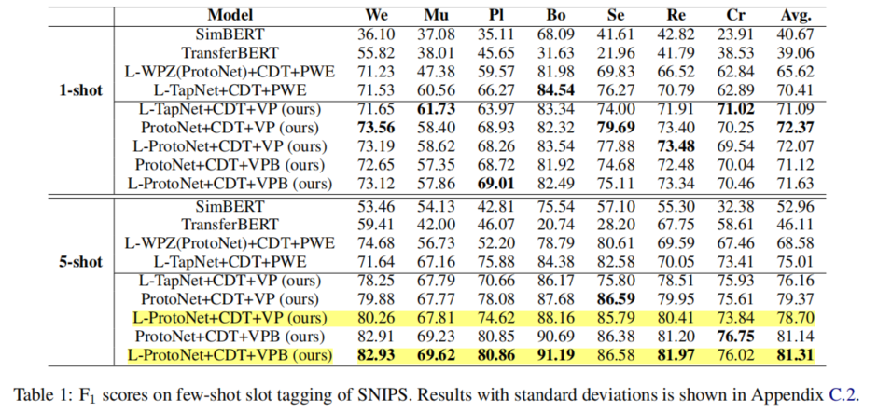
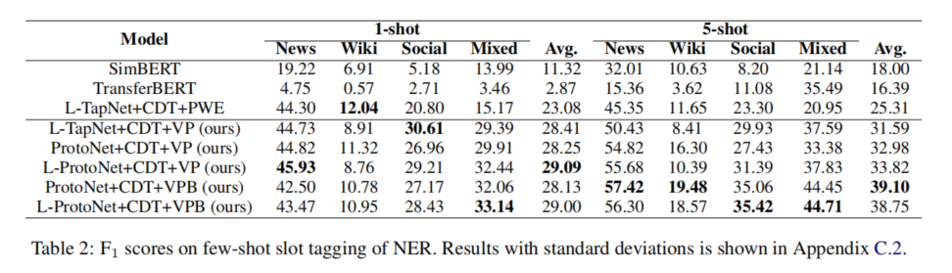
研究背景与现状
图片引用自参考文献5
图片引用自参考文献5
Notes:
Baseline
SimBert
TransferBERT
L-WPZ+CDT + PWE(LWCP)
L-TapNet+CDT + PWE(LTCP)
L-WPZ+CDT+PWE + VP(LWCPV)
L-TapNet+CDT+PWE +VP(LTCPV)
borrow the results of these baseline from Hou and Su
缩写描述

Slide 9
研究背景与现状
研究目的与意义
研究思路及方法
总结

Slide 10
研究目的与意义
任务的重要性： 在瞬息万变的今天，对话的热点和主题不断发生变化，如何在低资源、
少样本的情况下进行领域适应是对槽填充任务提出的新的要求。
同时这也是任务型对话系统要在真实场景中落地的必经之路。
当前挑战与问题：
包含大量参数的模型在少样本情境下极易过拟合，导致泛化性能低下
当前的方法借鉴于 CV 领域，然而缺乏对图像与文本之间差别的细致思考，从而导致自相关噪声的引入
当前方法关注于细粒度上的信息挖掘，缺乏基于全局视野的粗粒度文本信息
研究目的： 旨在应对当前挑战，提升模型在少样本槽填充任务上的性能并推动任务型对话 系统在真实场景中的发展
Notes:
Baseline
SimBert
TransferBERT
L-WPZ+CDT + PWE(LWCP)
L-TapNet+CDT + PWE(LTCP)
L-WPZ+CDT+PWE + VP(LWCPV)
L-TapNet+CDT+PWE +VP(LTCPV)
borrow the results of these baseline from Hou and Su
缩写描述

Slide 11
研究背景与现状
研究目的与意义
研究思路及方法
总结

Slide 12
研究思路及方法
针对少样本情况下模型的脆弱性进行鲁棒增强的探究
对抗数据增强
heuristic pattern 探究
Notes:
Baseline
SimBert
TransferBERT
L-WPZ+CDT + PWE(LWCP)
L-TapNet+CDT + PWE(LTCP)
L-WPZ+CDT+PWE + VP(LWCPV)
L-TapNet+CDT+PWE +VP(LTCPV)
borrow the results of these baseline from Hou and Su
缩写描述

Slide 13
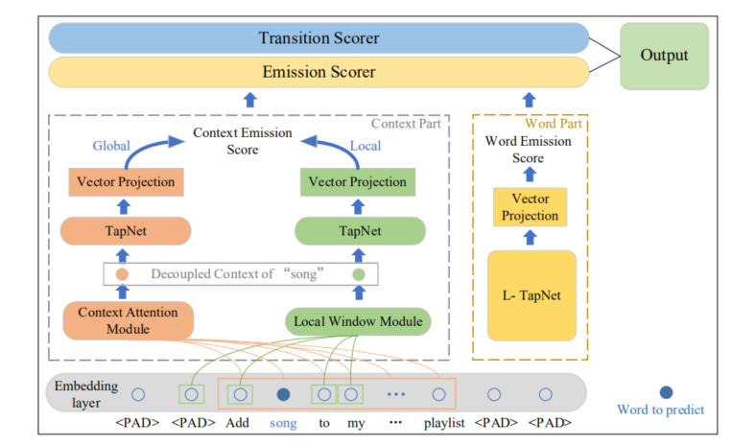
研究思路及方法
为消除之前方法导致的信息损失，提出 Context Part 以显式利用粗粒度文本信息
Notes:
Baseline
SimBert
TransferBERT
L-WPZ+CDT + PWE(LWCP)
L-TapNet+CDT + PWE(LTCP)
L-WPZ+CDT+PWE + VP(LWCPV)
L-TapNet+CDT+PWE +VP(LTCPV)
borrow the results of these baseline from Hou and Su
缩写描述

Slide 14
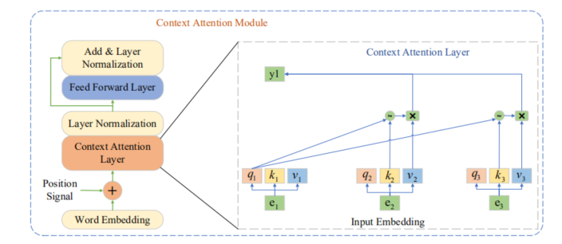
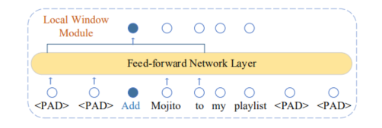
研究思路及方法
为消除自相关噪声的影响，设计 Context Attention Module 和 Local Window Module分别获取局部视野和全局视野的去噪上下文词嵌入
Notes:
Baseline
SimBert
TransferBERT
L-WPZ+CDT + PWE(LWCP)
L-TapNet+CDT + PWE(LTCP)
L-WPZ+CDT+PWE + VP(LWCPV)
L-TapNet+CDT+PWE +VP(LTCPV)
borrow the results of these baseline from Hou and Su
缩写描述

Slide 15
研究背景与现状
研究目的与意义
研究思路及方法
总结

Slide 16
总结
本工作首先分析了少样本槽填充在当前时代背景下的重要性
对当前的挑战和当前方法存在的问题进行了深入的分析
针对现存的挑战设计了可行的方案
下一步：
在经典数据集 SNIPS 上进行实验
对实验结果进行分析并对方法进行改进
分析本方法的内在机理以及可能存在的不足
探讨在该任务上下一步的发展方向
Notes:
Baseline
SimBert
TransferBERT
L-WPZ+CDT + PWE(LWCP)
L-TapNet+CDT + PWE(LTCP)
L-WPZ+CDT+PWE + VP(LWCPV)
L-TapNet+CDT+PWE +VP(LTCPV)
borrow the results of these baseline from Hou and Su
缩写描述

Slide 17
总结
1 绪论
1.1 研究背景和意义
1.2 国内外研究现状
1.3 论文组织框架
2 研究目的与内容
2.1 研究意义
2.2 当前挑战
2.3研究思路
3 实验设计与分析
3.1 研究范式及方法
3.2实验环境的搭建
3.3 实验结果与分析
3.4本章小结
4 总结与展望
时间 计划
2021.11 - 2021.12 相关文献阅读
2021.12 - 2022.1 设计方案，尝试实验
2022.1 - 2022.3 分析并总结
2022.3 - 2022.4 论文撰写、修改、定稿
2022.4 - 2022.5 准备答辩
Notes:
Baseline
SimBert
TransferBERT
L-WPZ+CDT + PWE(LWCP)
L-TapNet+CDT + PWE(LTCP)
L-WPZ+CDT+PWE + VP(LWCPV)
L-TapNet+CDT+PWE +VP(LTCPV)
borrow the results of these baseline from Hou and Su
缩写描述

Slide 18
Jixuan Wang, Kai Wei, Martin Radfar, Weiwei Zhang, Clement Chung: Encoding Syntactic Knowledge in Transformer Encoder for Intent Detection and Slot Filling. AAAI 2021: 13943-13951
Vinyals, Oriol, et al. "Matching networks for one shot learning." Advances in neural information processing systems 29 (2016): 3630-3638.
Jake Snell, Kevin Swersky, Richard S. Zemel: Prototypical Networks for Few-shot Learning. NIPS 2017: 4077-4087
Yutai Hou, Wanxiang Che, Yongkui Lai, Zhihan Zhou, Yijia Liu, Han Liu, Ting Liu: Few-shot Slot Tagging with Collapsed Dependency Transfer and Label-enhanced Task-adaptive Projection Network. ACL 2020: 1381-1393
Zhu, Su, et al. "Vector projection network for few-shot slot tagging in natural language understanding." arXiv preprint arXiv:2009.09568 (2020)

