Slide 1
Overview of Sentiment Analysis
Author: wlhu
Date: 2016/12/21
for j in xrange(60000):
l1 = 1/(1+np.exp(-(np.dot(X,syn0))))
l2 = 1/(1+np.exp(-(np.dot(l1,syn1))))
l2_delta = (y - l2)*(l2*(1-l2))
l1_delta = l2_delta.dot(syn1.T) * (l1 * (1-l1))
syn1 += l1.T.dot(l2_delta)
syn0 += X.T.dot(l1_delta)

Slide 2
Content
1
Sentiment Analysis and Its Application
2
Sentiment Analysis & linguistic patterns
3
Sentiment Analysis & Machine Learning
4
My Thoughts and Work
Sentiment Analysis
1

Slide 3
Part 1.1
Definition
1. Sentiment analysis (also known as opinion mining) refers to the use of natural language processing, text analysis and computational linguistics to identify and extract subjective information in source materials.
Example:
“The camara is light, but it will not easily fit in pockets”
2. binary classification : positive(+1) negative(-1) [neutral(0)]
fine-grained classification : very positive(+2) positive(+1) neutral(0) negative(-1) very negative(-2)
3. Fine-grained opinion analysis aims to detect the subjective expressions (not fact)in a text (e.g. “hate”) and to characterize their intensity (e.g. strong) and sentiment (e.g.negative) as well as to identify the opinion holder (the entity expressing the opinion) and the target, or topic,of the opinion.
Task:
Opinion extraction(explicit, implicit) Sentiment score Aspect extraction(explicit, implicit)
2

Slide 4
Part 1.2
Application
1. Applications in Business Intelligence.
it’s difficult for a potential customer to read them to make an informed decision on whether to purchase the product. It also makes it difficult for the manufacturer of the product to keep track and to manage customer opinions
2. Sentiment Analysis and Political
Analyzing trends, identifying ideological bias, targeting advertising/messages, gauging reactions, etc.
3. Sentiment Analysis and Sociology
Potential to augment psychological investigations/experiments with data extracted from NL text
Dream sentiment analysis (Nadeau et al., 2006)
4. ……
3

Slide 5
Why
How
Transition to
Why to analyze sentiment
How to analyze sentiment
4

Slide 6
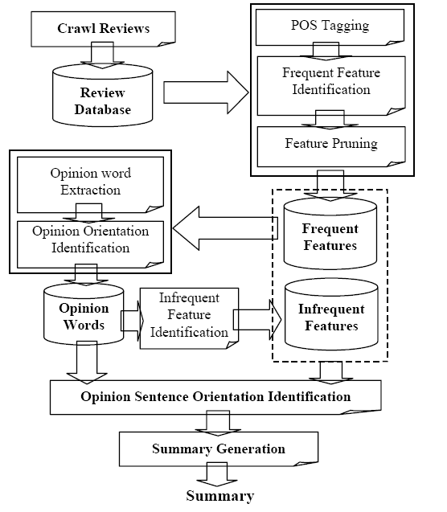
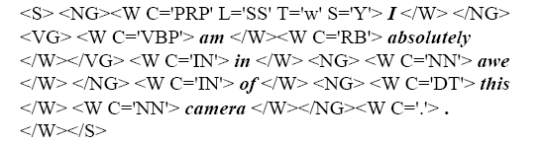
Part 2.1
Linguistic Patterns
Mining and Summarizing Customer Reviews (2004, SIGKDD)
------The source of evil
Part-of-Speech Tagging (POS)
Product features are usually nouns or noun phrases in review sentences. Thus the part-of-speech tagging is crucial.
2. Frequent Features Identification
Association miner CBA to find candidate frequent features
Compactness pruning----checks features that contain at least two words, which we call feature phrases, and remove those that are likely to be meaningless
Redundancy pruning---Removing redundant features that contain single words.
5

Slide 7
Part 2.1
Linguistic Patterns
3. Opinion Words Extraction
for each sentence, if it contains a frequent feature, extract all the adjective words as opinion words.
for each feature in the sentence the nearby adjective is recorded as its effective Opinion.
4. Orientation Identification for Opinion Words
use a set of seed adjectives, which we know their orientations and then grow this set by searching in the WordNet.
Infrequent Feature Identification
if a sentence contains no frequent feature but one or more opinion words, find the nearest noun/noun phrase around the opinion word as an infrequent feature.---works well in practice
6. Predicting the Orientations of Opinion Sentences
add up all orientation of opinion words in a sentence
Manual evaluation
6

Slide 8
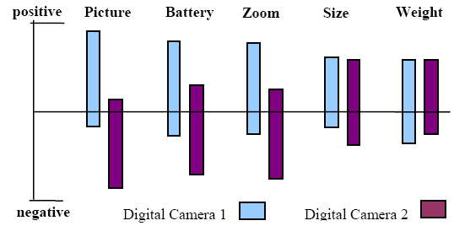

Part 2.2
Strengthening Rules
Extracting Product Features and Opinions from Reviews(2005, EMNLP)
The intuition is that an opinion phrase associated with a product feature will occur in its vicinity. but instead of using a window of size k or the output of a noun phrase chunker, OPINE takes advantage of the syntactic dependencies computed by the MINIPAR parser. Our intuition is embodied by 10 extraction rules.
Opinion observer: Analyzing and comparing opinions on the Web(2005, WWW)
Format (1) - Pros and Cons
Format (2) - Pros, Cons and detailed review
Format (3) - free format
number of positive or negative opinions shows opinion intensity
A Holistic Lexicon-Based Approach to Opinion Mining(2010, WSDM)
counting the number of positive and negative opinion words that are near the
product feature in each review sentence. it does not have an effective mechanism for dealing with context dependent opinion words. ------------ conjunction rule
opinion comparison
Example: “the battery life is very long”. Inferred from “This camera
takes great pictures and has a long battery life”
7

Slide 9
Linguistic Patterns
LPs
MLs
Transition to
crafted by hand; grammatical accuracy
Learning by Machine
Machine Learning
8

Slide 10

Part 3.1
Label Data
Twitter Sentiment Classification using Distant Supervision(2009, Stanford)
The main contribution of this paper is the idea of using tweets with emoticons for distant supervised learning.
Experimenting with Distant Supervision for Emotion Classification(2012, ACL)
The approach shows reasonable performance at individual emotion label prediction, for both emoticons and hashtags.
much better for some emotions (happiness, sadness and anger) than others (fear, surprise and disgust).
Annotate-Sample-Average (ASA): A New Distant Supervision Approach for Twitter Sentiment Analysis(2016, ECAI)
emoticon-annotation approach (EAA) ; lexicon-based annotation approach (LAA)
incorporates a rebalancing mechanism in which balanced training data can be generated
1. annotation: the tweets from C are annotated according to the prior sentiment knowledge provided by the lexicon
2. sampling: assuming that the “lexical polarity hypothesis” holds, averaging multiple tweets sampled from the same set increases the confidence of generating instances located in the region of the desired polarity.
3. averaging: the feature vectors of the sampled tweets are averaged and labelled according to the polarity of the set from which they were sampled
9

Slide 11
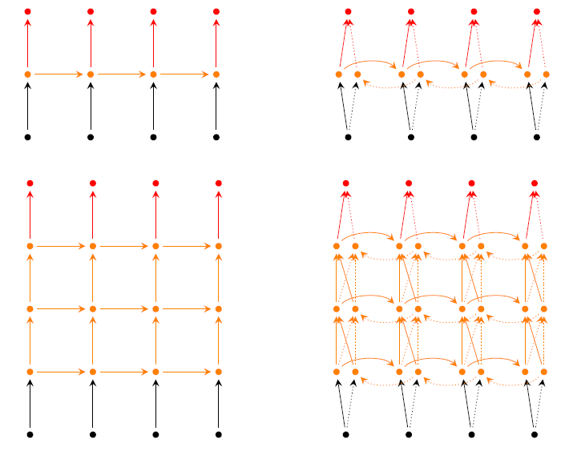
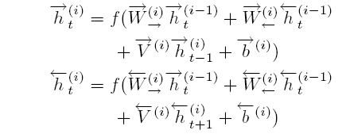
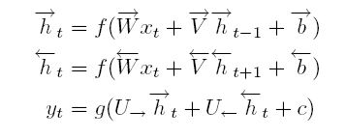

Part 3.2
Neural Network
Opinion Mining with Deep Recurrent Neural Networks(2014, EMNLP)
Traditional methods: conventional BIO tagging scheme; CRF; RNN;
Depth in time: assuming the input vectors together lie in the same representation space, as do the output vectors , hidden representations lie in the same space as well
Depth in space:
Bidirectional RNN:
10

Slide 12



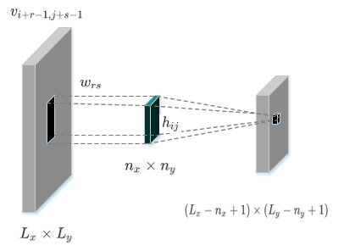






Part 3.2
Neural Network
Aspect extraction for opinion mining with a deep convolutional neural network(2016, Knowledge-Based Systems)
Task: tag each word in opinionated sentences as either aspect or non-aspect word
limitations: CRF is a linear model, so it needs a large number of features to work well; linguistic patterns need to be crafted by hand, and they crucially depend on the grammatical accuracy of the sentences
energy of a shallow DNN:
···············(3)
the score tag for the sentence s to have the tag path y
energy function of the layer l :
···············(4)
from （3）&（4）
the probability to assign the label y to x
token t has tag k
···············(1)
define the logadd operation as
···············(2)
11

Slide 13
What I See
Theirs
Mine
Transition to
What I Do
12

Slide 14
Part 4.1
My Work
Begin
单、多视角情况 是否只使用规则 |  | 混合(1 : 1.6) | 单视角(1) | 多视角(1.6)
是 （单、多视角使用规则） | P | 0.488288 | 0.500219 | 0.436511
 | R | 0.841446 | 0.677065 | 0.831935
 | F1 | 0.617970 | 0.575360 | 0.572589
否 （单视角使用句子情感） | P | 0.476617 | 0.467735 | 0.436511
 | R | 0.838192 | 0.662213 | 0.831935
 | F1 | 0.607688 | 0.548238 | 0.572589
Degree adverb
Negative adverb
Merge sentiment word
Handle transition
Match sentiment & car
git@github.com:TerrariaActionGroup/SentimentAnalysis.git
Handle relation
Begin
13

Slide 15
Part 4.1
My Thought
Raw data
Label data
Classifier
Get the weight between aspect ‘a’ and opinion ‘o’
Distant
Supervision
14

Slide 16
@asyncio.coroutine
def connect(self, sock, address):
f = Future()
sock.setblocking(False)
try:
sock.connect(address)
except BlockingIOError:
pass
def connected():
f.set_result(None)
self.selector.register(sock.fileno(), EVENT_WRITE, connected)
yield from f
self.selector.unregister(sock.fileno())
Thank
You
15

