Slide 1
Computation Graph Optimizations
日期：2021.12.15

Slide 2
Content
Rule-based Computation Graph Optimization
MLIR(Multi-Level Intermediate Representation)
Graph Optimization in TensorFlow
Graph Optimization in TVM
Search-based Computation Graph Optimization
Graph Optimization in TASO
My Thoughts

Slide 3
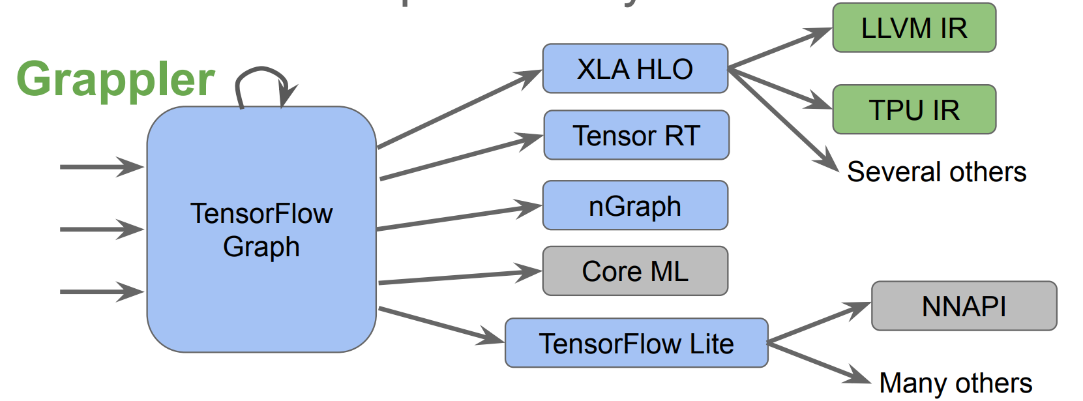
TensorFlow Compiler Ecosystem
Notes:
整个编译流程先将TensorFlow的图转化为XLA HLO，即一种类似高级语言的图的中间表达形式，可以基于此进行一些High-Level的优化。接着将XLA HLO翻译为LLVM IR，使用LLVM编译到各种硬件的汇编语言，从而运行在硬件上进行数值计算。
构建这样的编译系统的开销比较大，每一层的设计实现会有重复部分，同一个层次的IR彼此之间虽然相似，但是存在天生的“生殖隔离”

Slide 4
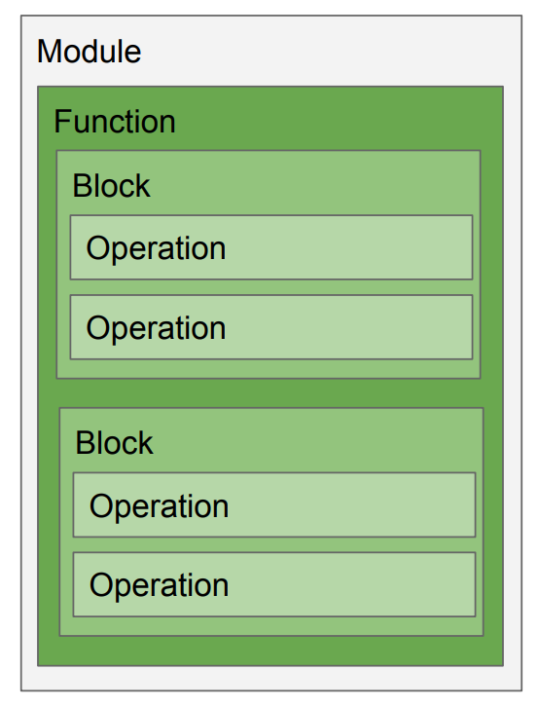
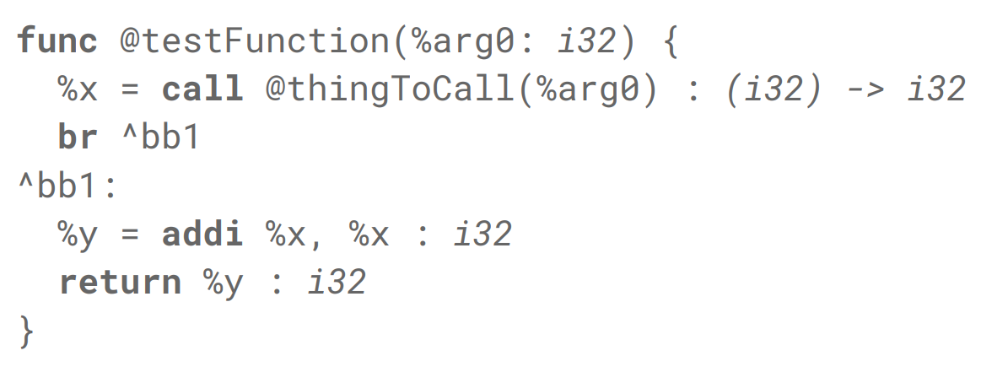
Multi-Level Intermediate Representation
Module/Function/Block/Operation structure
Round trippable textual form
Notes:
各种IR之间转换的效率和可迁移性不高。
MLIR希望为各种DSL提供一种中间表达形式

Slide 5
Multi-Level Intermediate Representation
Scalars:
f16, bf16, f32, … i1, i8, i16, i32, … i3, i4, i7, i57, …
Vectors:
vector<4 x f32>, vector<4 x 4 x f16>, etc.
Tensors, including dynamic shape and rank:
Tensor<4 x 16 x f32>, tensor<* x f16>, etc.
Attribute:
{data_format: "NHWC", epsilon: 0.001, is_training: false}

Slide 6
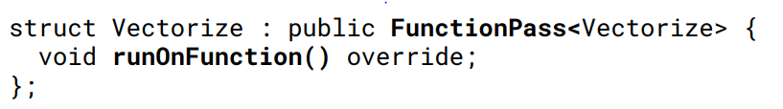
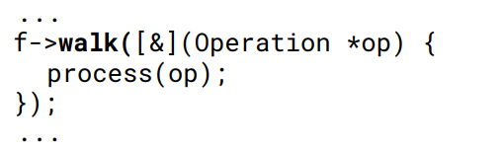
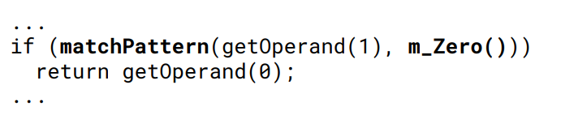
Multi-Level Intermediate Representation
Passes, Walkers, Pattern Matchers

Slide 7
TF Graph Optimization
Why transformations at the graph level?
Pros:
Many optimizations can be easier to discover and express as high-level graph transformations( Matmul(Transpose(x), y) => Matmul(x,y, transpose_x=True) )
Graph is backend independent
Optimizations can be applied at runtime or offline
Pragmatic: Helps the most existing TensorFlow users get better performance
Cons:
Rewrites can be tricky to implement correctly, because of loosely defined graph semantics (In-place ops, side-effects, control flow, control dependencies)
Currently requires extra graph format conversions in TF runtime
Graph-rewriting strategies are hard to maintain
Lack of other effective transformations.
Notes:
quantize_weights Compression method
fold_constant

Slide 8
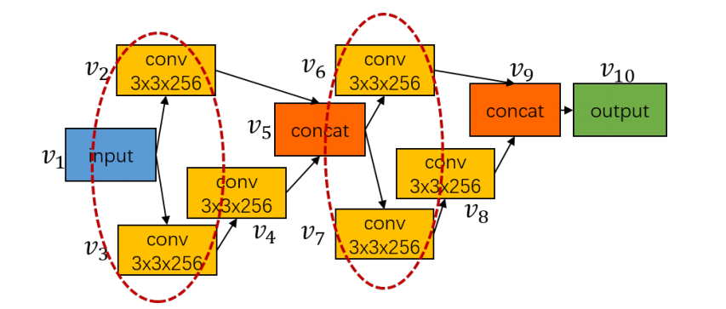
TF Graph Optimization
Concept
TensorFlow (v1.x) programs generate a DataFlow Graph (Device-independent)
Graph nodes represent operations “Ops” (Add, MatMul, Conv2D, …)
Abstract device-, execution backend-, and language independent API
Implemented by Op Kernels written in C++, specialized on
Graph edges represent “data” flowing between ops
Tensors (ref-counted, n-dimensional array buffers in device memory)
Control dependencies: A->B means A must finish before B can run
Resource handles to state (e.g. variables, input data pipelines)

Slide 9
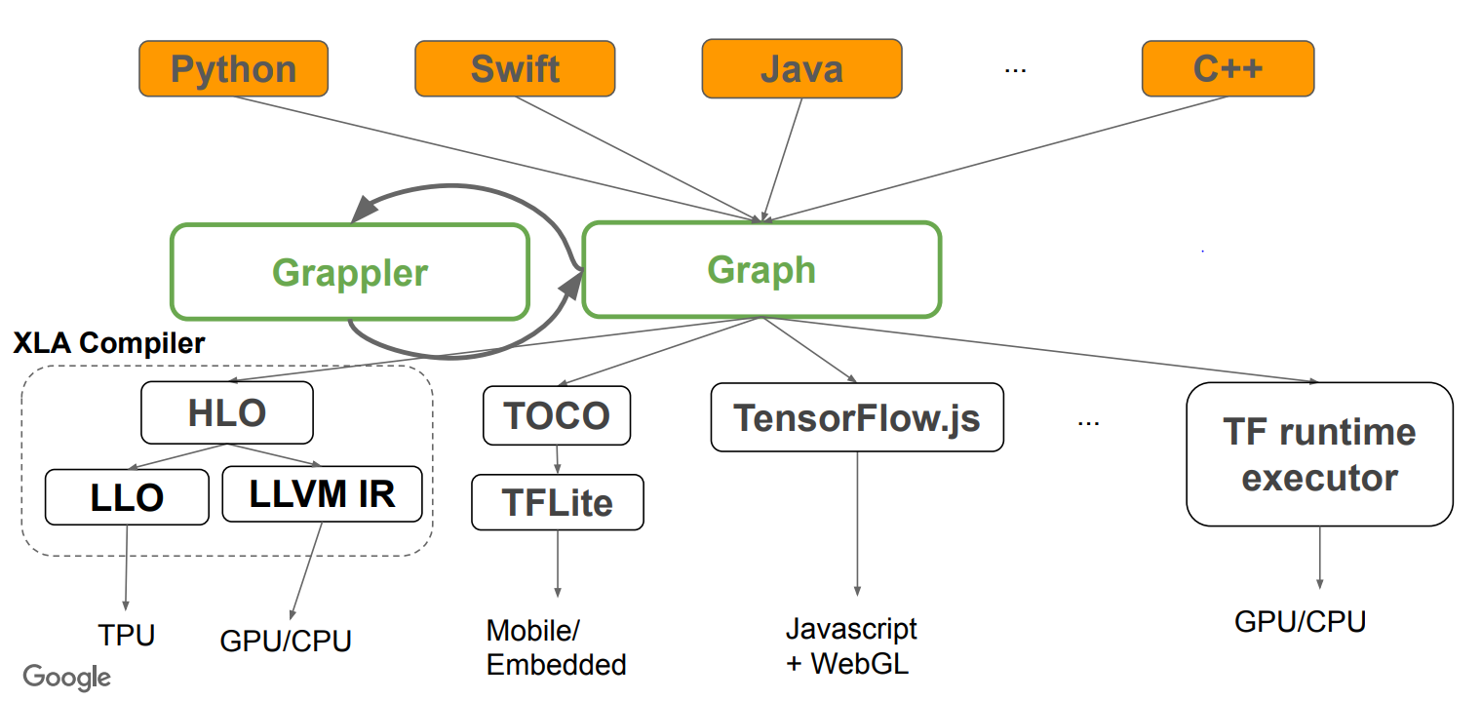
TF Graph Optimization
Grappler : default and automatic graph optimization system in the TF runtime
Re-writes graphs to improve TensorFlow performance
Provides a plugin infrastructure to register custom optimizers/rewriters
Provides cost models to drive optimization and help diagnose model performance

Slide 10
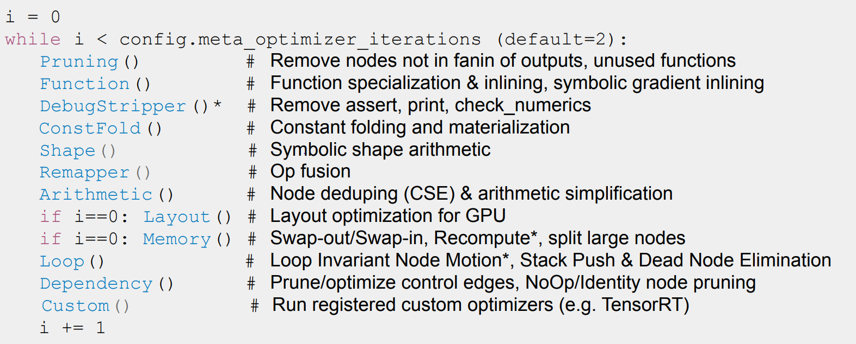
TF Graph Optimization
Meta Optimizer
tf.config.optimizer.set_experimental_options
Notes:
剪枝优化器 - 修剪对计算图的输出没有影响的节点。通常会首先运行剪枝来减小计算图的大小并加快其他 Grappler 传递中的处理速度。
函数优化器 - 优化 TensorFlow 程序的函数库，并内嵌函数体以实现其他程序间优化。
调试剥离器 - 从计算图中剥离与调试运算相关的节点
常量折叠优化器 - 通过折叠计算图中的常量节点来静态推断张量的值（如可能），并使用常量使结果具体化。
形状优化器 - 优化对形状和形状相关信息进行运算的子计算图。
重新映射优化器 - 通过将常见的子计算图替换为经过优化的融合一体化内核，将子计算图重新映射到更高效的实现上。
算术优化器 - 通过消除常见的子表达式并简化算术语句来简化算术运算。
布局优化器 - 优化张量布局以更高效地执行依赖于数据格式的运算，例如卷积。
内存优化器 - 分析计算图以检查每个运算的峰值内存使用量，并插入 CPU-GPU 内存复制操作以将 GPU 内存交换到 CPU，从而减少峰值内存使用量。
循环优化器 - 通过将循环不变式子计算图提升到循环外并通过移除循环中的冗余堆栈运算来优化计算图控制流。另外，还优化具有静态已知行程计数的循环，并移除条件语句中静态已知的无效分支。
依赖项优化器 - 移除或重新排列控制依赖项，以缩短模型步骤的关键路径或实现其他优化。另外，还移除了实际上是无运算的节点，例如 Identity。

Slide 11
TF Graph Optimization
Constant Folding Optimizer: ConstFold()
Removes trivial ops(Transpose of 1-d tensors, Slice(x) = x)
Rewrites that enable further constant folding
Arithmetic rewrites that rely on known shapes or inputs
Constant push-down
Add(c1, Add(x, c2)) => Add(x, c1 + c2)
ConvND(c1 * x, c2) => ConvND(x, c1 * c2)
Partial constfold
AddN(c1, x, c2, y) => AddN(c1 + c2, x, y)
Concat([x, c1, c2, y]) = Concat([x, Concat([c1, c2]), y)
Notes:
常量折叠优化器 - 通过折叠计算图中的常量节点来静态推断张量的值（如可能），并使用常量使结果具体化。

Slide 12
TF Graph Optimization
Arithmetic Optimizer: Arithmetic()
Arithmetic simplifications
Flattening: a+b+c+d => AddN(a, b, c, d)
Hoisting: AddN(x * a, b * x, x * c) => x * AddN(a+b+c)
Simplification to reduce number of nodes : x+x+x => 3*x
Broadcast minimization
(matrix1 + scalar1) + (matrix2 + scalar2) => (matrix1 + matrix2) + (scalar1 + scalar2)
Remove redundant ops or op pairs
BitCast(BitCast(x, dtype1), dtype2) => BitCast(x, dtype2)
Pairs of elementwise involutions f(f(x)) => x (Neg, Conj, Reciprocal, LogicalNot)
Hoist chains of unary ops at Concat/Split
[Exp(Cos(y)) for y in Split(x)] => Split(Exp(Cos(x), num_splits)
Notes:
算术优化器 - 通过消除常见的子表达式并简化算术语句来简化算术运算。

Slide 13
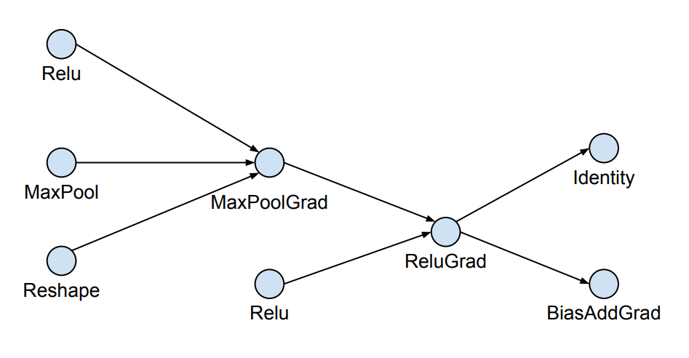
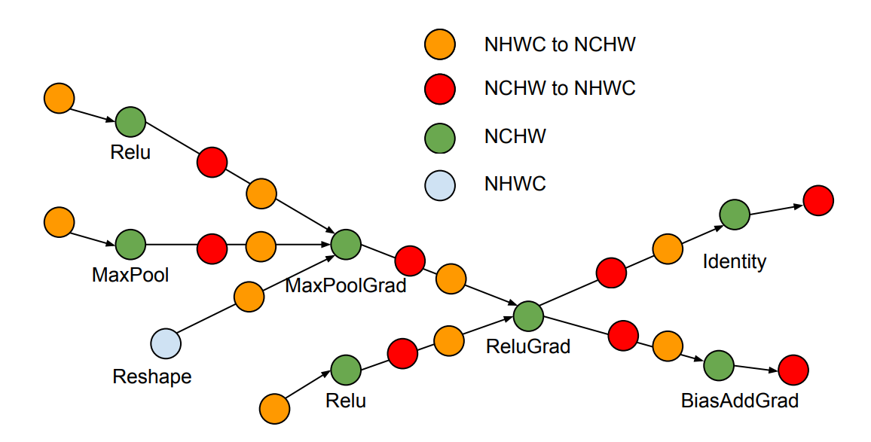
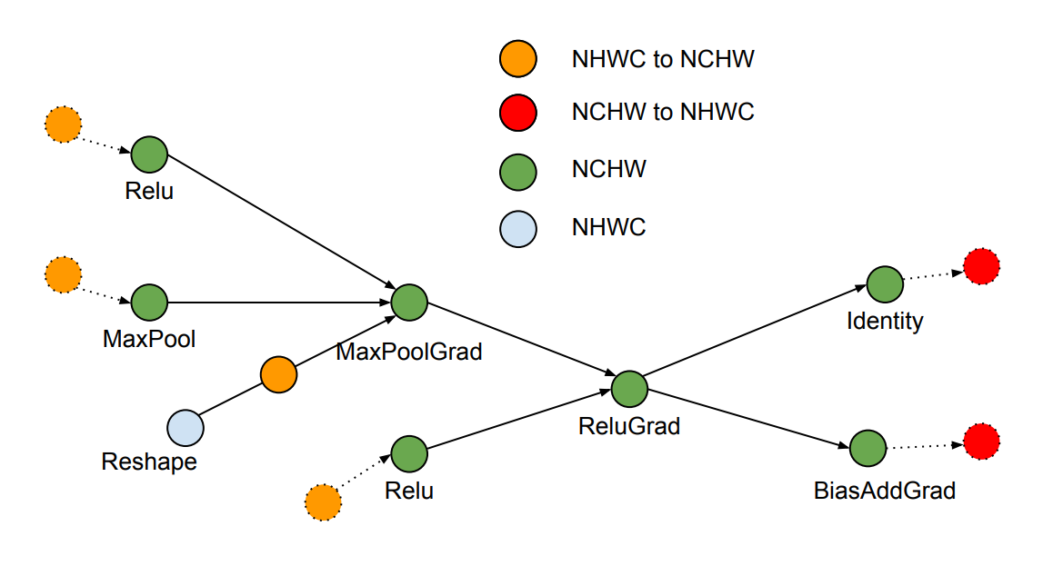
TF Graph Optimization
Layout Optimizer:
Notes:
布局优化器 - 优化张量布局以更高效地执行依赖于数据格式的运算，例如卷积。

Slide 14
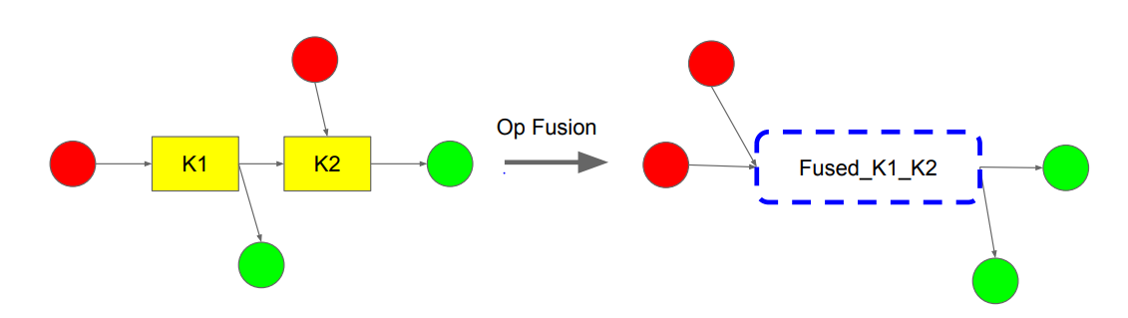
TF Graph Optimization
Remapper Optimizer: Remapper(), Op fusion
Replaces commonly occurring subgraphs with optimized fused “monolithic” kernels
Conv2D + BiasAdd + Activation
Conv2D + FusedBatchNorm + Activation
Conv2D + Squeeze + BiasAdd
MatMul + BiasAdd + Activation
Fusing ops together provides several performance advantages
Completely eliminates Op scheduling overhead (big win for cheap ops)
Increases opportunities for ILP, vectorization，etc
Improves temporal and spatial locality of data access
A separate mechanism allows the TensorFlow compiler to cluster subgraphs and generate fused kernel code on-the-fly
Notes:
重新映射优化器 - 通过将常见的子计算图替换为经过优化的融合一体化内核，将子计算图重新映射到更高效的实现上。

Slide 15
TF Graph Optimization
Memory Optimizer: Memory()
Memory optimization based on abstract interpretation
Swap-out / Swap-in optimization
Reduces device memory usage by swapping to host memory
Uses memory cost model to estimate peak memory
Uses op cost model to schedule Swap-In at (roughly) the right time
Enables models for Waymo, Cerebra mobilenet
Recomputation optimization (not on by default)
Rewrites large aggregation nodes to fit in device memory
Notes:
内存优化器 - 分析计算图以检查每个运算的峰值内存使用量，并插入 CPU-GPU 内存复制操作以将 GPU 内存交换到 CPU，从而减少峰值内存使用量。

Slide 16
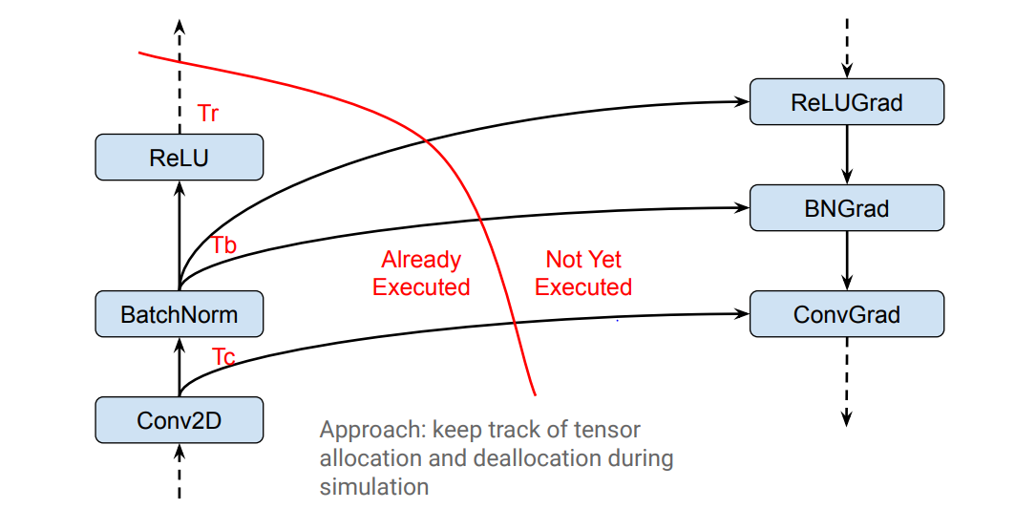
TF Graph Optimization
Memory Optimizer: Peak Memory Characterization

Slide 17
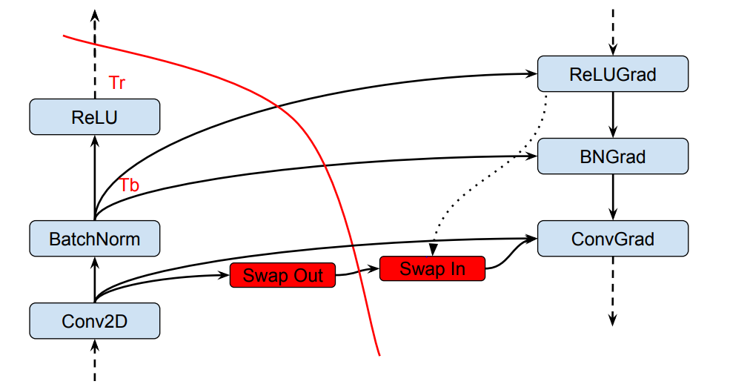
TF Graph Optimization
Memory Optimizer: Swapping

Slide 18
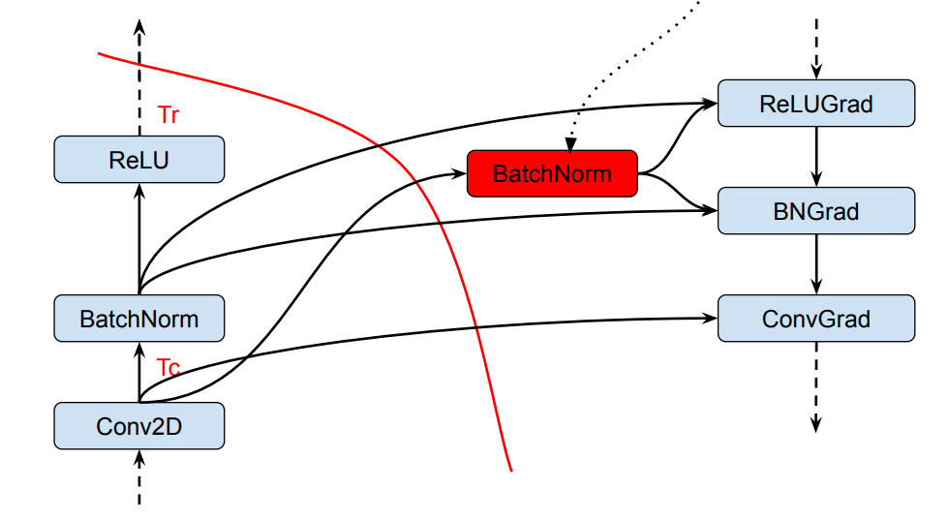
TF Graph Optimization
Memory Optimizer: Recomputation

Slide 19
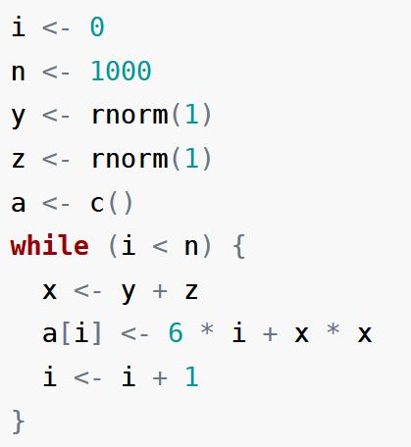
TF Graph Optimization
Control Flow Optimizer: Loop()
Loop Invariant Node Motion
Dead Branch Elimination for Switch with constant predicate
Deduce loop trip count statically
Remove loop for zero trip count
Remove control flow nodes for trip count == 1
Notes:
循环优化器 - 通过将循环不变式子计算图提升到循环外并通过移除循环中的冗余堆栈运算来优化计算图控制流。另外，还优化具有静态已知行程计数的循环，并移除条件语句中静态已知的无效分支。

Slide 20
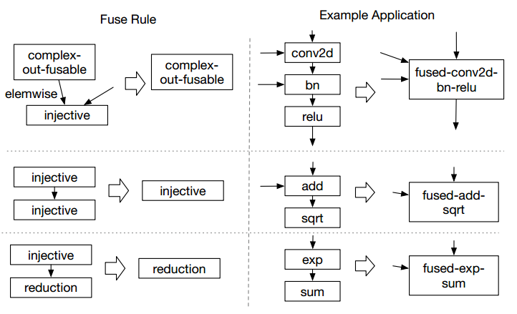
TVM Graph Optimization
Operator Fusion
Constant Parameter Path Pre-Computation
Static Memory Reuse Analysis
Data Layout Transformation
AlterOpLayout
SimplifyInference
…
injective: one-to-one map, add / sqrt / exp / sum
reduction：sum / max / min
complex-out-fusable：conv2d / bn / relu
opaque: cannot be fused, sort)

Slide 21
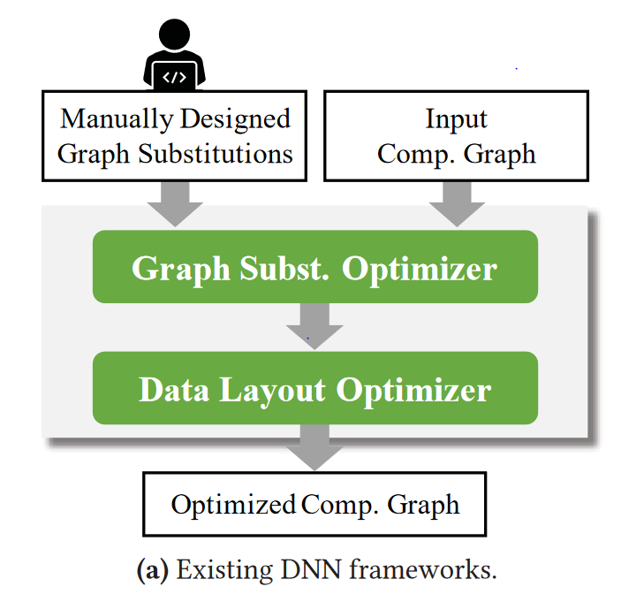
TASO Graph Optimization
Rule Pass: Arithmetic()
Substitution: a+b+c+d => AddN(a, b, c, d)

Slide 22
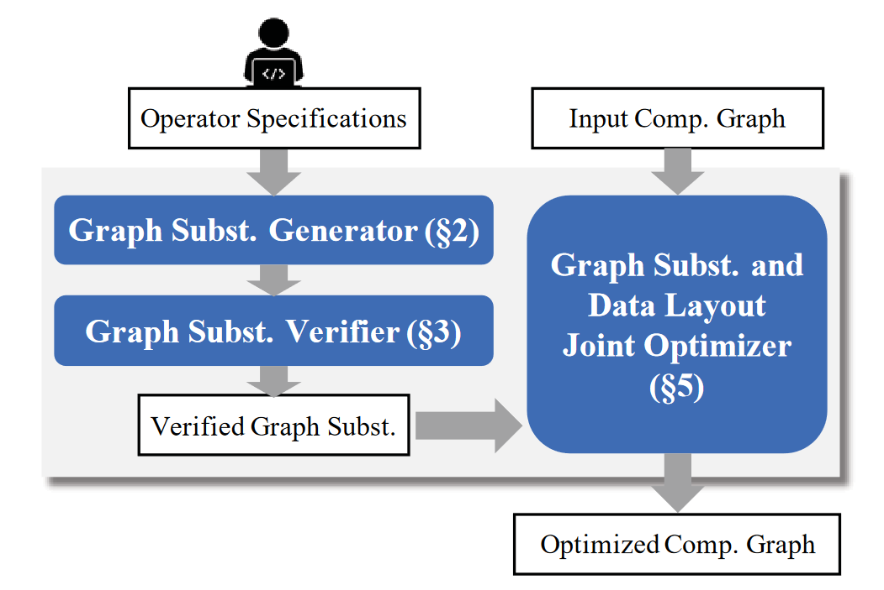
TASO Graph Optimization

Slide 23
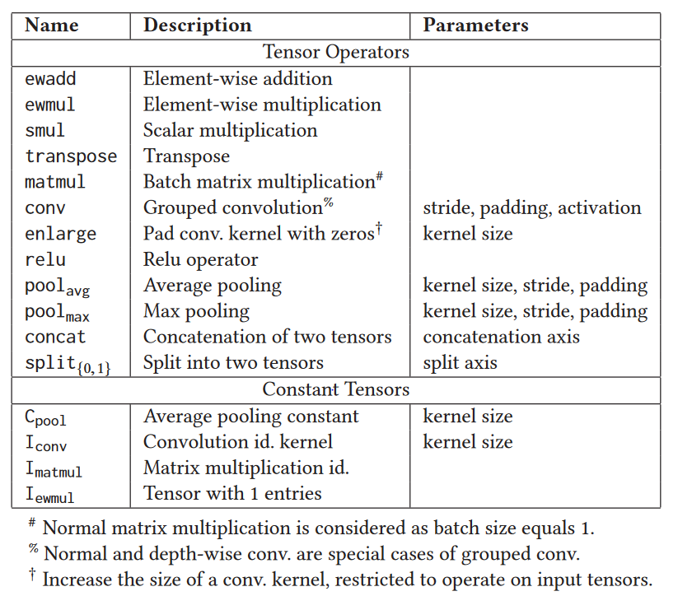
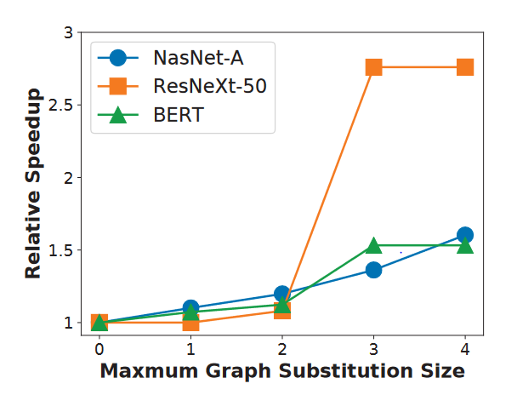
TASO Graph Optimization
Graph Subst Generator: Enumerating potential graphs and collecting their fingerprints
fingerprints: output_value.hash()
depth: less than 5

Slide 24
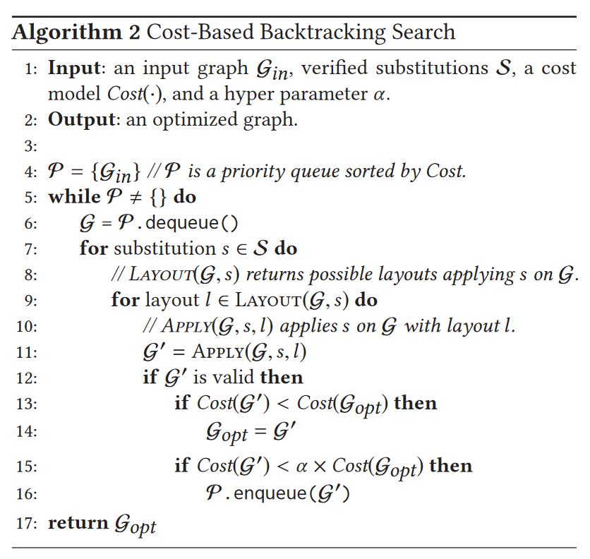
TASO Graph Optimization
Graph Subst Optimizer:
Profiling-base method:
Model-base method:
The time cost of the graph is the sum of operators’ time cost.
The time cost of an operator is collected from cuDNN runtime.

Slide 25
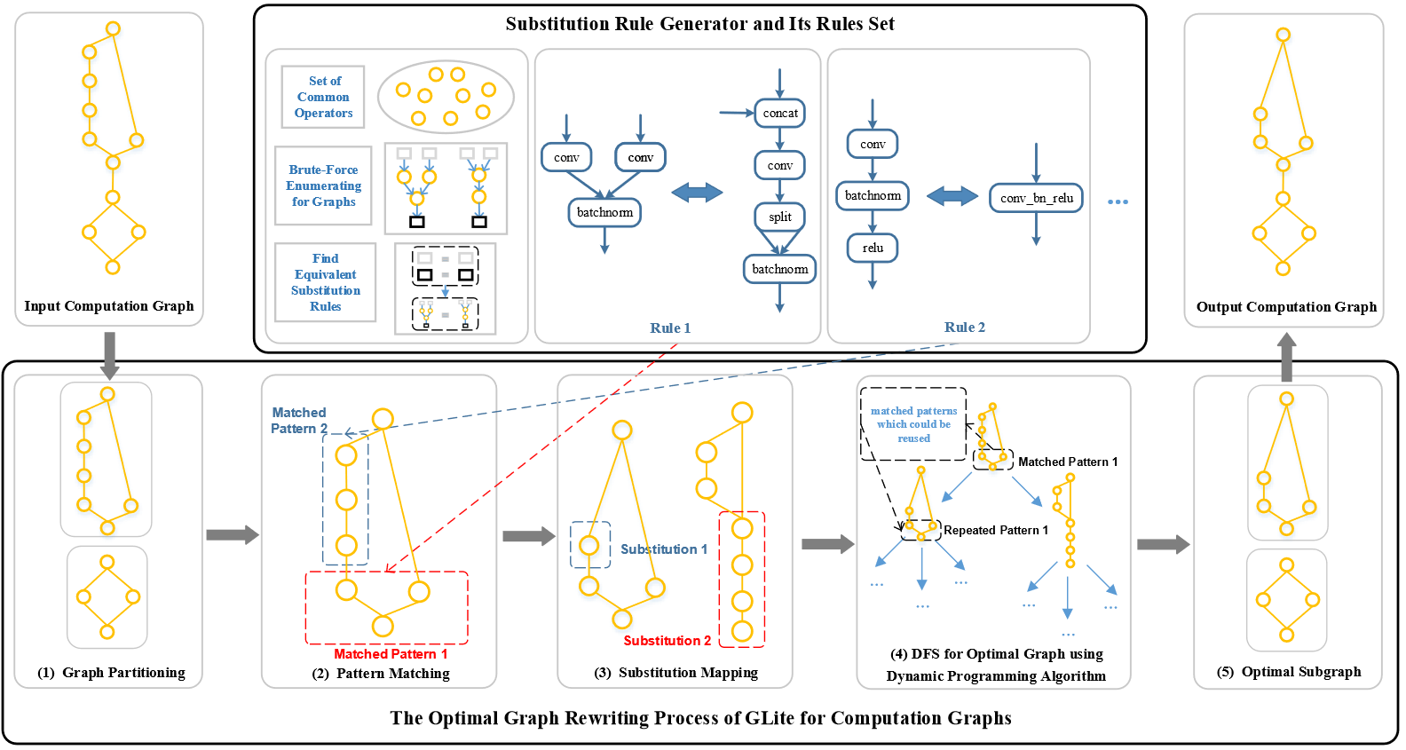
TASO Graph Optimization

Slide 26
My Thoughts
为什么Search-based Method(2018)没有被主流框架应用？
如何改进Search-based Method?

Slide 27
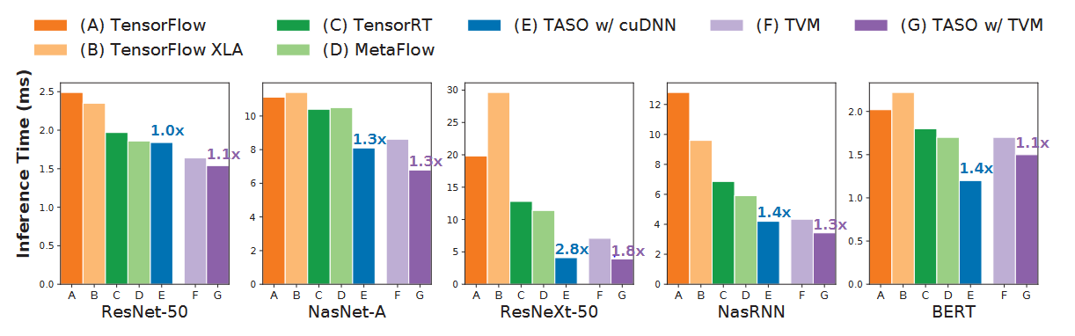
My Thoughts
为什么Search-based Method没有被主流框架应用？
编译代价（可通过图切分解决）
缺少端到端的实现
图优化是否都能用图替换表示？
是否存在其他无法通过subst generator找到的有效图替换？
Profiling-based method? Model-based method?
Low-level与high-level耦合性过高

Slide 28
My Thoughts
图优化是否都能用图替换表示？
CSE
Dead Branch Elimination for Switch with constant predication
Data Layout
跨越的pattern子图太大
Solution: 自动图优化+基于规则的图优化

Slide 29
My Thoughts
Low-level与high-level耦合性过高
Low-level

Slide 30
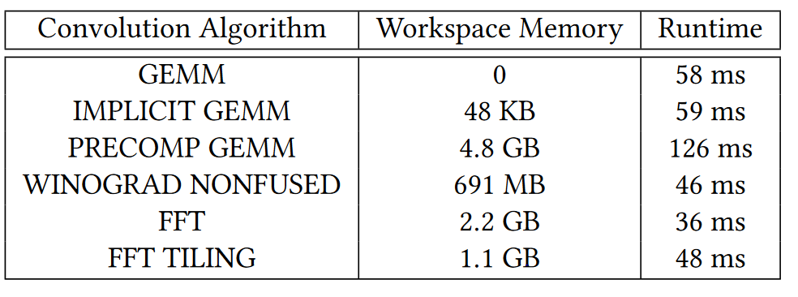
My Thoughts
是否存在其他无法通过subst generator找到的有效图替换？
Brief Announcement: On the Limits of Parallelizing Convolutional Neural Networks on GPUs
不同的卷积算子实现占用显存不同，会影响其算子concurrency
Solution: 扩充算子集, 图级别cost model

Slide 31
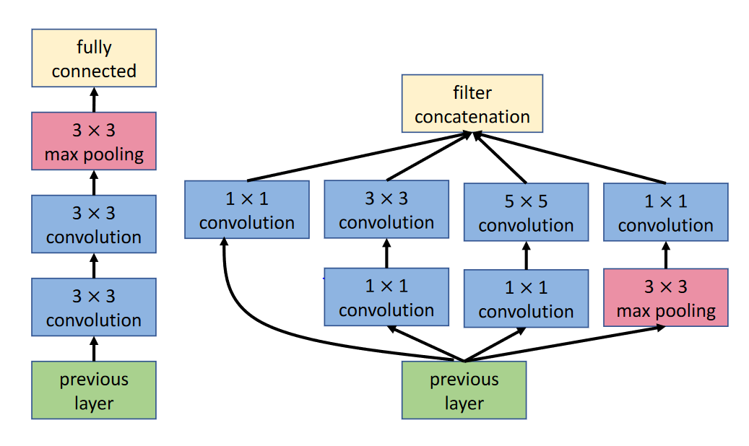
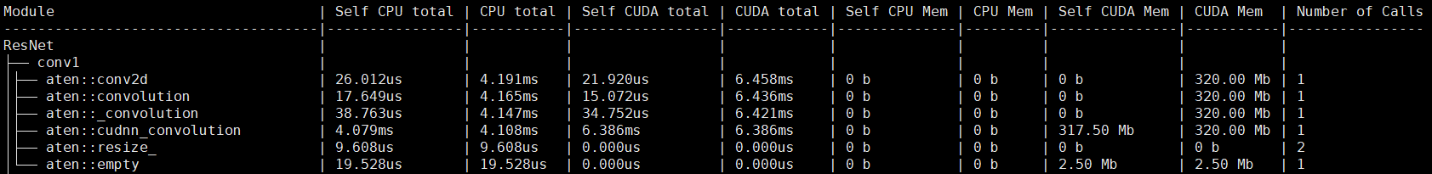
My Thoughts
Profiling-based method? Model-based method?
kernel concurrency
time cost on cpu(I/O, kernel launch)
Solution: 关键路径，cost model(cpu+cuda)

Slide 32
Thanks for watching
日期：2021.12.15

