Slide 1
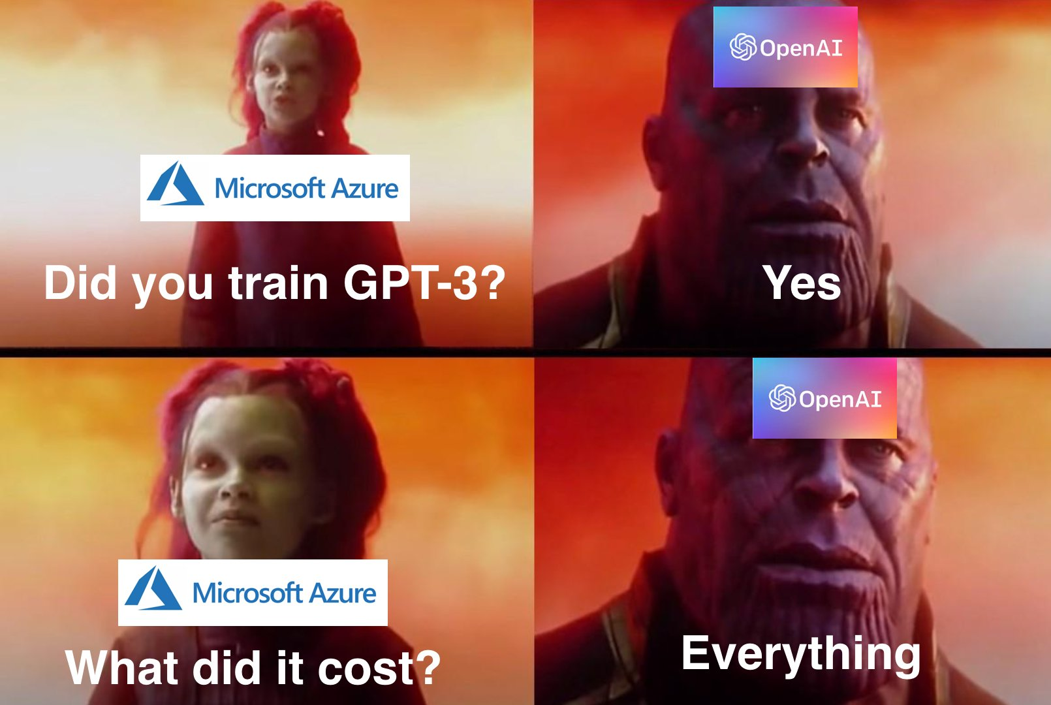
GPT-3

Slide 2
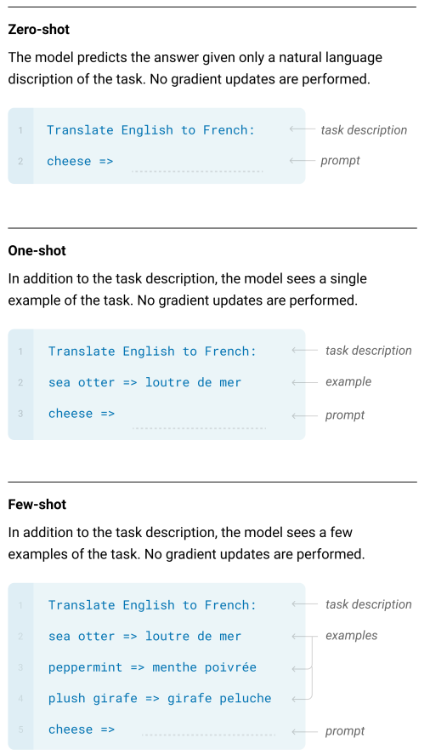
What’s New?
Bert: fine-tuned on specific tasks using much smaller task specific datasets.
Still need task specific datasets.
Fine-tuning allows the model to exploit spurious correlations, which lead to bad out-of-distribution performance.
Humans: learn a new task based on very few examples.
GPT-3: task agnostic model
Needs zero to very limited examples
Notes:
给他看之后又不用更新梯度，那么怎么找答案的

Slide 3
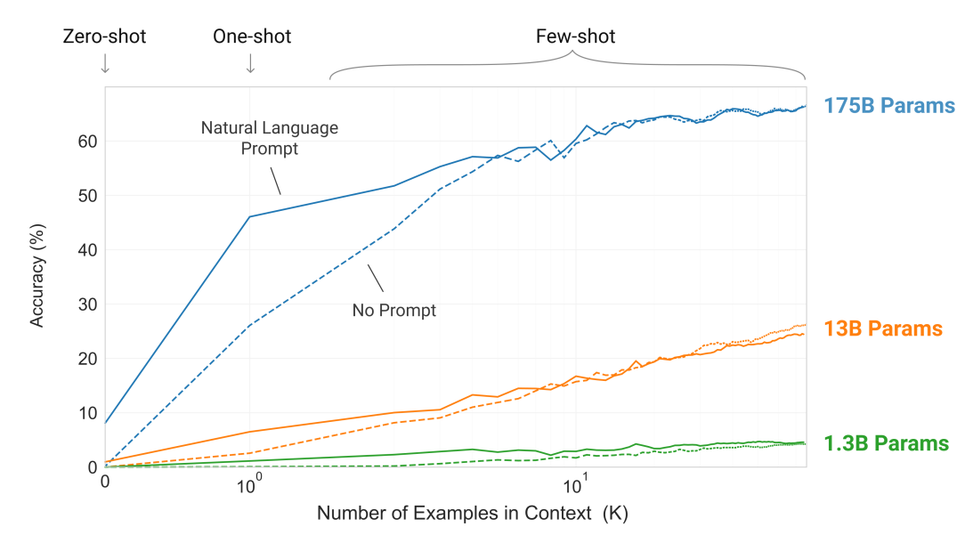
The Approach
96 Attention layers, Batch Size of 3.2M, 175B parameters, 12 million dollars

Slide 4
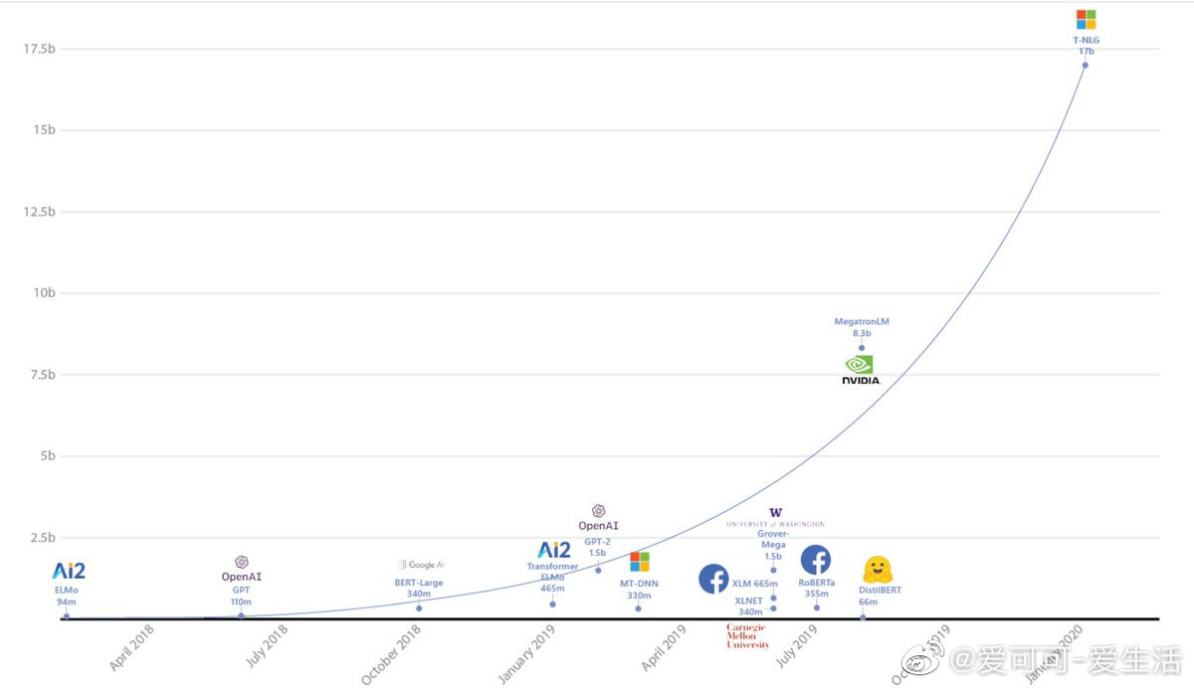

Slide 5
LAMBADA
Predict the last word of a given sentence.
76% accuracy in the zero-shot setting - a gain of 8% over the previous SOTA.
86.4% in the few-shots setting

Slide 6
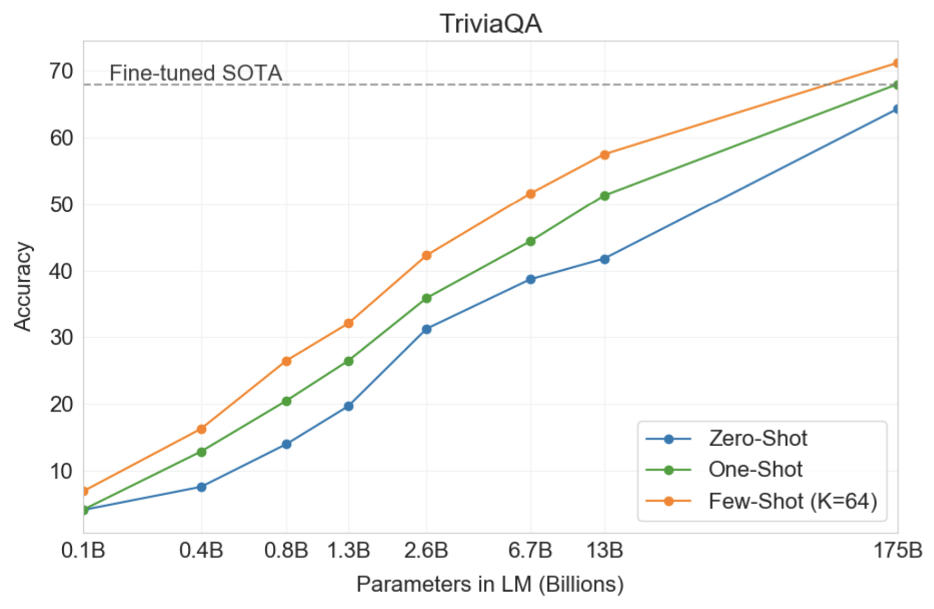
Closed Book Question Answering
GPT-3 is superior to the SOTA which not only fine-tunes on the task, but also uses an Information Retrieval component to retrieve pieces of texts that are likely to contain the answer.

Slide 7
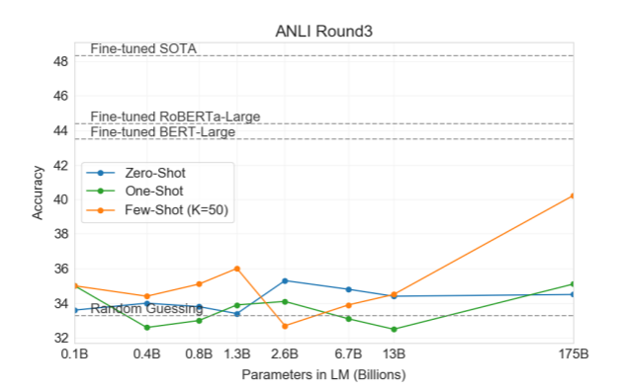
NLG
Weak in some tasks that require a comparison between two sentences
Whether a word is used the same way in two sentences,
Whether one sentence is a paraphrase of another,
Whether one sentence implies another.

Slide 8
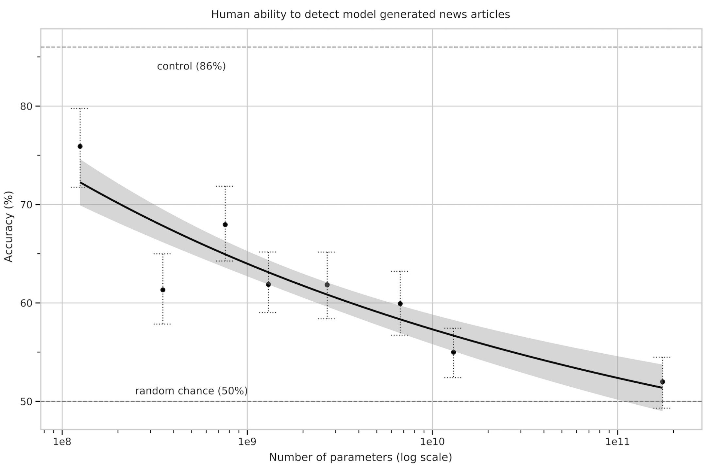
News Article Generation

Slide 9
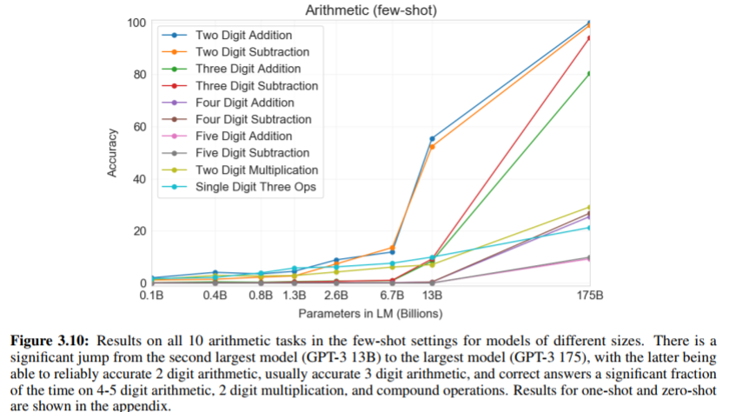
Arithmetic
There are 100 million possible 4-digit addition problems
If it was memorizing its training data, it should have gotten all 100 possible two-digit multiplication problems
Having trouble locating addition ?

Slide 10
When I prompt GPT-2 with addition problems, the most common failure mode is getting an answer that isn’t a number. Often it’s a few paragraphs of text that look like they came from a math textbook. It feels like it’s been able to locate the problem as far as “you want the kind of thing in math textbooks”, but not as far as “you want the answer to the exact math problem you are giving me”.
Or maybe that’s not it. Maybe it has trouble getting math problems right consistently for the same reason I have trouble with this. In fact, GPT-3’s performance is very similar to mine. I can also add two digit numbers in my head with near-100% accuracy, get worse as we go to three digit numbers, and make no guarantees at all about four-digit. I also find multiplying two-digit numbers in my head much harder than adding those same numbers. What’s my excuse? Do I understand addition, or not? I used to assume my problems came from limited short-term memory, or from neural noise. But GPT-3 shouldn’t have either of those issues. Should I feel a deep kinship with GPT-3? Are we both minds heavily optimized for writing, forced by a cruel world to sometimes do math problems? I don’t know.
an alert reader points out that when GPT-3 fails at addition problems, it fails in human-like ways – for example, forgetting to carry a 1.
Notes:
Speaking of which – can anything based on GPT-like principles ever produce superintelligent output? How would this happen? If it’s trying to mimic what a human can write, then no matter how intelligent it is “under the hood”, all that intelligence will only get applied to becoming better and better at predicting what kind of dumb stuff a normal-intelligence human would say. In a sense, solving the Theory of Everything would be a failure at its primary task. No human writer would end the sentence “the Theory of Everything is…” with anything other than “currently unknown and very hard to figure out”.

Slide 11
Limitations
Text synthesis ability still incurs the weak spots, such as repetitions, coherence loss over sufficiently long passages, and contradiction.
Bidirectional models are known to be better at downstream tasks after fine-tuning. At the end, training a bidirectional model at the scale of GPT-3, and/or trying to make bidirectional models work with few-shot learning, is a promising direction for future research.
Whether few-shot learning actually learns new tasks "from scratch” at inference time, or if it simply recognizes and identifies tasks that it has learned during training.
Size
Notes:
GPT-3 is doing what I used to do on essay questions – throw out a bunch of half-remembered names and dates and hope nobody looks too closely at the exact relations.

Slide 12
Discussion
Academic monopoly?
Understanding or memorizing?
Commercial gimmick?
Quantum computer

Slide 13
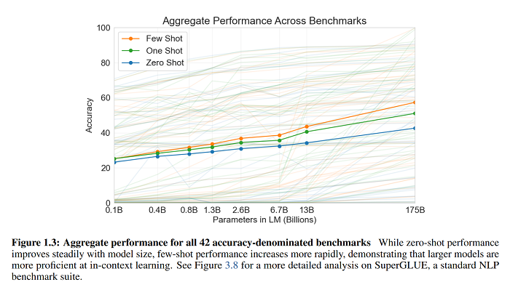
Summary
https://slatestarcodex.com/2020/06/10/the-obligatory-gpt-3-post/
https://anotherdatum.com/gpt-3.html
https://towardsdatascience.com/gpt-3-the-new-mighty-language-model-from-openai-a74ff35346fc
GPT-3 is, fundamentally, an attempt to investigate scaling laws in neural networks.

