Slide 1
Conditional Random Fields: Probabilistic Models
for Segmenting and Labeling Sequence Data
ICML 2000
by huweilong@whu.edu.cn

Slide 2
Contents
Introduction
The Label Bias Problem
Conditional Random Fields
Parameter Estimation for CRFs
Experiments
Further Aspects of CRFs
Related Word and Conclusions

Slide 3
Introduction
HMMs and stochastic grammars (generative models)
difficulty: enumerate; multiple interacting features; long-range dependencies
MEMMs (conditional models)
difficulty: label bias problem
CRFs (conditional models)
single exponential model for the joint probability of the entire sequence of labels
given the observation sequence.

Slide 4
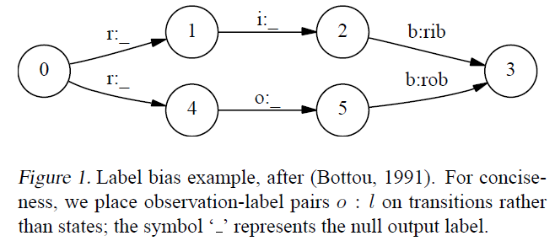
Label Bias Problem
Label Bias Problem
State with low-entropy
Two solution
Change the state-transition structure → combinatorial explosion
Fully-connected model → preclude the use of prior structural knowledge
Proper solution
Let some transitions “vote” more strongly than others depending on the corresponding observations

Slide 5
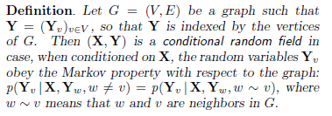

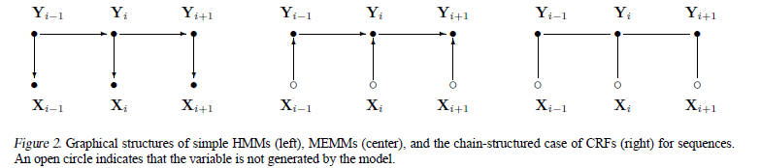




Conditional Random Fields
Definition
By theorem of random fields, joint distribution distribution
Chain structure
For each position i in the observation sequence x, we define the matrix random variable

Slide 6
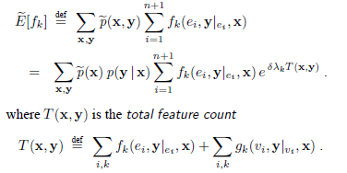
Parameter Estimation(1)
Improved iterative scaling (IIS) algorithm
Computing the exponential sums is problematic

Slide 7
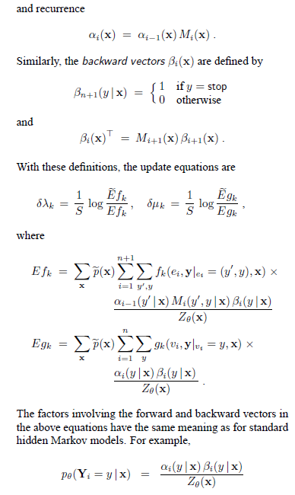
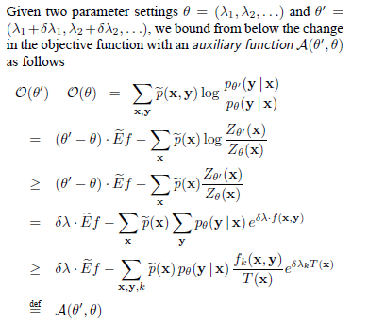
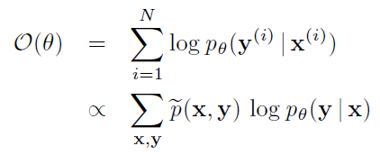
Parameter Estimation(2)
Algorithm S
Algorithm T
base case
define
update
where

Slide 8
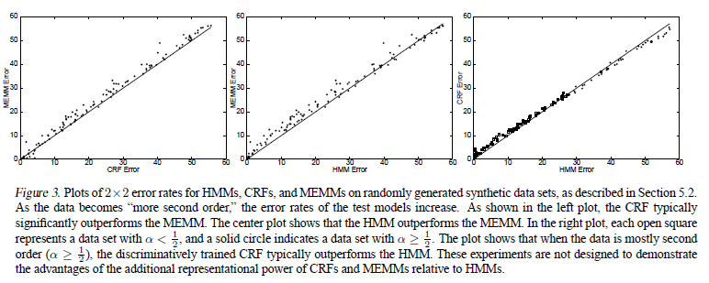
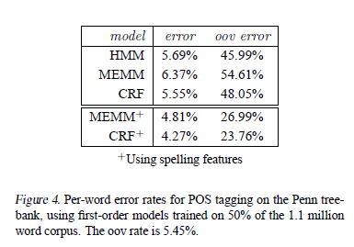
Experiments
Modeling label bias
Using 2000 training and 500 test samples, CRFs = 4.6%, MEMM=42%
Modeling mixed-order sources
POS tagging experiments

Slide 9
Further Aspects of CRFs
Trained using the exponential loss objective function used by the AdaBoost algorithm
Implement efficient feature selection and feature induction algorithms

Slide 10
Related Work and Conclusions
Related Work
Generative models
Non-probabilistic local decision models
Permissive generative model
Gradient-descent methods
Conclusions
Properties:
discriminatively trained models for sequence segmentation and labeling
combination of arbitrary ,overlapping and agglomerative observation features from both the past and future
efficient training and decoding based on dynamic programming
parameter estimation guaranteed to find the global optimum
Limitation:
slow convergence

Slide 11
Thank you
2017-04-26

