Slide 1

Neural Machine Reading Comprehension: Methods and Trends
Notes:
亮亮图文旗舰店https://liangliangtuwen.tmall.com

Slide 2


Task
Deep-Learning-Based
Methods
New Trends

Slide 3

1
Task

Slide 4
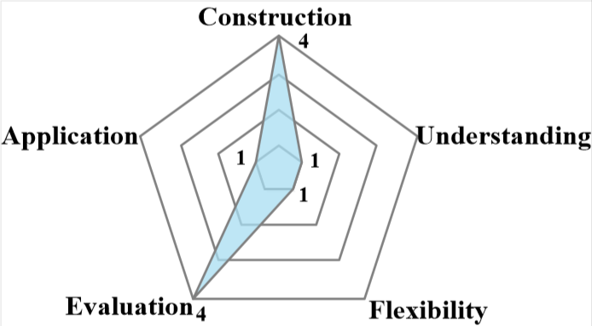
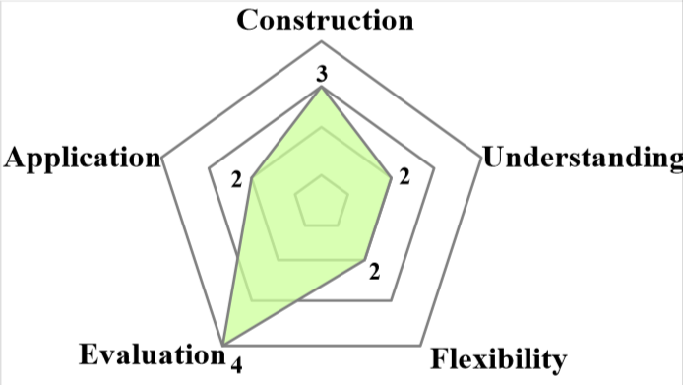
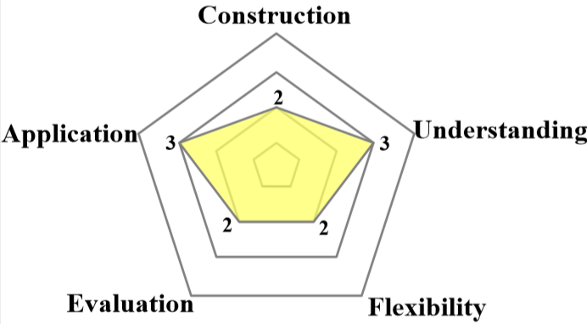
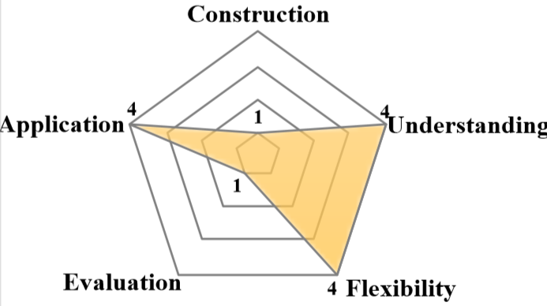
Task
01
02
03
04
Cloze
Tests
Multiple Choice
Span Extraction
Free Answering
代表数据集：CNN&Daily Mail,CBT,Who-did-What
代表数据集：
MCTest，Race
代表数据集：
SQuAD，NewsQA，TriviaQA
代表数据集：
MS MARCO，SearchQA, bAbl

Slide 5

2
Deep-Learning Based Methods

Slide 6
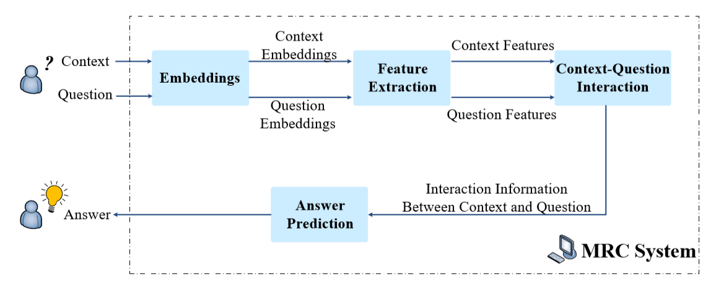
General Architecture

Slide 7
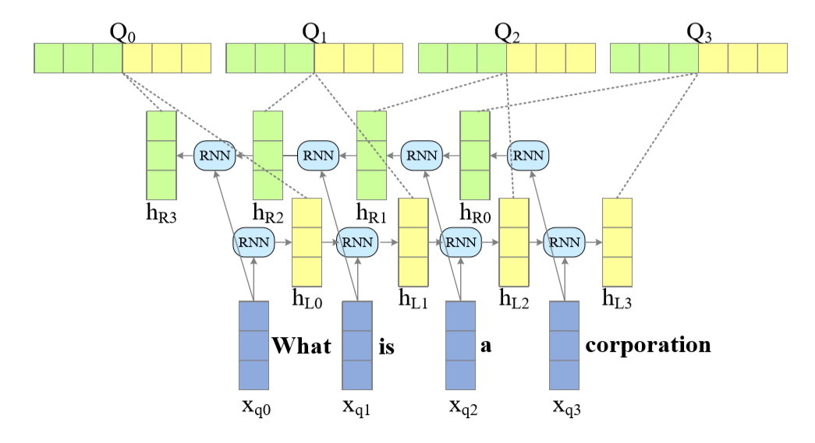
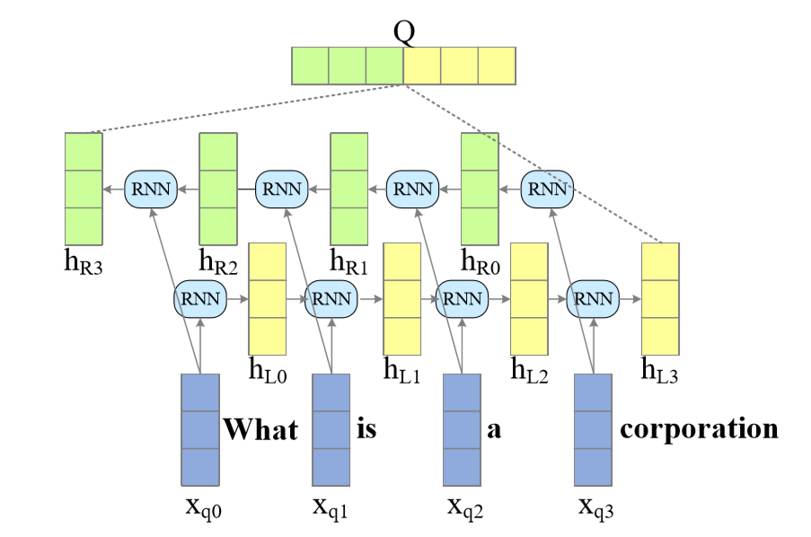
Feature Extraction
RNN:
Word-level encoding for questions:
Sentence encoding for questions:

Slide 8
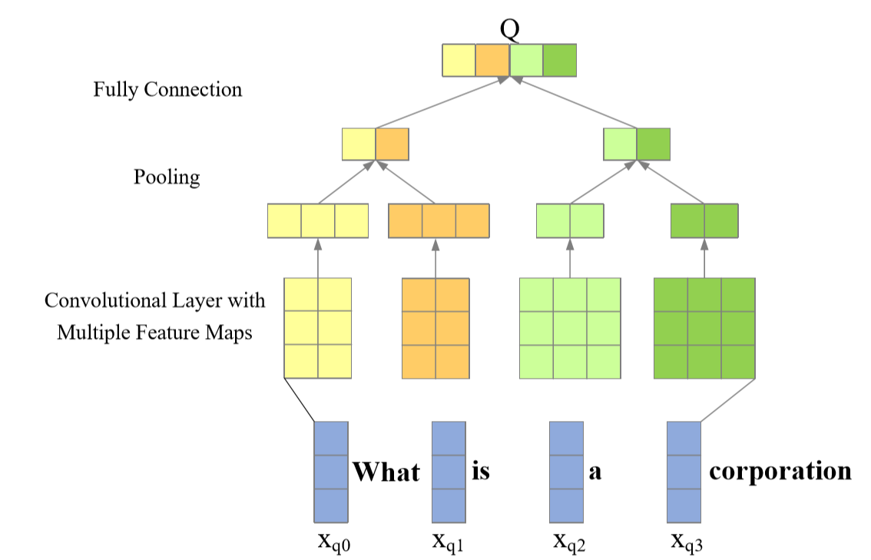
Feature Extraction
CNN:

Slide 9
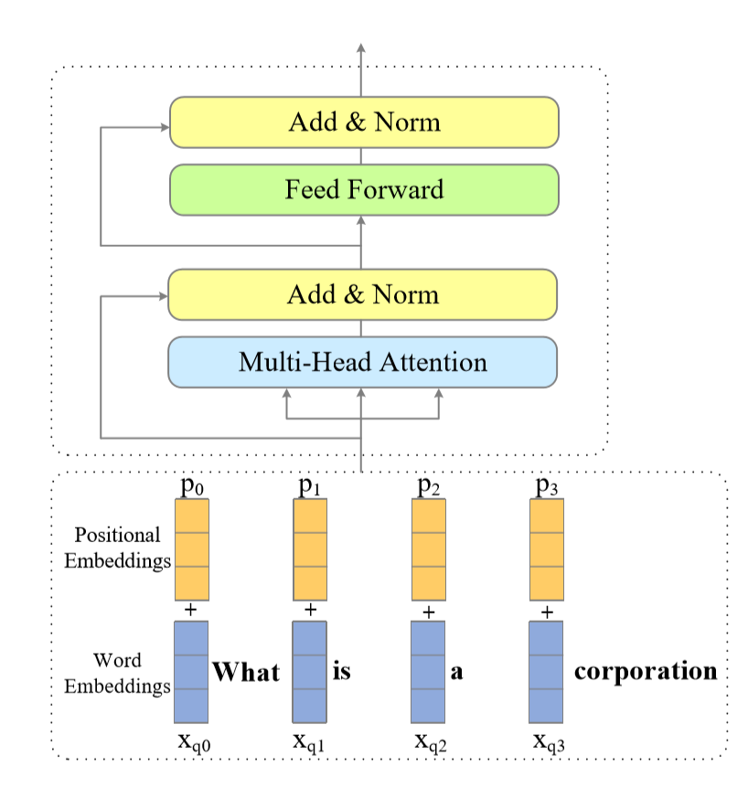
Feature Extraction
Transformer:

Slide 10
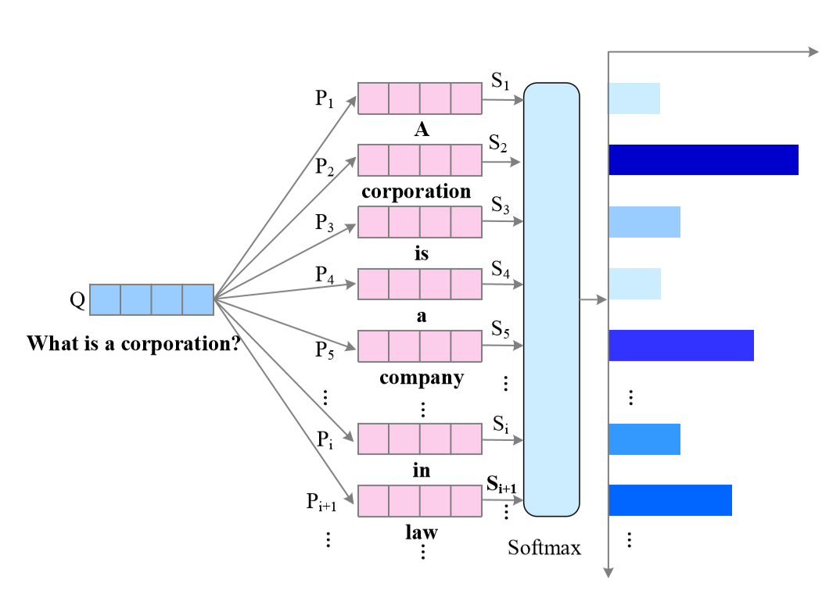
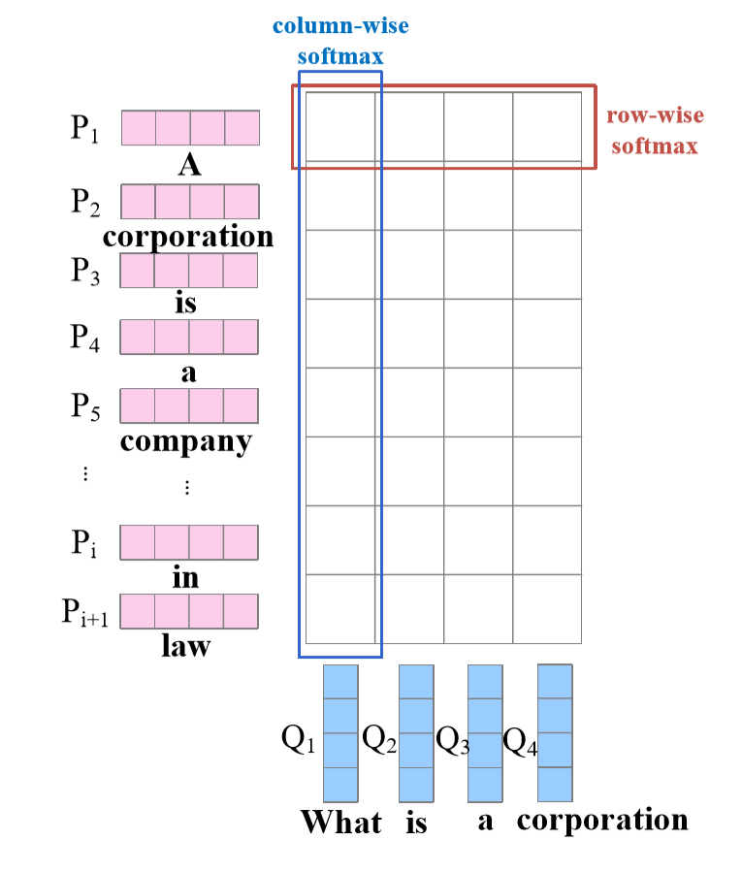
Context-Question Interaction
Unidirectional Attention:
Bidirectional Attention:

Slide 11
Answer Predicton
Option Selector
Span Extractor
Convolutional Spatial Attention model
Sequence Model， Boundary Model
02
03
Word Predictor
Answer Generator
Attentive Reader, Attention Sum Reader
01
04
S-Net

Slide 12
3
New Trends

Slide 13
Knowledge-Based Machine Reading Comprehension
Definition:
Given the context C, question Q and external knowledge K, the task requires predicting the correct answer A by learning the function F such that A=F(C,Q,K)
Key challenges:
Relevant External Knowledge Retrieval
External Knowledge Integration

Slide 14
Unanswerable Question
Definition:
Given the context C and question Q, the machine firstly determines whether Q can be answered or not based on the given context C alone. IF the question is impossible to be answered, the model marks it as unanswerable and abstains from answering, otherwise predicts the right answer.
Key challenges:
Unanswerable Question Detection
Plausible Answer Discrimination

Slide 15
Multi-Passage Machine Reading Comprehension
Definition:
Given a collection of m documents D = {D1,D2,··· ,Dm} and the question Q, the multi-passage MRC task requires giving the correct answer A to question Q according to documents D by learning the function F such that A = F(D,Q).
Key challenges:
Massive Document Corpus
Noisy Document Retrieval
No Answer
Multiple Answer
Evidence Aggregation

Slide 16
Conversational Machine Reading Comprehension
Definition:
Given the context C, the conversation history with previous questions and answers H = {Q1,A1,··· ,Qi−1,Ai−1} and the current question Qi, the CMRC task is to predict the correct answer Ai by learning the function F such that Ai = F(C,H,Qi).
Key challenges:
Conversational History
Coreference Resolution

