Slide 1
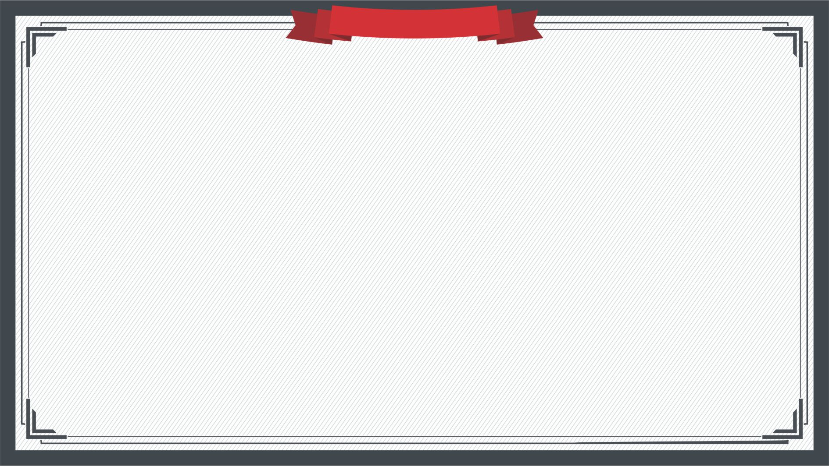
R-Net: Machine Reading Comprehension with Self-Matching
Notes:
亮亮图文旗舰店https://liangliangtuwen.tmall.com

Slide 2

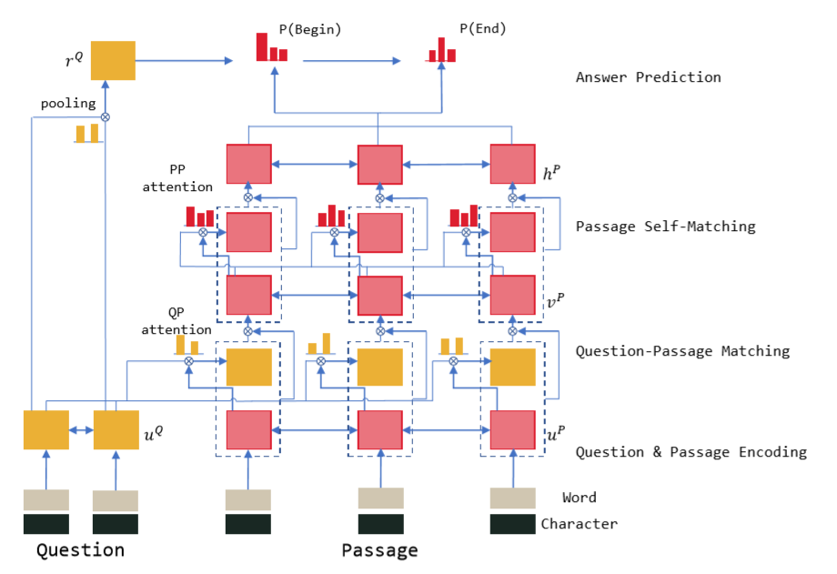

Slide 3

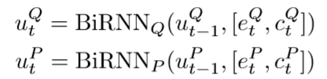

网络结构
Q&P Encoder

Slide 4


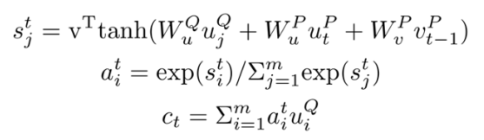
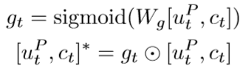
网络结构
Gated Attention-Based Recurrent Networks
sentence-pair representation:
c is an attion-pooling vector:
gate:

Slide 5

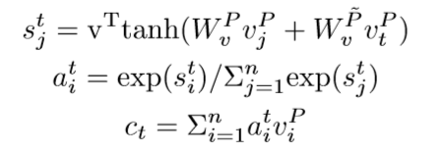
网络结构
Self-Matching Attention
passage representation:
c is an attion-pooling vector:

Slide 6
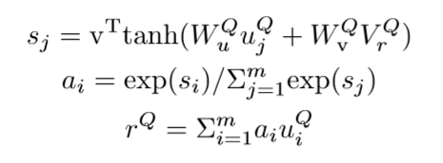
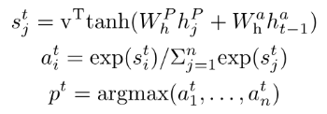

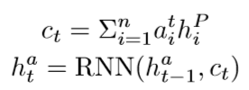
网络结构
Output Layer
initial hidden state:
output:
represents the last hidden state:

Slide 7
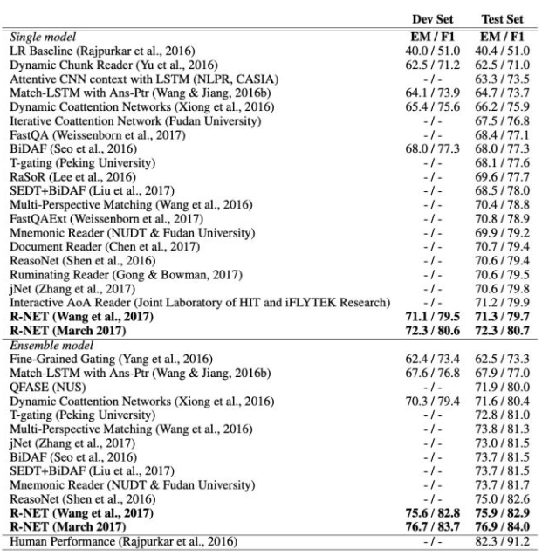
结果

