Slide 1
Self-supervised Learning
Dong Li
20 July, 2020

Slide 2
OUTLINE
1
Introduction
2
Models
3
Conclusions

Slide 3
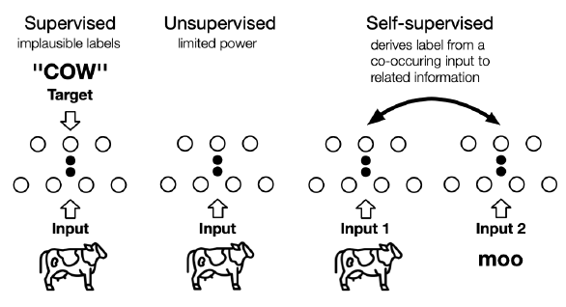
Introduction
Supervised Learning
dependence on manual Labels
Adversarial attacks
unsupervised learning
use pixel-wise loss, no structural loss incorporated
reconstruction can hardly represent semantic information

Slide 4
Introduction
Supervised Learning
dependence on manual Labels
Adversarial attacks
unsupervised learning
concentrates on detecting specific
data patterns
Self-supervised Learning （SSL）
The machine predicts any parts of its input for any observed part.
SSL：
a branch of unsupervised learning

Slide 5
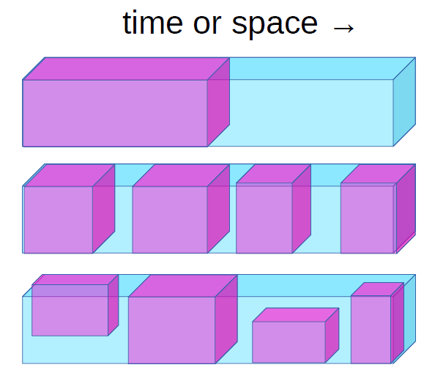
Introduction
Self-Supervised Learning = Filling in the Blanks
Predict any part of the input from any other part.
Predict the future from the past.
Predict the invisible from the visible.
Predict any occluded, masked, or corrupted part from all available parts
Reconstruction = SSL ; when any part could be known or unknown
Theoretical foundations: GAN

Slide 6
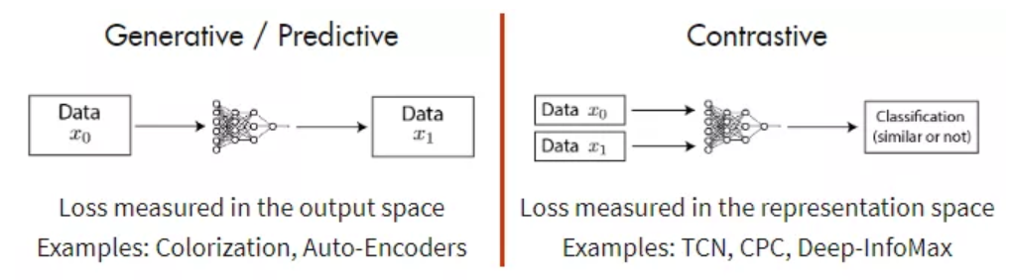
Models
SSL Models
Generative SSL
Contrastive SSL
Generative-contrastive (Adversarial) SSL

Slide 7
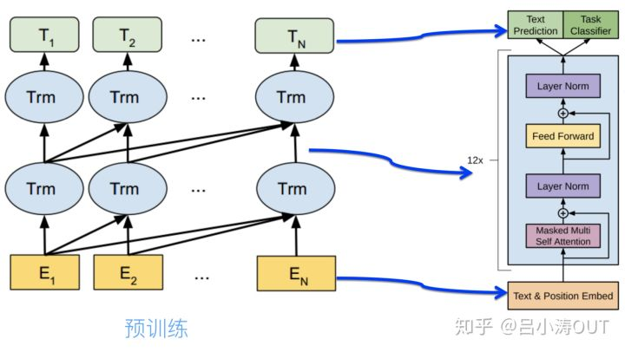

Models->Generative SSL
Auto-regressive (AR) Model
Bayes net structure (directed graph model)
Tasks:
NLP: GPT, GPT-2
CV: PixelRNN, Pixel-CNN
Graph: GraphRNN
Advantage & disadvantage

Slide 8

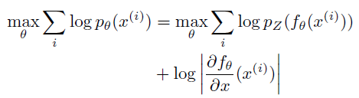
Models->Generative SSL
Flow-based Model
Goal: to estimate complex high dimensional densities from data
Advantage & disadvantage

Slide 9
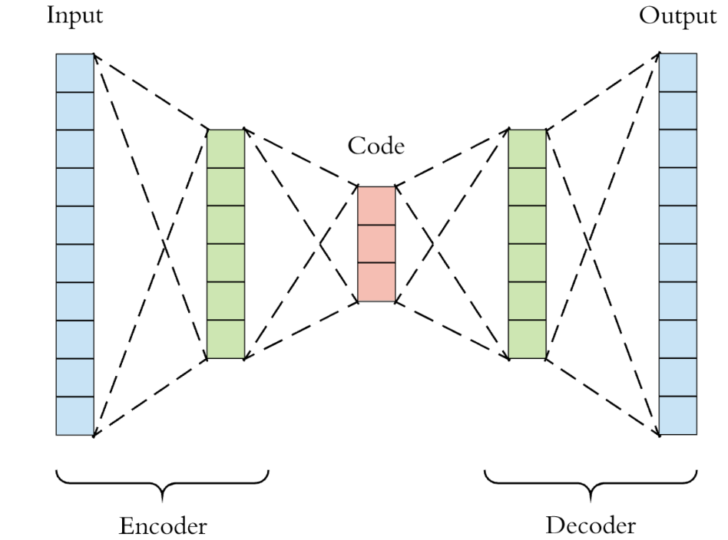
Models->Generative SSL
Auto-encoding (AE) Model
Goal: to reconstruct (part of) inputs from (corrupted) inputs.
AE Model
Context Prediction Model (CPM)
Denoising AE Model
Variational AE Model

Slide 10
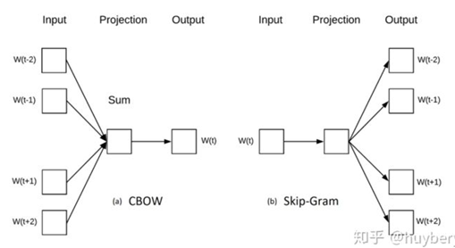
Models->Generative SSL
Auto-encoding (AE) Model
Context Prediction Model (CPM)
CBOW
Skip-Gram
Skip-Thought Vectors
FastText
NLP
Deepwalk
GNN
LINE

Slide 11
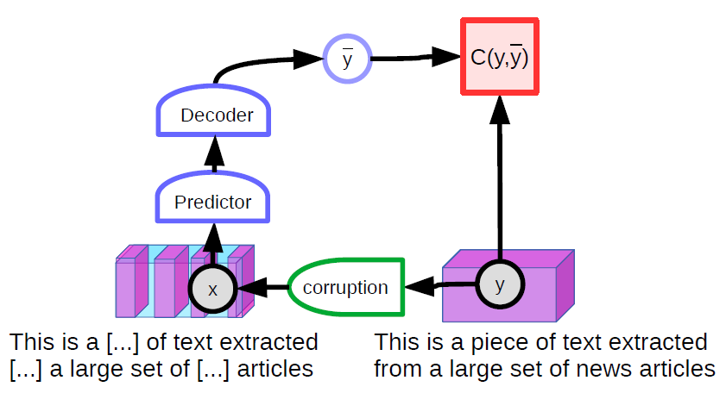
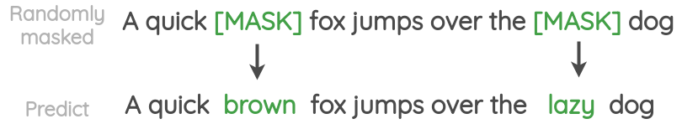
Models->Generative SSL
Auto-encoding (AE) Model
Denoising AE Model（masked AE）
MLM(masked language model )：
randomly masks some of the tokens from the input, and then predict them based their context information
BERT，SpanBERT，ERNIE
Advantage & disadvantage

Slide 12
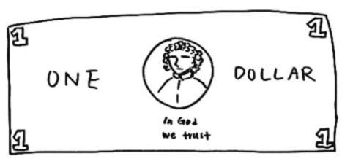
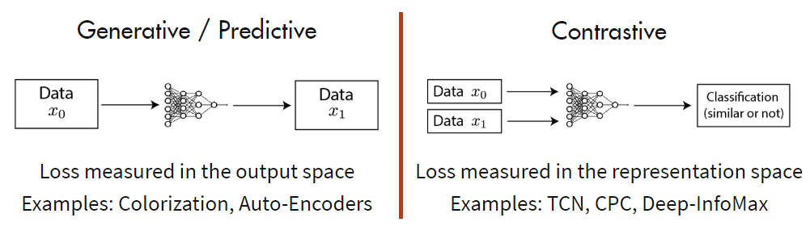
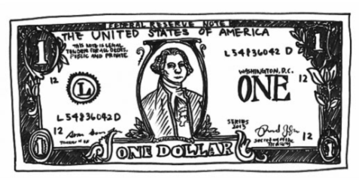
Models->Contrastive SSL
Generative V.S. Contrastive
Drawing of a dollar bill from memory
Drawing subsequently made with a dollar bill present

Slide 13




Models->Contrastive SSL
Contrastive SSL
”learn to compare” through a Noise Contrastive Estimation (NCE)
InfoNCE

Slide 14
Models->Contrastive SSL
Contrastive SSL
Context-Instance Contrast
Context-Context Contrast
Model: Deep InfoMax, MoCo and SimCLR

Slide 15
Models->Contrastive SSL
Contrastive SSL
Context-Instance Contrast （global-local contrast）
modeling the belonging relationship between the local feature of a sample and its global context representation
Predict Relative Position (PRP)
Maximize Mutual Information (MI)
learning relative positions between local components
learning the explicit belonging relationships between local parts and global context

Slide 16
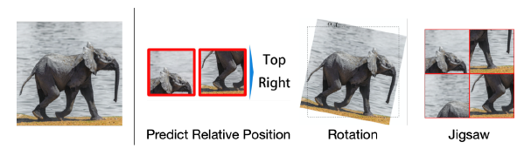
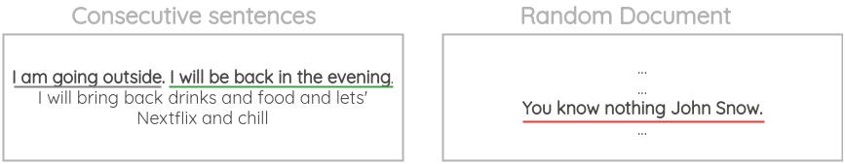
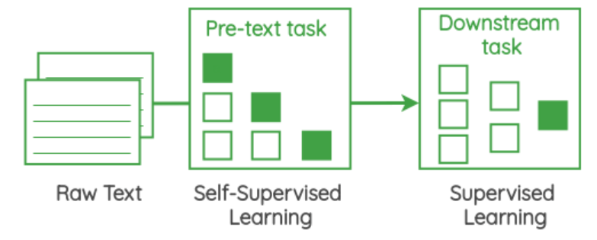
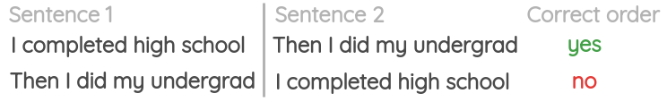
Models->Contrastive SSL
Context-Instance Contrast
Predict Relative Position

Slide 17
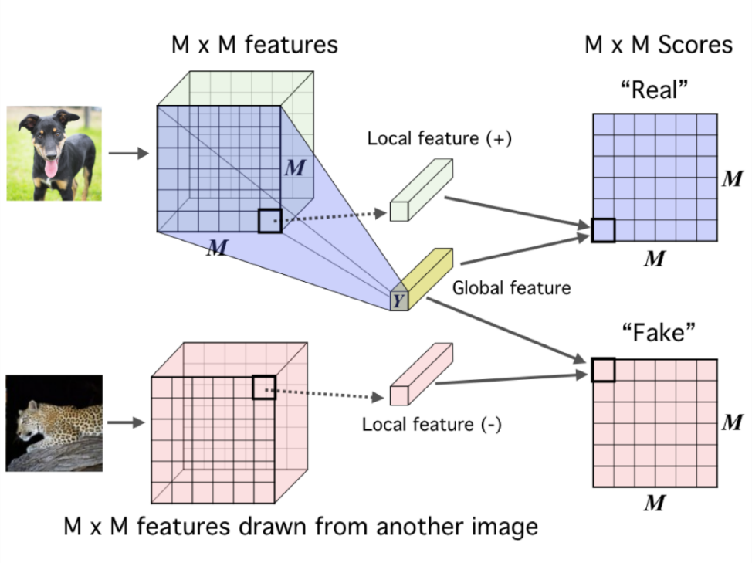

Models->Contrastive SSL
Context-Instance Contrast
Maximize Mutual Information
Deep InfoMax
CV
AMDIM
Graph :
Deep Graph InfoMax
Deep InfoMax
NLP :
InfoWord

Slide 18
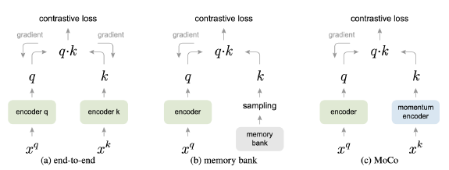
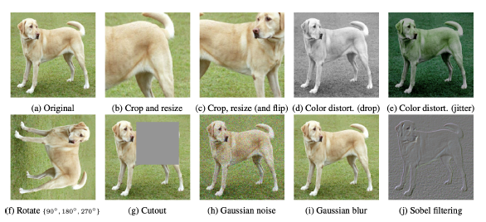
Models->Contrastive SSL
Context-Context Contrast
MoCo
SimCLR

Slide 19

Models->Adversarial SSL
Why Generative-Contrastive (Adversarial)?
MLE has two fatal problems
Sensitive and Conservative Distribution
Low-level Abstraction Objective
Low-level abstraction
High-level abstraction
Pixels, words,nodes
object detection, long paragraph understanding, molecule classification

Slide 20
Conclusion
Conclusion
Self-Supervised Learning (SSL) is learning dependencies
The main obstacle is uncertainty, many y are compatible with an x
Finding suitable pretext is the most needed problem for self-supervised learning
The more data and resources, the better effect of self-supervised PTMs
Task Related Self-Supervised Learning is a future direction

Slide 21
Thanks!

