Slide 1

2012年营业部上半年工作总结
四篇 主题模型 相关论文
2012.7.20
高望
2017-6-15
1
PowerPoint Template Guidelines/2007

Slide 2
1
1
Integrating Topic Modeling with Word Embeddings by Mixtures of vMFs
2016.12 COLING
2

Slide 3
1
MOTIVATION
Gaussian LDA (2015 ACL) integrates topic modeling with word embeddings by replacing discrete topic distribution over word types with multivariate Gaussian distribution on the embedding space.
This encourages the model to group words that are a priori known to be semantically related into topics.

Slide 4
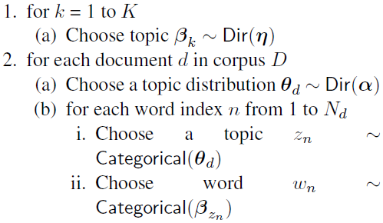
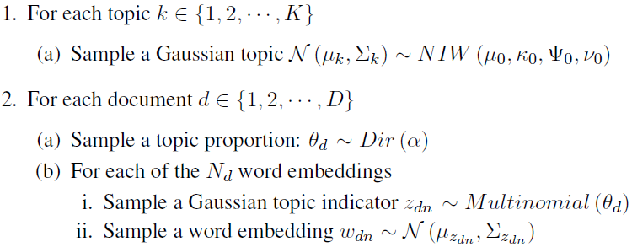
2
MODEL
Generative process
LDA G-LDA
Notes:
高斯(逆)威沙特分布 inverse Wishart distributio

Slide 5
1
MOTIVATION
However, the Euclidean similarity used in Gaussian topics is not an optimal semantic measure for word embeddings
This paper uses von Mises-Fisher (vMF) distributions on the embedding space to represent topics, replacing Gaussian topics in G-LDA
Notes:
冯·米塞斯分布

Slide 6
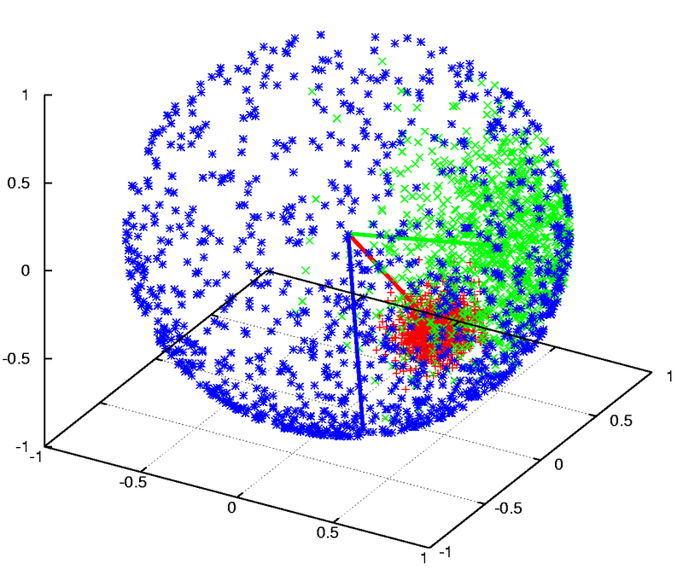
1
MOTIVATION
The von Mises–Fisher (vMF) distribution has been used to model directional data by placing points on a unit sphere
vMF concerns the cosine similarity, which is a better way to represent topics of word embeddings
Notes:
在概率论和定向统计中，冯·米塞斯分布（von Mises distribution）指一种圆上连续概率分布模型，它也被称作循环正态分布（circular normal distribution）
The vMF distribution

Slide 7
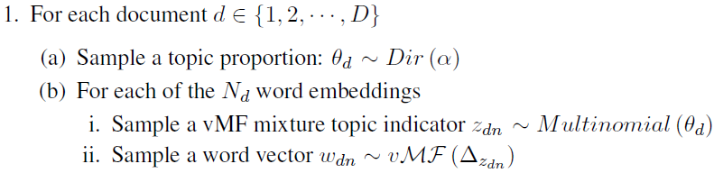
2
MODEL
Generative process
G-LDA MvTM

Slide 8
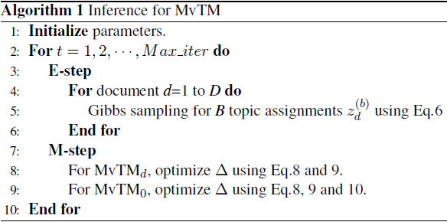
2
MODEL
Inference
This paper uses hybrid variational-Gibbs (HVG) (Mimno et al., 2012) to approximate a posterior

Slide 9
3
EXPERIMENTS
Data set : Newsgroup, NIPS and Wikipedia
Baseline model : LDA and G-LDA
Evaluation : PMI and Classification
Experimental results show that the model can discover more coherent topics than the state-of-the-art baseline models, and achieve competitive classification performance.

Slide 10
2
1
Latent Topic Embedding
Baidu
2016.12 COLING
10

Slide 11
1
MOTIVATION
Topic models utilize word co-occurrences to compose the ”topics”, which ignores the valuable sub-sequence information between words.
Word embedding models focus on the word co-occurrences within small sliding windows, which enable word embedding to capture the information of word sequences.
This paper proposes the Latent Topic Embedding (LTE) to seamlessly integrate topic modeling and word embedding in one framework.
Notes:
词袋模型假设

Slide 12
1
MOTIVATION
In the generative process of LTE, they assume that the observed words in document can be generated through two channels:
one is through the Multinomial distribution
the other is based upon topic embeddings as well as word embeddings..
Notes:
词袋模型假设

Slide 13
1
MOTIVATION
In this way, the embedding information influences the result of topic modeling
the topic information affects the training of word embeddings in return.
LTE enables topic modeling to utilize word sequence information and it equips word embeddings with the document-level vision
Notes:
词袋模型假设

Slide 14
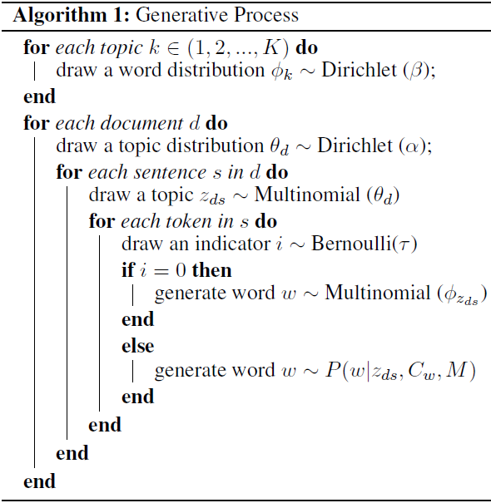
2
MODEL
LTE views each document as a bag of sentences and each sentence is composed of words.
Notes:
两个变量

Slide 15

2
MODEL
v_{w} is the embedding of w.
C_{w} stands for the sliding window for w
M = {v_{w}, v_{z}} stands for the word embedding and the topic embedding
x_{w} = v_{cw}⊕v_{zds}
Notes:
两个变量

Slide 16
2
MODEL
The parameters of interest are Θ, Φ and M
How to sample the latent topics for sentences…
How to optimize the vectors via stochastic gradient descent…
The parameter inference algorithm…
Notes:
两个变量

Slide 17
3
EXPERIMENTS
LTE discovers latent topics from two perspectives. The first perspective is based on the Θ parameter. The second perspective is based on the topic embedding and word embedding.
Words whose embeddings have the highest cosine similarity with the topic embedding can be considered as the content of this topic
Notes:
两个变量

Slide 18
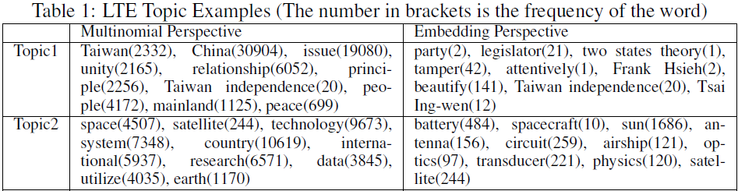
3
EXPERIMENTS
For each topic, the words from the two perspectives are semantically relevant and complimentary to each other.
By using the topic and word embeddings, we can effectively discover the semantics of words of relatively low frequency.
Notes:
两个变量

Slide 19
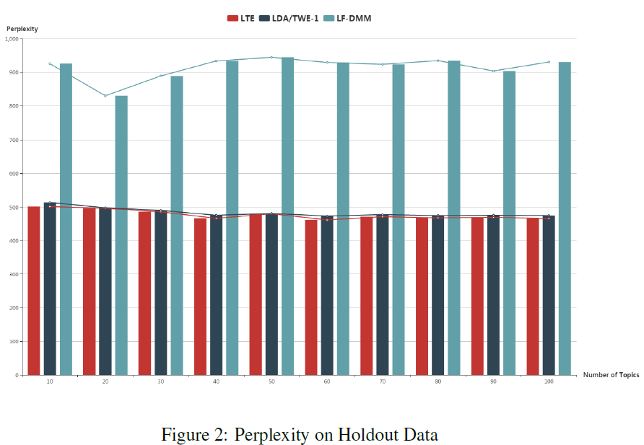
3
EXPERIMENTS
LTE outperforms LFDMM, showing that adding the sentence assumption and jointly utilizing word embedding and topic embedding to generate words result in better fit for the latent data structure of natural language documents.
Notes:
两个变量

Slide 20
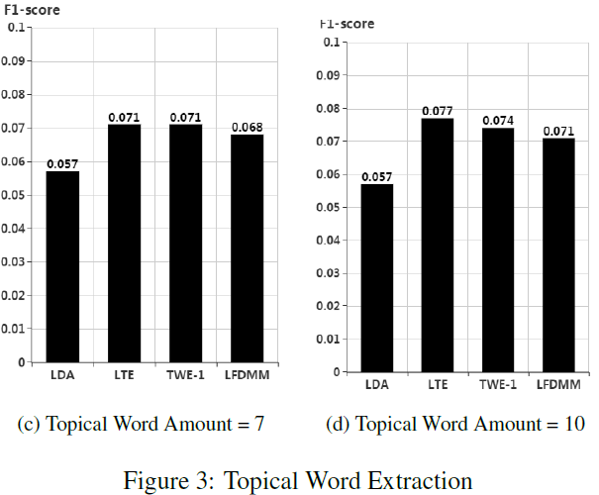
3
EXPERIMENTS
Comparing to TWE-1 and LFDMM which either reuse the output of LDA or Word2Vec, LTE jointly trains the Multinomial parameters and the embeddings, which are complimentary to each other and is effective to result in better topic modeling results and embeddings.
Notes:
两个变量

Slide 21
3
1
Using Recurrent Neural Network for Short Text Topic Discovery
2017.2 AAAI
21

Slide 22
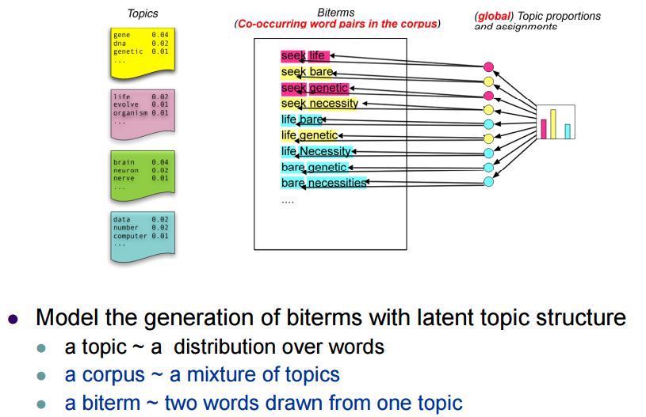
1
MOTIVATION
BTM (2013 WWW) uses word co-occurrence relationship from original corpus to learn topics.

Slide 23
1
MOTIVATION
However, BTM lack quantifiable relationship between words.
For instance, given a document with words (iPhone, iPad, house), BTM models biterms (iPhone, iPad) and (iPhone, house) equally for learning topics.
This means we can not ignore the prior knowledge of relationship between words.
Modeling word pairs is highly likely to bring high-frequency words into final results

Slide 24
1
MOTIVATION
Main contributions:
Brings quantifiable relationship between words learned by RNN to describe biterms better.
Using IDF of words to help filter high-frequency common words in a probabilistic way.
Discovering RNN’s positive effects on RIBS-TM which means we can optimize this topic model by optimizing RNN’s performance.

Slide 25
2
MODEL
If two words are more likely to appear in the same generative sentence, they are more related.
If two words are far away from each other in the same sentence, the relationship between them shall be weakened.
The learning process of RNN can guarantee that the earlier a word is learned, the less influence it will have on current learning word.

Slide 26
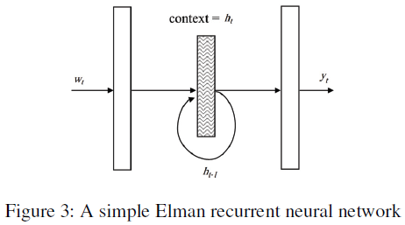
2
MODEL
h_{t−1} has remembered all the words observed before time t.
This means RNN can learn the relationship between the current word and previously observed words.

Slide 27

2
MODEL
What’s more, to filter high-frequency words, we utilize IDF to decrease some topic-irrelevant biterms' probability of generating a topic.
We can give the definition of prior knowledge β

Slide 28
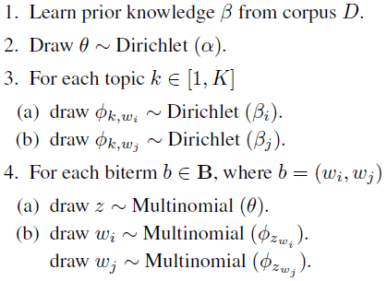
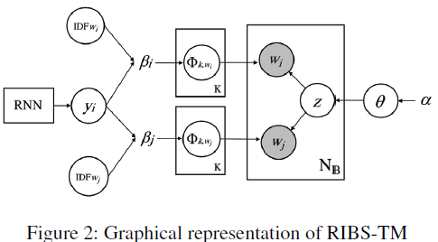
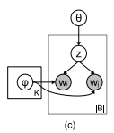
2
MODEL

Slide 29
3
EXPERIMENTS
Baseline: LDA, BTM and d-BTM
Topic coherence…
Short text classification…
Short text clustering…

Slide 30
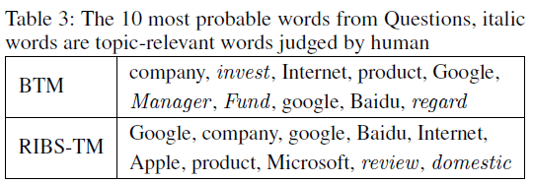
3
EXPERIMENTS
RIBS-TM discovers less irrelevant words than BTM because it utilizes quantifiable relationship between words.

Slide 31
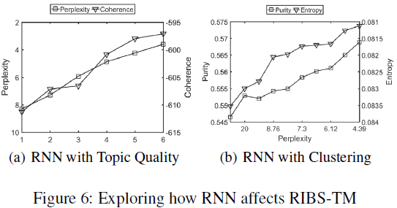
3
EXPERIMENTS
This result not only proves the effectiveness of RNN but also inspires us that maybe we can optimize our topic model by optimizing RNN which is quite encouraging.

Slide 32
4
1
Incorporating Knowledge Graph Embeddings into Topic Modeling
2017.2 AAAI
32

Slide 33
1
MOTIVATION
Topic models without any human knowledge often result in topics that are difficult to interpret.
Knowledge graph embedding aims at embedding components of a knowledge graph like WordNet and Freebase into continuous vectors, so as to simplify the knowledge representation while preserving the inherent structure of the original knowledge graph.

Slide 34
1
MOTIVATION
This paper proposes a new knowledge-based topic model, which combines topic model and knowledge graph embeddings.
The proposed method explicitly models document-level word co-occurrence in a corpus with knowledge encoded by entities’ vectors automatically learned from a knowledge graph in a unified model

Slide 35
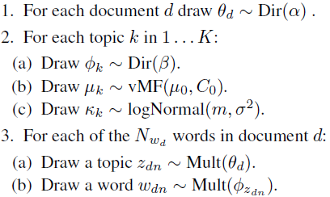
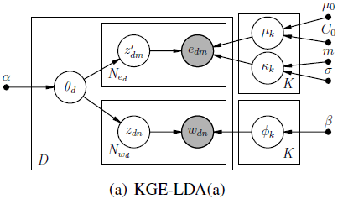
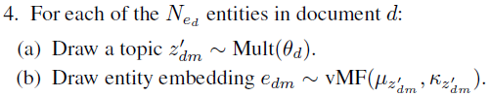
2
MODEL

Slide 36
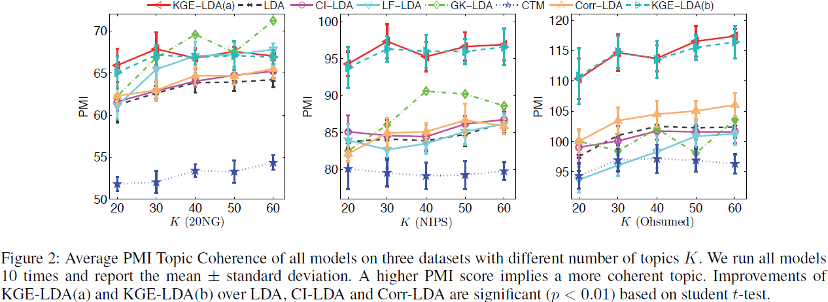
3
EXPERIMENTS
Topic Coherence
Notes:
CI-LDA and Corr-LDA perform slightly better than LDA, which means using entities in text can improve topic interpretability, but the improvements are not significant. When using entity embeddings instead of entities, the topic coherence scores are significantly improved because entity embeddings encode
more information about knowledge graph structure.

Slide 37
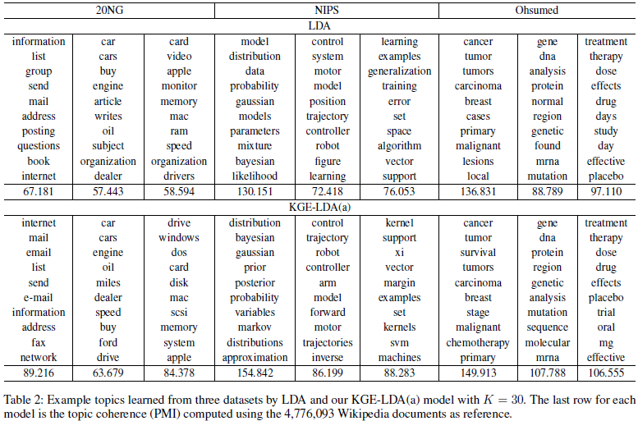
3
EXPERIMENTS
Qualitative Analysis

Slide 38
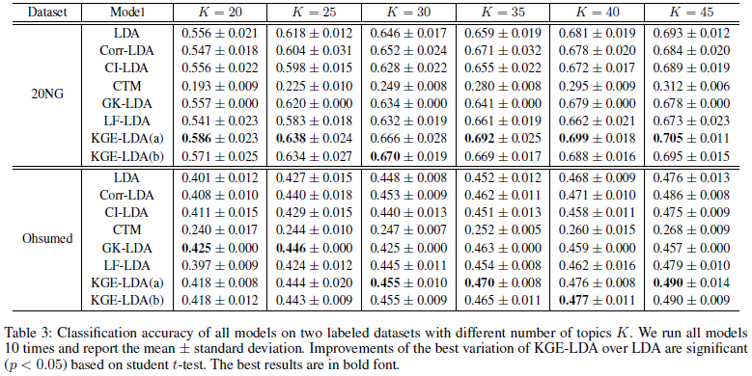
3
EXPERIMENTS
Classification Evaluation

