Slide 1
Semi-Supervised Learning
— by Qianqian Xie
Computer School, Wuhan University
xieq@whu.edu.cn

Slide 2
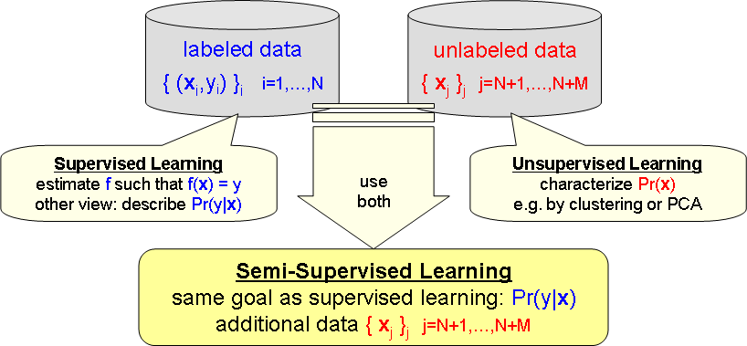
Why SSL?
labeled data: labeling usually
. . . requires experts
. . . costs time
. . . is boring
. . . requires measurements and devices
. . . costs money
⇒ scarce, expensive
unlabeled data: can often be
. . . measured automatically
. . . found on the web
. . . retrieved from databases and collections
⇒ abundant, cheap . . . “for free”

Slide 3
Max-Margin Deep Generative Models (NIPs2015)
Deep Generative Models (DGMs):
focusing on the generative capability on inferring the observations
little work has been done on investigating the predictive power
Max-Margin Deep Generative Models (MMDGM):
Incorporating the max-margin principle with DGM to improve the discriminative ability

Slide 4
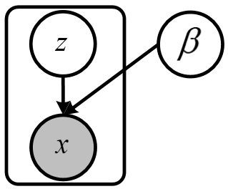

Basics of Deep Generative Models
Given a set of unlabeled samples, learn the unknown parameters (or a distribution)
The joint probability of a DGM:
ELBO:

Slide 5
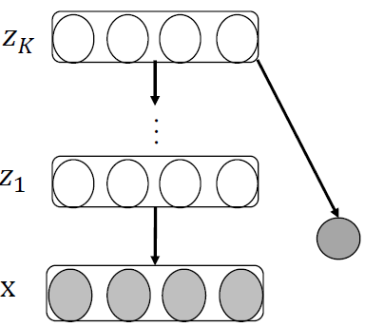
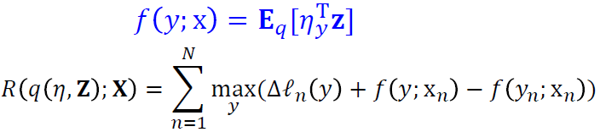
Max-Margin Deep Generative Models
A DGM to describe input features:
A max-margin classifier to consider supervision:
where f(y,z) is the MK-dimensional vector that concatenates M subvectors, with the yth being z and all others being zero

Slide 6


Max-Margin Deep Generative Models
The Learning Problem:
mean-field (SMF) assumption:
analytical form:
A doubly stochastic sub-gradient descent:

Slide 7
Max-Margin Deep Generative Models
The gradients:
Reparameterize the variational distribution:

Slide 8
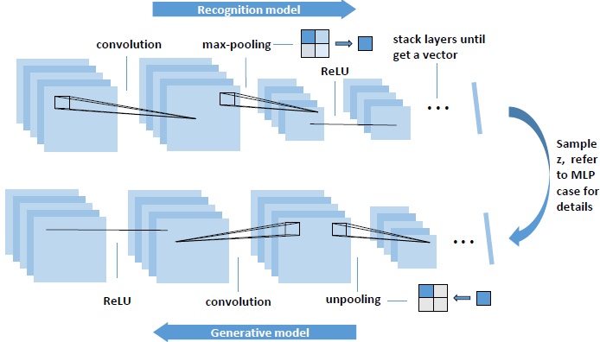
Max-Margin Deep Generative Models
The network architectures:

Slide 9
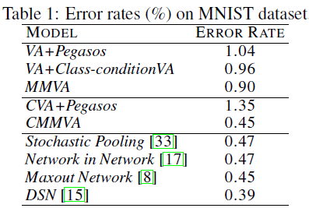
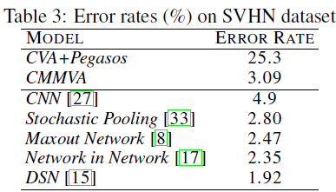
Max-Margin Deep Generative Models
Predictive Performance:

Slide 10
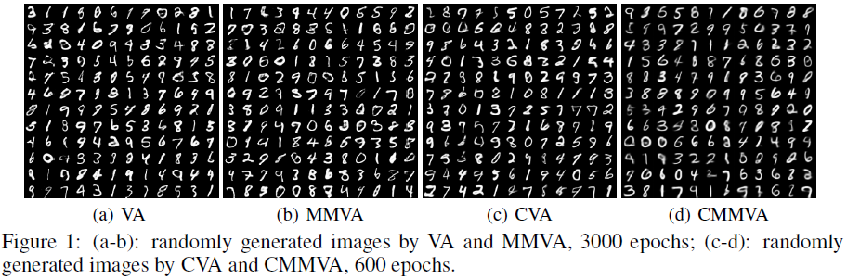
Max-Margin Deep Generative Models
Generative Performance:

Slide 11


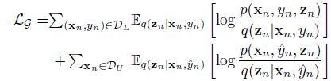
Conditional Variants for Semi-supervised Learning
A class-conditional deep generative model to describe the joint distribution of the data, labels and latent variables:
for the labeled data:
for the unlabeled data:
the overall generative loss :

Slide 12



Conditional Variants for Semi-supervised Learning
A deep max-margin classifier to infer labels given data:
Hinge loss for the labeled data:
Hat loss for the unlabeled data:
Label-balance regularization:
The overall loss:

Slide 13
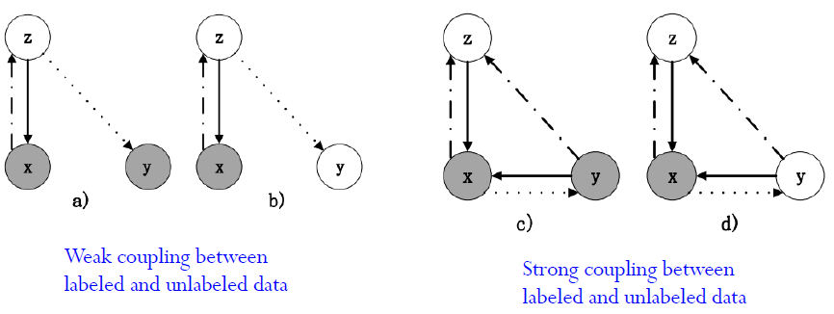
Conditional Variants for Semi-supervised Learning
Compare:

Slide 14
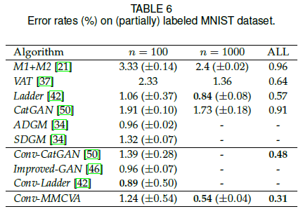
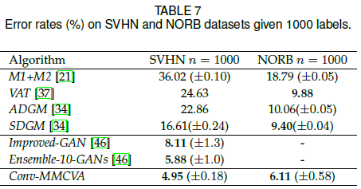
Conditional Variants for Semi-supervised Learning
Some results:

Slide 15
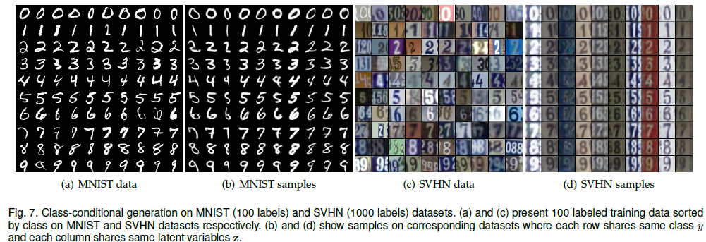
Conditional Variants for Semi-supervised Learning
Some results:

Slide 16

Triple Generative Adversarial Nets (Nips2017)
A minimax game for semi-supervised learning：
GAN is for unsupervised learning
We aim to learn the joint distribution
We need three players：
Two generators to generate (x, y)
A discriminator to distinguish fake (x, y)
𝑝_{model}(x) = 𝑝_{data}(x)
𝑝_{model}(x, y) = 𝑝_{data}(x, y)

Slide 17
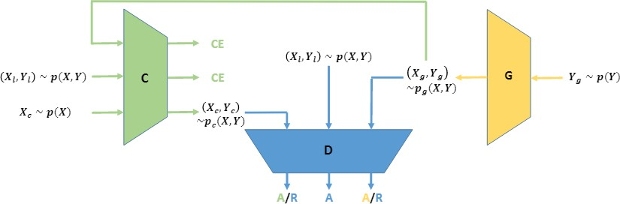
Triple-GAN
The network architecture：
Both C and G are generators
D is the discriminator
CE: cross-entropy loss for learning classifier

Slide 18


A minimax game
The optimization problem:
The hyper-parameter a is often set at 1/2
The standard supervised loss can be incorporated

Slide 19
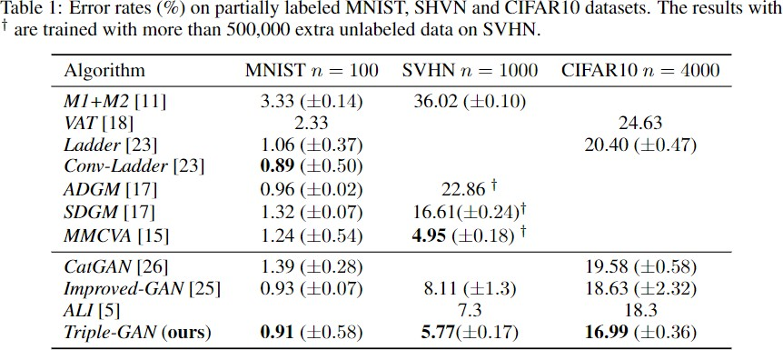
Some Results
Semi-supervised classification

Slide 20
Variational Autoencoder for Semi-Supervised Text Classification (AAAI2017)
SemiVAE has proven to be ineffective in sequential text classification problem
The semi-supervised Sequential Variational Autoencoder (SSVAE) is proposed for semi-supervised sequential text classification
Making the SSVAE effective by using conditional LSTM that receives labels at each step, and give the explanation from the RL perspective.

Slide 21



Semi-supervised Variational Inference
Given a labeled data pair (x, y), the evidence lower bound:
For the unlabeled data, the unobserved label y is predicted from the inference model with a learnable classifier:
The objective for entire dataset :

Slide 22
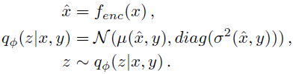
Semi-supervised Variational Autoencoder
three main components: an encoder network, a decoder network and a classifier
the encoder network:
the decoder:
They can be implemented by various models, e.g., MLP or CNN networks

Slide 23
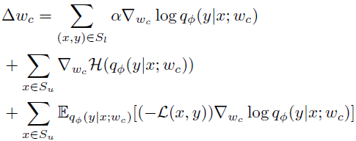

Learning from Unlabeled Data
the gradient of the classifier:
Reinforce algorithm:
from the additional classification loss of labeled data
from the unlabeled objective function
A reward signal
Policy network

Slide 24
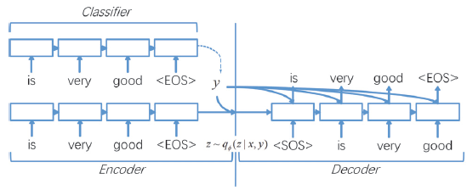
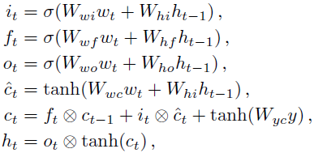
Conditional LSTM Structures
Feeding label y at each time step:

Slide 25


Optimizing via Sampling
The variance of the sampling-based gradient estimator can be very high
S1: a sequence-length-dependent baseline
S2: the averaged baseline

Slide 26
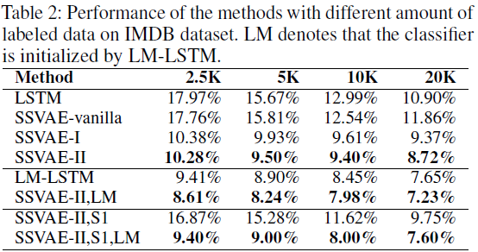
Some Results
Benchmark Classification

Slide 27
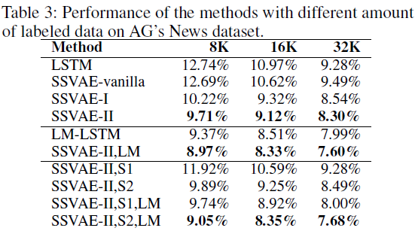
Some Results
Benchmark Classification

Slide 28

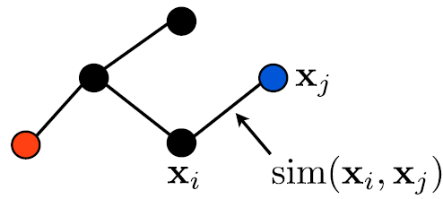

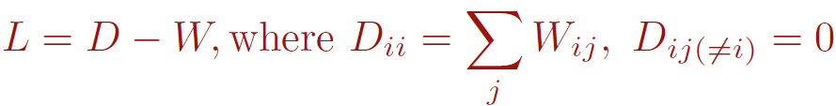
Manifold Regularization
Smooth assumption: If two instances are similar according to the graph, then output labels should be similar
The manifold regularization SSL solves the problem:
Laplacian Eigenmaps

