Slide 1
A Latent Concept Topic Model for Robust Topic Inference
Using Word Embeddings
Speaker: Yalan Yao
1

Slide 2
1
Introduction
2
Related Work
Contents
3
Latent Concept Topic Model
4
Experiments
5
Conclusion
2

Slide 3
Contents
One
Two
Three
1、Introduction
Four
Five
3

Slide 4
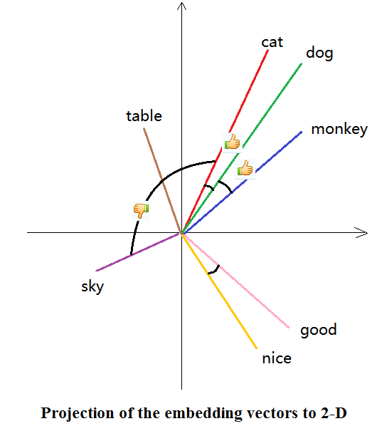
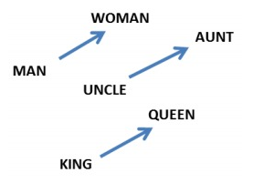
目 录
Background
Contents
How to express the word?
One-hot Representation
cat:[ 0 0 0 1 0 0 0 0 0 0 0 0 0 0 0 0 …]
dog:[ 0 0 0 0 0 0 0 0 0 0 0 0 0 0 0 1 …]
high dimension、sparse data
words gap
Word Embeddings/Distributed Representations
cat: (-0.065, -0.035, 0.019, -0.026, 0.085,…)
dog: (-0.019, -0.076, 0.044, 0.021,0.095,…)
Similar words are mapped to the similar direction.
Low dimension
unsupervised learning
polysemy
rare words
Word Analogies:
A-B=C-D; v(“king”) – v(“queen”) ≈ v(“man”) – v(“woman)”
Tool:
GloVe;word2vec
4

Slide 5
目 录
Problem & Solution
Contents
Uncovering thematic structures of SNS and blog posts is a crucial yet challenging task, because of the severe data sparsity induced by the short length of texts and diverse use of vocabulary.
This hinders effective topic inference of traditional LDA because it infers topics based on document-level co-occurrence of words.
we propose a latent concept topic model (LCTM) that infers topics based on document-level co-occurrence of references to the same concept.
5

Slide 6
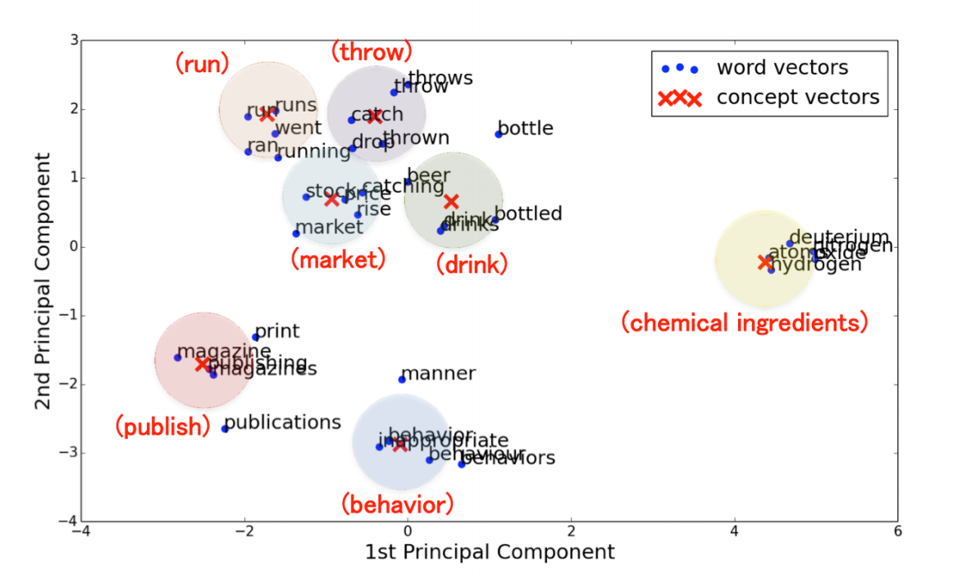
目 录
Problem & Solution
Contents
we introduce a new latent variable, termed a latent concept to capture conceptual similarity of words, and redefine each topic as a distribution over the latent concepts.
Each latent concept is then modeled as a localized Gaussian distribution over the embedding space.
Figure 1: Projected latent concepts on the word embedding space. Concept vectors are annotated with their representative concepts in parentheses.
6

Slide 7
目 录
Contributions
Contents
We propose LCTM that infers topics via document-level co-occurrence patterns of latent concepts, and derive a collapsed Gibbs sampler for approximate inference.
We show that LCTM can accurately represent short texts by outperforming conventional topic models in a clustering task.
LCTM achieves superior performance to other state-of-the-art topic models in handling documents with a high degree of OOV words.(OOV : out of vocabulary)
7

Slide 8
Contents
One
Two
Three
2、Related Work
Four
Five
8

Slide 9
目 录
Related Work
Contents
Gaussian LDA(Das et al., 2015) ,which models each topic as a Gaussian distribution over the word embedding space. However, the assumption that topics are unimodal in the embedding space is not appropriate.
Topic models proposed by Nguyen et al. (2015) or Petterson et al. (2010) cannot handle OOV words, because they assume fixed word types.
Latent concepts in LCTM are closely related to ‘constraints’ in interactive topic models (ITM) (Hu et al., 2014). The difference lies in their modeling assumptions.
Biterm Topic Model (BTM) (Yan et al., 2013) BTM directly models the generation of biterms (pairs of words) in the whole corpus. However, the assumption that pairs of cooccurring words should be assigned to the same topic might be too strong (Chen et al., 2015).
9

Slide 10
Contents
One
Two
Three
3、Latent Concept Topic Model
Four
Five
10

Slide 11
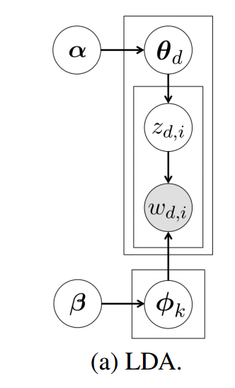
Symbol in LDA
: parameter for the Dirichlet prior in a document topic distribution;
: parameter for the Dirichlet prior in a topic concept distribution;
: word vector (the document);
: topic;
: a topic word distribution
: a document topic distribution;
: topic assignment;
LDA: document-topic-word
11

Slide 12
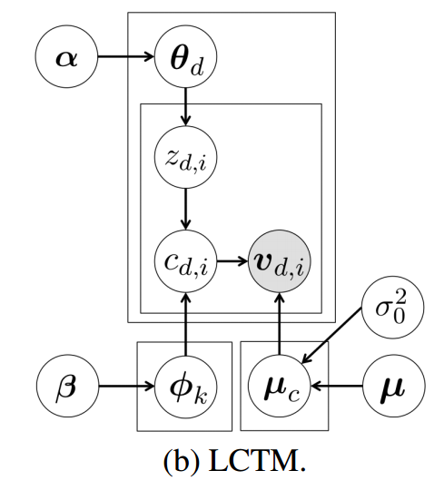
Symbol in LCTM
: parameter for the Dirichlet prior in a document topic distribution;
: parameter for the Dirichlet prior in a topic concept distribution;
: word vector;
: topic;
: a topic concept distribution;
: a concept vector;
: a document topic distribution;
: topic assignment;
: latent concept assignment;
LCTM: document-topic-concept-word
12

Slide 13
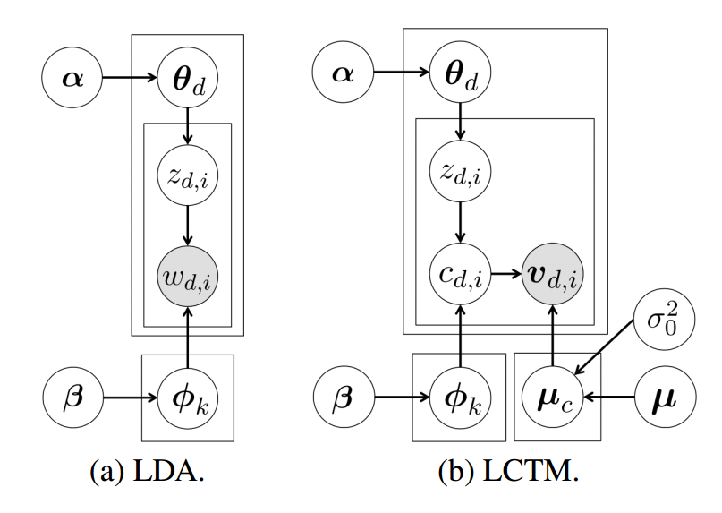
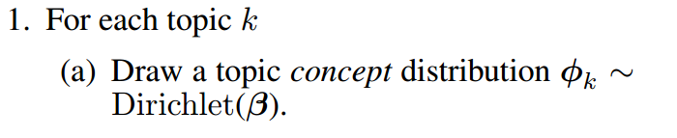
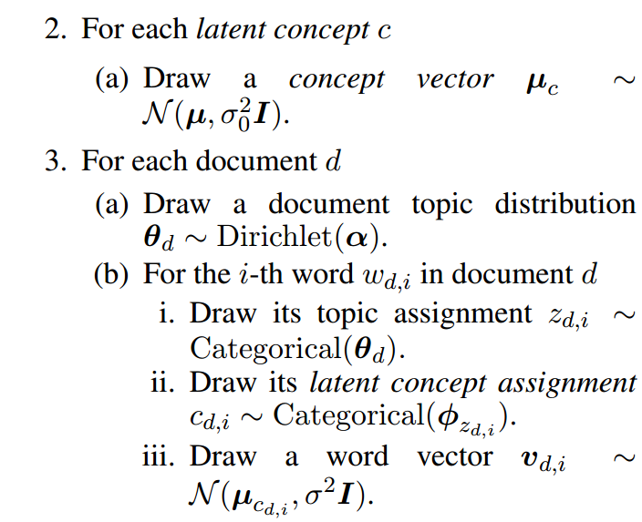
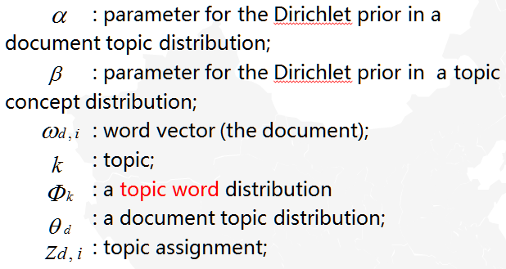
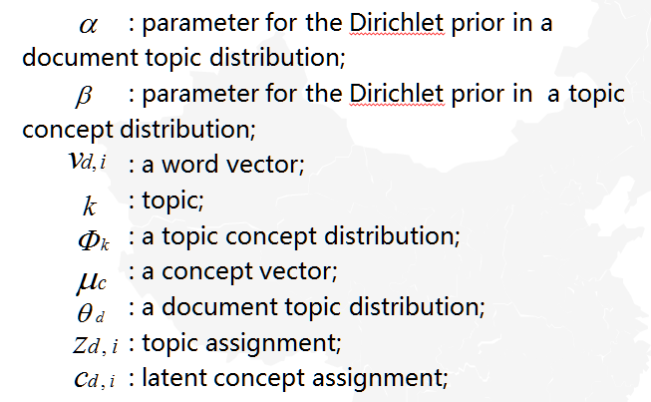
Generative Model
Figure 2: Graphical representation.
13

Slide 14
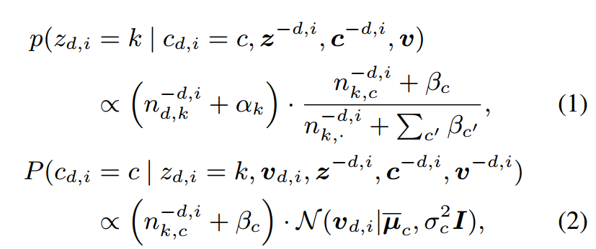
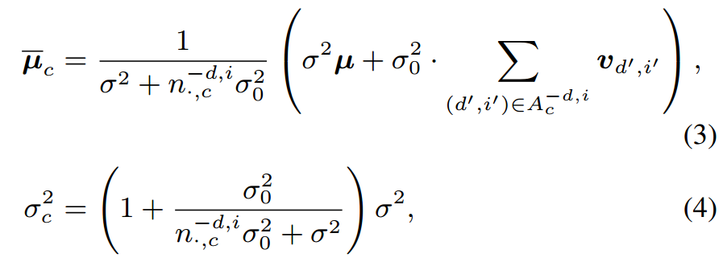








目 录
Posterior Inference
Contents
: the number of words assigned to topic k in document d;
: the number of words assigned to both topic k and latent concept c;
: the current assignments of and are ignored;
: summing over the index ;
: a multivariate Gaussian density function with mean µ and covariance
matrix ;
: are parameters associated with the latent concept c ;
14

Slide 15
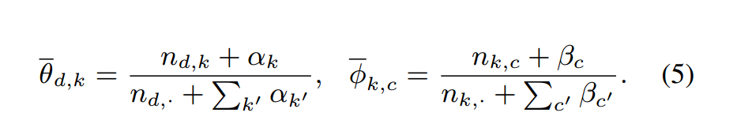
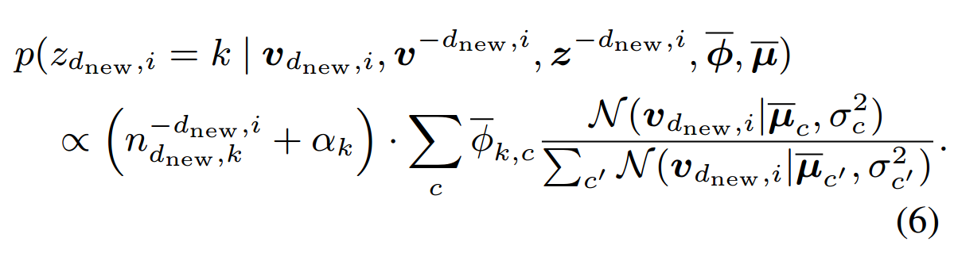

目 录
Prediction of Topic Proportions
Contents
The second term of Eq. (6) is a weighted average of with respect to latent concepts;
The topic assignment of a word is determined by its embedding, instead of its word type.
15

Slide 16
Contents
One
Two
Three
4、Experiments
Four
Five
16

Slide 17
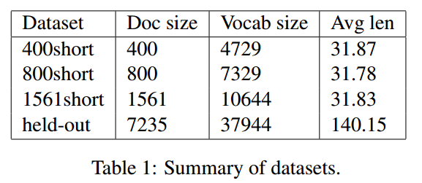
目 录
Datasets
Contents
20Newsgroups corpus: discussion posts about various news subjects authored by diverse readers;
Each document in the corpus is tagged with one of twenty newsgroups.
Only posts with less than 50 words are extracted for training datasets.
word embeddings : we used 50-dimensional GloVe1 that were pre-trained on Wikipedia.
17

Slide 18
目 录
Baselines
Contents
LFLDA (Nguyen et al., 2015), an extension of Latent Dirichlet Allocation that incorporates word embeddings information.
LFDMM (Nguyen et al., 2015), an extension of Dirichlet Multinomial Mixtures that incorporates word embeddings information.
nI-cLDA, non-interactive constrained Latent Dirichlet Allocatoin, a variant of ITM (Hu et al., 2014), where constraints are inferred by applying k-means to external word embeddings. Each resulting word cluster is then regarded as a constraint. See appendix B for the detail of the model.
GLDA (Das et al., 2015), Gaussian LDA.
BTM (Yan et al., 2013), Biterm Topic Model.
LDA (Blei et al., 2003).
18

Slide 19
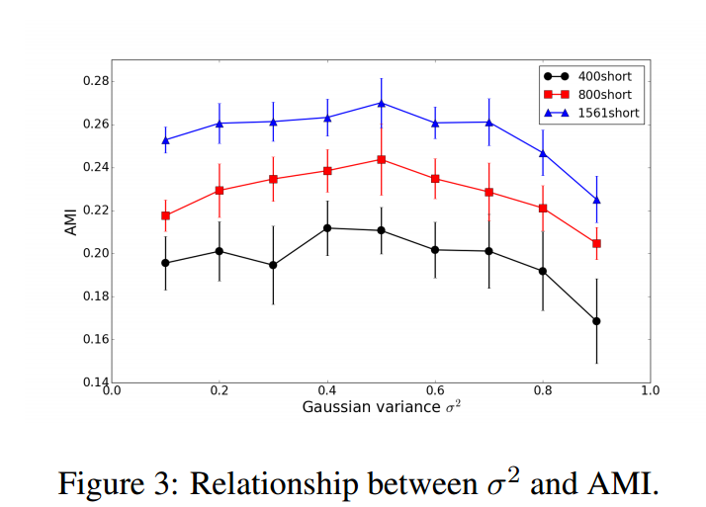

目 录
Document Clustering
Contents
Clustering performance is measured by Adjusted Mutual Information (AMI) (Manning et al., 2008). Higher AMI indicates better clustering performance.
We see that setting = 0.5 consistently obtains good clustering
performance for all the datasets with varying sizes. We therefore set = 0.5 in the later evaluation.
19

Slide 20
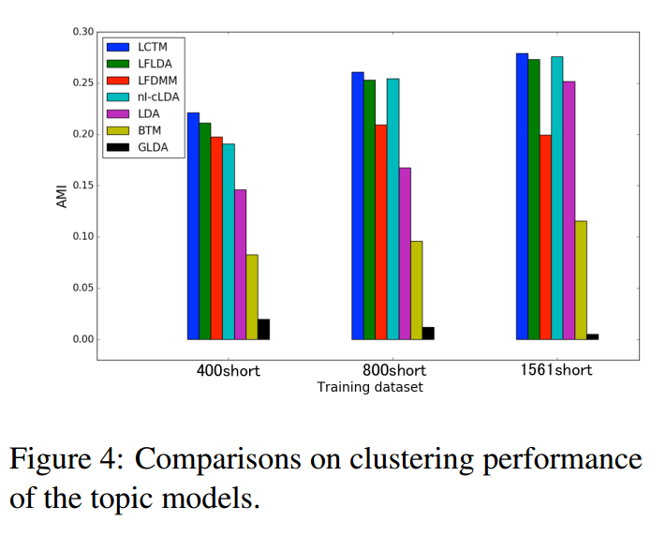
目 录
Document Clustering
Contents
We see that LCTM outperforms the topic models without word embeddings.
20

Slide 21
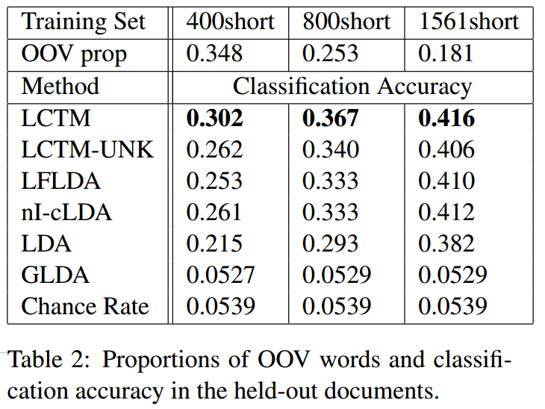
目 录
Representation of Held-out Documents with OOV words
Contents
We see that LCTM-UNK outperforms other topic models in almost every setting, demonstrating the superiority of our method, even when OOV words are ignored.
The results show that the level of improvement of LCTM over LCTM-UNK increases as the proportion of OOV becomes greater.
21

Slide 22
Contents
One
Two
Three
5、Conclusion
Four
Five
22

Slide 23
目 录
Conclusion
Contents
we have proposed LCTM that is well suited for application to short texts with diverse vocabulary.
LCTM infers topics according to document-level co-occurrence patterns of latent concepts, and thus is robust to diverse vocabulary usage and data sparsity in short texts.
We showed experimentally that LCTM can produce a superior representation of short documents, compared to conventional topic models.
LCTM can exploit OOV to improve the representation of unseen documents.
Introducing the latent concept for each word can be readily applied to other topic models that extend LDA.
23

Slide 24
THANKS!
Speaker: Yalan Yao
24

