Slide 1
AliCoCo: Alibaba E-commerce Cognitive Concept NetS
潘佳鑫

Slide 2
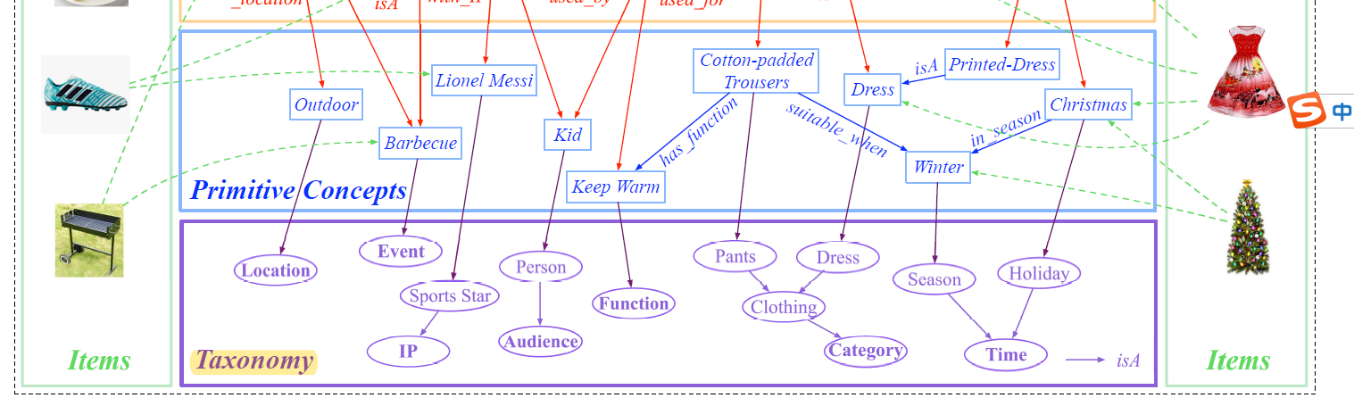
INTRODUCTION
Keyword based searching only works for those users who know the exact product they want to buy.
users do not always know the exact product.

Slide 3
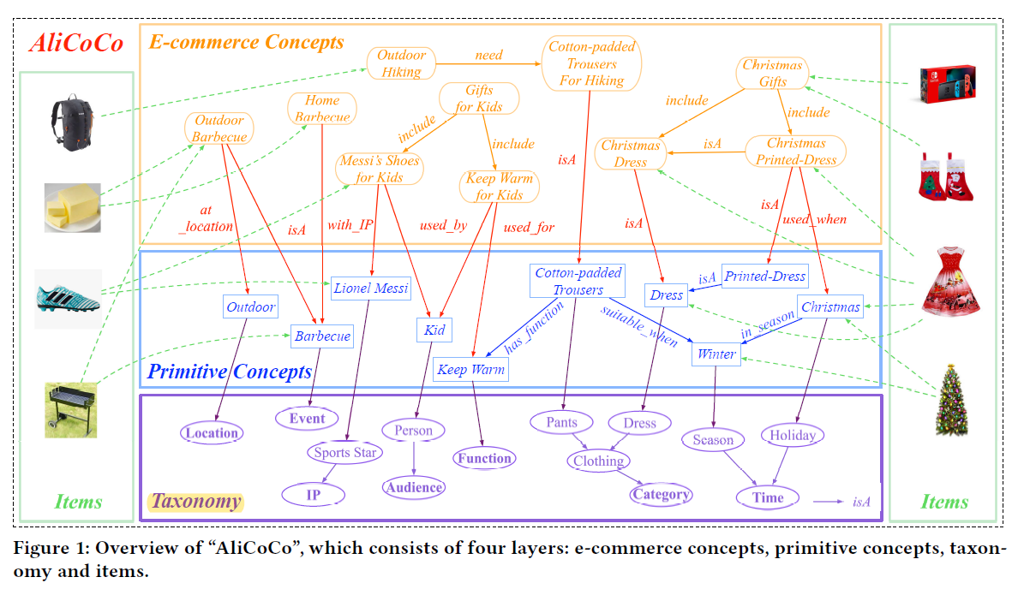
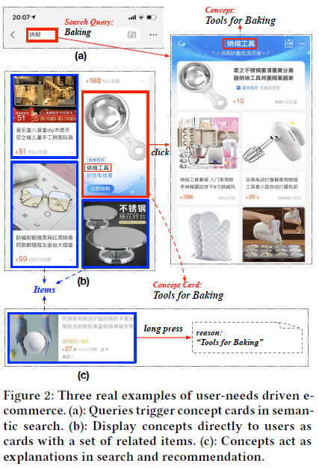
Bridging concepts connecting user and items to satisfy some high level user needs or shopping scenarios
Recommend things that can “keep warm for your kids” when a snowstorm will come next week
Conceptualizing user needs and are easy to understand

Slide 4
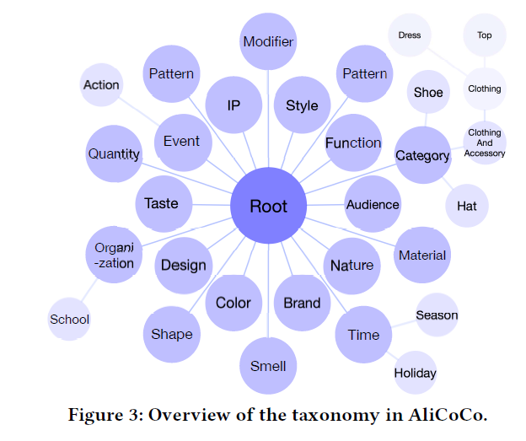
TAXONOMY
Domain Experts

Slide 5
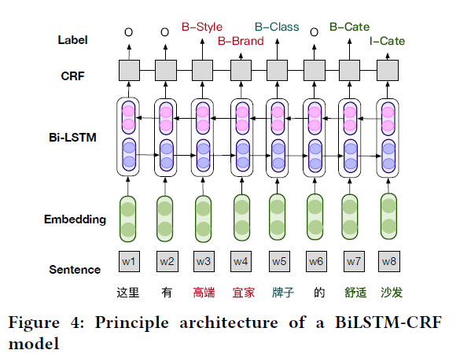
PRIMITIVE CONCEPTS
Vocabulary Mining
Ontology matching(rule-based, human efforts)
Mining new concepts from large-scale text corpus

Slide 6
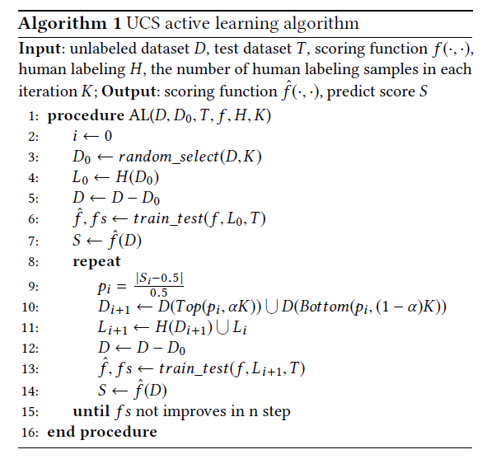
PRIMITIVE CONCEPTS
Hypernym Discovery
Pattern based (xx pants must be pants)
Projection learning
Active learning
The prediction score of a sample is close to 0.5
The model is likely to predict some difficult negative samples as positive with high confidence when encountering relations such as same_as or similar

Slide 7
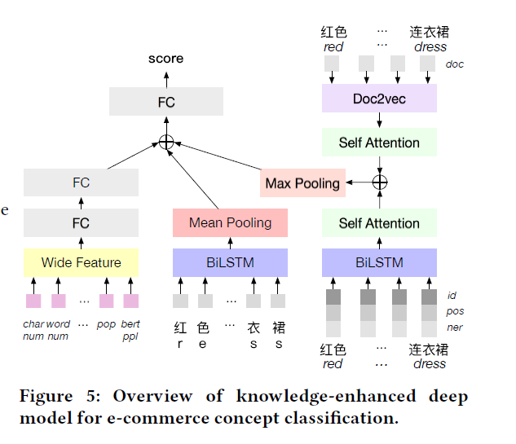
E-COMMERCE CONCEPTS
Generation
Candidate Generation
AutoPhrase
Generating new candidates using existing primitive concepts. For example, we combine “Location: Indoor” with “Event: Barbecue” to get a new concept “indoor barbecue”
Classification
Plausibility
Sexy baby dress

Slide 8
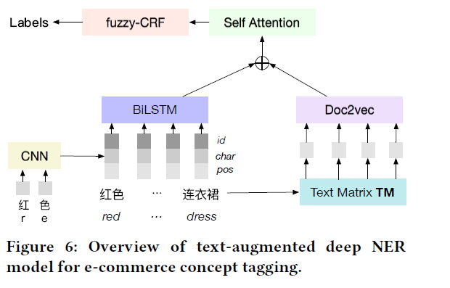
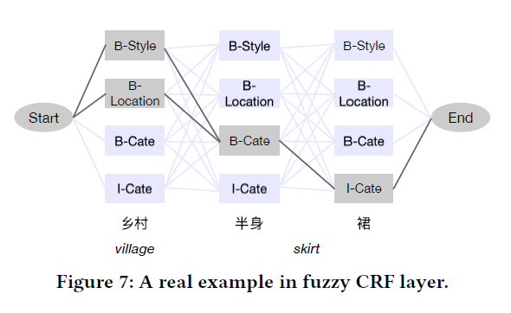
E-COMMERCE CONCEPTS
Understanding(link them to the layer of primitive concepts)
short text Named Entity Recognition (NER) problem
Fuzzy CRF: the valid class label of each word is not unique
Notes:
adjust the representations of each words by con
sidering
the augmented textual embeddings of surrounding
words

Slide 9
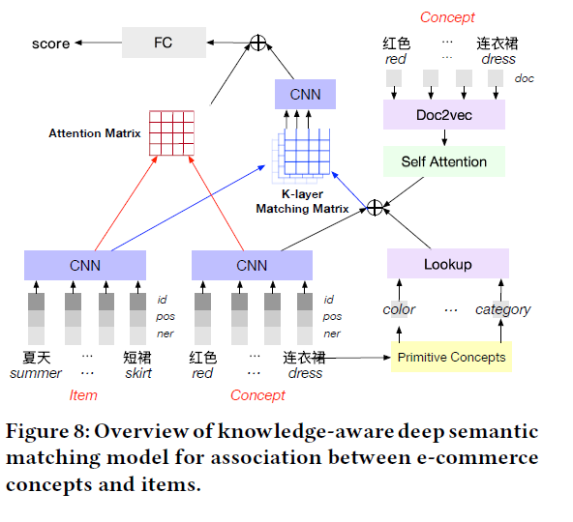
ITEM ASSOCIATION
The mapping between primitive concepts and items are relatively straightforward
E-commerce: Semantic Matching
“semantic drift”
Outdoor barbecue: charcoals
Notes:
For example, charcoals are necessary when we want to hold an “outdoor barbecue”, however, they have nothing to do with primitive concept “Location: Outdoor”.

Slide 10
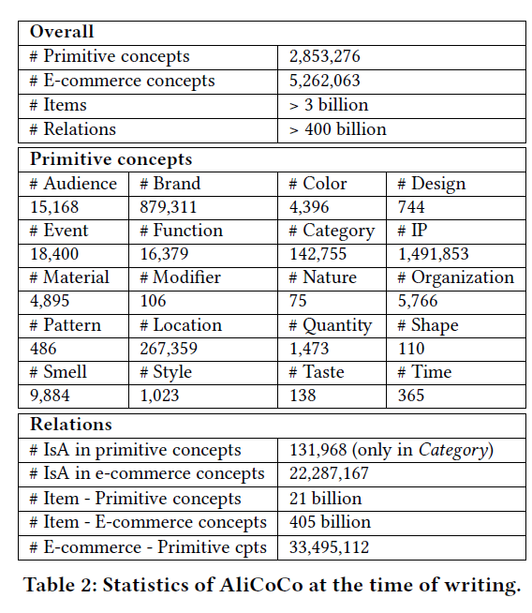
EVALUATIONS
AliCoCo covers over 75% of shopping needs on average in continuous 30 days, while this number is only 30% for the former ontology.
Concept-Item Semantic Matching
“中秋节礼物”
“老式大月饼共800g云南特产荞三香大荞饼荞酥散装多口味”
“中秋节自古便有赏月、吃月饼、赏桂花、饮桂花酒等习俗。
Notes:
Sample 2000 queries

Slide 11
APPLICATIONS
E-commerce Search
search for a “top→prior knowledge: “jacket is a kind of top”
former category taxonomy only has 15k different category words and 10k isA relations. AliCoCo contains 10 times categories words and isA relations.
“What should I prepare for hosting next week’s barbecue?”
E-commerce Recommendation
Cognitive recommendation
Recommendation reason

Slide 12
Future Work
Commonsense knowledge, for example, “boy’s T-shirts” implies the “Time” should be “Summer
Bring probabilities to relations between concepts and items.
Benefit more applications in e-commerce or even beyond e-commerce.

