Slide 1
Day 1: Introduction to Artificial Intelligence and Machine Learning
Jeffrey Risberg, Jennifer Cai
May 2018

Slide 2
Welcome!
Today we start our two-day workshop on AI and ML.
My name is Jeffrey Risberg
Over the past thirty years, I have led development organizations and teams providing analytic decision support technology in domains such as finance, online marketing, environment management, digital health, manufacturing management, and digital music. Many of these projects and products have integrated AI and machine learning technologies.
Since 2010, angel investor and technology advisor to multiple startups applying business analytics. Provide product and engineering execution skills, actively engaged in development efforts across web and mobile platforms. Working on all levels from strategy and leadership to hands-on coding in multiple development languages. Currently engineering leader at Aisera Inc., a Silicon Valley AI firm in stealth mode. Also a technology advisor and senior developer at QuanticMind, and investor and technology advisor at Levanto Financial, and advisor at Edhitch (an education tech provider in India). Former board member at JustGiving, former CEO and CTO/developer of Squirrel Legend Games, former hands-on technology advisor at RallyOn, former VP Engineering at RallyOn, and former CTO at Sustainable Silicon Valley.

Slide 3
Welcome!
Jennifer Cai
Extensive experience in machine learning, predictive analytics, and software development. Proficient across the entire pipeline from data wrangling, feature selection, model evaluation, API creation, up to data product.
Lead Data Scientist at Moxie from November 2015 to present.
Led study groups with Jeff Risberg on AI and Machine Learning concepts from 2013 to present

Slide 4
Outline
Today
What is AI?
Where is it being used?
What are the economic and social impacts?
How does a computer represent knowledge?
How does a computer reason with knowledge?
How do we handle uncertainty?
How do we reason with uncertain knowledge?
What is the role of a data scientist?

Slide 5
Welcome
Next Saturday
Machine Learning
Statistical approaches to data
Deep Learning
Frameworks and tools
Analyzing Images
Text Processing

Slide 6
Logistics
You should have a computer running Python
We are focused on:
Python version 3.5.2 or 3.6.5
Jupyter Notebook version 5.4.1
Using pip3 for installation of packages
This software can be installed freely
We will download courseware from GitHub

Slide 7
What is AI?
Back in the 1950s, the fathers of the field Minsky and McCarthy, described artificial intelligence as any task performed by a program or a machine that, if a human carried out the same activity, we would say the human had to apply intelligence to accomplish the task.
That obviously is a fairly broad definition, which is why you will sometimes see arguments over whether something is truly AI or not.
AI systems will typically demonstrate at least some of the following behaviors associated with human intelligence: planning, learning, reasoning, problem solving, knowledge representation, perception, motion, and manipulation and, to a lesser extent, social intelligence and creativity.

Slide 8
What are the Uses of AI?
AI is ubiquitous today, used to recommend what you should buy next online, to understand what you say to virtual assistants such as Amazon's Alexa and Apple's Siri, to recognize who and what is in a photo, to spot spam, or detect credit card fraud.
What are the different Types of AI?
At a very high level artificial intelligence can be split into two broad types: narrow AI and general AI.
Narrow AI is what we see all around us in computers today: intelligent systems that have been taught or learned how to carry out specific tasks without being explicitly programmed how to do so.
This type of machine intelligence is evident in the speech and language recognition of the Siri virtual assistant on the Apple iPhone, in the vision-recognition systems on self-driving cars, in the recommendation engines that suggest products you might like based on what you bought in the past. Unlike humans, these systems can only learn or be taught how to do specific tasks, which is why they are called narrow AI.

Slide 9
What can Narrow AI do?
There are a vast number of emerging applications for narrow AI: interpreting video feeds from drones carrying out visual inspections of infrastructure such as oil pipelines, organizing personal and business calendars, responding to simple customer-service queries, co-ordinating with other intelligent systems to carry out tasks like booking a hotel at a suitable time and location, helping radiologists to spot potential tumors in X-rays, flagging inappropriate content online, detecting wear and tear in elevators from data gathered by IoT devices, the list goes on and on.

Slide 10
What can General AI do?
Artificial general intelligence is very different, and is the type of adaptable intellect found in humans, a flexible form of intelligence capable of learning how to carry out vastly different tasks, anything from haircutting to building spreadsheets, or to reason about a wide variety of topics based on its accumulated experience.
This is the sort of AI more commonly seen in movies, the likes of HAL in 2001 or Skynet in The Terminator, but which doesn't exist today and AI experts are fiercely divided over how soon it will become a reality.

Slide 11
Andrew Ng’s Definition
Think of a task that requires a specialist and takes about 5-10 minutes to generate a solution/response.
This task will be replaced by AI
What are some examples?
AI is the “electricity” of our age

Slide 12
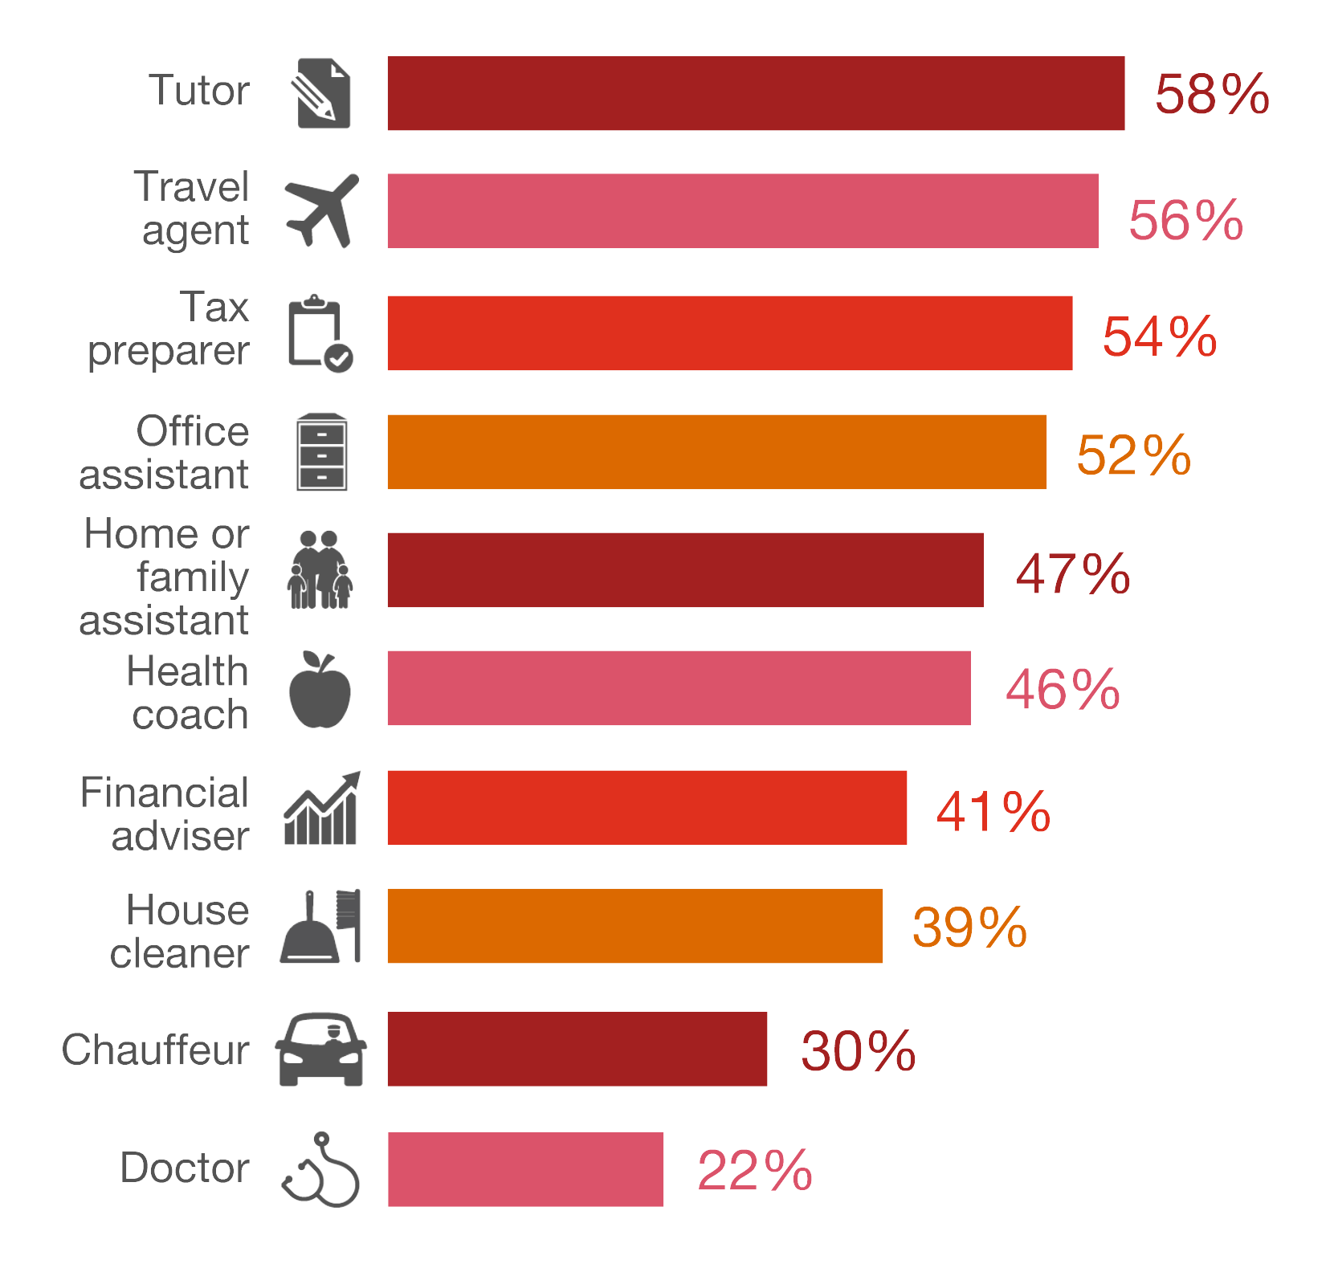
Likely to be replaced by AI

Slide 13
Is this good or bad?
Automation has been a factor in economic and social culture since the 1950’s.
Consider financial services: 40 years ago the banking and investment world was carried out by elitist, expensive broker/advisors.
Automation and info tech came in
Today the financial industry has 10x-20x the number of people employed, and opportunities exist at a far wider range of skill levels and financial levels.

Slide 14
Lets cover a few more definitions
WHAT IS MACHINE LEARNING?
There is a broad body of research in AI, much of which feeds into and complements each other.
Currently enjoying something of a resurgence, machine learning is where a computer system is fed large amounts of data, which it then uses to learn how to carry out a specific task, such as understanding speech or captioning a photograph.

Slide 15
More definitions
WHAT ARE NEURAL NETWORKS?
Key to the process of machine learning are neural networks. These are brain-inspired networks of interconnected layers of algorithms, called neurons, that feed data into each other, and which can be trained to carry out specific tasks by modifying the importance attributed to input data as it passes between the layers. During training of these neural networks, the weights attached to different inputs will continue to be varied until the output from the neural network is very close to what is desired, at which point the network will have 'learned' how to carry out a particular task.
A subset of machine learning is deep learning, where neural networks are expanded into sprawling networks with a huge number of layers that are trained using massive amounts of data. It is these deep neural networks that have fueled the current leap forward in the ability of computers to carry out tasks like speech recognition and computer vision.

Slide 16
More definitions
Another area of AI research is evolutionary computation, which borrows from Darwin's famous theory of natural selection, and sees genetic algorithms undergo random mutations and combinations between generations in an attempt to evolve the optimal solution to a given problem.
This approach has even been used to help design AI models, effectively using AI to help build AI. This use of evolutionary algorithms to optimize neural networks is called neuroevolution, and could have an important role to play in helping design efficient AI as the use of intelligent systems becomes more prevalent, particularly as demand for data scientists often outstrips supply. The technique was recently showcased by Uber AI Labs, which released papers on using genetic algorithms to train deep neural networks for reinforcement learning problems.

Slide 17
What is driving the resurgence in AI?
The biggest breakthroughs for AI research in recent years have been in the field of machine learning, in particular within the field of deep learning.
This has been driven in part by the easy availability of data, but even more so by an explosion in parallel computing power in recent years, during which time the use of GPU clusters to train machine-learning systems has become more prevalent.
Not only do these clusters offer vastly more powerful systems for training machine-learning models, but they are now widely available as cloud services over the internet. Over time the major tech firms, the likes of Google and Microsoft, have moved to using specialized chips tailored to both running, and more recently training, machine-learning models.
An example of one of these custom chips is Google's Tensor Processing Unit (TPU), the latest version of which accelerates the rate at which useful machine-learning models built using Google's TensorFlow software library can infer information from data, as well as the rate at which they can be trained.

Slide 18
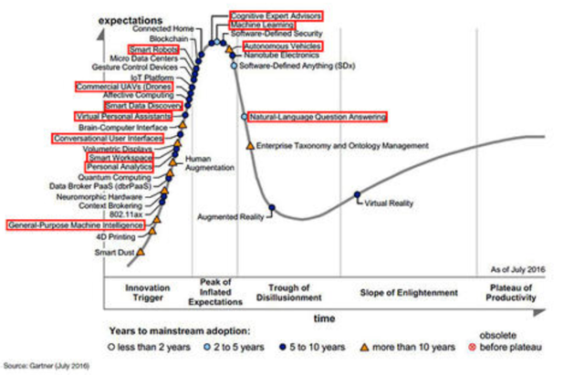
Is this Hype?

Slide 19
What should we do?
While AI won't replace all jobs, what seems to be certain is that AI will change the nature of work, with the only question being how rapidly and how profoundly automation will alter the workplace.
There is barely a field of human endeavor that AI doesn't have the potential to impact. As AI expert Andrew Ng puts it: "many people are doing routine, repetitive jobs. Unfortunately, technology is especially good at automating routine, repetitive work", saying he sees a "significant risk of technological unemployment over the next few decades".
The evidence of which jobs will be supplanted is starting to emerge. Amazon has just launched Amazon Go, a cashier-free supermarket in Seattle where customers just take items from the shelves and walk out. What this means for the more than three million people in the US who works as cashiers remains to be seen. Amazon again is leading the way in using robots to improve efficiency inside its warehouses. These robots carry shelves of products to human pickers who select items to be sent out. Amazon has more than 100,000 bots in its fulfillment centers, with plans to add many more. But Amazon also stresses that as the number of bots have grown, so has the number of human workers in these warehouses. However, Amazon and small robotics firms are working to automate the remaining manual jobs in the warehouse, so it's not a given that manual and robotic labor will continue to grow hand-in-hand.

Slide 20
What should we do?
Focus on areas where human skill and experience is critical, and can’t be distilled or packaged
Stay current!
Embrace new opportunities!
Douglas Engelbart, a U.S. computing pioneer, famously said in 1958: “Technology should not aim to replace the humans, rather amplify human capabilities.” Although AI was in its infancy in the 1950s, Engelbart predicted that this day would come. By educating yourself about AI today, you can help amplify your work abilities tomorrow, making yourself an irreplaceable asset to your organization.

