Slide 1
Convolutional Neural Networks
In machine learning, a convolutional neural network (CNN, or ConvNet) is a class of deep, feed-forward artificial neural networks that has successfully been applied to analyzing visual imagery.
CNNs use a variation of multilayer perceptrons designed to require minimal preprocessing.
They are also known as shift invariant or space invariant artificial neural networks (SIANN), based on their shared-weights architecture and translation invariance characteristics.

Slide 2
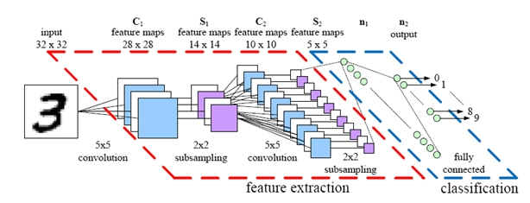
Convolutional Neural Networks

Slide 3
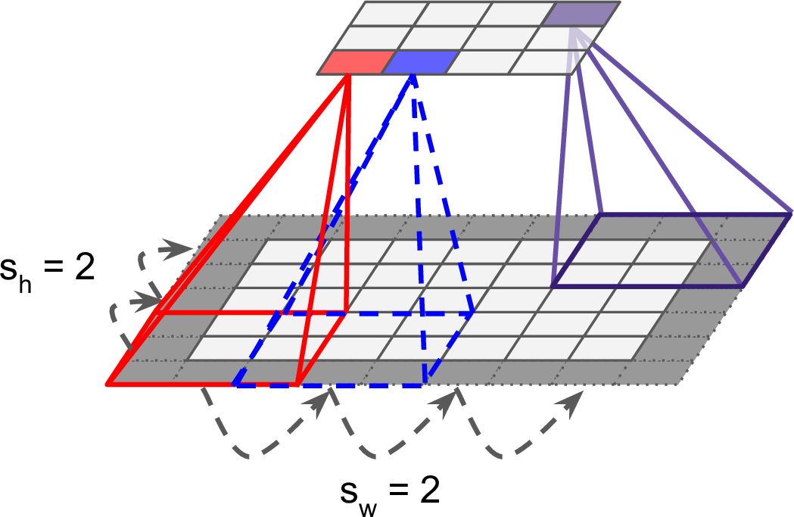
Convolution Layer

Slide 4
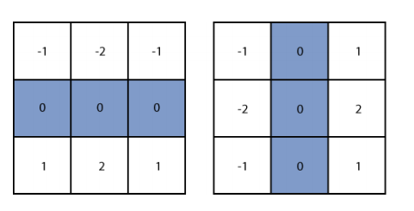
Weights to look for features
Horizontal Line
Vertical Line

Slide 5
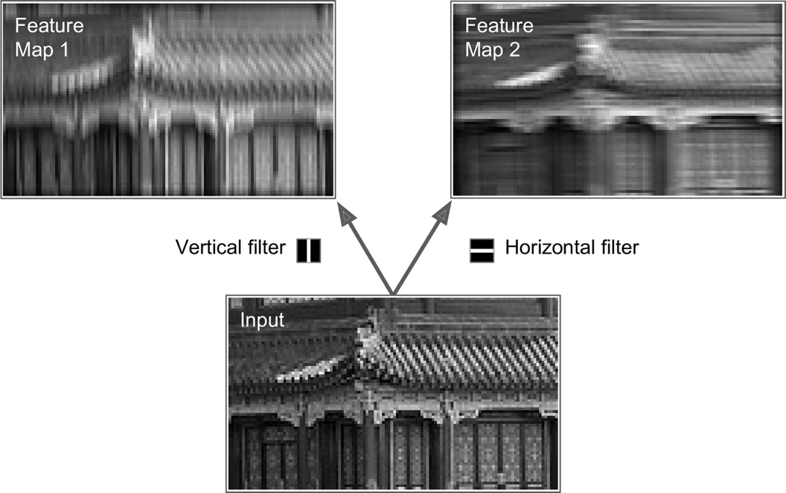
Applying these to images

Slide 6
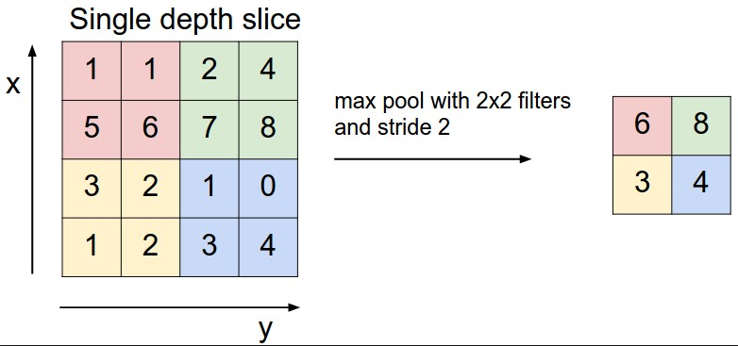
Pooling Layer

Slide 7
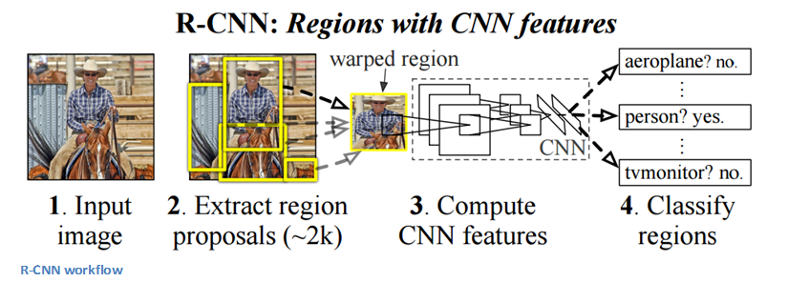
End to End view

Slide 8
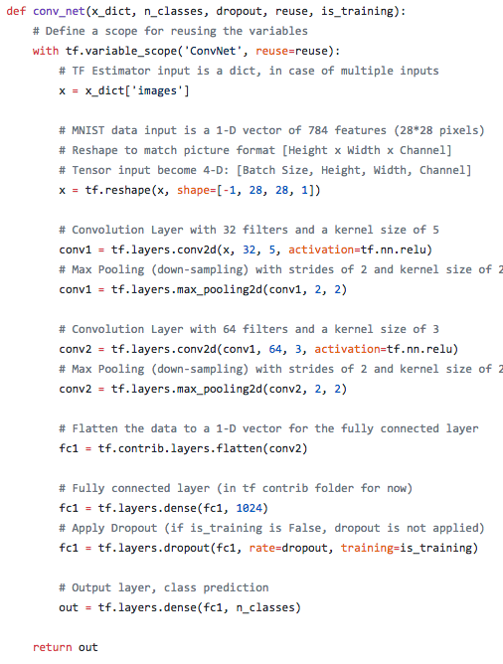
TensorFlow example

