Slide 1
Data Science and Data Engineering
Jennifer Cai

Slide 2
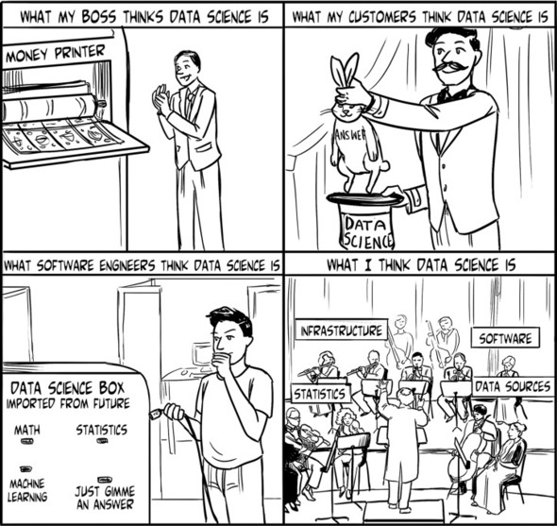

Slide 3
Data Science Defined
Data science is a "concept to unify statistics, data analysis, machine learning and their related methods" in order to "understand and analyze actual phenomena" with data.[3]

Slide 4
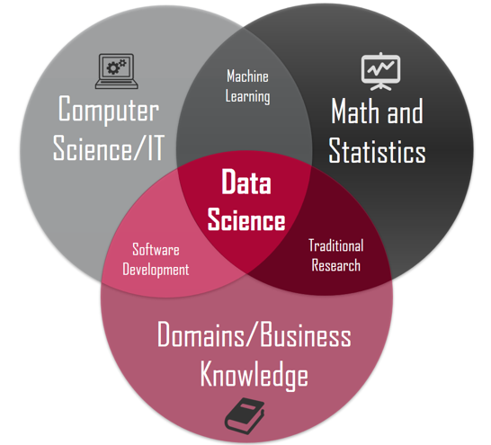
Data Science

Slide 5
Data Science Defined
When Harvard Business Review called it "The Sexiest Job of the 21st Century” the term became a buzzword, and is now often applied to business analytics, or even arbitrary use of data, or used as a hyped-up term for statistics.
While many university programs now offer a data science degree, there exists no consensus on a definition or curriculum contents. Because of the current popularity of this term, there are many "advocacy efforts" surrounding it.

Slide 6
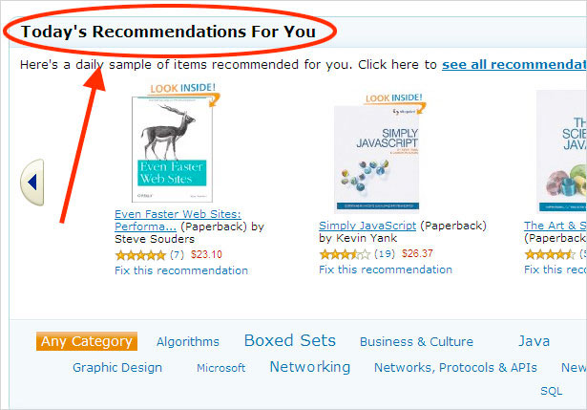
Data Science applications in business
Recommender Systems

Slide 7
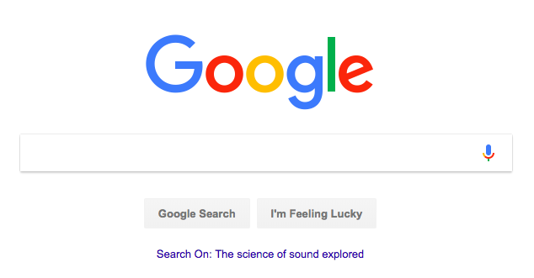
cont…Data Science applications in business
Internet Search

Slide 8
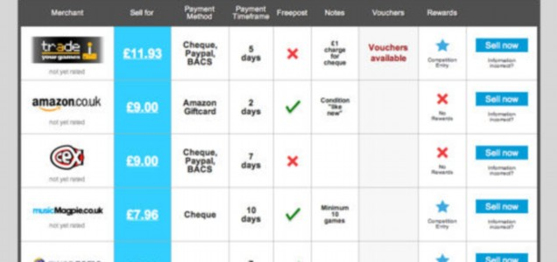
cont…Data Science applications in business
Price Comparison

Slide 9
Delivery Logistics

Slide 10
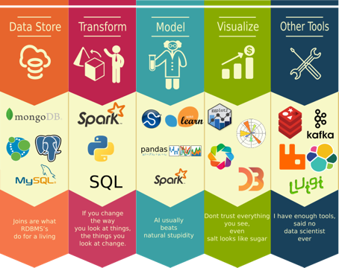
Tools

Slide 11
Data Engineering
Why is data engineering relevant?
1. in startups, you often do both data scientist work and data engineer work
2. good data collection and pipeline enable fast data science experimentations
3. more job opportunities

Slide 12


Slide 13


Slide 15
Data Sources
NoSQL and SQL
Moxie uses both. Data from e-commerce sites is stored in Cassandra. Regularly scheduled Spark jobs aggregate the data and write results to SQL tables. Front end code pulls data from SQL tables.

Slide 16
Common activities
If a product manager asks for new analytics, collaborate with full stack engineers to design SQL tables then create Spark jobs to transform data and write to SQL tables.
If we change schema for a new release, create Spark jobs to convert old schema data to new schema data.
Design Spark jobs to correct wrong data. For example, a newly released back-end software might have a bug causing double counting of transactions.

Slide 17
Store Raw Data
Record data in its original raw format, i.e. have an events table to record at what time what event happened. It's important to make events table immutable. This raw data contains rich information and can be transformed or aggregated to answer all the questions about the collected data.

