Slide 1
Error Measures Commonly Used
Mean Squared Error (MSE) is by far the most common measure of numerical model performance. It is simply the average of the squares of the differences between the predicted and actual values. It is a reasonably good measure of performance, though it could be argued that it overemphasizes the importance of larger errors. Many modeling procedures directly minimize the MSE.
Mean Absolute Error (MAE) is similar to the Mean Squared Error, but it uses absolute values instead of squaring. This measure is not as popular as MSE, though its meaning is more intuitive (the "average error").
Bias is the average of the differences between the predicted and actual values. With this measure, positive errors cancel out negative ones. Bias is intended to assess how much higher or lower predictions are, on average, than actual values.
Mean Absolute Percent Error (MAPE) is the average of the absolute errors, as a percentage of the actual values. This is a relative measure of error, which is useful when larger errors are more acceptable on larger actual values.

Slide 2
Which to use?
Mean Absolute Error (MAE) and Root mean squared error (RMSE) are two of the most common metrics used to measure accuracy for continuous variables. Not sure if I’m imagining it but I think there used to be a time when there were a lot more published MAE results. It seems that publications I come across now mostly use either RMSE or some version of R-squared.

Slide 3
It looks easy: what can go wrong
Overfitting
Overfitting is a modeling error which occurs when a function is too closely fit to a limited set of data points. Overfitting the model generally takes the form of making an overly complex model to explain idiosyncrasies in the data under study. In reality, the data often studied has some degree of error or random noise within it. Thus attempting to make the model conform too closely to slightly inaccurate data can infect the model with substantial errors and reduce its predictive power.

Slide 4
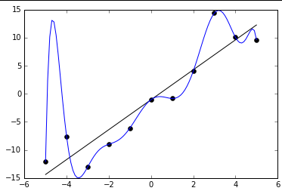
Example of Overfitting

Slide 5
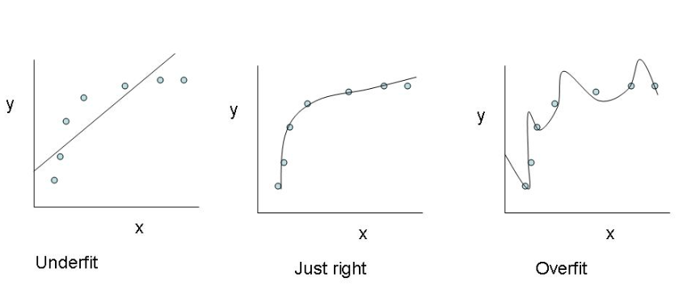
Under and Overfitting

Slide 6
Regularization
The cost function for this without regularization as mentioned in earlier posts
J(Ɵ) = 1/2m Σ(hƟ (xi – yi)2
Where the key is minimize the above function for the least error
The cost function with regularization becomes
J(Ɵ) = 1/2m Σ(hƟ (xi – yi)2 + λ Σ Ɵj2
As can be seen the regularization now adds a factor Ɵj2 as a part of the cost function which needs to be minimized.
Hence with the regularization factor the problem of underfitting/overfitting can be solved
However the trick is determine the value of λ. If λ is too big then it would result in underfitting or resulting in a high bias.
Similarly the regularized equation for logistic regression is as shown below
J(Ɵ) = |1/m Σ -y * log(hƟ (x)) – (1-y) * (log(1 – hƟ (x)) | + λ/2m Σ Ɵj2
Some tips suggested by Prof Andrew Ng while determining the parameters and features for regression
a) Get as many training examples. It is worth spending more effort in getting as many examples
b) Add additional features
c) Observe changes to the learning algorithm with different values of λ

Slide 7
Bias-Variance Trade-off
https://elitedatascience.com/bias-variance-tradeoff

