Slide 1
Artificial Neural Networks
The idea of ANNs is based on the belief that working of human brain by making the right connections, can be imitated using silicon and wires as living neurons and dendrites.
The human brain is composed of 86 billion nerve cells called neurons. They are connected to other thousand cells by Axons. Stimuli from external environment or inputs from sensory organs are accepted by dendrites. These inputs create electric impulses, which quickly travel through the neural network. A neuron can then send the message to other neuron to handle the issue or does not send it forward.

Slide 2
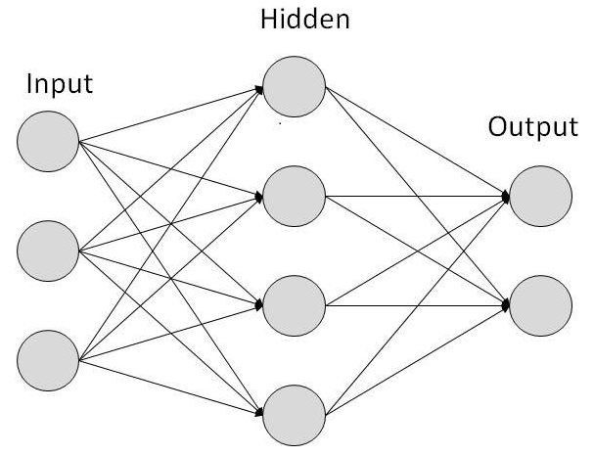
ANN Structure

Slide 3

Math in the Neural Network
Each node has a value which is sum of products of weights times inputs
There may be huge numbers of nodes
There may be several layers of nodes
But as Andrew Ng says, it is really just
But for a gazillion nodes!

Slide 4
How do we train the ANN?
Define a cost function (this is supervised learning)
Seek to minimize it using Gradient Descent
Use an algorithm called “Backpropagation” to run the minimization algorithm from the outputs back to the inputs.

Slide 5
Why is this Hot Today?
We now have enough data and enough CPU compute power to run these calculations
You might need a million records, and you might use hours of iterations for training
The surprise is how broadly this concept can be applied

Slide 6
Applications of Neural Nets
system identification and control (vehicle control, trajectory prediction, process control)
game-playing and decision making (backgammon, chess, poker),
pattern recognition (radar systems, face identification, signal classification, object recognition and more),
sequence recognition (gesture, speech, handwritten and printed text recognition),
medical diagnosis,
natural resource management,
finance (e.g. automated trading systems),
data mining,
visualization,
machine translation,
social network filtering,
e-mail spam filtering.

