Slide 1
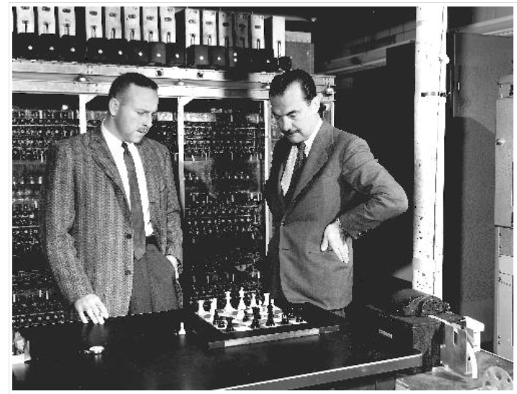
Conclusion
We have covered many topics, from search to a multi-layer neural network
We have covered a 50-60 year span
We’ve taken full advantage of the million times improvement in computer power over that span!
Early computer chess program – note the 6x6 board!

Slide 2
Conclusion
We have described AI in “non-magical” terms
Described that much is math and statistics
Much AI is brute-force search
But heuristics can capture human intuition
We emphasized the broad applicability of these approaches
We’ve discussed how tools and libraries now exist for using AI/ML concepts in software development

Slide 3
Staying Current
Book publishers
O’Reilly
Manning
Online books
Safari books
Two primary books for this course
Russell/Norvig: “AI: a modern approach”
Geron: “Hands-On ML with Scikit-Learn and TensorFlow”

Slide 4
Online courseware
This course is based strongly on the free AI course at Udacity (CS271), by Peter Norvig and Sebastian Thrum. That was created back in 2010, and had over 150,000 students.
Sign up at https://classroom.udacity.com/courses/cs271
Related Courseware
Udacity now offers a number of current AI classes, which include:
https://www.udacity.com/course/ai-artificial-intelligence-nanodegree--nd898
This is their primary nanodegree program. It is one three-month term for $799, discounted to $599.
https://www.udacity.com/course/ai-programming-python-nanodegree--nd089
This is a supplementary nanodegree program. It is two months for $399.
https://www.udacity.com/course/deep-learning-nanodegree--nd101
This is their deep learning nanodegree program. It is several months, for $599.

Slide 5
Online courseware
Coursera has more individual courses, often by outside presenters
https://www.coursera.org/learn/machine-learning
This was 11 weeks, free, or at $49/month if you want a certificate. Taught by Andrew Ng (Stanford)
https://www.coursera.org/specializations/deep-learning
This was 4 months, at $49/month with a certificate. Course was created in 2017. Taught by Andrew Ng (Stanford)
https://www.coursera.org/specializations/probabilistic-graphical-models
This was 3 months, at $49/month with a certificate. Course was created in 2011. Taught by Daphne Koller (Stanford)

Slide 6
Online courseware
edX has a
https://www.edx.org/course/artificial-intelligence-ai-columbiax-csmm-101x-4
This is a great intro course. It is 12 weeks long. Free or you can get a verified certificate for $199.
"A fantastic survey of AI approaches, methods and state-of-the-art. Intelligence, agents, searches, games, constraint-satisfaction problems, and different kinds of machine learning. Developed skills in Python and data structures.”
https://www.edx.org/course/introduction-to-artificial-intelligence-ai
This is provided by Microsoft, and is 4 weeks long. Free or you can get a verified certificate for $99.
“Build simple machine learning models with Azure Machine Learning; Use Python and Microsoft cognitive services to work with text, speech, images, and video; Use the Microsoft Bot Framework to implement conversational bots.”
Udemy has a few courses
https://www.udemy.com/artificial-intelligence-az/
This is a bit more informal, and doesn’t have the support forum, quiz structure, or instructor feedback that Udacity, Coursera, etc. have. But the courses are much lower cost, at $12 to $100.

Slide 7

Thank you
We hope you have enjoyed this workshop!

