Slide 1
Day 2: Introduction to Artificial Intelligence and Machine Learning
Jeffrey Risberg, Jennifer Cai
May 2018

Slide 2
Summary of Last Week
We discussed the Definition and History of AI
AI is about using computers to process knowledge, facts, rules, and uncertainty
Much of AI “reasoning” is about search
Search combines exhaustive evaluation plus heuristics
Jupyter Notebooks are a way to capture and present code, data, and textual markup

Slide 3

Summary of Last Week
A-star search performed 4x better than breadth-first
The world of logic and objects used expressions such as:
With rules like these, we could classify animals
To deal with uncertain information, we draw from probability and statistics

Slide 4
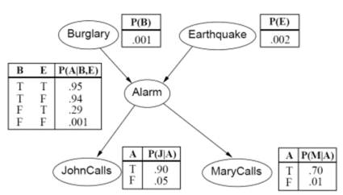
Summary of Last Week
Belief nets (Bayesian nets) show uncertain implication
Evidence flows down and up these links, following Bayes Rule for generator posterior probability from prior plus evidence

Slide 5
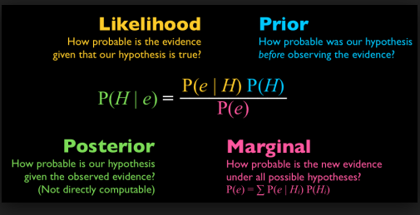
Bayes Rule

Slide 6
Data Science and Data Engineering
Data Science deals with algorithms and models, to learn from information and derive new information
Data Engineering deals with how to gather, cleanse, store, and query large data sets.
We discussed (software) tools used for these functions
Python is a common-used language because it is compact and extensible
We can load libraries of support functions (e.g., numpy)

Slide 7
Machine Learning
Definition:
Machine learning is a field of computer science that often uses statistical techniques to give computer systems the ability to "learn" (e.g., progressively improve performance on a specific task) with data, without being explicitly programmed.

Slide 8
Example
Consider the problem deciding when to issue a mortgage/loan
The person may default on the loan
Can we predict this?
Do we have a record of other loans, and the result of them?
Yes, we have a spreadsheet of 1000 loans, along with a flag indicating if they were defaulted
Also, information about the borrower:
Number of years employed
Debt/income ratio
Number of years at same address
Prior defaults
Renter or homeowner

Slide 9
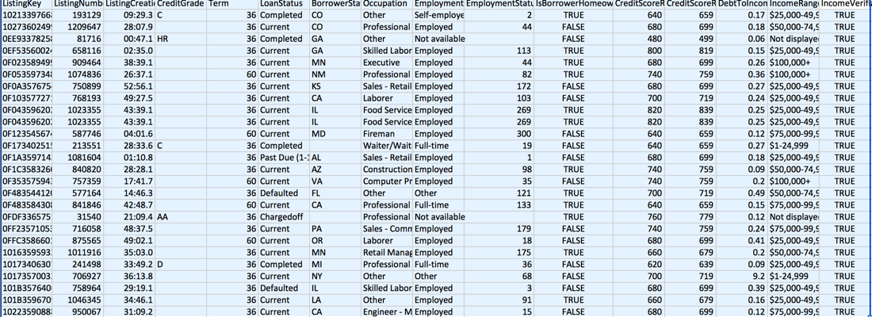
Data Set

Slide 10
Prediction model
Simple: if homeowner, loan will be good
Better: if homeowner and employed, loan will be good
Better: P(good) = 0.3 * (1 if homeowner) +0 .7 * (1 if employed)
In general, the computed probability that a loan will be good is:
P(good) = theta1* feature1 + theta2* feature2 + theta3* feature3 + …
We need to select the most useful features, and we need to find the best values of the thetas using the training data set.

Slide 11
How to determine the alpha’s
Suppose you start with [theta1=0.3, theta2=0.7]
Now you could loop through the given data set, and determine how many predictions were incorrect.
We call this the “cost” or “loss”
We can also calculate the first derivative of cost w.r.t. theta1 and also theta2
Since we are minimizing the cost, take a step backwards in the direction of the derivative.

Slide 12
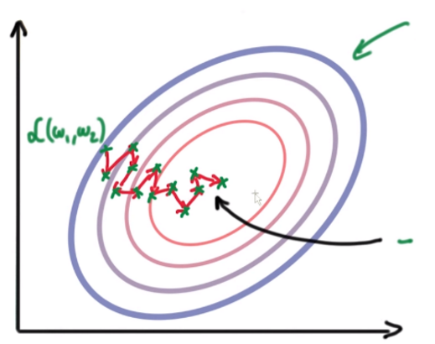
Taking Iterative Steps

Slide 13
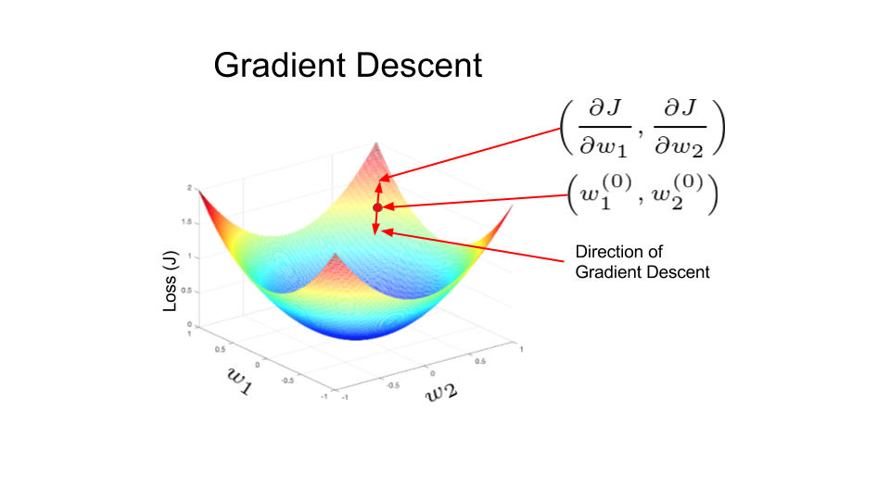
Taking iterative steps

Slide 14
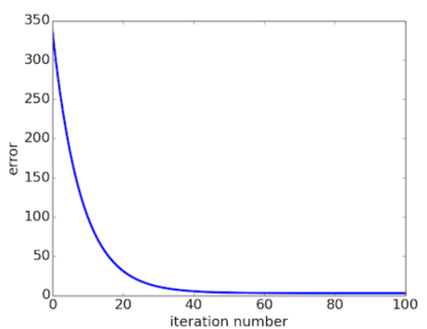
The cost (error) will be reduced for each iteration

Slide 15
This is called Multiple Regression
Extending from 2 thetas to several thetas. Call them “weights”.
Step 1: Initialize the weights(a & b) with random values and calculate Error (SSE)
Step 2: Calculate the gradient i.e. change in SSE when the weights (a & b) are changed by a very small value from their original randomly initialized value. This helps us move the values of a & b in the direction in which SSE is minimized.
Step 3: Adjust the weights with the gradients to reach the optimal values where SSE is minimized
Step 4: Use the new weights for prediction and to calculate the new SSE
Step 5: Repeat steps 2 and 3 till further adjustments to weights doesn’t significantly reduce the Error

Slide 16
Result
P(good) =
0.18 * debt/equityRatio +
0.06 * isHomeOwner +
0.04 * employmentStatus +
0.028 * employmentDuration ...
This model shows the most important features. We will find via training thetas for all 60+ features, but we will keep only those with the high coefficients.

Slide 17
Now we have “learned” a model
Save the weights – it took many iterations to derive them
But using them to predict is just a set of multiplies and adds.
Did we write if/then rules? No, and we didn’t have to interview loan officers, bank managers, etc.
To implement, we just need to decide what the required P(good) is for the loan to be issued.

Slide 18
Variants on Regression/Training
Different rules for stopping iterations
Fixed number, fixed cost, lack of change in cost from iteration to iteration
Different approaches to organize iterations
Stochastic gradient descent – work with a randomly chosen subset of data.
Transformations applied to the data
Normalization or regularization

