Slide 1
Knowledge Representation
Take the below question for example, try to infer what day it is:
If I have an AI lecture today, then it is Monday or Wednesday
It is not Monday
I have an AI lecture today or I have no class today
If I have no class today then I am sad
I am not sad

Slide 2
Knowledge Representation and Reasoning
Did you manage to work out the day? It’s Wednesday. You took multiple sources of information and combined them to reason that it was Wednesday. That was great, but how would a machine do that?
This is where KR&R comes in

Slide 3
Building knowledge-based agents
Declarative approach to building knowledge based agents
The declarative way to build a knowledge based agent is to provide the agent with two things:
A knowledge base which contains facts (assertions, propositions) and general knowledge about a domain in a formal language
A reasoning engine that produces relevant consequences of the knowledge base.
In other words, the agent needs a knowledge base which is a set of facts (Liverpool is in Merseyside, Merseyside is in the UK) and it needs a means to reason and produce relevant consequences of these facts (therefore Liverpool is in the UK).

Slide 4
“Reasoning” is often search
In the earlier example, we could search over the known days of the week
Consider each one a hypothesis
For each day, we could evaluate the conditions, and see if they are all true
If not move on to the next day.
The result is the list of valid hypotheses

Slide 5

What is the search space?
In the above example, it is “discrete” – there are only 7 days in the week
For other problems, it might be “continuous” – for instance consider all possible prices you might charge for selling your action figures on eBay:
So we might partition the continuous space:
$0 to $10 is too low
$10 to $45 is low
$45 to $90 is reasonable
$90 to $1000 is too high

Slide 6
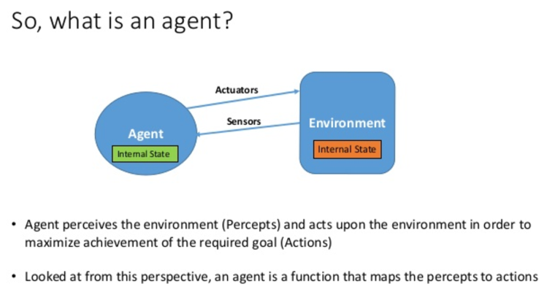

Slide 7
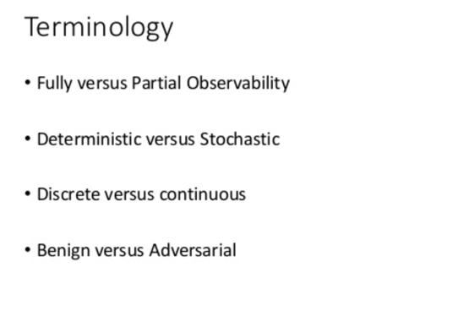

Slide 8
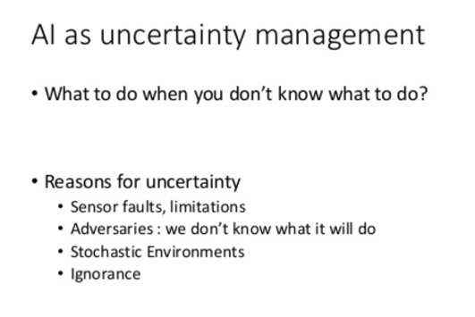

Slide 9
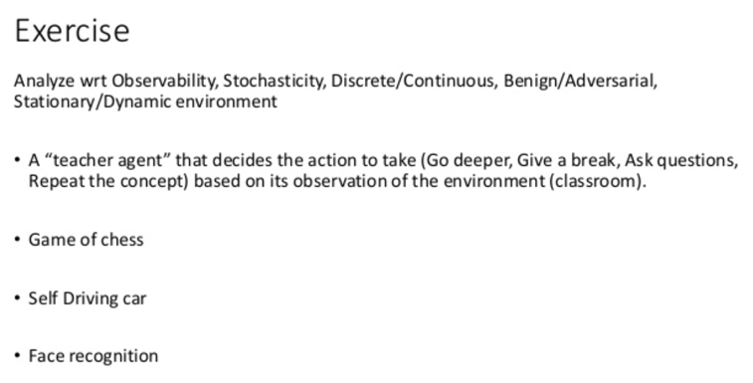

Slide 10
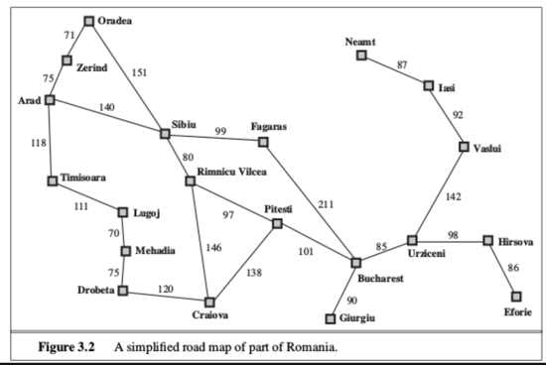
Searching over hypotheses/states

Slide 11
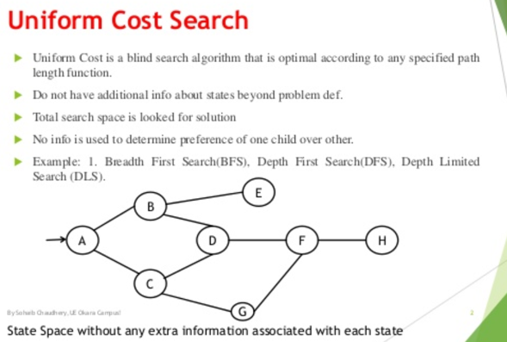

Slide 13
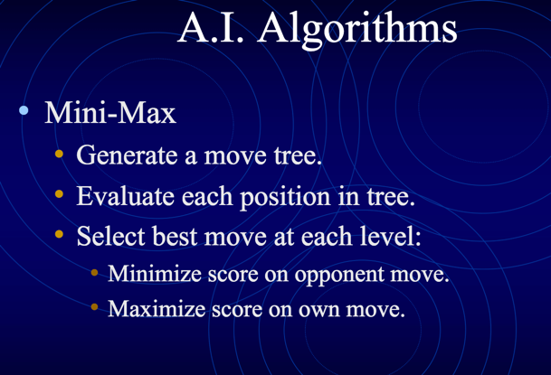

Slide 14
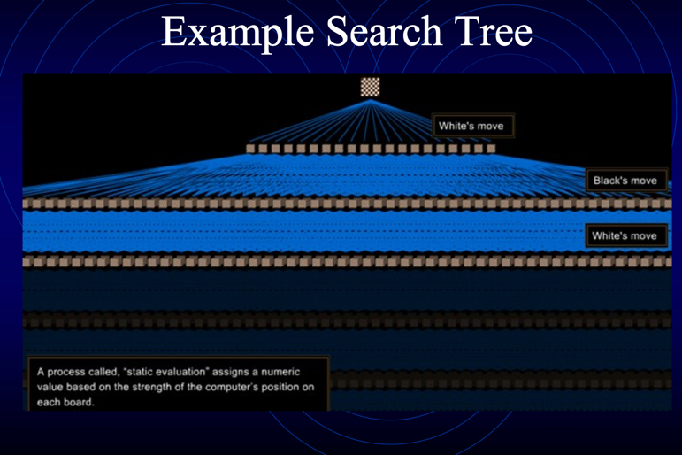

Slide 15
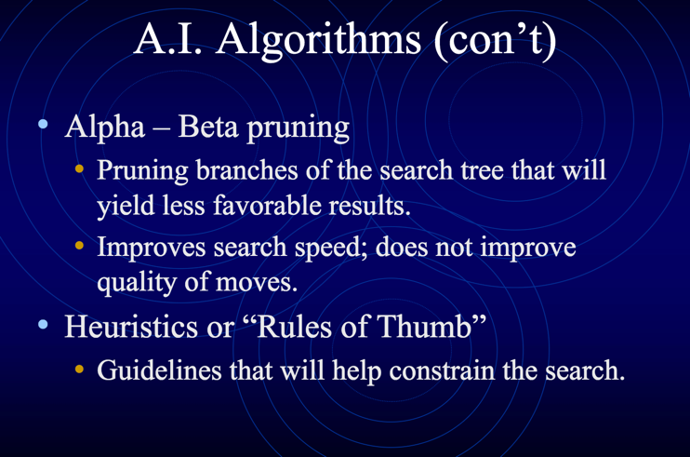

Slide 16
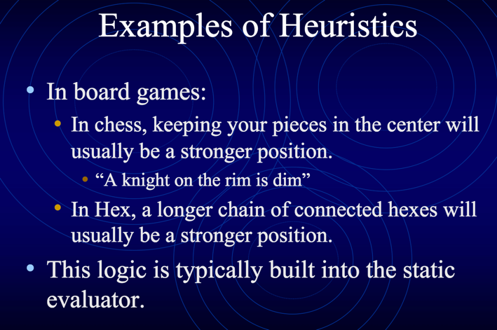

Slide 17
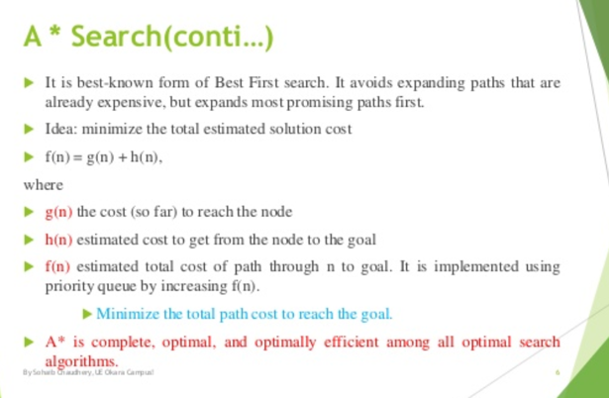

Slide 18
Conclusions
We can consider many AI problems as state-space search
The state could be discrete or continious
AI algorithms are a combination of brute force evaluation, and heuristic pruning.
Because many problems have thousands of paths, even the fastest computers requiring path pruning
Search could be depth-first, breath-first, or a combination
A-Star is the best-known combination of efficient search.

