Slide 1
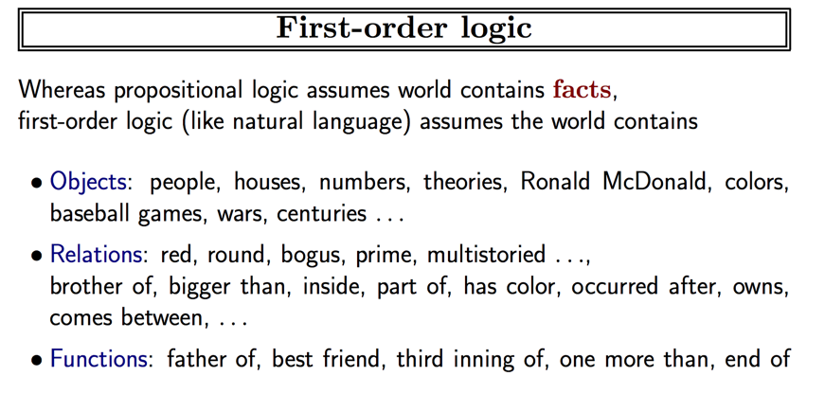
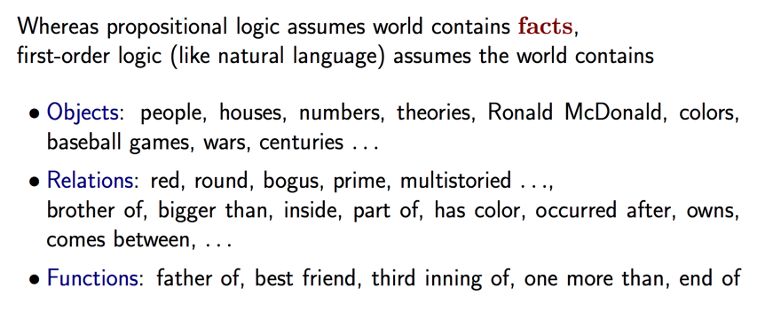
First Order Logic

Slide 2
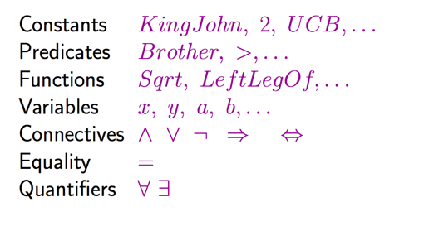
Syntax of First Order Logic

Slide 3
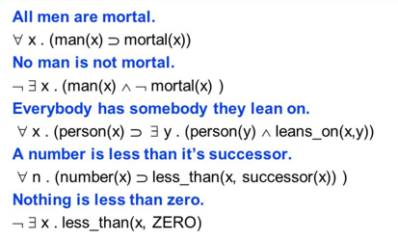
Examples

Slide 4
Why is this used in AI?
Allows us to reason
Derive new facts from existing facts
Check existence of facts
Adjust state of knowledge for new or retracted facts
Operates efficiently
There are well-known algorithms for updating state of knowledge.
Forward chaining
Backward chaining

