Slide 1
Uncertainty
Basic definitions about probabilities
Statistics
Bayes’ Rule
Belief Nets

Slide 2
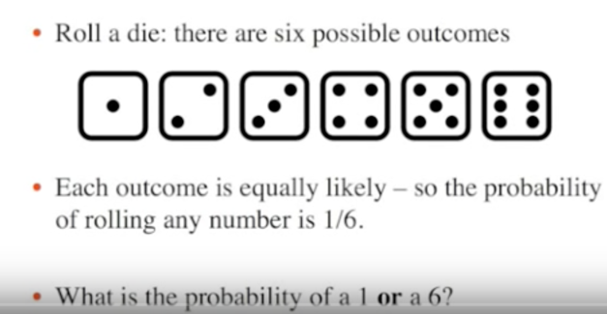
Basic Concepts

Slide 3
Independent Events
Independent Events
Events can be "Independent", meaning each event is not affected by any other events.
head tails coin
Example: Tossing a coin.
Each toss of a coin is a perfect isolated thing.
What it did in the past will not affect the current toss.
The chance is simply 1-in-2, or 50%, just like ANY toss of the coin.
So each toss is an Independent Event.

Slide 4
Conditional Probablity
We love notation in mathematics! It means we can then use the power of algebra to play around with the ideas. So here is the notation for probability:
P(A) means "Probability Of Event A"
In our marbles example Event A is "get a Blue Marble first" with a probability of 2/5:
P(A) = 2/5
And Event B is "get a Blue Marble second" ... but for that we have 2 choices:
If we got a Blue Marble first the chance is now 1/4
If we got a Red Marble first the chance is now 2/4
So we have to say which one we want, and use the symbol "|" to mean "given":
P(B|A) means "Event B given Event A"
In other words, event A has already happened, now what is the chance of event B?
P(B|A) is also called the "Conditional Probability" of B given A.

Slide 5
Statistics
noun
1.
(used with a singular verb) the science that deals with the collection, classification, analysis, and interpretation of numerical facts or data, and that, by use of mathematical theories of probability, imposes order and regularity on aggregates of more or less disparate elements.
2.
(used with a plural verb) the numerical facts or data themselves.

Slide 6
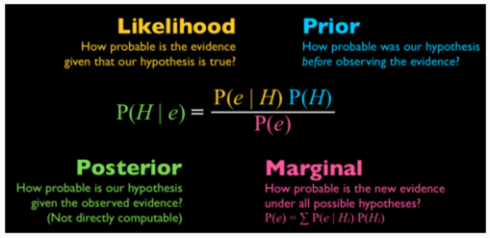
Bayes’ Rule

Slide 7
Reasoning Networks
https://www.youtube.com/watch?v=5s7XdGacztw

Slide 8
