Slide 1
Other Machine Learning Models
Logistic Regression
Support Vector Machines
Decision Trees

Slide 2
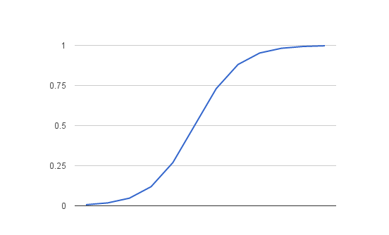
Logistic Regression
Logistic regression is named for the function used at the core of the method, the logistic function.
The logistic function, also called the sigmoid function was developed by statisticians to describe properties of population growth in ecology, rising quickly and maxing out at the carrying capacity of the environment. It’s an S-shaped curve that can take any real-valued number and map it into a value between 0 and 1, but never exactly at those limits.
1 / (1 + e^-value)

Slide 3
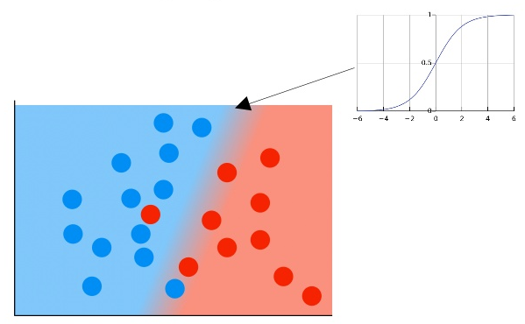
Logistic Regression for Classification

Slide 4
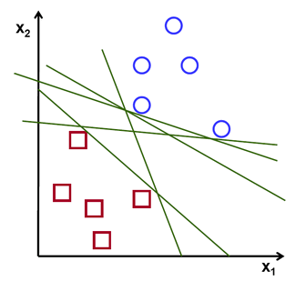
Support Vector Machines

Slide 5
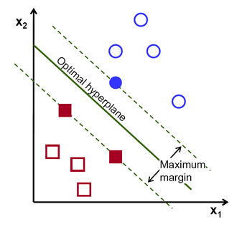
Support Vector Machines

Slide 6
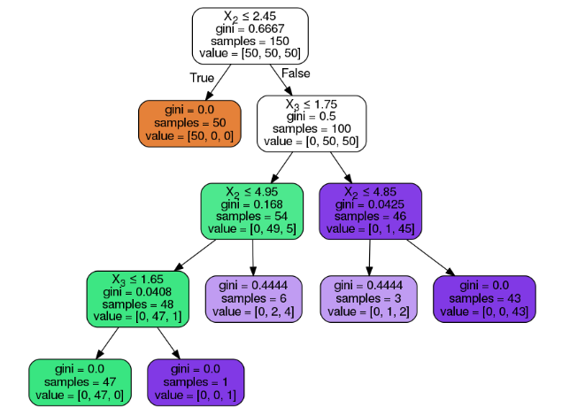
Decision Trees

Slide 7
Supervised and Unsupervised Learning
Supervised is training from labeled samples
For example, the loan data
Unsupervised is training from unlabeled samples
For example, clustering

Slide 8
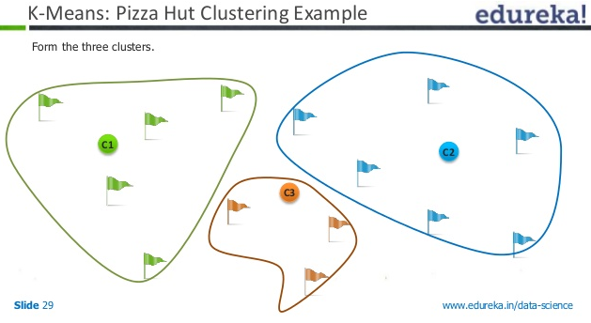
Clustering Example

Slide 9
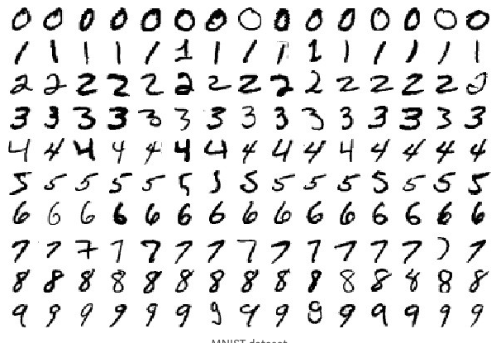
Classification Example
We will use MNIST handwritten digits dataset

Slide 10
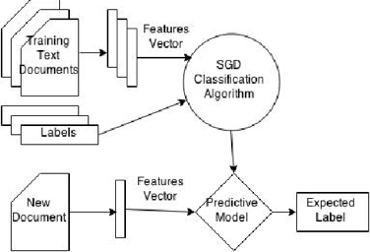
Simple classifier

Slide 11
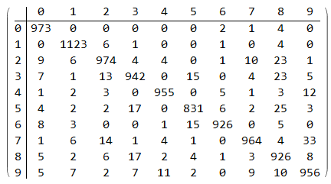
How to Measure Accuracy
This is called a “Confusion Matrix”

