Slide 1

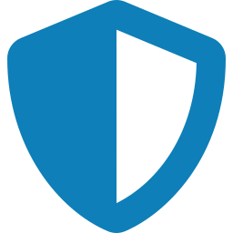


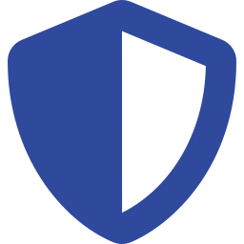
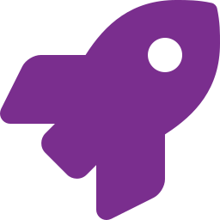

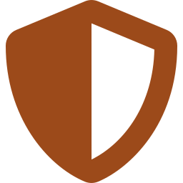




Top 10 initiatives generate 733 M€ of Future Days sales
Future Days only, de-risked by probability of success (base case excluded); cumulative sales 2026–2036 in M€
Part 4
Menquadfi: 305 M€
242
Egypt
Menquadfi
116
Morocco
RSV
62
Algeria
RSV
Egypt (242 M€) relies on the local manufacturing agreement; Libya (63 M€) is a new launch
RSV (Beyfortus): 223 M€
Morocco alone is 116 M€; Algeria and Libya follow
45
Libya
RSV
Hexaxim: 86 M€
48
Egypt
Hexaxim
47
South Africa
Adacel
38
Algeria
PCV21
Introduction in Egypt and local manufacturing in Algeria
Adacel, PCV21, Vaxigrip: 119 M€
63
Libya
Menquadfi
38
Algeria
Hexaxim
34
Algeria
Vaxigrip
Regain Adacel South Africa and Vaxigrip Algeria via MAMPs; PCV21 in Algeria
Secure the base
410 M€ (56%)
New launches
324 M€ (44%)
Win the tenders
none in top 10
Expand the market
none in top 10
Key message Top 10 = 60% of the 1.2 Bi€ Future Days de-risked sales; 56% secure the base through MAMPs
‹#›
Notes:
Future Days scenario only (base case excluded), MEASURE = Value (de-risked by probability of success), summed over 2026-2036, from the All sheet of All Country Data Jul26. Top 10 = 733 M€ out of 1225 M€ Future Days de-risked. Categories: MAMPs = Secure the base; new launches = New launches. Menquadfi Libya is tagged as new launch in the Excel TOP10 FD sheet.

