Slide 1

Team Comet -
Rasmus, Laila, Patrick & Benjamin

Slide 2
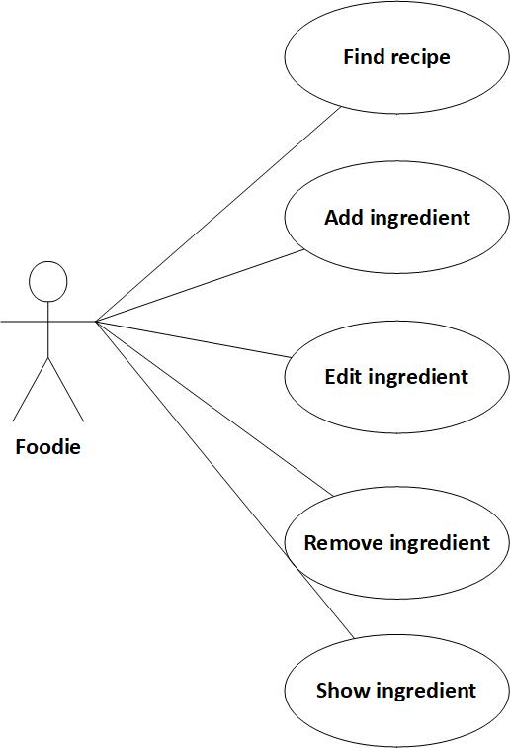
Use Case Diagram

Slide 3
Use Case 2 – Add Ingredient (Gammel)
Add ingredient
Brief
The user adds an ingredient to a list of ingredients.
When the ingredient is added, information about calories, protein, fat and carbohydrates are drawn from external source and all the information is added to a list.
Casual
Main success scenario:
The user specifies by name which ingredient he wants to add to the list and the ingredient is added.
Alternate scenarios:
The ingredient cannot be found in the external source when searching by name.

Slide 4
Use Case 2 – Add Ingredient (Gammel)
Use Case Section | Comment
Use Case Name | Add ingredient
Scope | Ideal Food application
Level | User goal
Primary Actor | Application user
Stakeholders and Interest | Application user, developer
Preconditions | The user knows which ingredient he wants to add
Success Guarantee | The ingredient exists in the system
Main Success Scenario | The application user wants to add an ingredient. System responds with OK The user specifies by name which ingredient he wants to add to the list. The system finds all the information about the ingredient from an external source. The System saves the ingredient to a list of ingredients. The system responds with OK.
Extensions | 3a. The ingredient cannot be found in the external source 3b. The system prompts the user to enter a valid name
Special Requirements | None
Technology and Data Variations | Windows OS, iOS, Android, Internet connection
Frequency of Occurrence | Will be used whenever the application user acquires a new ingredient.
Miscellaneous

Slide 5
Use Case 2 – Add Ingredient (Ny Version)
Add ingredient
Brief
The user adds an ingredient to a list of ingredients. He writes information about name, calories, protein, fat and carbohydrates himself.
Casual
Main success scenario:
The user specifies which ingredient he wants to add to the list by id and name, gives the ingredient its attributes(calories, protein, fat and carbohydrates) and the ingredient is added to the list of ingredients.

Slide 6
Use Case 2 – Add Ingredient (Ny Version)
Use Case Section | Comment
Use Case Name | Add ingredient
Scope | Ideal Food application
Level | User goal
Primary Actor | Foodie
Stakeholders and Interest | Foodie
Preconditions | Foodie knows which ingredient he or she wants to add and its attributes.
Success Guarantee | The ingredient exists in the list of ingredients.
Main Success Scenario | The user specifies an ingredient by name and its attributes The System saves the ingredient to a list of ingredients. The system responds with showing the specified ingredient in the list of ingredients.
Extensions | 2a. If the ingredient id already exists the system cant add it to the list.
Special Requirements | N/A
Technology and Data Variations | Windows OS, iOS, Android, Internet connection
Frequency of Occurrence | Will be used whenever the application user acquires or wants a new ingredient.
Miscellaneous | N/A

Slide 7
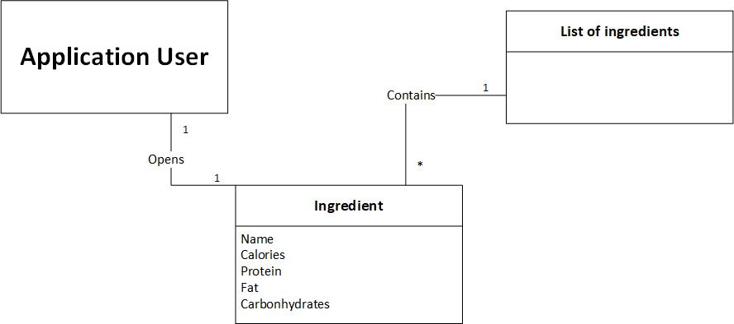
Domænemodel 5 – Show Ingredient (Gammel)

Slide 8
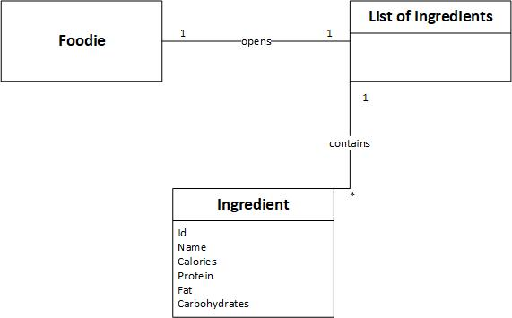
Domænemodel 5 – Show Ingredient (ny Version)

Slide 9
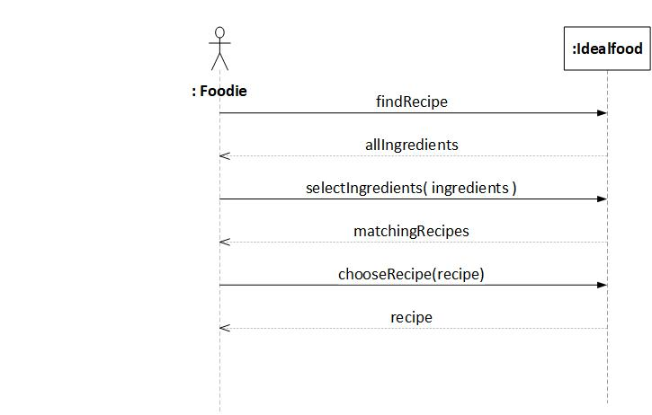
SSD 1 – Find Recipe (Gammel)

Slide 10
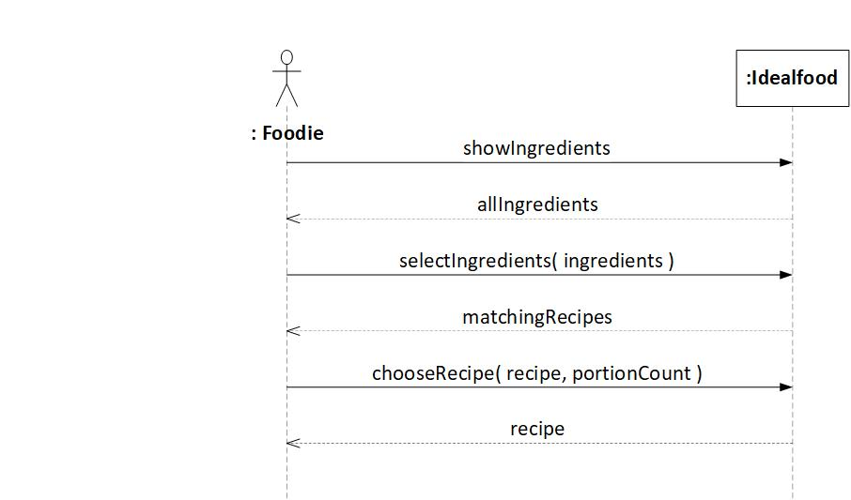
SSD 1 – Find Recipe (Ny)

Slide 11
OC - 1 Find Recipe (gammel)
Operation: findRecipe
Cross References: Find Recipe
Preconditions: foodie exist ListOfRecipes lor exists
An instance of recipes r exists
listOfIngredients loi exists
An instance of ingredients I exists
Postconditions:
A list of all ingredients has been returned

Slide 12
OC - 1 Find Recipe (gammel)
Operation: selectIngredients(ingredients)
Cross References: Find Recipe
Preconditions: A list of all ingredients has been returned
Postconditions:
A list of matching recipes has been returned

Slide 13
OC - 1 Find Recipe (gammel)
Operation: chooseRecipe(recipe, portionCount)
Cross References: Find Recipe
Preconditions: A list of matching recipes has been returned
Postconditions:
A recipe r was selected
r.portionCount was set to portionCount
r.amount was set to r.potionCount * r.portionSize

Slide 14
OC - 1 Find Recipe (ny)
Operation: showIngredients
Cross References: Find Recipe
Preconditions: foodie exist
listOfIngredients loi exists
An instance of one ingredient I exists
Postconditions:
A list of all ingredients has been returned

Slide 15
OC - 1 Find Recipe (ny)
Operation: getSelected
Cross References: Find Recipe
Preconditions: A list of all ingredients has been returned
Postconditions:
A list of selected ingredients has been created.

Slide 16
OC - 1 Find Recipe (ny)
Operation: matchIngredientsToRecipes
Cross References: Find Recipe
Preconditions: A list of selected ingredients exists
Postconditions:
A sql query with matching recipes has been created

Slide 17
OC - 1 Find Recipe (ny)
Operation: getRecipesList
Cross References: Find Recipe
Preconditions: A sql query with matching recipes exists
Postconditions:
A list with matching recipes has been created

Slide 18
OC - 1 Find Recipe (ny)
Operation: showRecipes
Cross References: Find Recipe
Preconditions: A list of matching recipes exists
Postconditions:
A list of matching recipes has been returned

Slide 19
OC - 1 Find Recipe (ny)
Operation: chooseRecipe
Cross References: Find Recipe
Preconditions: A list of matching recipes has been shown
Postconditions:
A chosen Recipe object has been created

Slide 20
OC - 1 Find Recipe (ny)
Operation: getSelectedRecipe
Cross References: Find Recipe
Preconditions: A chosen Recipe object exists
Postconditions:
A chosen Recipe has been shown
GUI henter information fra Databasen, altså textFields bliver populated fra Databasen

Slide 21
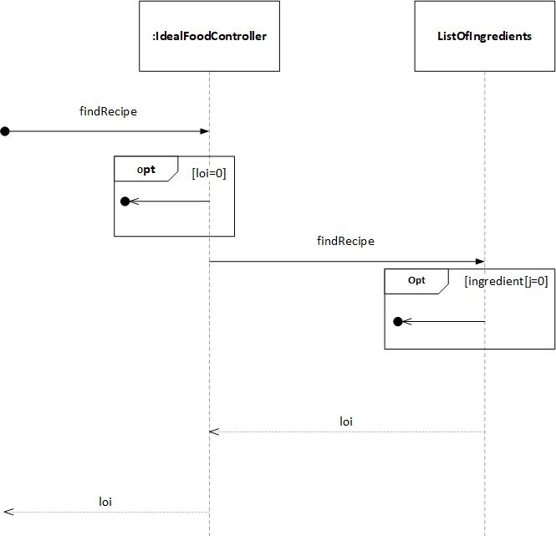
SD – 1 Find Recipe (Gammel)

Slide 22
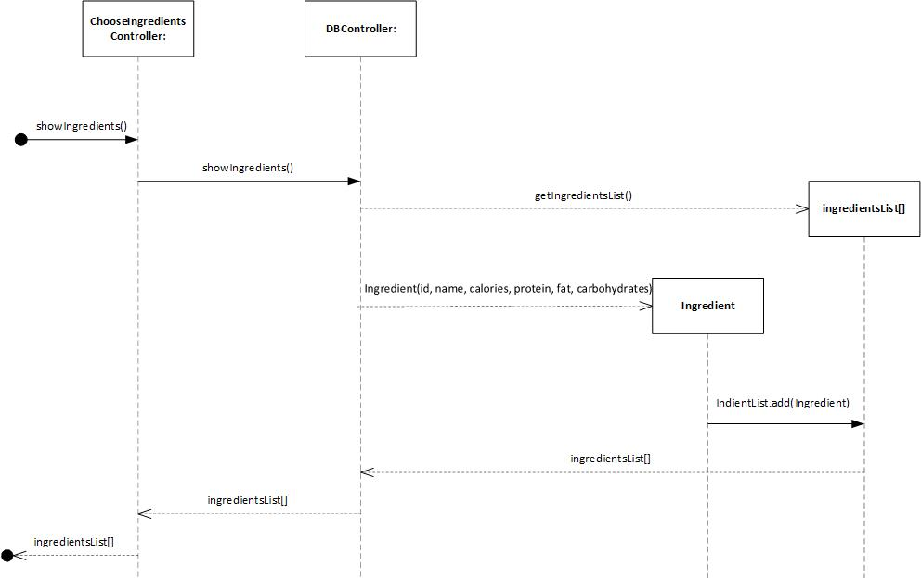
SD – 1 Find Recipe (Ny)

Slide 23
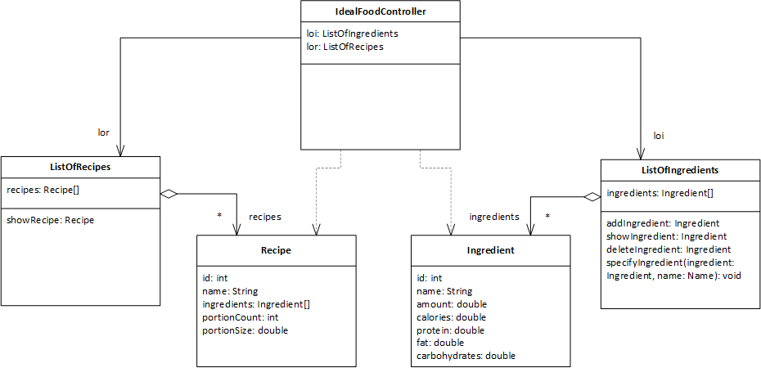
Klassediagram (Gammel)

Slide 24
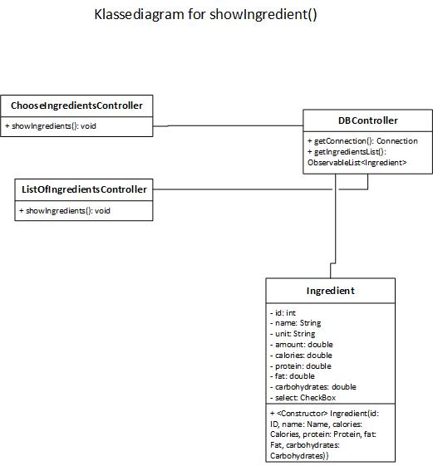
Klassediagram (Ny)

