Slide 1
Hadoop: Big Data Ecosystem
Foundamental concepts and
Major composants

Slide 2
A Big Data definition: the 3 V’s
Volume: A significant amount of data, more than easily handled by a single database, computer or spreadsheet
Velocity: Process incoming data and get answers quickly enough, as to not delay research or critical decision making
Variety: Different kind of information, with a mix of data types and varying degrees of structures

Slide 3
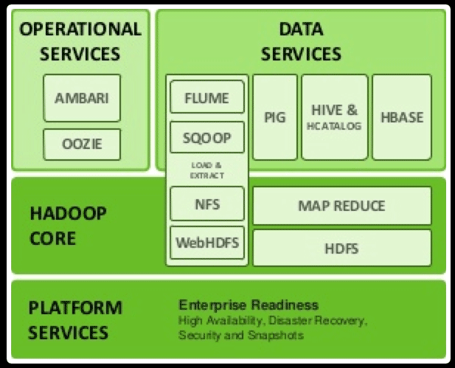
The historical architecture

Slide 4
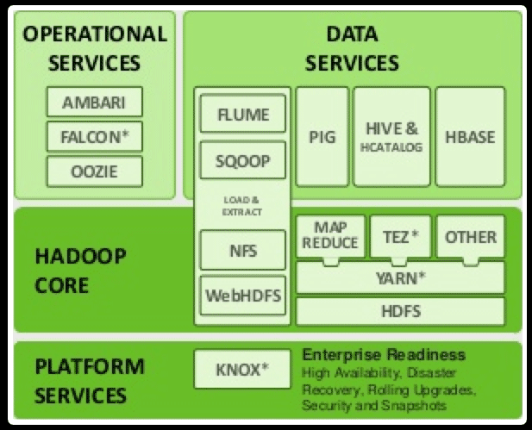
The modern architecture

Slide 5
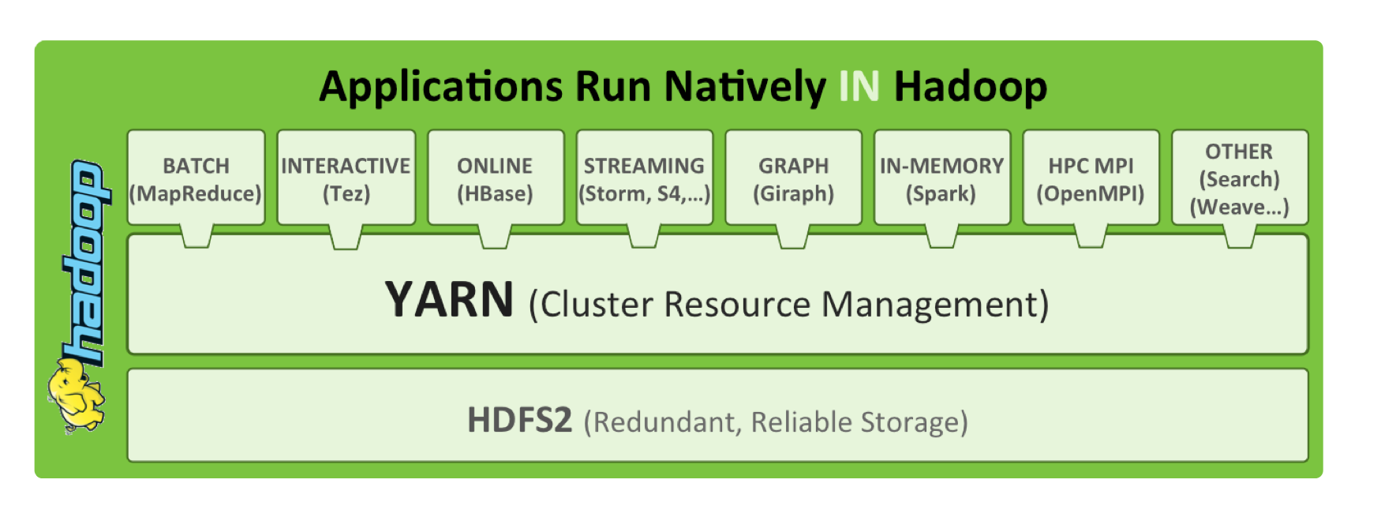
A cluster operating system

Slide 6
Hadoop distributions
Official project hosted by Apache
CDH: Cloudera distribution
HDP: Hortonworks distribution
Intel, EMC, …

