Slide 1
HDFS and Map Reduce: an introduction
Get used to HDFS
Write your first MapReduce project

Slide 2
Prerequisite
Grab twitter data from ECE mkdir ece wget --recursive --mirror -np -A.html -Q100m -P ./ece http://www.ece.fr
Upload them to HDFS hadoop fs -put ./ece .
Install Eclipse for Java EE and Maven http://www.eclipse.org http://maven.apache.org

Slide 3
Prepare Maven
cd wordcount
The ./pom.xml file: project definition Hortonworks dependencies Hadoop dependencies
Initial directory layout Maven settings: ./conf/settings.xml Java packages: mkdir –p ./src/main/java Test packages: mkdir –p ./src/test/java
Eclipse initialisation mvn eclipse:eclipse

Slide 4
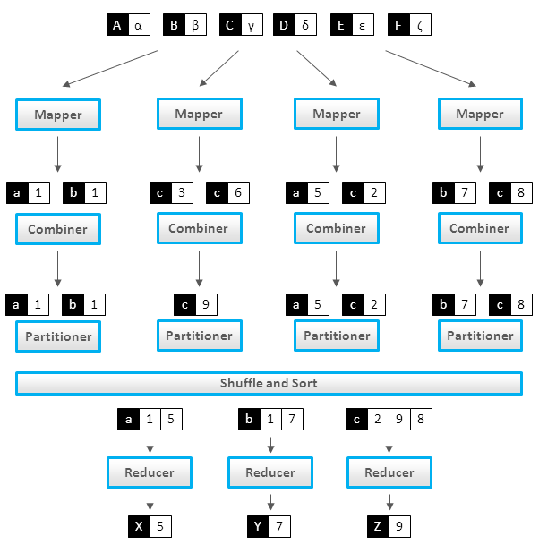
Workflow of a MapReduce Job
http://lintool.github.io/MapReduceAlgorithms/

Slide 5
Prepare the job
Create a class with a main static function
Define the Mapper, Combiner, Reducer
Define the InputFormat and OutputFormat
Define the InputPaths and OutputPaths
http://hadoop.apache.org/docs/stable/mapred_tutorial.html

Slide 6
Mapper
Extends MapReduceBase
Implements Mapper
Call output.collect K, V

Slide 7
Combiner and Reducer
Extends MapReduceBase
Implements Reducer
Call output.collect K, V

