Slide 1

Tuition Freeze - Purdue

Slide 2
The Problem
Purdue Tuition Freeze
14 consecutive years
Current Tuition
$28,794
Note: 2018 Data
What factors influence tuition price?
Can Purdue’s optimal tuition price be predicted with a model?

Slide 3
What factors drive tuition?
1. Instructional
Expenditure
2. Graduation
Rate
3. Top
10%
Instructional expenditure per student
Graduation rate of all students
Percent of new students from top 10% of H.S. class
Other notable features - State tuition mean, Student/faculty ratio, PHD faculty,
Room and Board, Top 25%, Privatization

Slide 4
Exploratory Data Analysis

Slide 5
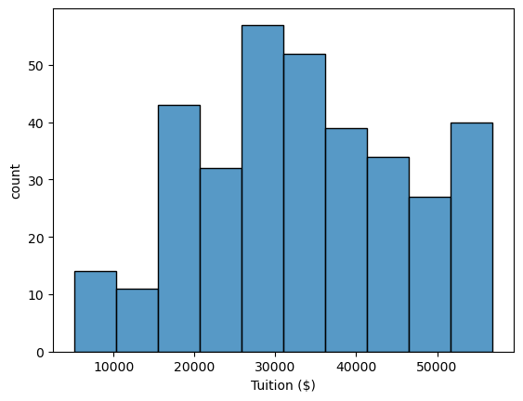
Tuition Distribution

Slide 6
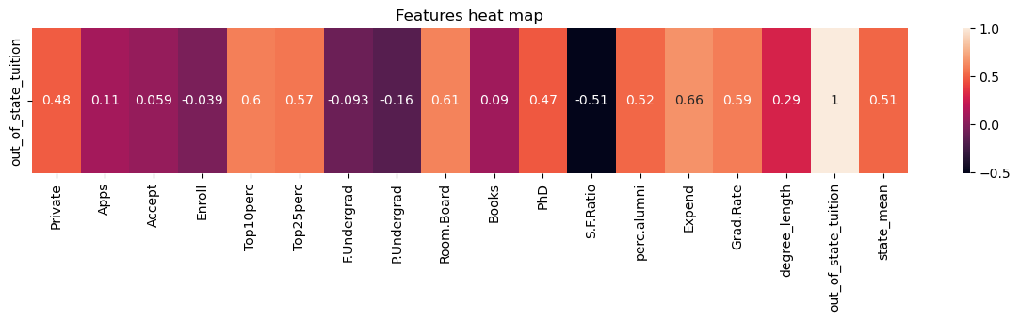
Correlation Heatmap

Slide 7
Modeling

Slide 8
Models
Linear Regression
Random Forest
StandardScaler
SelectKBest
LinearRegression object
SelectKBest
RandomForest object

Slide 9
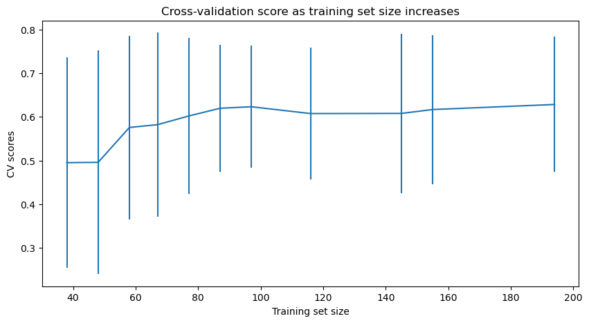
Data Quantity Evaluation

Slide 10
Results

Slide 11
Model Comparison
Linear Regression
Random Forest
MAE = $5,230.81
SD = 359.46
MAE = $5,375.50
SD = 520.35

Slide 12
Hyperparameters
n_features: 10
max_depth: 10
min_samples_leaf: 1
min_samples_split: 5
n_estimators: 25

Slide 13
Optimal Pricing
Actual Tuition:
$28,794
Optimal Estimate
$33,712

Slide 14
Recommendation

Slide 15
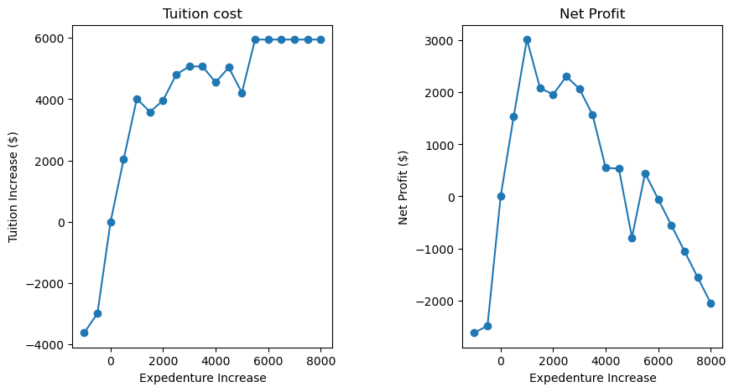
Instructional Expenditure

Slide 16
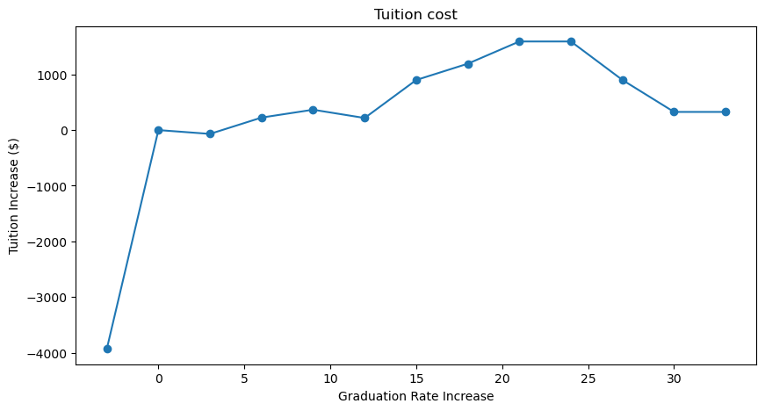
Graduation Rate

Slide 17
Further Research
Data Completeness
Policy Implementation
In-State Tuition
Revenue Impact

