Slide 1
Reconfigurable Computing 2
Using Kernels and Unified Shared Memory
Greg Stitt
Associate Professor
Department of Electrical and Computer Engineering
University of Florida

Slide 2
Framework for SYCL/DPC++
Single Source
Both host code and device code exist in the same file
Application Code
Setting up devices
Managing queues for different tasks
Allocating data for devices
Kernel Code
Any code that runs on the target devices
Typically expressed as a lambda function
Certain restrictions
Dynamic memory allocation
Static variables
Function pointers
Etc.

Slide 3
Writing Code for Kernels
C++ Lambda Functions
Very common practice for parallel programming
Used to create anonymous, inline functions
[capture-list] (params) -> return {body}
Capture list is the set of variables to be returned
Params is set of variables being passed in
Return is the return type
Body is the function code
Capture list and params can be by value or reference
SYCL Restrictions
Capture list and params must be by value only
Return type must be void

Slide 4

Different Types of Kernels
Single Task
Executes a single instance of a function on device
Parallel For
Executes multiple instances based on a range parameter
Should not be thought of as a “for loop”
Multiple instances are run at the same time

Slide 5
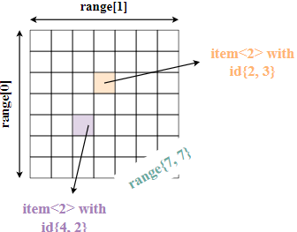
Parallel For
Parallel for is the most common type of Kernel
Best at exploiting “embarrassing data parallelism”
Embarrassing parallelism requires little effort to separate tasks
Common when tasks have little to no dependency
Ex: Manipulating pixels in an image, matrix multiplication
Must specify ranges when calling parallel for

Slide 6
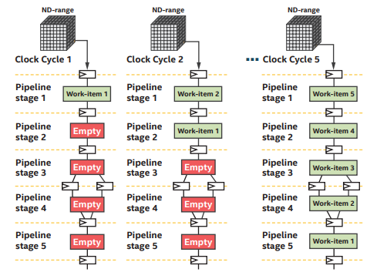
Pipelining on FPGA via SYCL
Spatial pipeline
We can fill a pipeline with different tasks of a kernel
Consider effects on clock frequency
Routing issues as placement increases

Slide 7
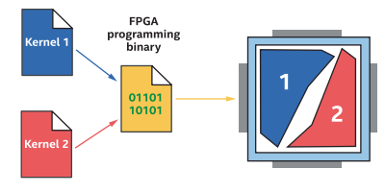
Kernels on FPGAs
Multiple kernels can run on FPGA
Kernels can run concurrently
Each kernel occupies its own space

Slide 8
Unified Shared Memory
How to manage data between host and device?
Device needs to data to run
Host needs to get data back from device
3 types of memory:
Device allocations: kernels can read and write but host cannot
Host allocations: host memory that can accessed remotely by device via bus like PCI-express
Shared allocations: memory that can migrate from host to device freely automatically
Device no longer must use bus system to write data

Slide 9
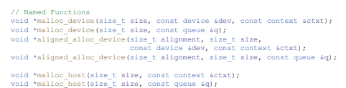
Managing Memory with USM
USM is a pointer-based strategy
Memory is dynamically allocated via malloc or new
Different functions to differentiate between host or device
Returns pointers to memory
Memory must be freed when program ends

Slide 10
Memory Movement with USM
Explicit memory movement between host and device
Utilize memcpy to specify source and destination
Memory movement can also be implicit
Memory allocation must be specified as shared
Compiler will handle copies and movement as needed
Safer but not as optimized as explicit contrl

Slide 11
Using Buffers
Buffers can be used as an alternative to USM
High-level abstraction for data
Data is not tied to single memory location
Both host and device can access the buffer
Data from a buffer cannot be directly managed
Must make use of accessor object
Accessor objects can be read only, write only, or both
Accessor objects must be created in reference to a particular buffer

Slide 12
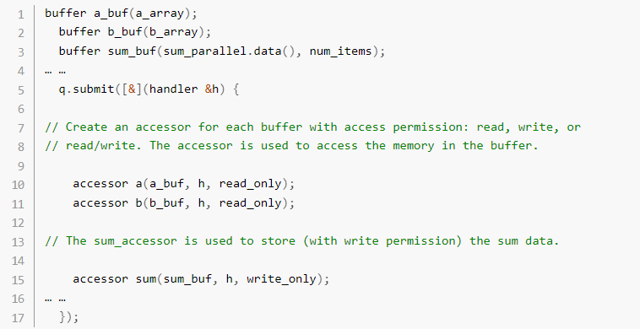
Buffer and Accessor Example

