Slide 1
Reconfigurable Computing 2
HLS Memory Models
Greg Stitt
Associate Professor
Department of Electrical and Computer Engineering
University of Florida

Slide 2
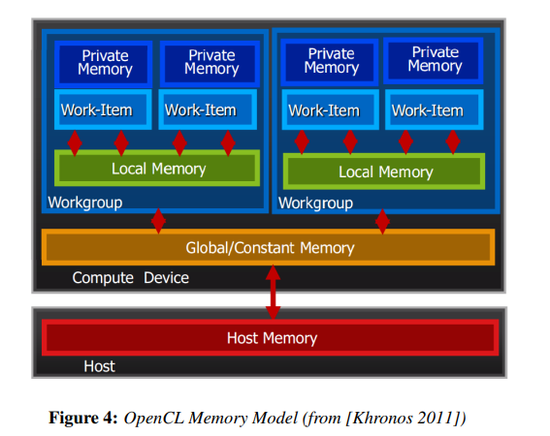
OpenCL Memory Layout
Host Memory – only accessible on host processor
Global Memory – both host and device have read/write access
Local Memory – memory belonging to a single compute unit or workgroup
Private Memory – individual memory to a single work-item

Slide 3
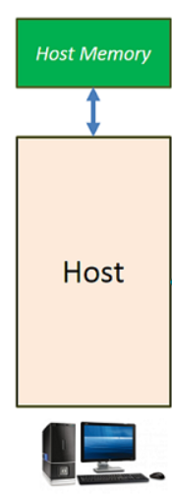
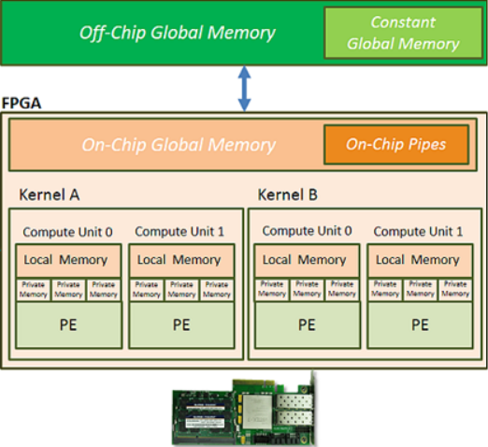

FPGA Memory Layout
Local and Private memories within FPGA will usually be implemented using registers or BlockRAMs
Global memory will likely be memory chips (ex: SDRAM) but may also be BlockRAM
PCIE

Slide 4
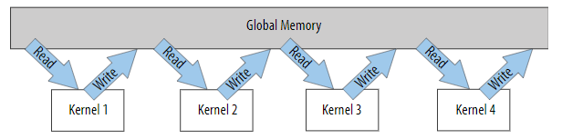
FPGA Memory Considerations
A major bottleneck arises from transfers between global and kernel memory
Especially true when kernels have dependency on previous computation (kernel 1 must read then write before kernel 2 can read)

Slide 5
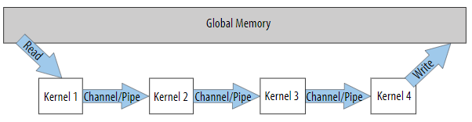
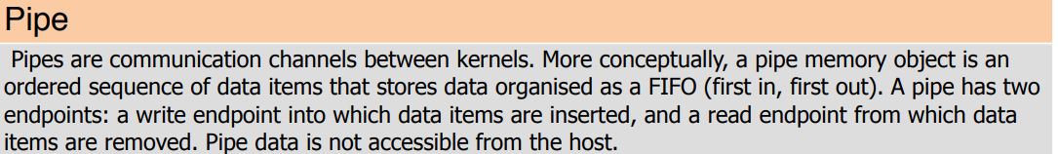
Memory Using Pipes
The total number of global transfers can be reduced by using channel pipes

Slide 6
Unified Shared Memory
How to manage data between host and device?
Device needs to data to run
Host needs to get data back from device
3 types of memory:
Device allocations: kernels can read and write but host cannot
Host allocations: host memory that can accessed remotely by device via bus like PCI-express
Shared allocations: memory that can migrate from host to device freely automatically
Device no longer must use bus system to write data

Slide 7
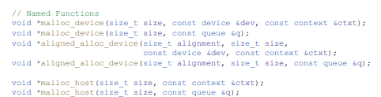
Managing Memory with USM
USM is a pointer-based strategy
Memory is dynamically allocated via malloc or new
Different functions to differentiate between host or device
Returns pointers to memory
Memory must be freed when program ends

Slide 8
Memory Movement with USM
Explicit memory movement between host and device
Utilize memcpy to specify source and destination
Memory movement can also be implicit
Memory allocation must be specified as shared
Compiler will handle copies and movement as needed
Safer but not as optimized as explicit contrl

Slide 9
Using Buffers
Buffers can be used as an alternative to USM
High-level abstraction for data
Data is not tied to single memory location
Both host and device can access the buffer
Data from a buffer cannot be directly managed
Must make use of accessor object
Accessor objects can be read only, write only, or both
Accessor objects must be created in reference to a particular buffer

Slide 10
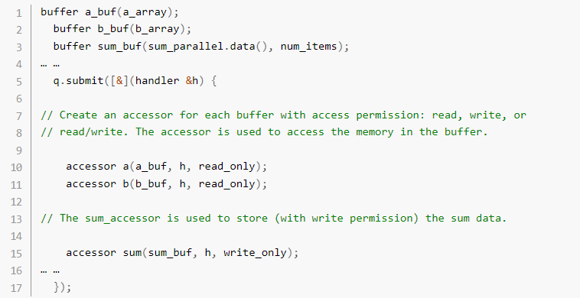
Buffer and Accessor Example

