Slide 1
Reconfigurable Computing 2
HLS Memory Models
Greg Stitt
Associate Professor
Department of Electrical and Computer Engineering
University of Florida

Slide 2
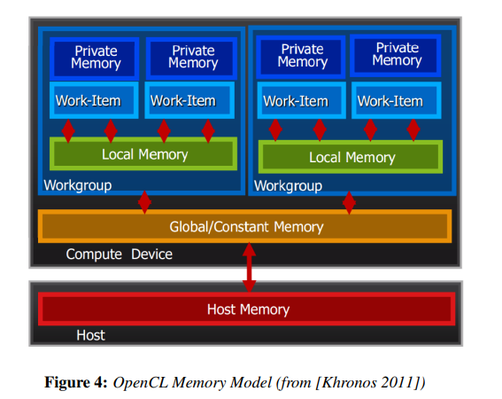
OpenCL Memory Layout
Host Memory – only accessible on host processor
Global Memory – both host and device have read/write access
Local Memory – memory belonging to a single compute unit or workgroup
Private Memory – individual memory to a single work-item

Slide 3
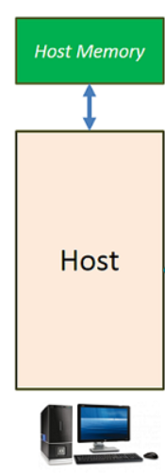
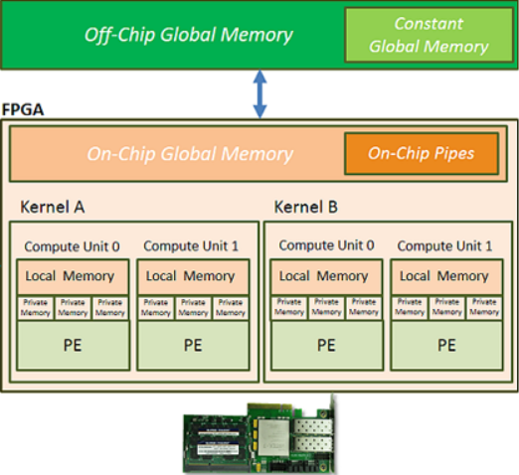

FPGA Memory Layout
Local and Private memories within FPGA will usually be implemented using registers or BlockRAMs
Global memory will likely be memory chips (ex: SDRAM) but may also be BlockRAM
PCIE

Slide 4
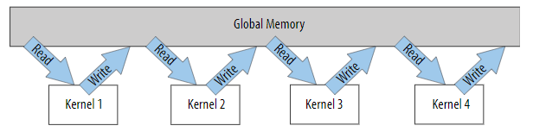
FPGA Memory Considerations
A major bottleneck arises from transfers between global and kernel memory
Especially true when kernels have dependency on previous computation (kernel 1 must read then write before kernel 2 can read)

Slide 5
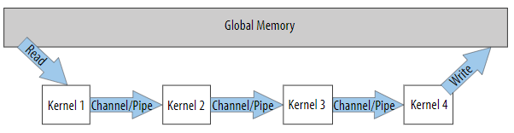
Memory Using Pipes
The total number of global transfers can be reduced by using channel pipes

Slide 6

Different Types of Kernels
Single Task
Executes a single instance of a function on device
Parallel For
Executes multiple instances based on a range parameter
Should not be thought of as a “for loop”
Multiple instances are run at the same time

Slide 7
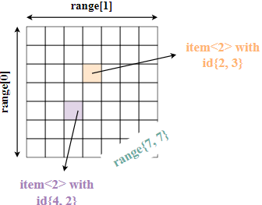
Parallel For
Parallel for is the most common type of Kernel
Best at exploiting “embarrassing data parallelism”
Embarrassing parallelism requires little effort to separate tasks
Common when tasks have little to no dependency
Ex: Manipulating pixels in an image, matrix multiplication
Must specify ranges when calling parallel for

Slide 8
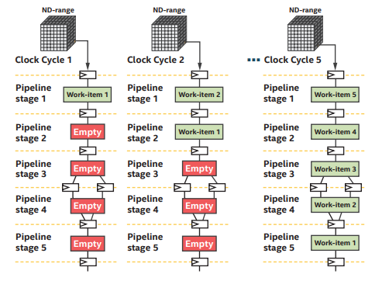
Pipelining on FPGA via SYCL
Spatial pipeline
We can fill a pipeline with different tasks of a kernel
Consider effects on clock frequency
Routing issues as placement increases

