Slide 1
Reconfigurable Computing 2
Introduction to SYCL and DPC++
Greg Stitt
Associate Professor
Department of Electrical and Computer Engineering
University of Florida

Slide 2
What is SYCL?
SYCL
  An abstraction layer that builds upon OpenCL
    Framework for programming heterogeneous platforms
  Allows for data parallel programming for C++
    Higher level than OpenCL but has seamless integration with OpenCL and C++ libraries
  Targets a variety of hardware accelerators using a unified, high-level programming language
    CPUs
    GPUs
    FPGAs

Slide 3
What is DPC++?
Data Parallel C++
  Extends the SYCL framework
    The programming language used to write SYCL programs
    Open source
    Aims to become a core SYCL extension
  Incorporates SYCL standard for data parallelism and heterogeneous programming
    Very similar to C++ but with extra functionality for data parallelism
  Offloads computation from host computer to accelerator
    Programmer specifies which code to offload to which accelerator in code

Slide 4
Why use SYCL?
Many different devices are used for workload acceleration
  CPUs
  GPUs
  FPGAs
Writing custom-tailored code for accelerators is not flexible or distributable
  Code cannot be shared or re-used with other devices
  Code may need to be entirely re-written if changing devices
SYCL allows for one higher-level code base to be run on a variety of devices
  The same code can be re-used on different devices
  Code can be more easily tweaked for different applications
Libraries contain pre-written code custom-made for each architecture
  Every high-level function call is optimized for each supported device
  Performance theoretically equivalent to writing lower-level code manually
  Much faster to write than lower-level code, especially RTL

Slide 5
Framework for SYCL/DPC++
Single Source
  Both host code and device code exist in the same file
Application Code
  Setting up devices
  Managing queues for different tasks
  Allocating data for devices
Kernel Code
  Any code that runs on the target devices
  Typically expressed as a lambda function
  Certain restrictions
    Dynamic memory allocation
    Static variables
    Function pointers
    Etc.

Slide 6
Device Selection
Default selector chooses most capable device at runtime
Device selector classes exist to choose from specific class of device
  gpu_selector
  cpu_selector
  accelerator_selector
  fpga_selector exists via intel extension
  Useful for quick development, but typically want specific device for a task
Custom selectors created by extending device_selector base class
    virtual int operator()(const device &dev) const {
    /* Device selection logic */
    }

Slide 7
Custom Device Selection
operator() is key to device selection
  Runs on each available device
  Returns an integer score for each device
    Device which returns highest score is selected
    Devices which return negative scores will never be selected
User is free to define any logic for scoring
  Allows for arbitrarily complex device selection logic
  In simple cases, selecting based on device name or vendor is sufficient

Slide 8
Custom Device Selection Example
class my_selector : public device_selector {
public:
int operator()(const device &dev) const override {
if (
dev.get_info<info::device::name>().find("Arria") != std::string::npos &&
dev.get_info<info::device::vendor>().find("Intel") != std::string::npos) {
return 1;
}
return -1;
}
};
Source: Data Parallel C++, James Reinders et al. pg. 46

Slide 9
Queues
Abstractions used for submitting work to a device
  Bound to a single device upon creation
  Device is selected via device_selector class
  Can allow selector to select from a class of devices or write custom selector
Tasks submitted to queue are offloaded to device when conditions are met
  Host continues execution of the program after submission to the queue
Task execution can be in-order or out-of-order
  Out-of-order by default, execution order determined by runtime
  Can be instantiated with the in-order property for implicit dependency specification

Slide 10
Queues - Example
auto q = sycl::queue(sycl::default_selector()); //select default device for queue (CPU usually)
q.submit([&](sycl::handler &cgh) { auto os = sycl::stream{128, 128, cgh}; //define the queue interface
cgh.single_task<class hello_world>([=] { os << "Hello World!\n"; }) //submit task to queue
q.wait(); //wait for all queued tasks to finish

Slide 11
Universal Shared Memory (USM)
Pointer-based memory management system, similar to C/C++ malloc() or new
Defines a unified virtual memory space shared between host and devices
  A pointer is valid both on the host and any devices, so no translation is necessary
Defines three types of allocation
  Device
    Explicit, accomplished via memcpy() function as part of the queue and handler classes
    Located on device-attached memory
    Only accessible via device. Data must be copied explicitly to move between host and device
  Host
    Implicit
    Accessible via both host and device
    Data accessed on host memory by devices does not transfer into local device memory
      Sent via bus such as PCI-E
  Shared
    Implicit
    Accessible via both host and device
    Can migrate between host and device, allowing for faster execution on device. Occurs automatically via runtime
  All allocations are performed by the host

Slide 12
Buffers
Data abstractions of a certain C++ type
  Can be scalar data types, vectors, or other user-defined class/structure
    Must not require the use of copy constructors for copying
Represent data objects, not memory addresses
  Cannot be accessed like C++ arrays
  Accessors must be used to read from and write to buffers
A single buffer may be distributed across multiple locations
  Between discrete memory locations and devices
An empty buffer may be created by specifying a range for size
  Data must later be initialized before the buffer can be read from
Existing host data may be used to initialize a new buffer
  Accomplished by invoking a constructor that takes a pointer to an existing host allocation
May also be created from existing cl_mem objects if using OpenCL compatibility

Slide 13
Accessors
The only way in which to read from or write to buffers
Can be instantiated with read, write, or read_write access modes
  Accessors are read_write by default
Using appropriate access modes is important
  Provides implicit information used to help the runtime manage memory
    For example: read mode tells the runtime that it does not need to copy memory back to the host, as the device has not changed it.
  Appropriate use of access modes will help the runtime optimize kernel scheduling and data migration

Slide 14
Accessors - Example
queue q;
buffer my_buffer(my_data);
q.submit([&](handler &h) {
  accessor my_accessor(my_buffer, h); // create an accessor to update the buffer on the device
  //operations for the device to perform on the buffer go here
  });
host_accessor host_accessor(my_buffer); // create host accessor
for (int i = 0; i < N; i++) {
  std::cout << host_accessor[i] << " "; // access myBuffer on host
} //all the above code is inside a loop or function
for (int i = 0; i < N; i++) {
  std::cout << my_data[i] << " "; // myData is updated when myBuffer is destroyed upon exiting scope
}

Slide 15
Reconfigurable Computing 2
Kernels and Data Management
Greg Stitt
Associate Professor
Department of Electrical and Computer Engineering
University of Florida

Slide 16
Introduction to Kernels
What is a kernel?
  Any code written targeting a device
  Not unique to SYCL/DPC++, used in OpenCL, CUDA, etc.
  SYCL is single source
    Kernel code embedded within outer code abstraction
    Separate kernel code for each device and each task per device
Kernel code restrictions
  Restrictions in place to allow broad device support and parallelism
  No dynamic allocations, function pointers, recursion, polymorphism, and more

Slide 17
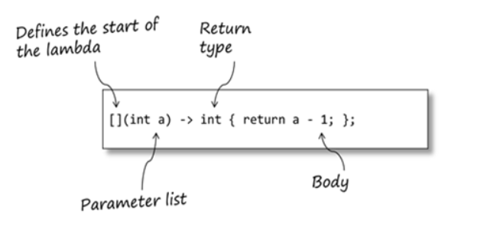
Writing Code for Kernels
C++ Lambda Functions
  Most common way to define kernel code
  Used to create anonymous, inline functions
  [capture-list] (params) -> return {body}
    Capture list bring variables into scope
    Params is set of variables being passed in
    Return is the return type
    Body is the function code
    Capture list and params can be by value or reference
Further SYCL Restrictions
  Capture list and params must be by value only
  Return type must be void

Slide 18
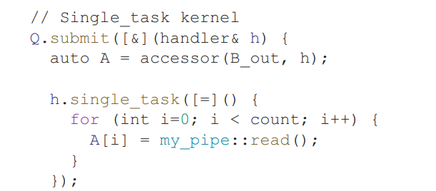
Different Types of Kernels
Single Task
  Executes a single instance of a function on device
Parallel For
  Executes multiple instances based on a range parameter
  Should not be thought of as a “for loop”
  Multiple instances are run at the same time

Slide 19
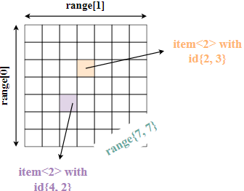
Parallel For
Parallel for is the most common type of Kernel
Best at exploiting “embarrassing data parallelism”
  Embarrassing parallelism requires little effort to separate tasks
  Common when tasks have little to no dependency
  Ex: Manipulating pixels in an image, matrix multiplication
Must specify ranges when calling parallel for

Slide 20
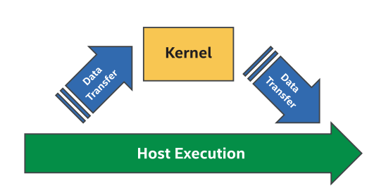
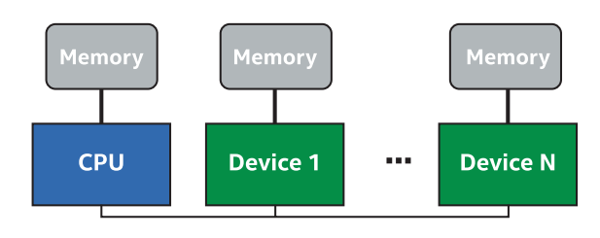
Data Management Considerations
Running heterogeneous computing systems efficiently requires careful handling of data
  Data must be available for accelerator execution as promptly as possible as any idle time is wasted
Device code requires data as input and may output its own data
Devices may each have their own distinct memory
Remote Accesses are accesses to data in another device’s memory and is often very slow
Local Accesses are accesses to data in directly-attached memory
  Much faster
  Desirable for a device to utilize local memory for computation
  May require manual movement of data between memory pools to ensure data is in local scope

Slide 21
Implicit vs Explicit Memory Management
Memory Management between devices can be either implicit or explicit
  Explicitly copied by the programmer within the program itself
  Implicitly copied by the compiler during runtime
Implicit Memory Management
  Utilizes buffers
  Simple and safe
  Often at the cost of potential performance
Explicit Memory Management
  Defined manually by the programmer
    Memcpy calls
  May be optimized for better performance
    For example: transfer data while device is busy with execution
  Time consuming and error prone
  Should be reserved for the most performance-critical areas

Slide 22
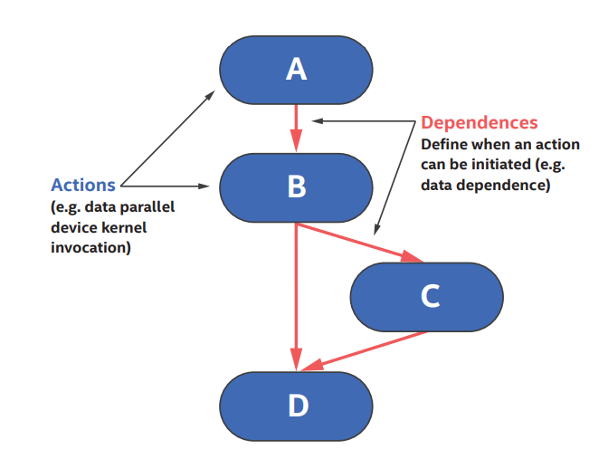
Dependency
Dependencies between tasks may be implicit or explicit
Explicit dependency refers to dependency between computations
  Dependencies specified using events
  Kernel A must run before B
Implicit dependency refers to dependency between data accesses
  Relevant to code utilizing buffers for data management
  Order specified by accessors

Slide 23
Computational Dependency (Explicit)
A queue’s submit() function returns an event
Event objects can be captured and referenced for other purposes
  wait()
  depends_on()
depends_on() is a handler function used to specify dependency
  Specifies events on which the current operation depends
  Takes an event or vector of events as parameters
  Will wait until all specified events have finished before continuing execution

Slide 24
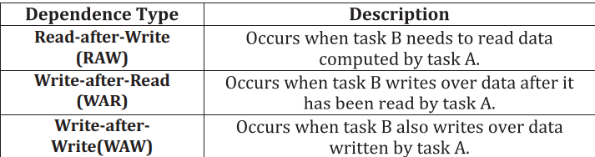
Data Dependency (Implicit)
Different tasks may depend on one another’s data
These relationships are specified implicitly via
  Accessor access modes
  Task ordering
    If two accessors exist for the same data, whichever task is submitted first will be executed first
    An implicit dependency is created based on the types of access

Slide 25
Reconfigurable Computing 2
Using SYCL and DPC++ for FPGAs
Greg Stitt
Associate Professor
Department of Electrical and Computer Engineering
University of Florida

Slide 26
SYCL and FPGAs
FPGA support is not natively built into SYCL, but instead relies on vendor supported options
  Different compilers (DPC++, triSYCL, ComputeCPP) will have different options
Optimal FPGA performance will require you to reference the vendor’s documentation
  For DPC++, Intel provides references in the oneAPI documentation
DPC++ supports dataflow pipes, FPGA emulators, FPGA selectors, and additional tools for timing/spatial analysis
  These features are available via Intel extensions provided in the oneAPI toolkit

Slide 27
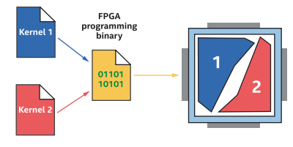
Kernels on FPGAs
Multiple kernels can run on FPGA
Kernels can run concurrently
Each kernel occupies its own space

Slide 28
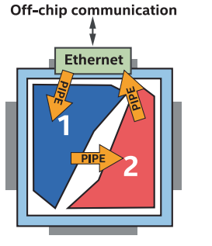
Multiple Kernels on FPGAs
Pipes:
  Pipes are an Intel-supported SYCL extension that adds FIFO implementations to support spatial architectures on FPGAs
    Extension is included with the oneAPI base toolkit
  Pipes store information in registers on the FPGA, which allows for communication between kernels without using off-chip memory
  Important for running multiple kernels

Slide 29
Developing for FPGAs
Typical development cycle:
  Write/edit code
  Perform functional validation using an FPGA emulator
    Compile time: seconds
  Generate static reports for timing and spatial analysis
    Compile time: minutes
  Perform full hardware compile and generate bitstreams
    Compile time: hours

Slide 30
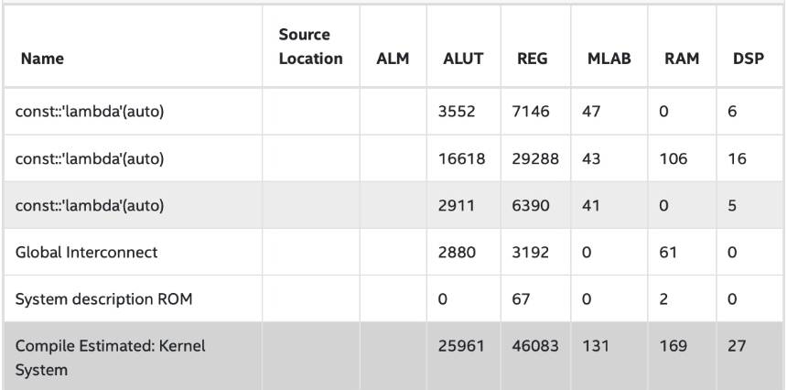
Early Image FPGA Report
Provides estimated resource usage
Can see visualization of generated structures
Identifies bottlenecks

