Slide 1
Reconfigurable Computing 2
OpenCL
Greg Stitt
Associate Professor
Department of Electrical and Computer Engineering
University of Florida

Slide 2
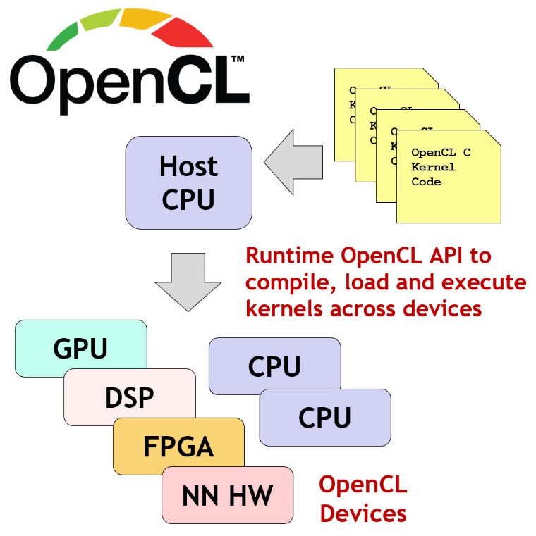
What is OpenCL?
A cross-platform programming framework for heterogeneous parallel computing
Abstracts lower-level hardware functions
Allows the same code to be used across different devices and vendors
Gives the ability to utilize different accelerators without use of vendor-specific languages
Provides models for memory and execution
Probably expand on this
2

Slide 3
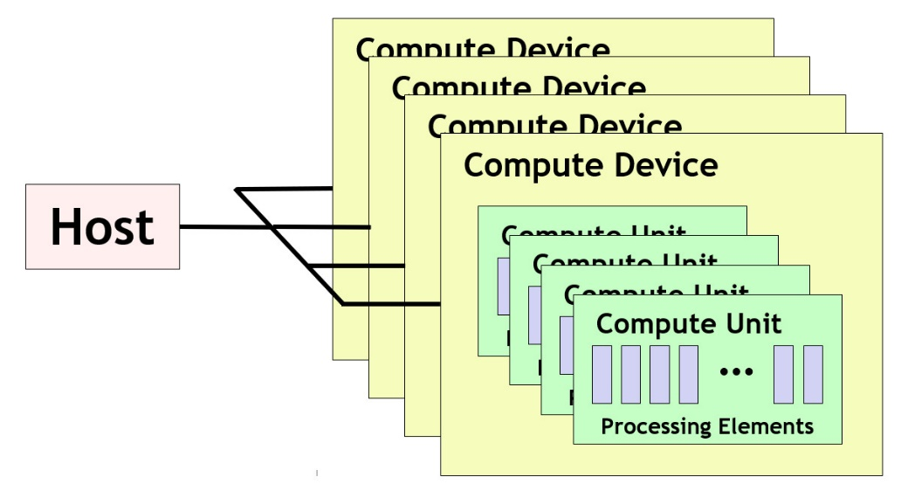
OpenCL Architecture
OpenCL standard defines a single Host which controls multiple Compute Devices
CPUs, GPUs, FPGAs, etc.
Each Compute Device consists of one or more Compute Units
Such as cores in a CPU
Each Compute Unit consists of multiple Processing Elements
Executes OpenCL code in the form of Kernels
A compute device may be a GPU. Its compute units would be the streaming multiprocessors inside the GPU. The streaming multiprocessors are themselves comprised of individual streaming processors, which would be the processing elements.
3

Slide 4
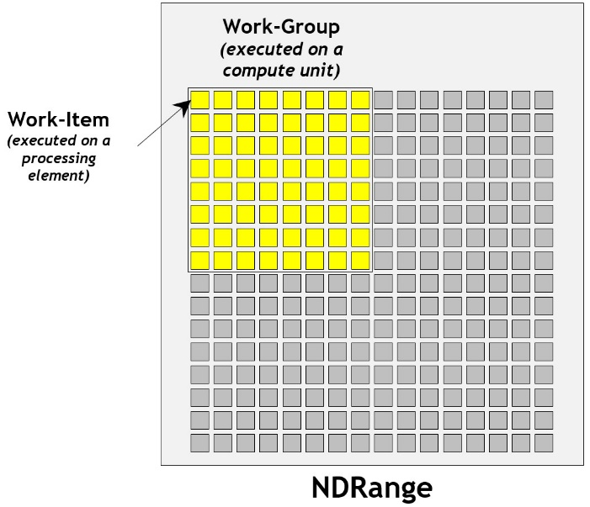
OpenCL Execution Model
The Host uses OpenCL API to manage and interface with Compute Devices
CPUs, GPUs, FPGAs
Work is submitted to the Processing Elements in the form of “Kernels”
Written in an extension of C99, called OpenCL C
C++ for OpenCL, a C++17-based language, can also be used
After submission, Kernels will execute in parallel with the host process
Each item of execution is referred to as a “work-item” (CUDA threads)
Work-items are grouped together to form “work-groups” (thread blocks)
4

Slide 5
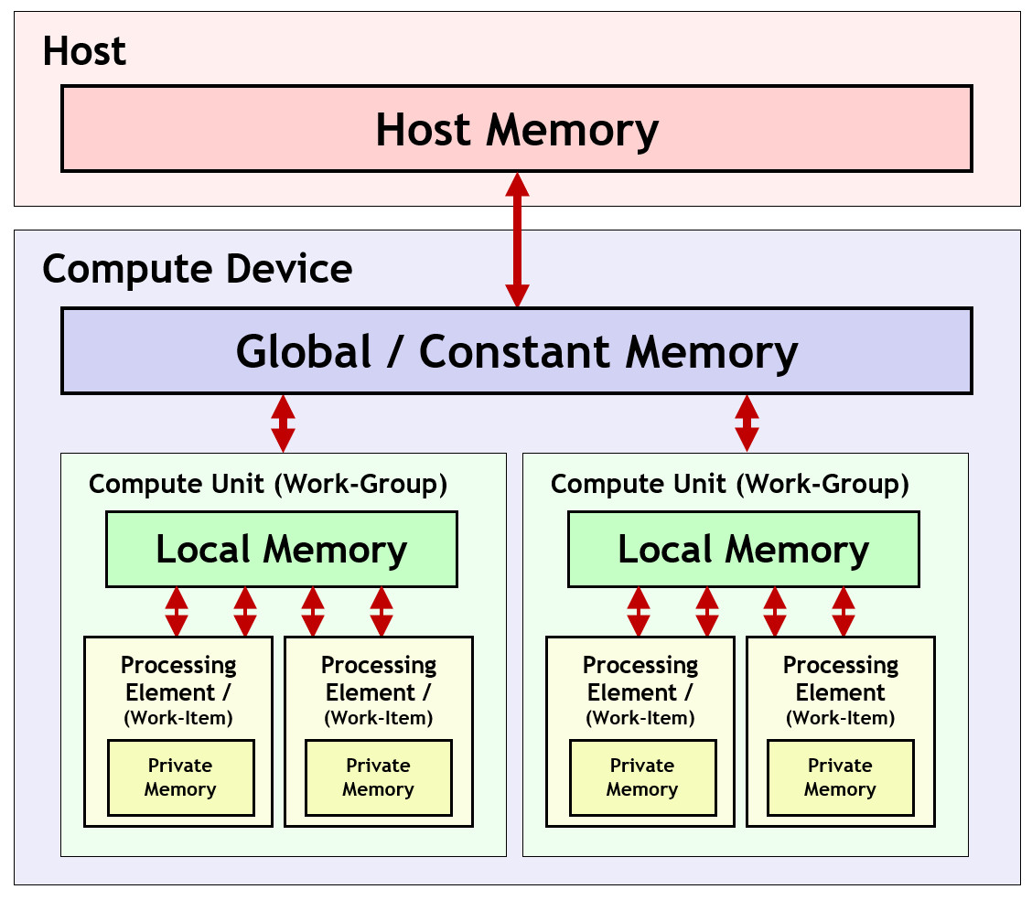
OpenCL Memory Model
The OpenCL memory model defines a hierarchy of memory types:
Host Memory
Available only to the host CPU
Global/Constant Memory
Available to all compute units in a compute device
Local Memory
Available to all processing elements in a compute device
Private Memory
Available to a single processing element
5

Slide 6
OpenCL Execution Sequence
A complete sequence for executing an OpenCL program is:
Query for available OpenCL platforms and devices
Create a context for one or more OpenCL devices in a platform
Create and build programs for OpenCL devices in the context
Select kernels to execute from the programs
Create memory objects for kernels to operate on
Create command queues to execute commands on an OpenCL device
Enqueue data transfer commands into the memory objects, if needed
Enqueue kernels into the command queue for execution
Enqueue commands to transfer data back to the host, if needed
6

