Slide 1
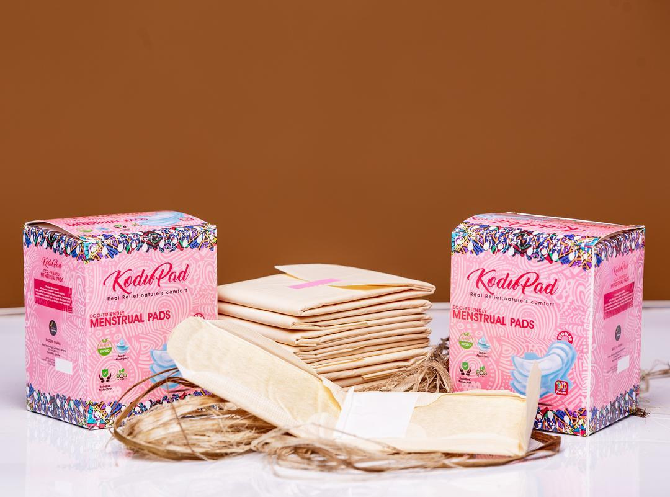


KODU PADS
DIGITAL GROWTH
STRATEGY FOR KODU PADS
Building Awareness, Trust, Community & Sustainable Growth

Slide 2
KODU PADS
BUSINESS OVERVIEW
Kodu Technology is a Ghanaian social enterprise focused on creating sustainable menstural products from agricultural waste
THE PRODUCT
  Biodegradable sanitary pads
  Made using banana and plantain fibres
  Positioned around affordability, sustainability and menstrual-health access
  Sold through selected physical stockists and online/WhatsApp ordering
CURRENT OPPORTUNITY
  Kodu already has a strong story and differentiated product.
  The challenge is turning that differentiation into:
  Awareness → Trust → Easy access → Purchase → Repeat
WHAT WE RECOMMEND
  Educate before selling
  Use sustainability + local innovation as differentiators
  •Make enquiries, purchase and partnership steps easy

Slide 3
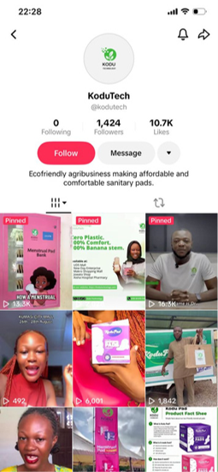
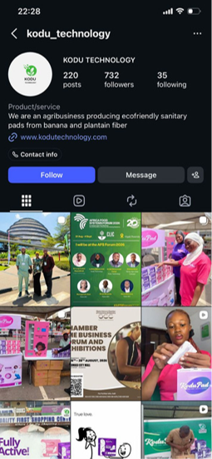
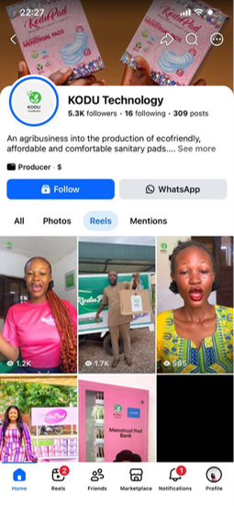
KODU PADS
CURRENT CHANNELS
Kodu pads is doing quite well on Facebook, TikTok and Instagram.
Has no Google Business Profile
WhatsApp
Current role: Customer/order channel
Current problem: The account appears under an individual's name and provides little immediate information about Kodu pads
Website: provides product information and directs customers toward WhatsApp ordering

Slide 4

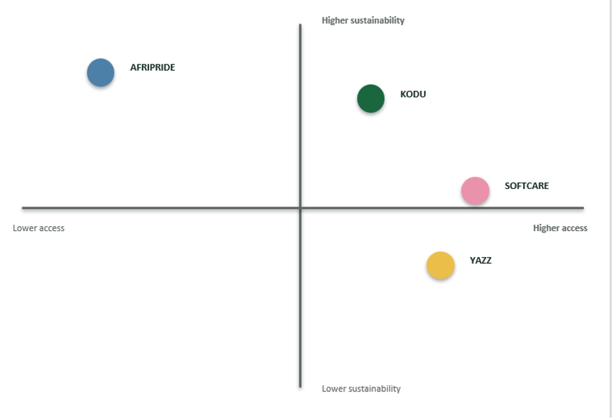
KODU PADS
MARKET ANALYSIS
KEY COMPETITORS
  Yazz — strong awareness and market presence
  • Softcare — affordability and availability
  • Propa — local competition
  • Always / Kotex — established international brands
IMPLICATION FOR KODU
  Do not compete only on price.
  Do not rely on sustainability alone.
  Make product benefits clear and credible.
  Build a distinctive local innovation story.
  Validate competitor price, distribution and digital activity

Slide 5
S
W
O
T
Strengths | Weaknesses | Opportunities | Threats
Unique agricultural-waste innovation Sustainable product proposition Strong social-impact story Ghanaian production Awards & institutional credibility education can improve | Limited distribution Weak digital purchase journey No Google Business Profile WhatsApp not optimised as a business channel Consumer-facing product | Growing sustainability awareness TikTok/short-form education Digital nationwide ordering Schools/NGOs/CSR partnerships Retail/pharmacy expansion | Established menstrual-care brands Strong competitor distribution Price competition Consumer scepticism about product claims Competing eco-friendly products

Slide 6
MARKETING OBJECTIVES
Digital Marketing Goal | KPIs
Increase online brand awareness | 250+ new followers each month across platforms 10,000+ people reached each month
Increase audience engagement | 5%+ average engagement rate each month 500+ monthly content interactions
Increase website visibility and traffic | 20%+ increase in organic website traffic within 6 months 500+ monthly website visits from social media
Generate qualified digital leads | 250+ qualified enquiries each month 150+ WhatsApp enquiries each month
Drive digital conversions | 800+ individual units sold each month 25+ bulk boxes sold each month
Build an engaged digital community | 20%+ of followers actively engaging each month* 20%+ repeat purchase rate within 6 months

Slide 7
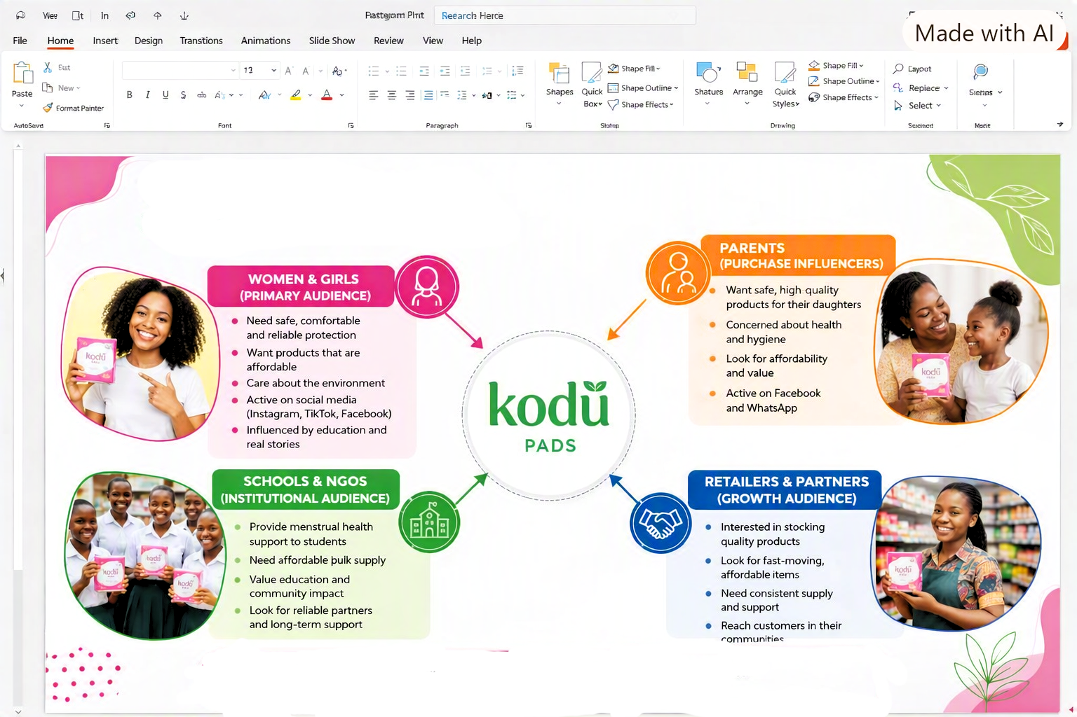
TARGETED AUDIENCE

Slide 8







MARKETING STRATEGY
01
02
03
04
05
06
AWARENESS
CONSIDERATION/ EDUCATION
WHY SHOULD I CARE?”
MENSTRUAL HEALTH MATERIALS SUSTAINABILITY PRODUCT EDUCATION
TRUST
ENQUIRY
CONVERSION
ADVOCACY
  “WHAT IS KODU?”
  .TIKTOK .INSTAGRAM FACEBOOK CREATORS PAID ADS
CAN I BELIEVE KODU?”
  TESTIMONIALS • DEMONSTRATIONS • EXPERT VOICES • PRODUCT PROOF • PARTNERSHIPS
WHERE CAN I GET IT?”
  GOOGLE • WEBSITE • WHATSAPP • STOCKISTS
  MAKE A PURCHASE.
  POST-PURCHASE ENGAGEMENT ENHANCES CUSTOMER SATISFACTION, PROMOTES REPEAT TRANSACTIONS, AND BUILDS LOYALTY.
  “I CHOSE KODU — YOU SHOULD TOO.”
  REVIEWS •
  UGC REFERRALS COMMUNITY

Slide 9







DIGITAL PLATFORM STRATEGY
CHANNEL | KET CONTENT | ROLE
 | Reels & carousels, product stroytelling, Brand building. | Awarenes + trust
 | Answer questions, conversion route, take oders, partnership enquiries. | Conversion
 | Impact, CSR, Case studies | partnerships
 | short educational videos, relatable ontent,Myth vs Fact | Discovery
 | Search+ Maps + | Internet
 | Community, Parent-focused education, Campaigns | Reach + community
 | Awareness reach | Blog post about period hygine

Slide 10










CONTENT STRATEGY
EDUCATE
CONVERSION
  PRICES, WHERE TO BUY, ORDER INSTRUCTIONS, BUNDLE OFFERS, RESELLER LOCATIONS, AND PARTNERSHIP CALLS TO ACTION.
  MENSTRUAL-HEALTH EDUCATION
  PERIOD HYGIENE, CHANGING PADS, MANAGING PERIODS AT SCHOOL.
PRODUCT
COMMUNITY AND IMPACT
PRODUCT CONFIDENCE
  PRODUCT FEATURES, ABSORBENCY DEMONSTRATIONS, PACKAGING,
SUSTAINABILITY
  GIRLS’ STORIES, SCHOOL PROGRAMMES, PAD BANKS, WOMEN’S EMPOWERMENT, FARMER CONNECTIONS, AND PARTNERSHIP RESULTS.
  BANANA AND PLANTAIN FIBRES, AGRICULTURAL WASTE, BIODEGRADABILI-TY ,CLAIMS, AND RESPONSIBLE DISPOSAL.

Slide 11
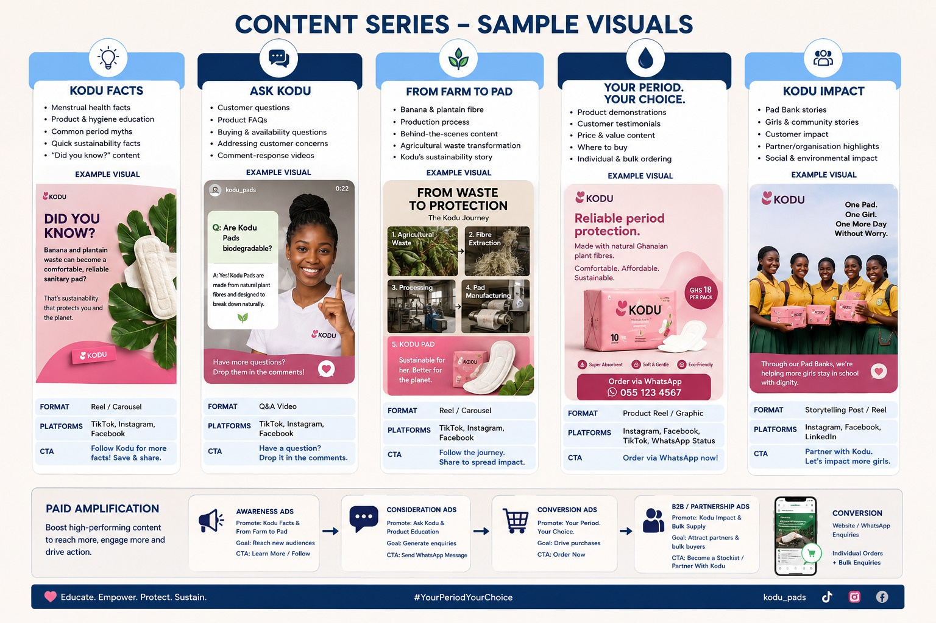

Slide 12






PARTNERSHIP & COMMUNITY GROWTH
SCHOOLS
NGOs / ORGANISATIONS
RETAIL / CORPORATE
• Menstrual-health education
• Product access
• Bulk supply opportunities
• Programme partnerships
• Community outreach
• Impact stories
• Retail distribution
• CSR initiatives
• Bulk purchase & referral partnerships

Slide 13


SIX-MONTH IMPLEMENTATION ROADMAP
MONTH 1
MONTH 2 -3
MONTH 4-5
MONTH 6
• Digital audit
• Improve profiles
• Optimise WhatsApp
• Set KPI baseline
• Launch content pillars
• Run awareness tests
• Launch campaign
• Build community
Lead generation
• WhatsApp conversion
• Partnership outreach
• Retargeting interest
Review results
• Identify winners
• Fix weak areas
• Scale what works

Slide 14
BUDGET, ROI & EXPECTED OUTCOMES
ACTIVITY | BUDGET
Paid social / lead generation | GH₵ 8,000
Content production | GH₵ 3,500
Creators / influencers | GH₵ 3,000
Community activations | GH₵ 2,000
Google/Search + local discovery | GH₵ 1,000
WhatsApp/CRM optimisation | GH₵ 1,000
Contingency | GH₵ 1,500
TOTAL | GH₵20,000
GHS 40,000 Total Investment
↓
5,000 Individual Packs + 150 Bulk Boxes
↓
GHS 86,000 Projected Revenue
↓
GHS 46,000 Revenue Surplus
↓
115% Projected Revenue-Based ROI

