Slide 1
Result of Final Project
Ishwari & Ming
2026 Dsa
Notes:
Self introduction
Title. Hyperspectral imaging or HSI
department

Slide 2
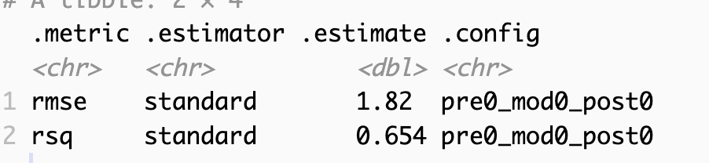
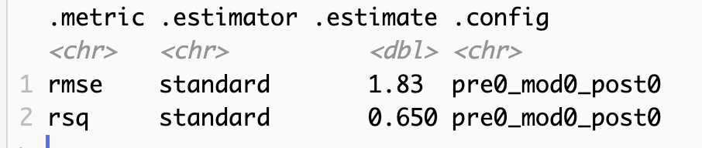
Result of prediction on test set
First model: XGBoost
Second model: LIGHTGBM
Notes:
That’s why we need Hyperspectral imaging
Before that, we need to learn about spectral info
Our environment contains
Their 400-700 band, and RGB
But the HIS has hundreds of countinuos bands
So now we have 2-dimensional spatial info, plus 1 dimensional spectral info
That’s why we can load this image as 3-d cube into numpy in PY

Slide 3
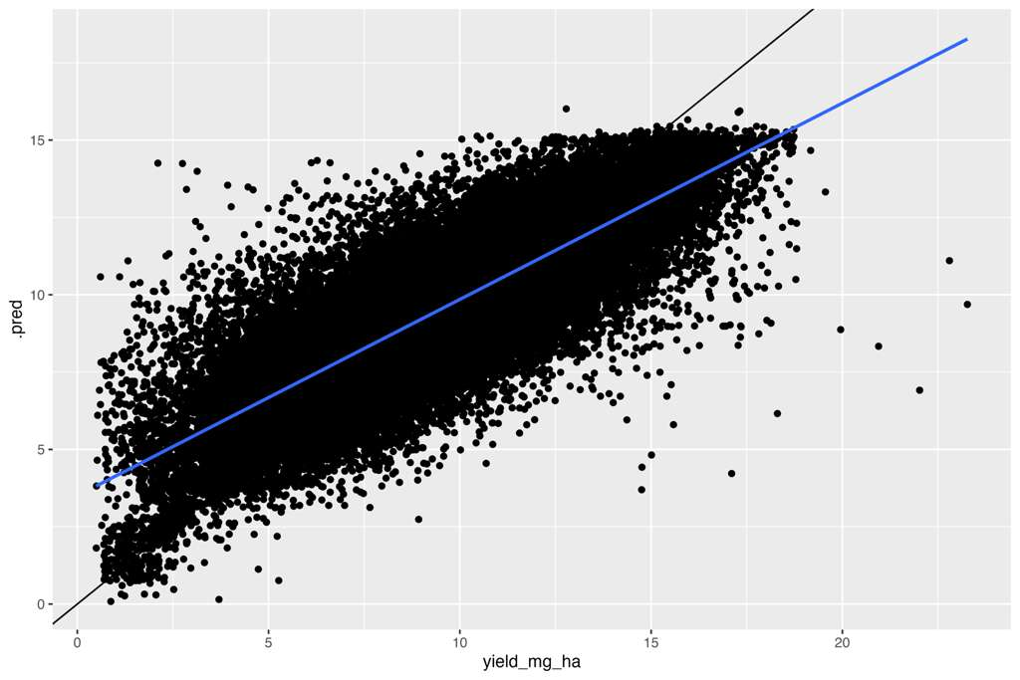
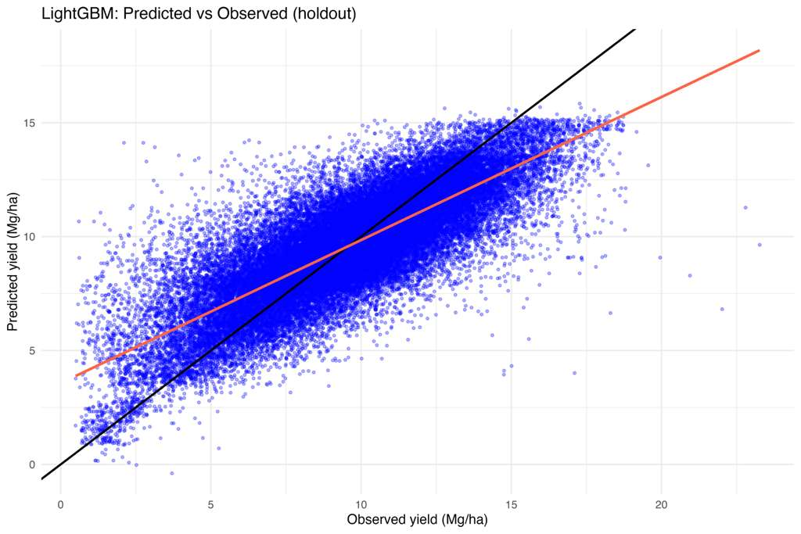
Predicted vs Observed Plot
Notes:
That’s why we need Hyperspectral imaging
Before that, we need to learn about spectral info
Our environment contains
Their 400-700 band, and RGB
But the HIS has hundreds of countinuos bands
So now we have 2-dimensional spatial info, plus 1 dimensional spectral info
That’s why we can load this image as 3-d cube into numpy in PY

Slide 4
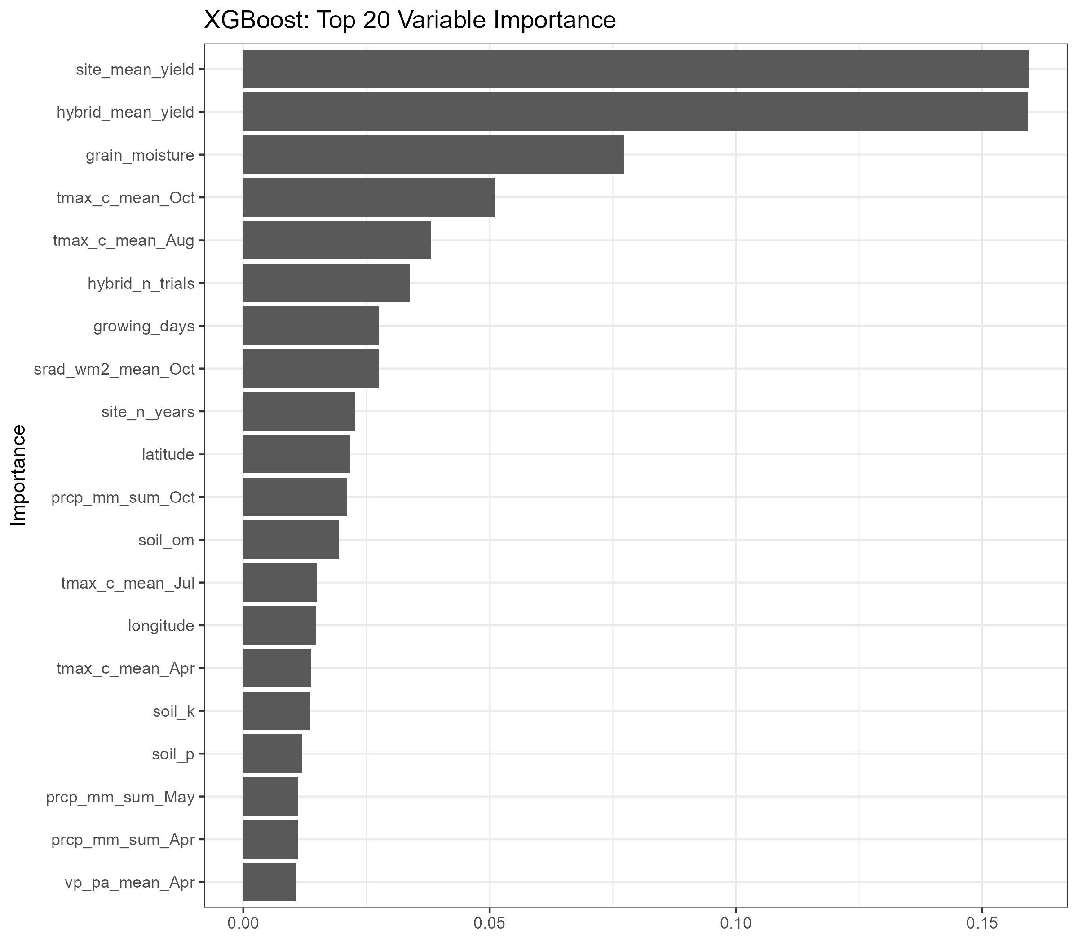
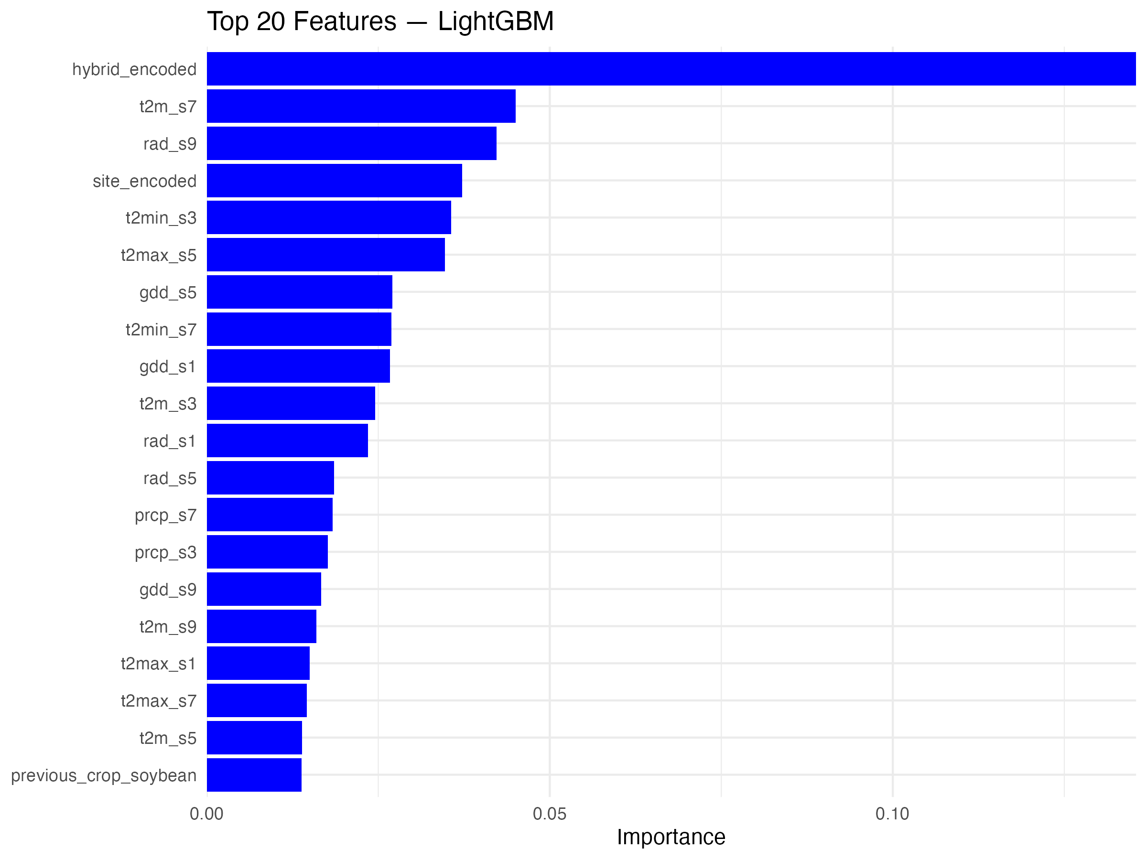
Variable Importance
Notes:
That’s why we need Hyperspectral imaging
Before that, we need to learn about spectral info
Our environment contains
Their 400-700 band, and RGB
But the HIS has hundreds of countinuos bands
So now we have 2-dimensional spatial info, plus 1 dimensional spectral info
That’s why we can load this image as 3-d cube into numpy in PY

Slide 5
Shiny app
🌽 Corn Yield Prediction – XGBoost R² = 0.6536 RMSE = 1.8177 Mg/ha
Notes:
That’s why we need Hyperspectral imaging
Before that, we need to learn about spectral info
Our environment contains
Their 400-700 band, and RGB
But the HIS has hundreds of countinuos bands
So now we have 2-dimensional spatial info, plus 1 dimensional spectral info
That’s why we can load this image as 3-d cube into numpy in PY

