Slide 1

Capstone Project: Continuous Integration and Continuous Deployment (CI/CD)
By: Benjamin Ortiz Jr.
AFS-205 Week 7 Capstone Project

Slide 2
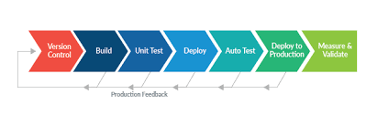
Continuous Integration and Continuous Deployment (CI/CD)

Slide 3
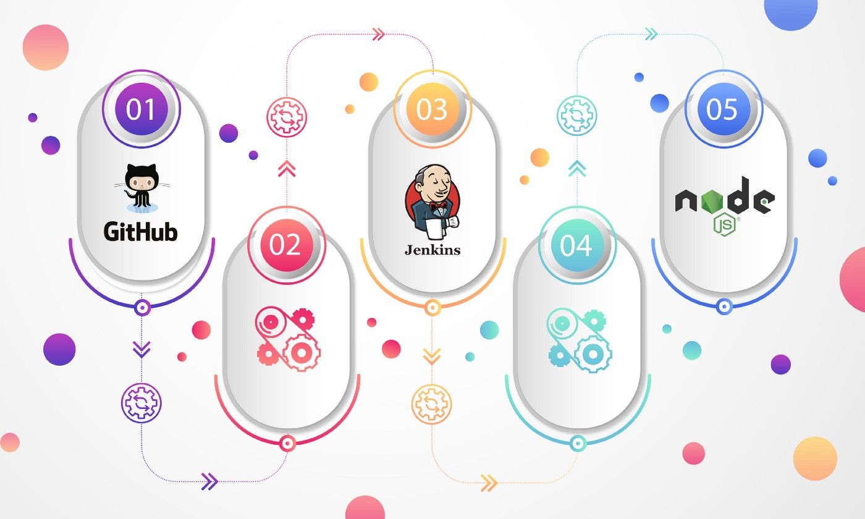
CI/CD Pipeline for a Node.js app with Docker & Jenkins

Slide 4

Requirements for the CI/CD Pipeline
Java 1.8.0 251, x86 64
Docker Version 19.03.8
Docker Hub Account
Jenkins 2.235.5
Jenkins Account

Slide 5
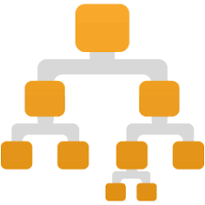
File Structure
. ├── Dockerfile ├── README.md ├── app.js ├── package.json ├── public │ └── images │ └── docker.jpg ├── test │ └── test-server.js └── views └── index.ejs

Slide 6
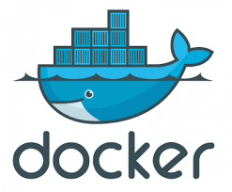
Configuring the Docker file
The Docker file is configured to use the official Docker image for node.js
1 FROM node
2 WORKDIR /usr/src/app
3 COPY package*.json ./
4 RUN npm install
5 COPY . .
6 EXPOSE 3000
7 CMD [“node”, “app.js”]

Slide 7
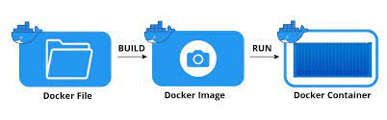
Building the docker image
We then build the docker image using the command:
$ docker build -t bortizjr84/nodeApp:v1 .

Slide 8
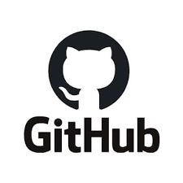
Configure GitHub Repo
Next, we would create a GitHub repository and then clone this repo on our local machine.
In order to do this from our local machine we have to set up a web-hook. However, this only works over a public IP, so we need to create a reverse proxy for a secure tunnel from github to our Jenkins web service.
The Jenkins service runs on http://localhost:8080/ by default. We need to forward this to a public address such as https://naistangz-hqujjbbo.socketxp.com/github-webhook/.

Slide 9

Socketxp.com
In order to setup this secure tunnel we have to use a service called Socketxp.
Install Socketxp via a terminal for macOS or download exe file for Windows.
Sign up for an account and get Login Token.
The login token will allow you to setup a secure tunnel from your local machine running Jenkins to your GitHub webhook.
You then go back to the GitHub repository and setup the webhook.

Slide 10

Configuring Jenkins
We need to install Jenkins.
You will need to have Java installed.
You can choose to run Jenkins locally or assign a domain.
We can install Jenkins using homebrew
We can start Jenkins up by entering $ brew services start jenkins-lts
Jenkins runs on port 8080 by default.

Slide 11
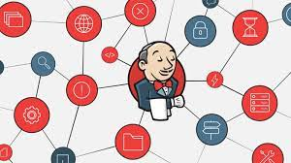
Jenkins Plugins
For this project, the below list of plugins is required:
Blue Ocean
Credentials Plugin
Docker Plugin
GitHub Plugin
NodeJS Plugin
Oracle Java SE Development Kit Installer Plugin
Pipeline Plugin
Timestamper

Slide 12
Create Continuous Integration Build
Select new project in Jenkins and complete the initial project setup
Set days to keep build
Select Git in the Source Code Management section
Enter GitHub project URL and branch name after “*/”
Set GitHub hook trigger for GITScm polling
In the Build Environment section Add timestamps to console output and Provide Node and npm bin/folder to PATH.
The Nodejs plugin via Jenkins will test out app every time we commit a change to GitHub.

Slide 13
Create Continuous Integration Build (cont.)
The add npm install & npm test in the Build section in the execution shell
Select the “Push Only if Build Succeeds” and “Merge Results” options.

Slide 14
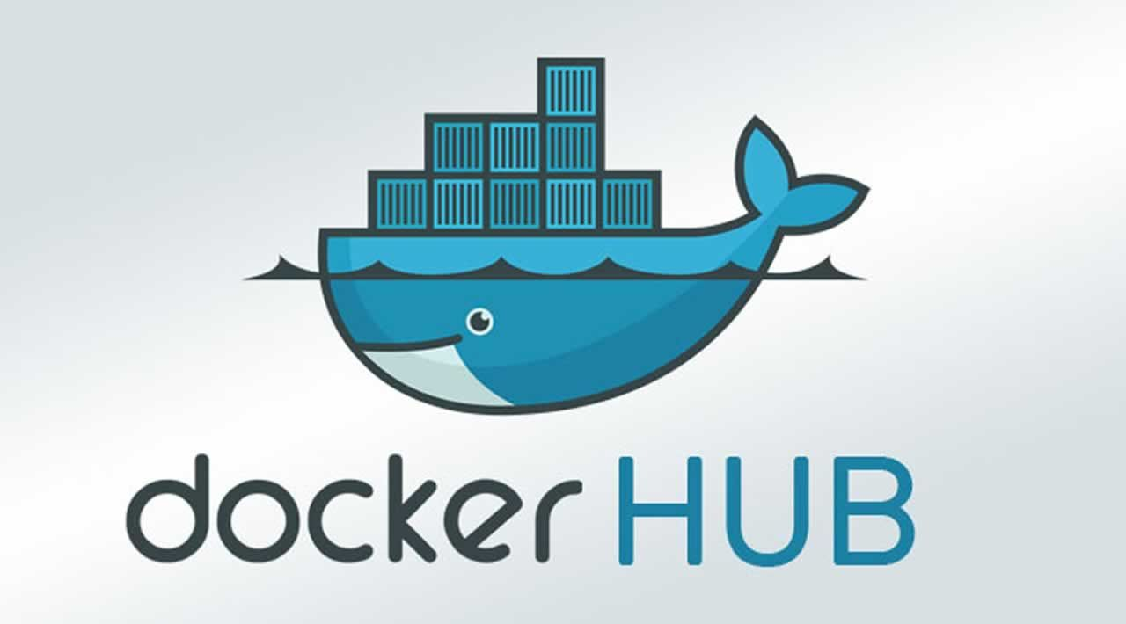
Docker Hub Setup
Create a Docker Repo and record the name of the repo
Enter Docker Hub credentials on Jenkins using Credential plugin
You can then create your project in Jenkins and select Pipeline
Setup your build triggers
Create script to tell Jenkins to create a Docker Image and deploy to Dockerhub.
Pipeline script is using the Apache Groovy programming language
Add script to pipeline script section

Slide 15
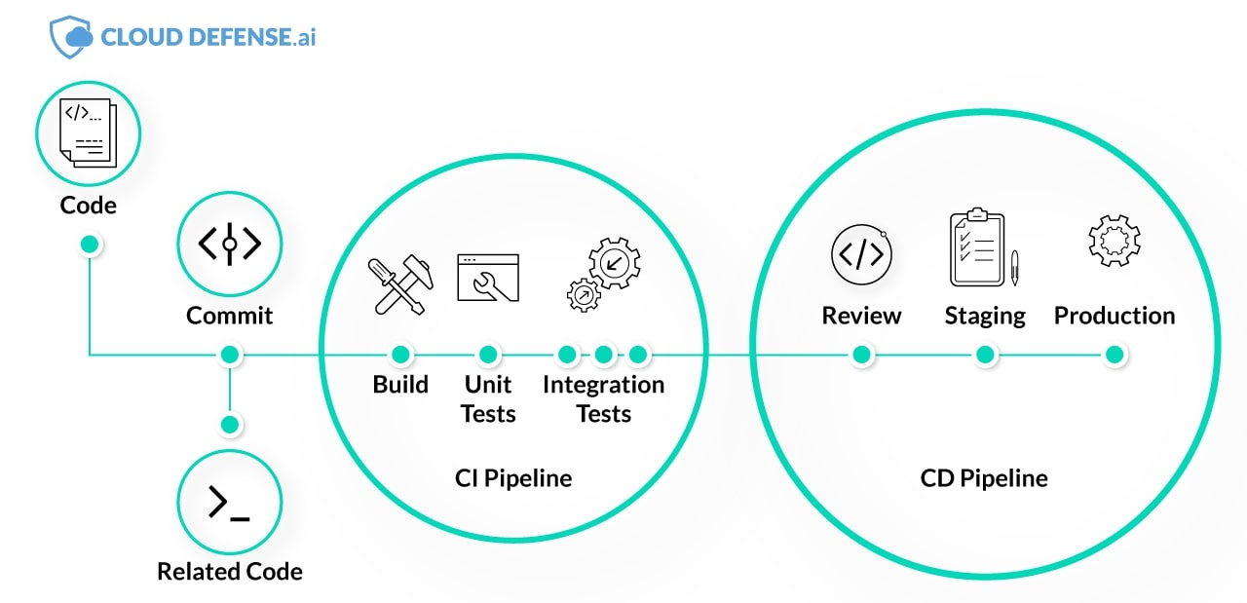
Our CI/CD Pipeline is Now Setup!!!
To test our pipeline, we can commit some code changes to our github repository and watch our app move across the pipeline.
We can use the Blue Ocean plugin to get a GUI to see our app go through the different phases of the pipeline.

Slide 16

By: Benjamin Ortiz Jr.
Capstone Project: Continuous Integration and Continuous Deployment (CI/CD)
Sources:
https://medium.com/@naistangz/building-a-ci-cd-pipeline-for-a-node-js-app-with-docker-and-jenkins-ee6db6e70d25
https://www.socketxp.com/docs/guide/
https://www.jenkins.io/doc/book/installing/windows/
https://stackoverflow.com/questions/33766275/i-need-help-setting-up-a-github-webhook-with-a-localhost-jenkins

