Slide 1
Trees, Admixture graphs and population structure

Slide 2
Using trees to describe
(human) population structure

Slide 3
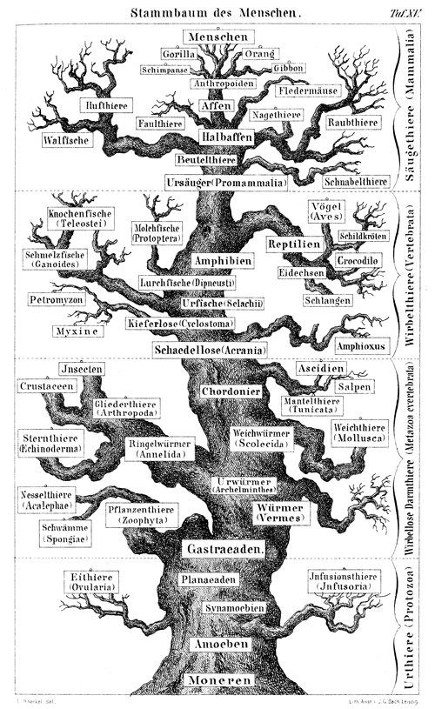

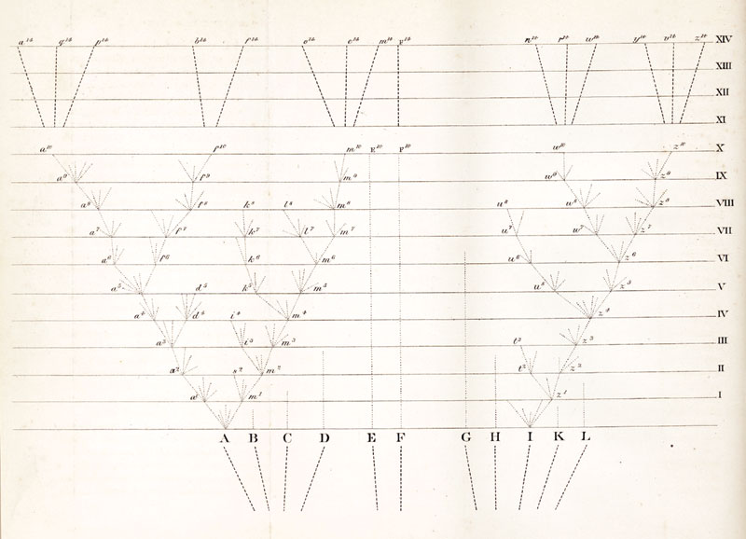
Trees are foundational to Systematics and Evolution
Wikipedia.org; Darwin 1859, Haeckel 1868

Slide 4
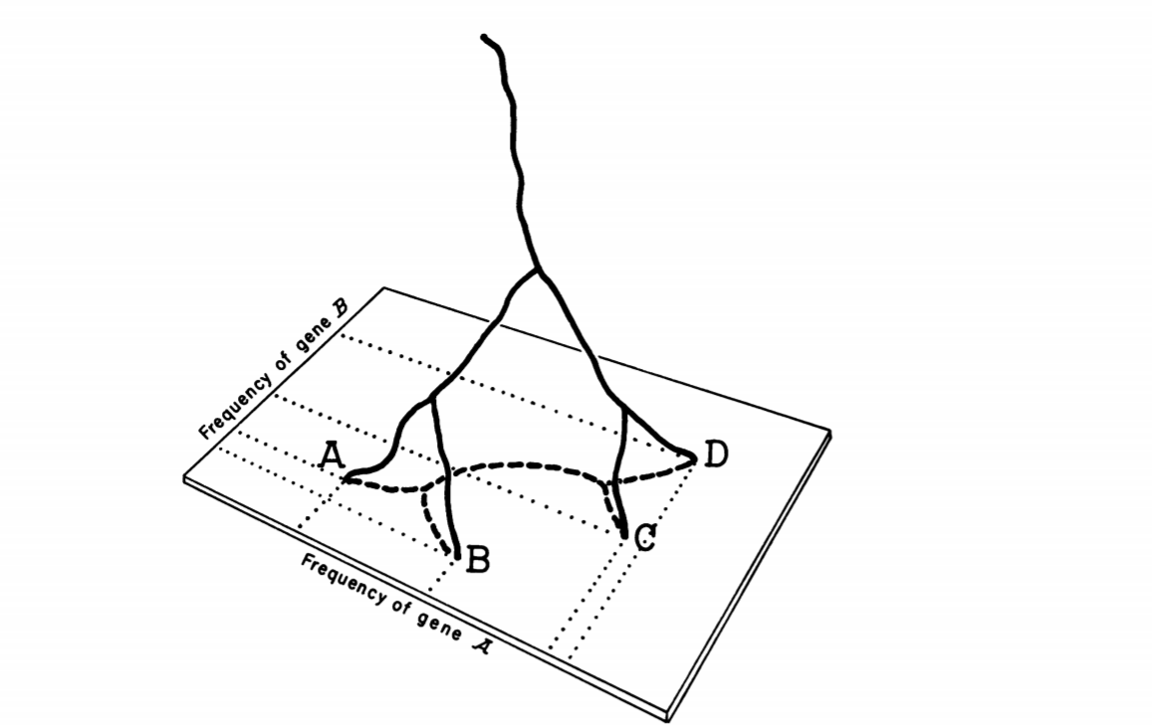
Where do trees come from?
Cavalli-Sforza & Edwards, 1967

Slide 5
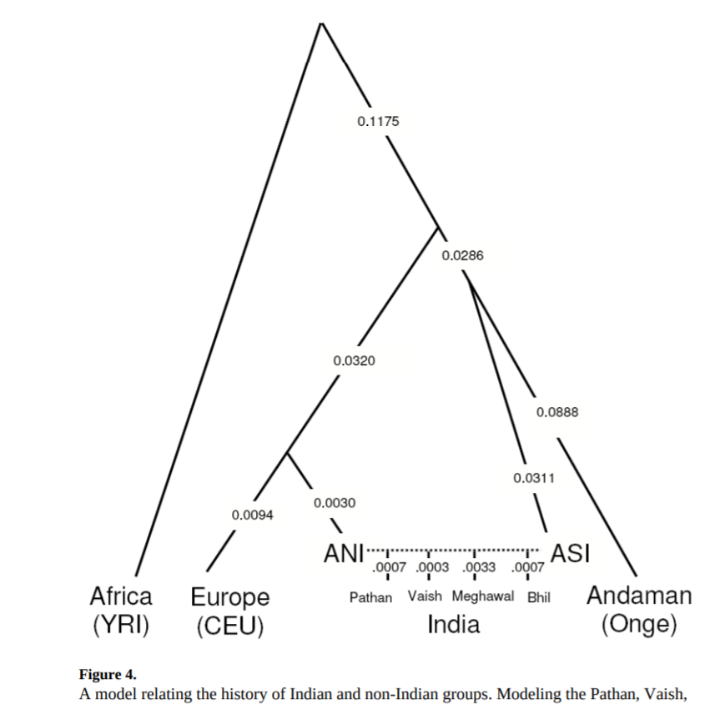
But when does this model break?
Reich et al. 2009

Slide 6
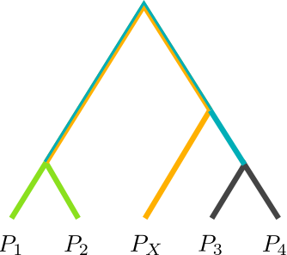
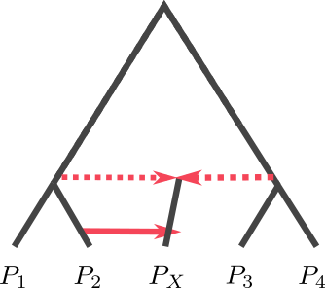
Trees and Admixture Graphs

Slide 7


Estimating Admixture Graphs
Admixtools / treemix

Slide 8
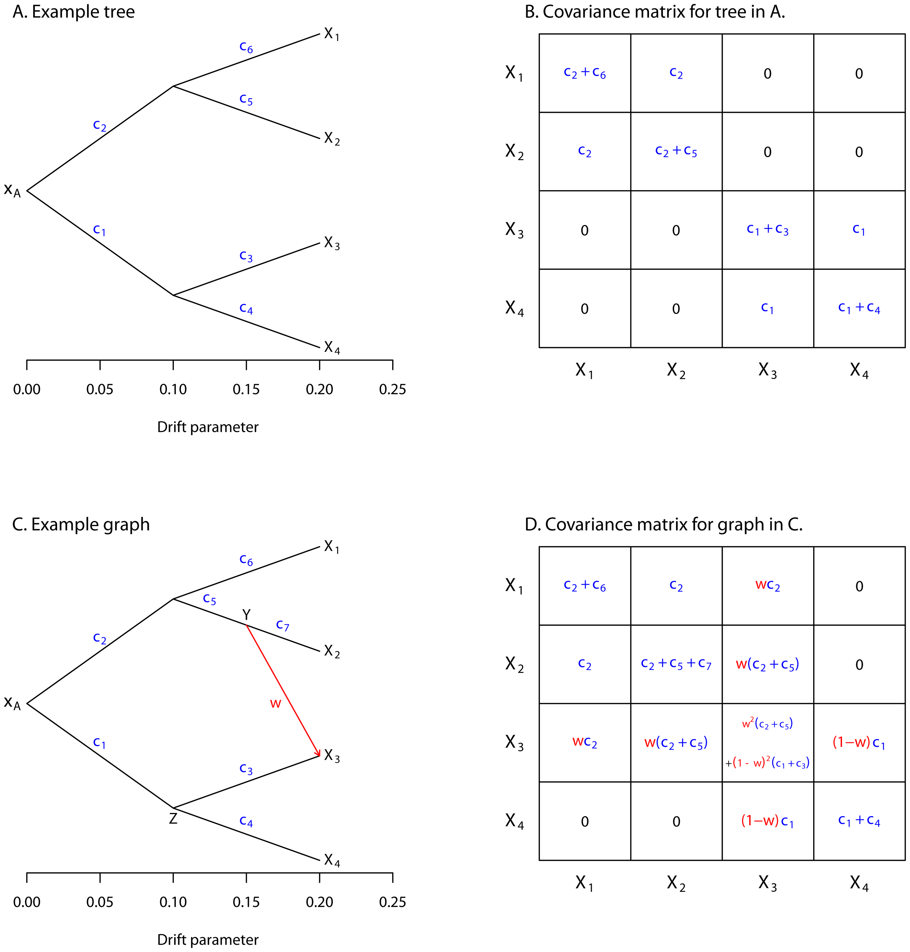

Slide 9
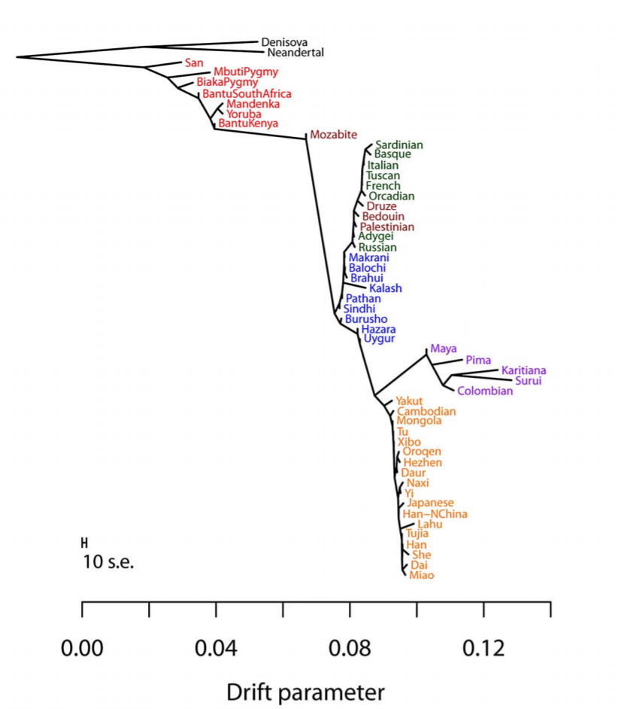
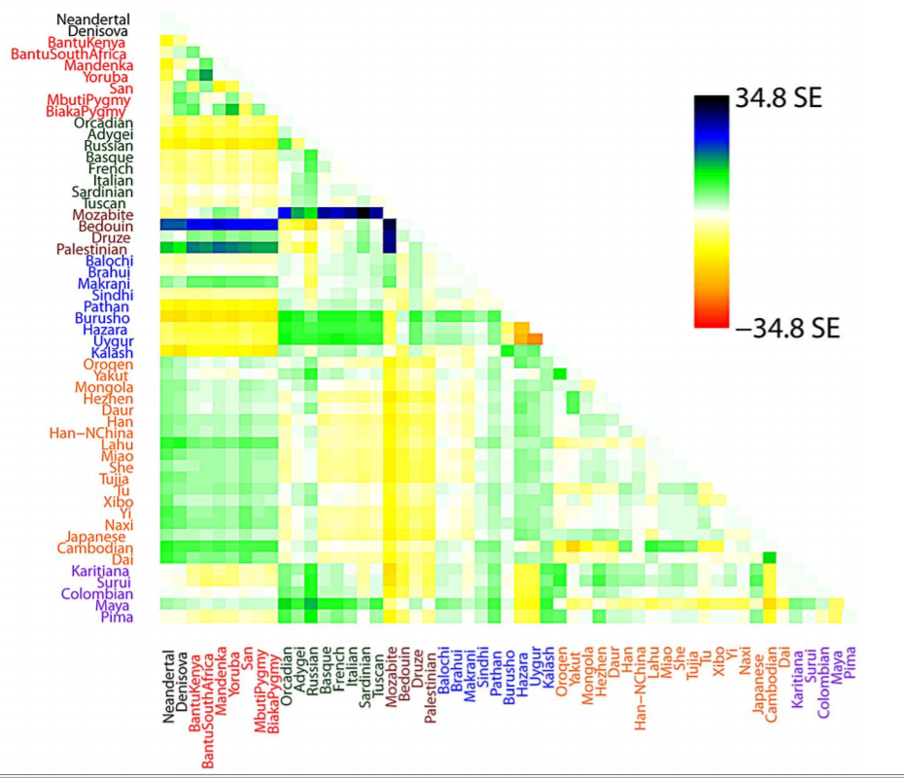

Slide 11
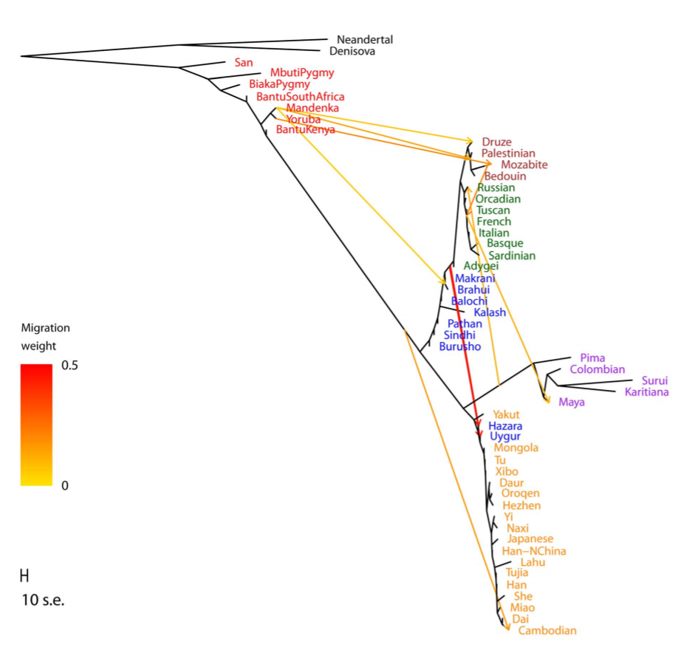

Slide 12
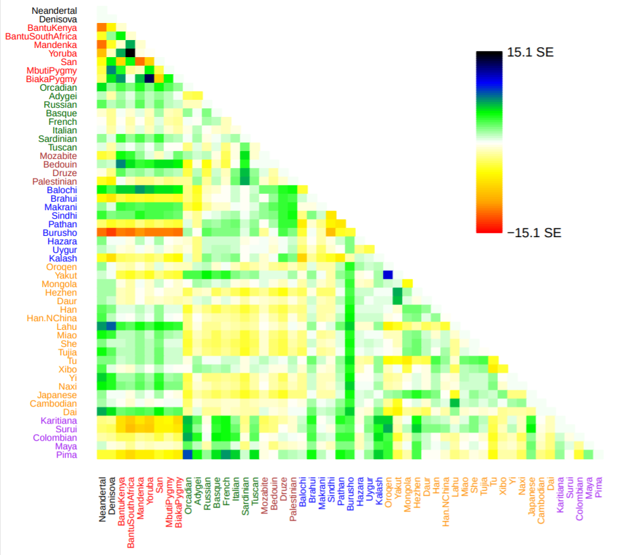

Slide 13
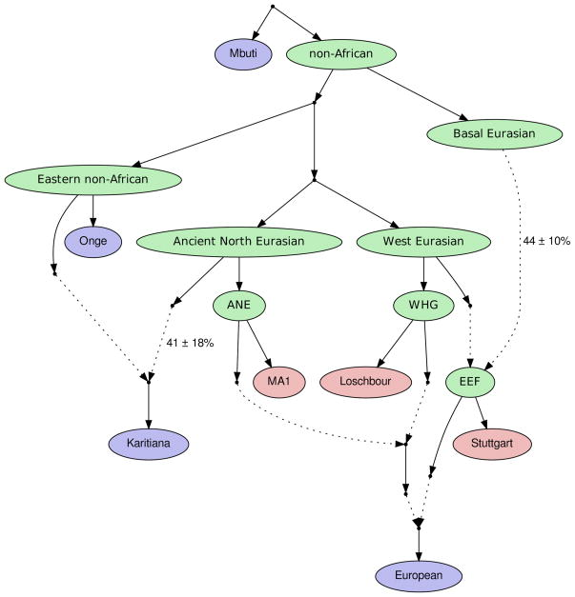
Admixture graphs
Lazaridis et al. 2014, Nature

Slide 14
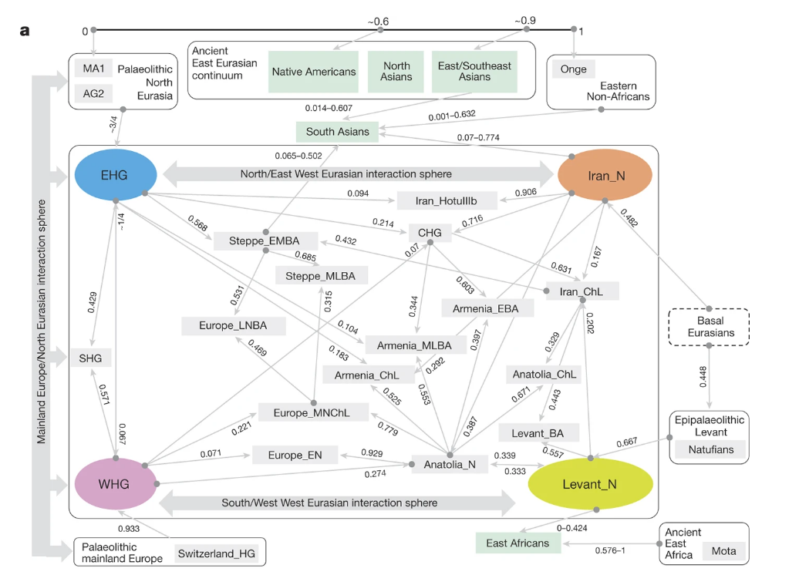
Lazaridis et al. 2016, Nature

Slide 15
Practical Considerations: Which approach should I use?
Admixture
PCA
Trees / Admixture Graph
All of the above?

Slide 16
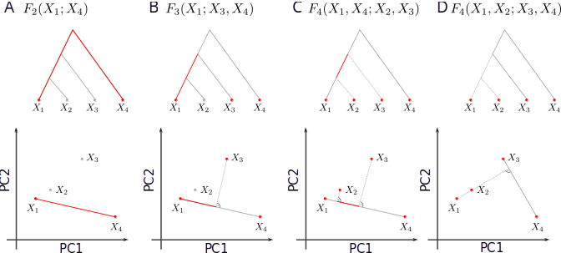
Trees vs PCA

Slide 17
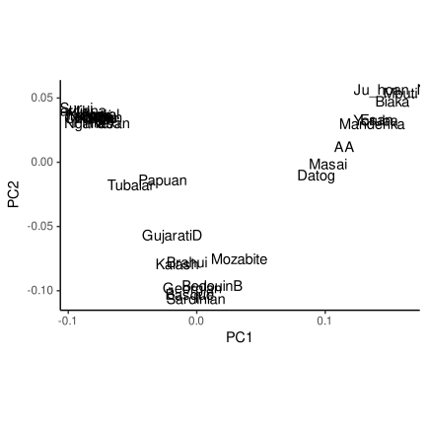
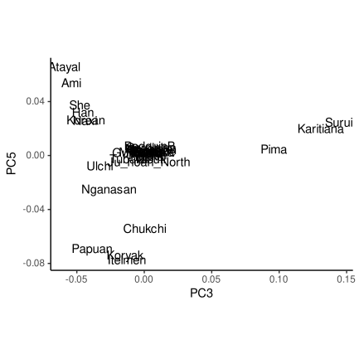
Trees vs PCA
PCA on worldwide data
PCA on Eurasian data

Slide 18
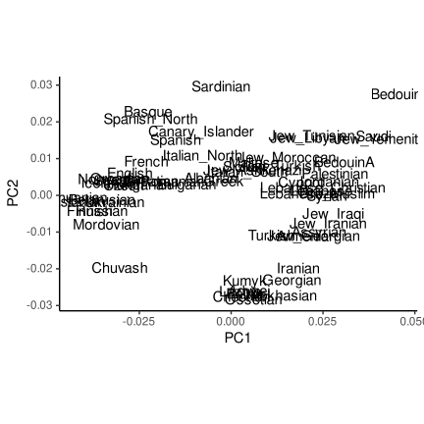
Trees vs PCA
PCA on worldwide data
PCA on Eurasian data

Slide 19
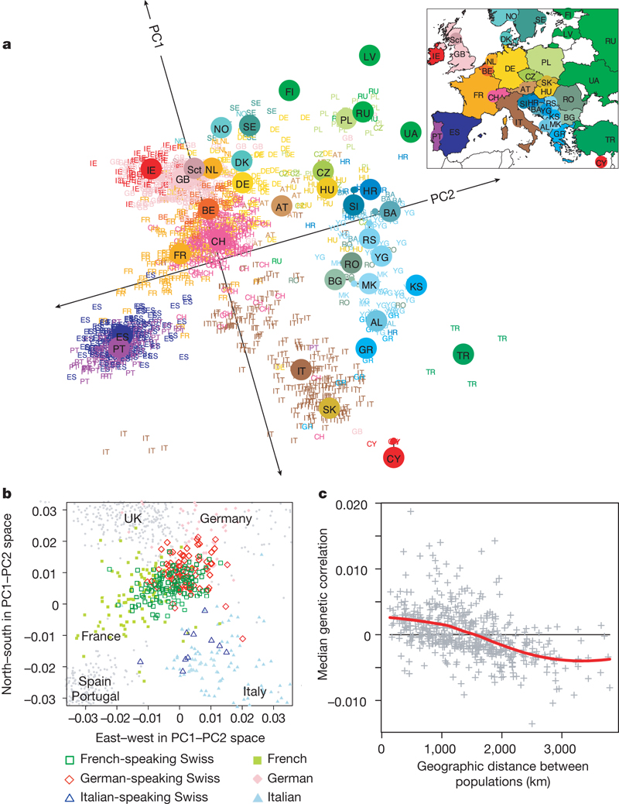
Many other possibilities

Slide 20
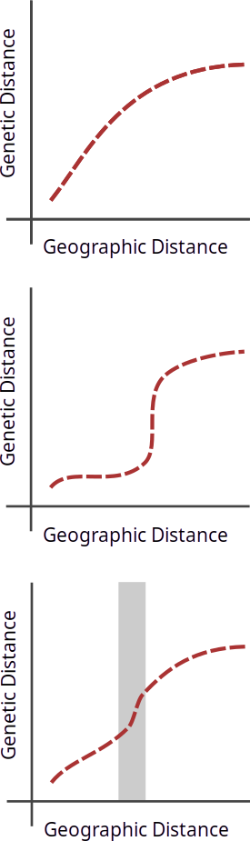
Spatial structure

Slide 21
Discrete structure

Slide 22
Inferring discontinuities

Slide 23



EEMS: Estimating Effective Migration Surfaces
Petkova, Novembre & Stephens (2016)

Slide 24


Slide 25
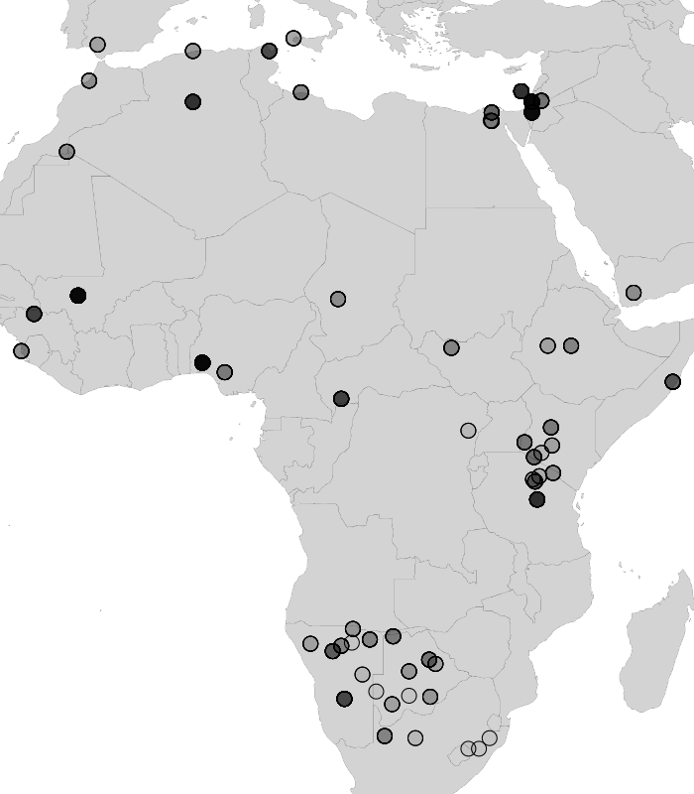

Slide 26
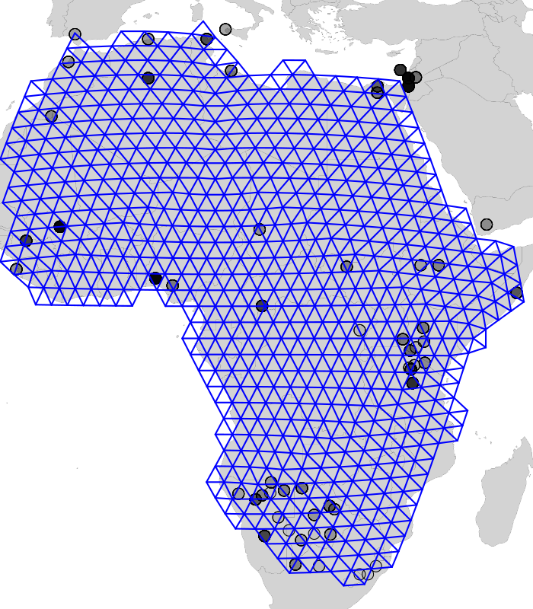

Slide 27
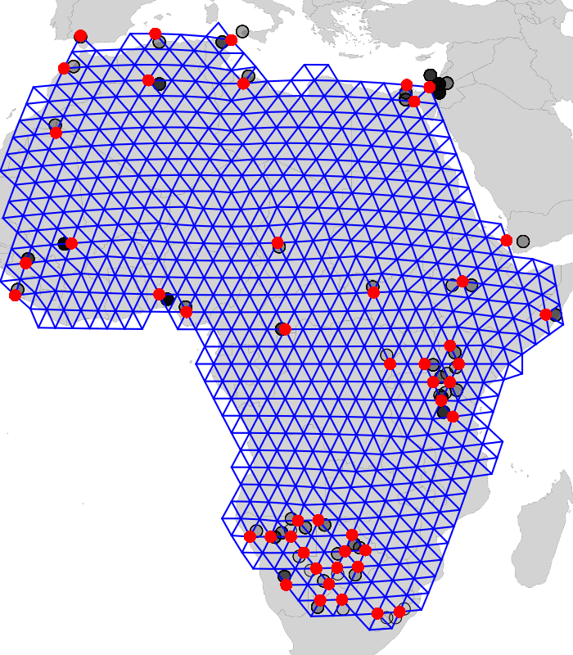

Slide 28
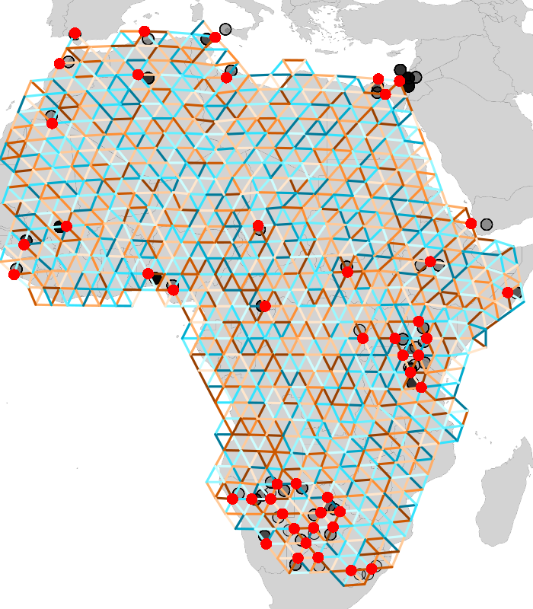
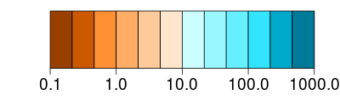
Migration Rate

Slide 29
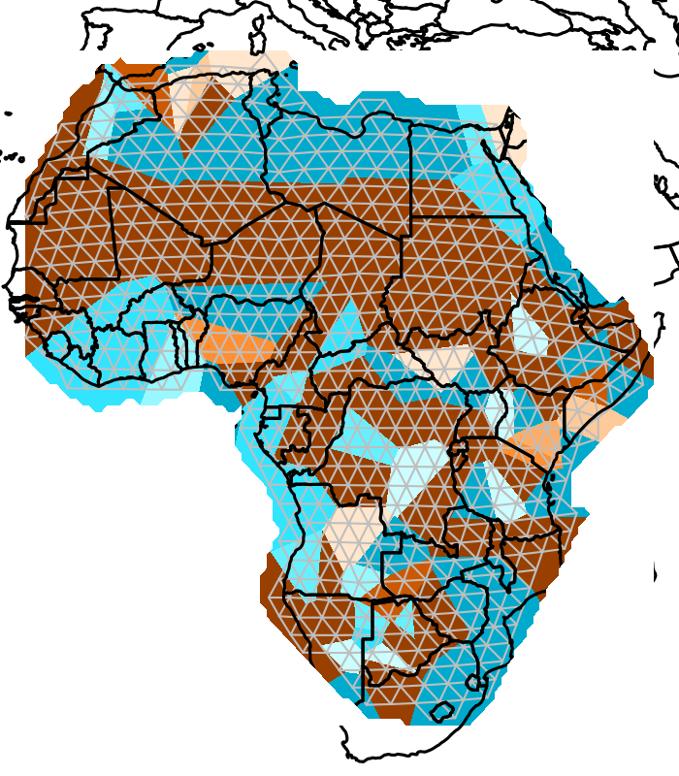
Migration Rate

Slide 30
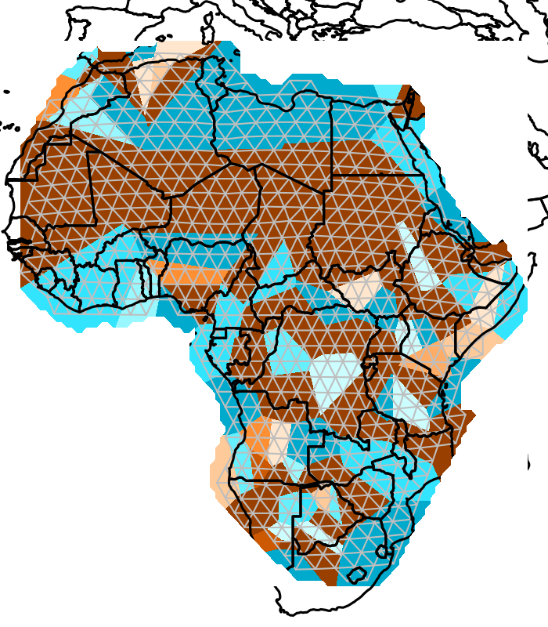
Migration Rate

Slide 31
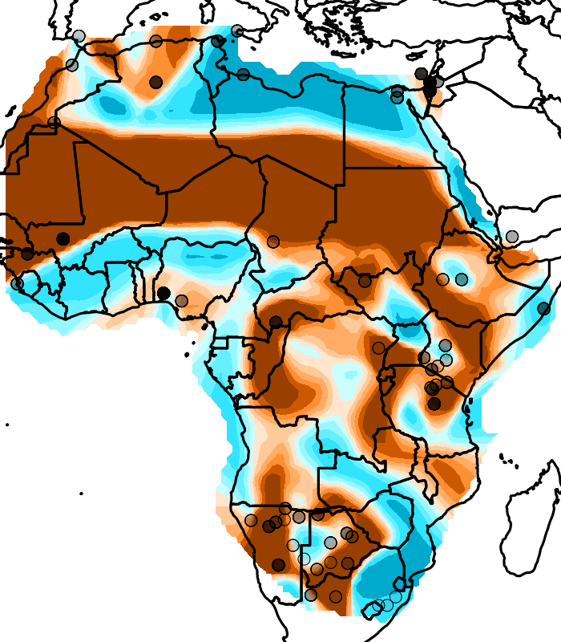
Migration Rate

Slide 32
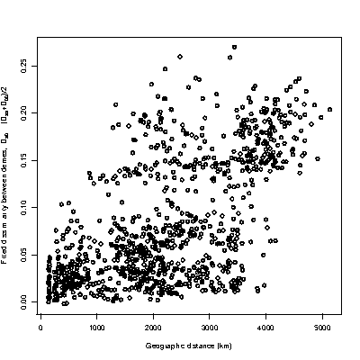
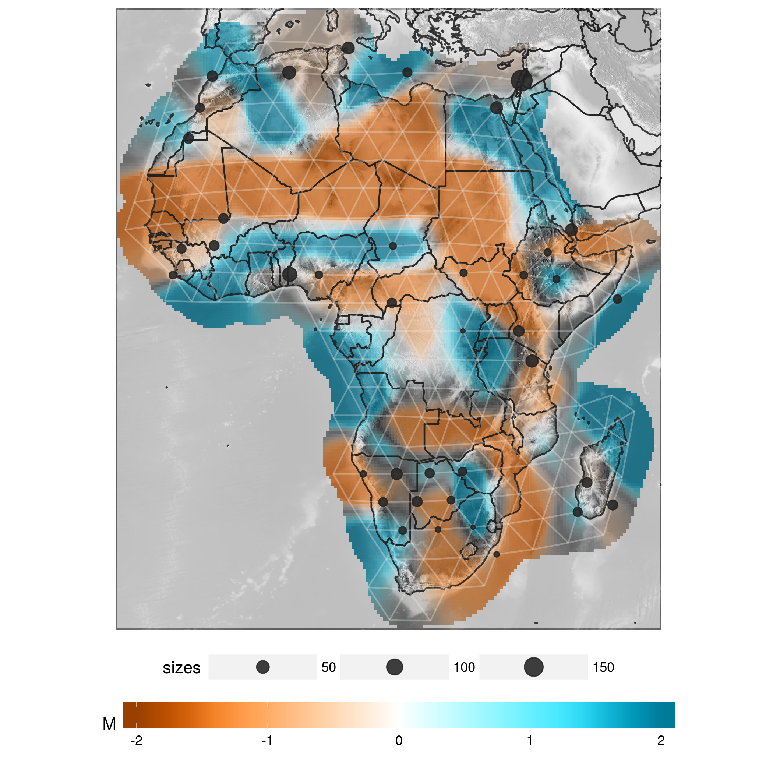
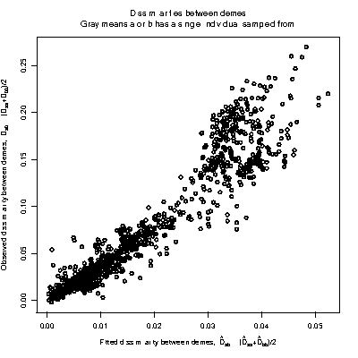
Genetic distance
Genetic distance
Geographic distance
Migration Rate
Fitted circuit distance
Fitted circuit distance

Slide 33
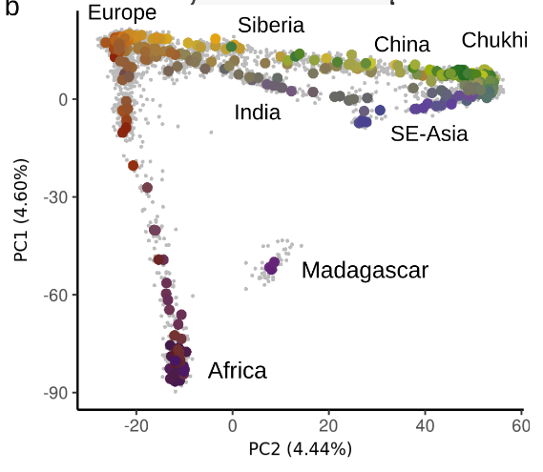
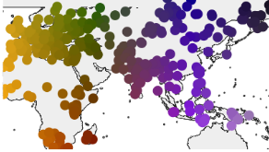
Example

Slide 34
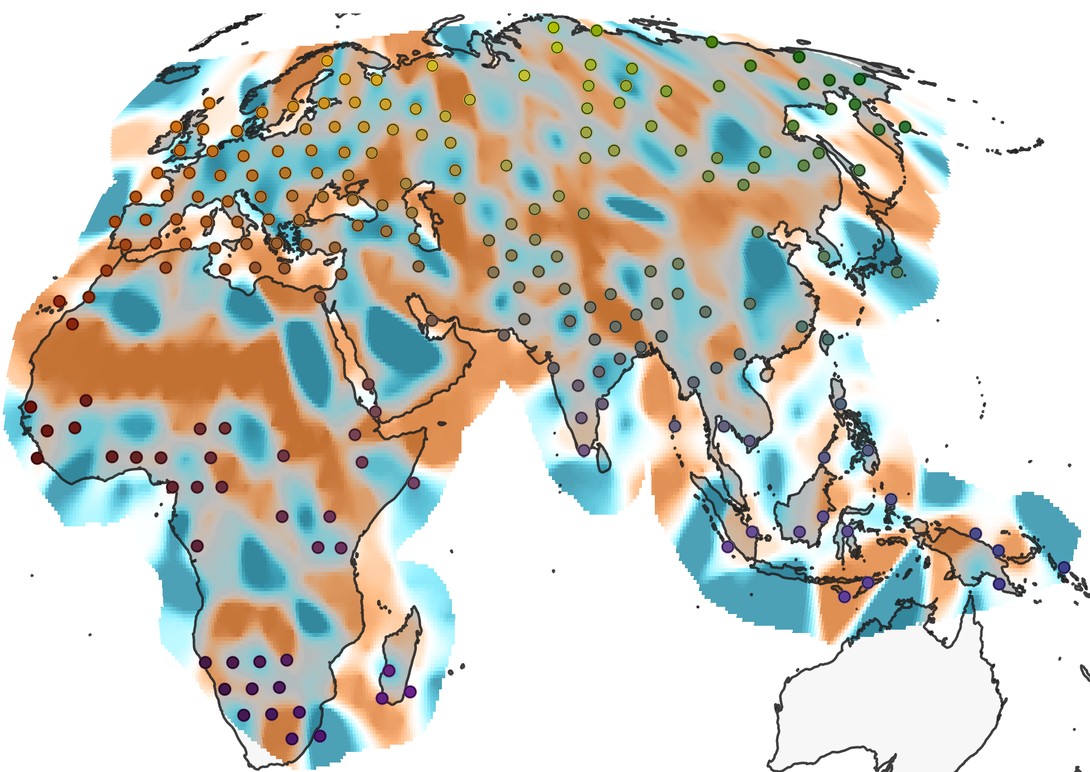

Slide 35
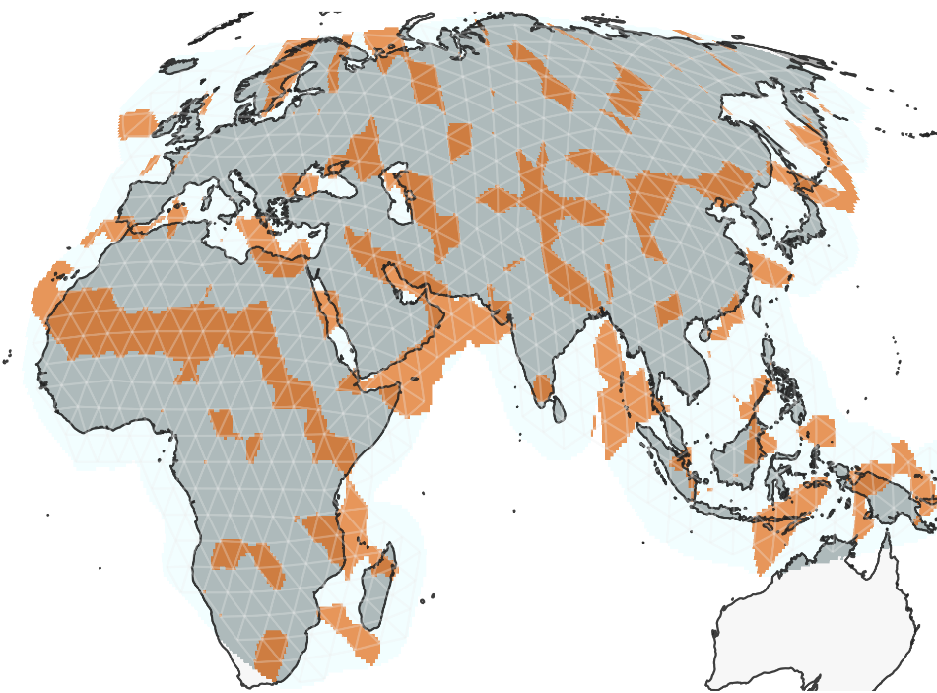

Slide 37
When should we use trees/admixture graphs?
Trees / Admixture graph
Sparse structure / sampling
Hierarchical structure
Large time scales
Spatial/continuous models
High-density sampling
Small time scales
Continuous structure

