Slide 1
Trees, Admixture graphs and population structure

Slide 2
Using trees to describe
(human) population structure

Slide 3
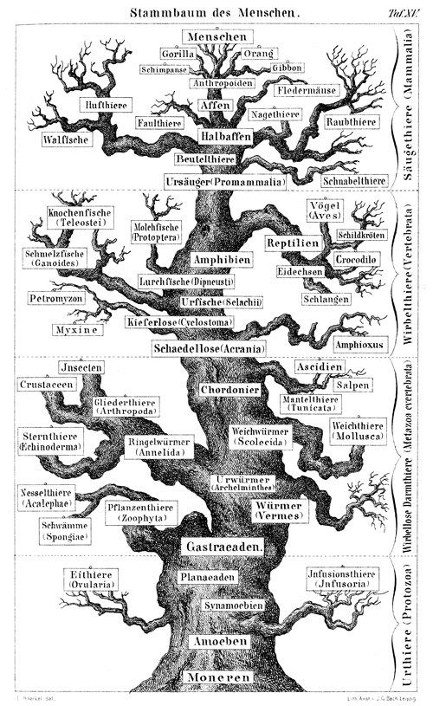
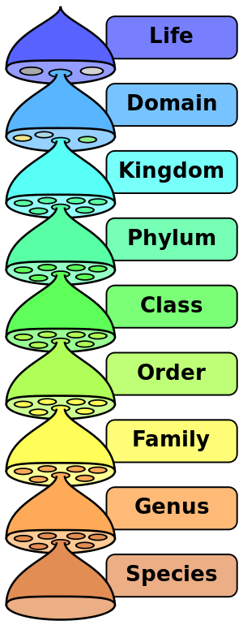
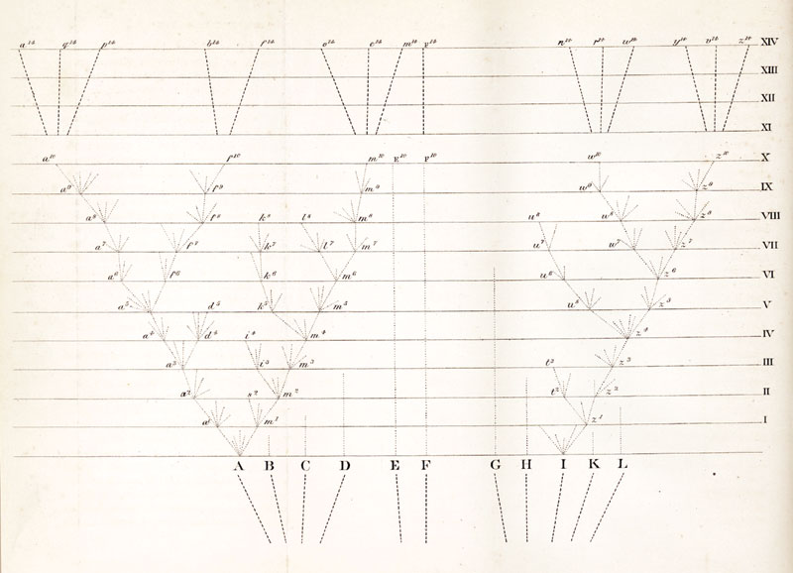
Trees are foundational to Systematics and Evolution
Wikipedia.org; Darwin 1859, Haeckel 1868

Slide 4
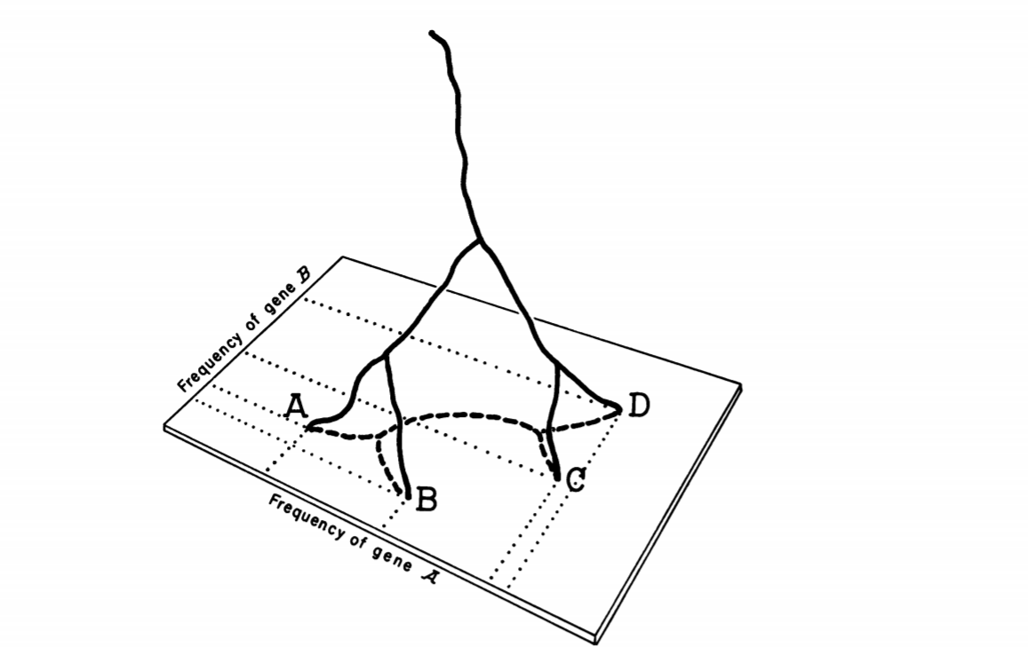
Where do trees come from?
Cavalli-Sforza & Edwards, 1967

Slide 5
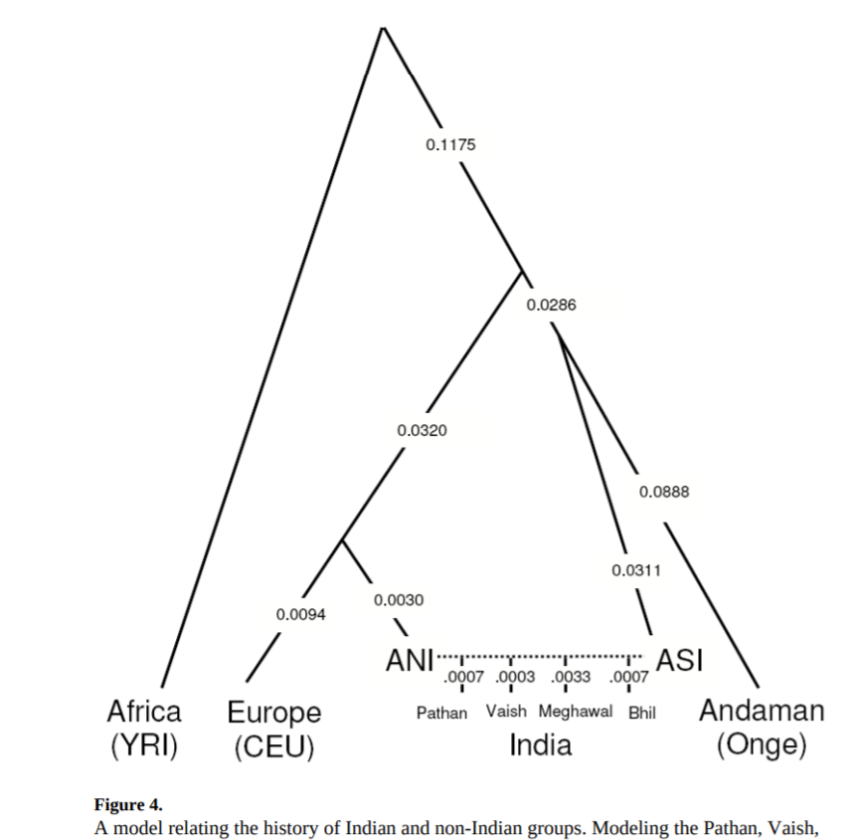
But when does this model break?
Reich et al. 2009

Slide 6
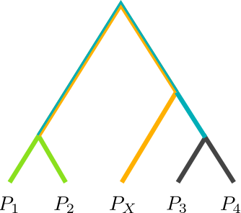
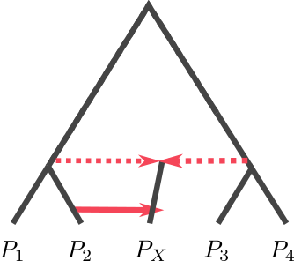
Trees and Admixture Graphs

Slide 7


Estimating Admixture Graphs
Admixtools / treemix

Slide 8
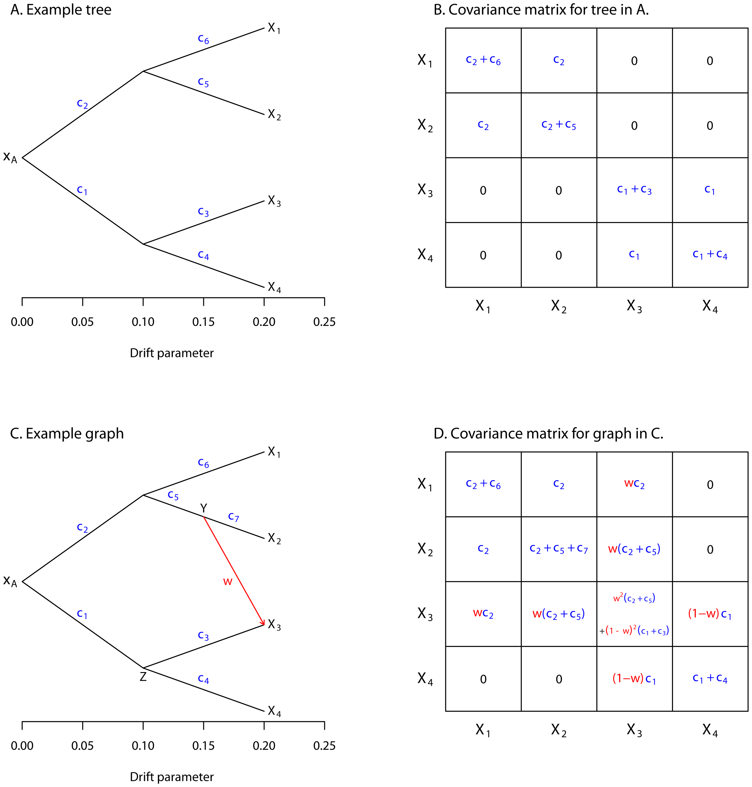

Slide 9
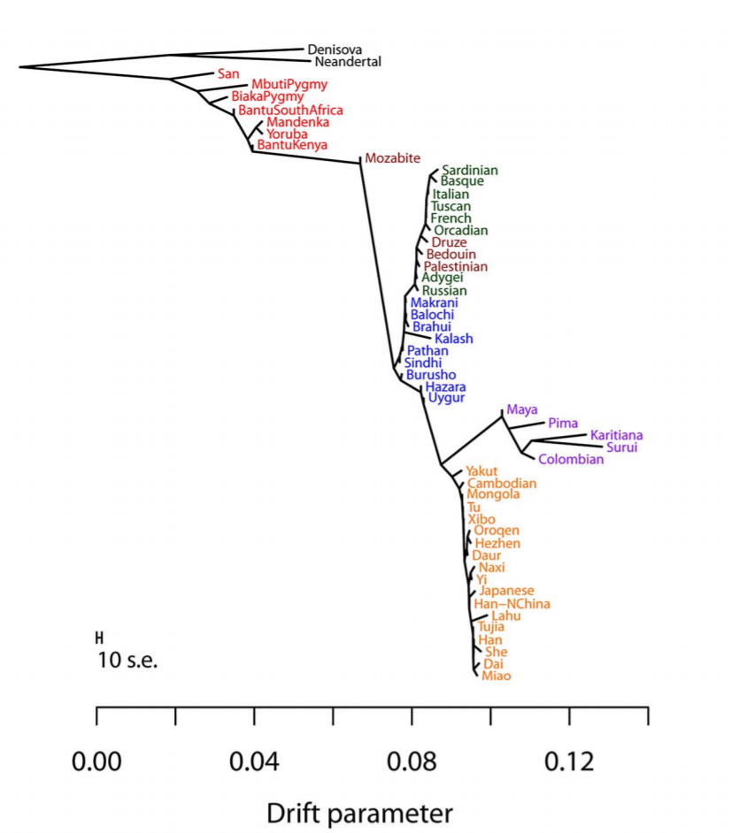
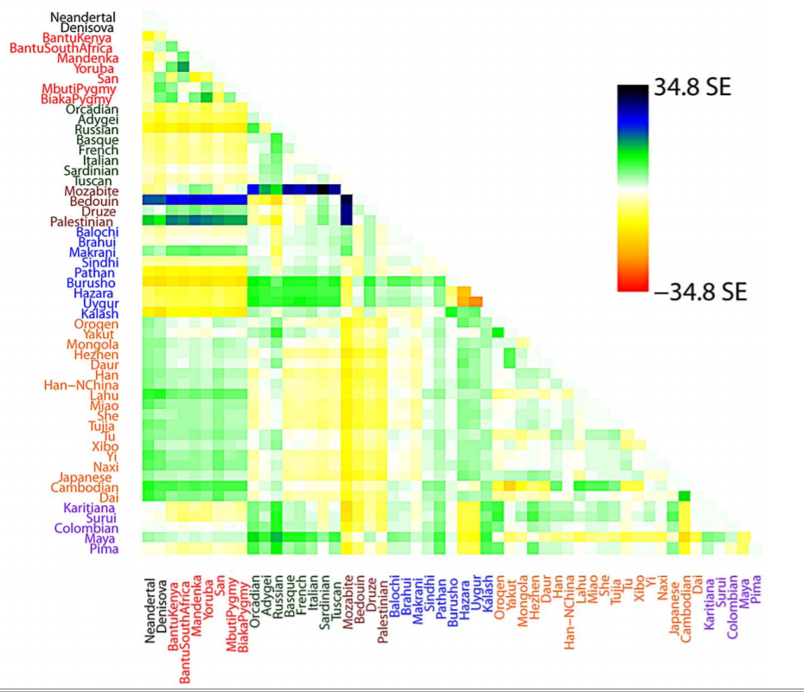

Slide 11
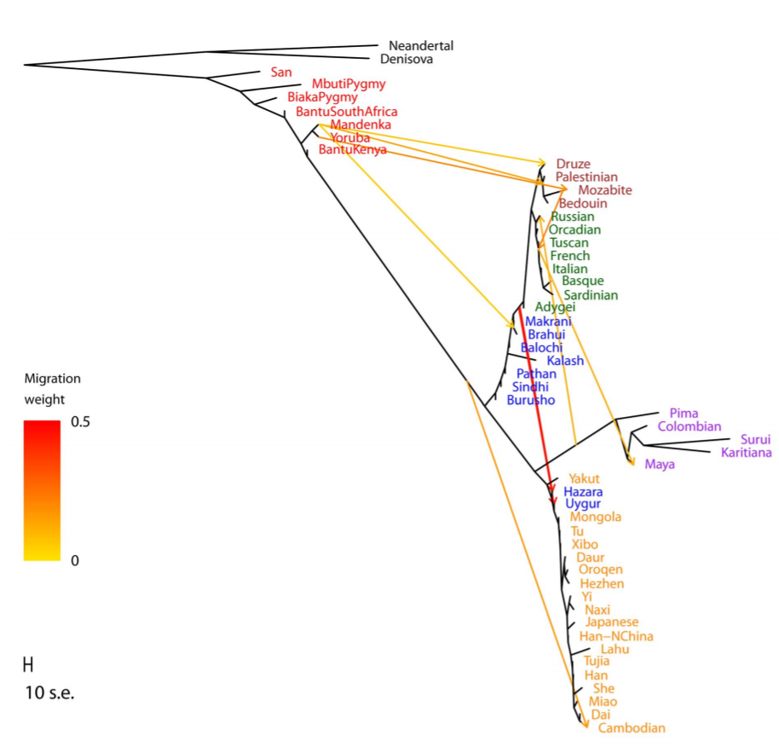

Slide 12
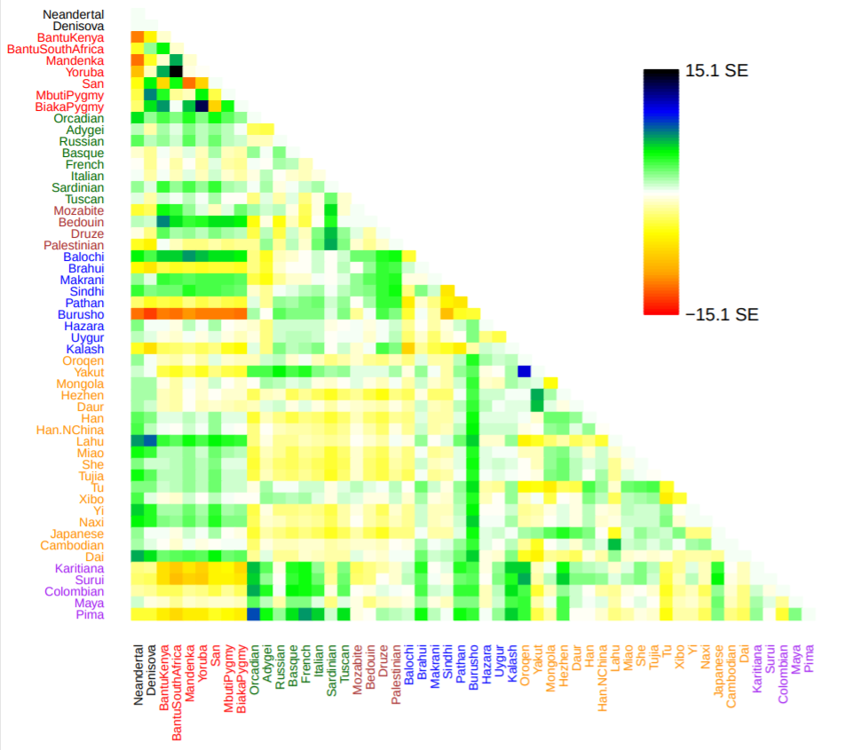

Slide 13
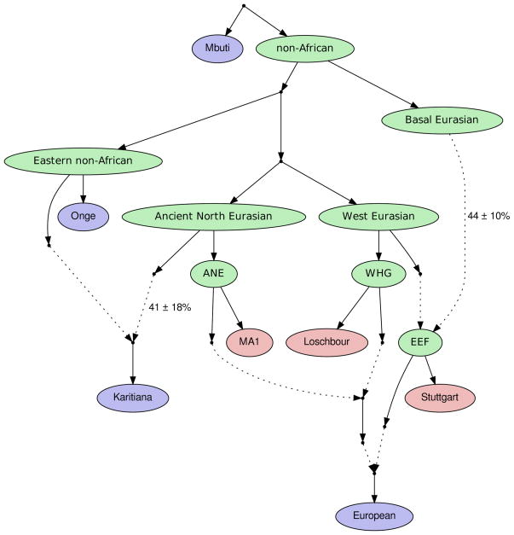
Admixture graphs
Lazaridis et al. 2014, Nature

Slide 14
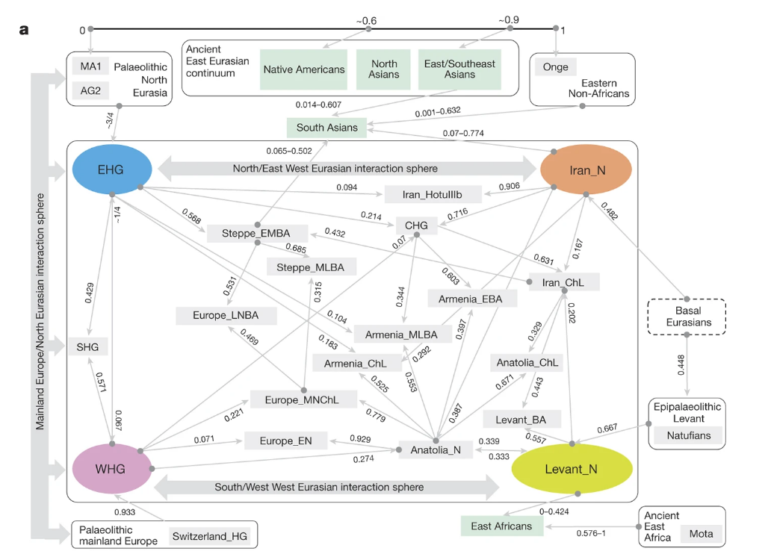
Lazaridis et al. 2016, Nature

Slide 15
Practical Considerations: Which approach should I use?
Admixture
PCA
Trees / Admixture Graph

Slide 16
When should we use trees/admixture graphs?
Trees / Admixture graph
Sparse structure / sampling
Hierarchical structure
Large time scales
Non-spatial structure
Spatial/continuous models
High-density sampling
Small time scales
Continuous structure

Slide 17
Population structure models
When should we use trees?

Slide 19
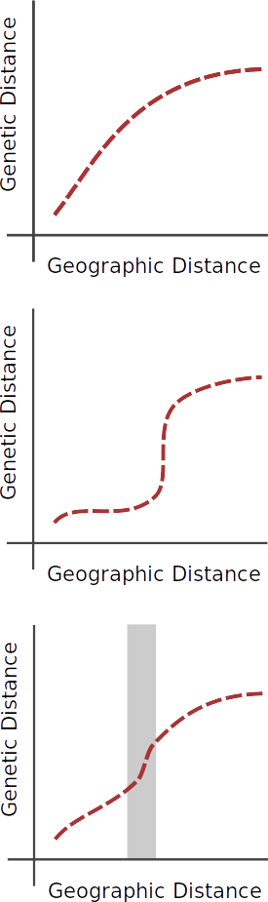
Continuous structure

Slide 20
Discrete structure

Slide 21
Inferring discontinuities

Slide 22

